Slide 1
Land Use and Zoning
Candidate Briefing and Update

Slide 2
Land Use and Zoning
45 minutes. Not a lot of time for most, for me IMPOSSIBLE !
  Personal background
  Vision
  Development of a comprehensive plan
  Zoning justification and process
  Task Force Summary

Slide 3
Land Use and Zoning
One of the leading “factors” that lead
to the idea and ultimate creation of
THE CITY OF DUNWODY
Along with Police and Public Safety, how you “rezone” within the city of Dunwoody will shape the public perception of your success as an elected official

Slide 4
Land Use and Zoning
Vision, yours, ours, NOT DeKalb County’s
  Now
  5 Years
  10 years
  20 years

Slide 5
Land Use and Zoning
Development of a Comprehensive Land Use Plan
Professional Consultation
Research
  What is on the ground now
    Zoning patterns
    Density
    Infrastructure
    Traffic

Slide 6
Land Use and Zoning
Demographic Study
  Patterns
  Trends
  Forecast
Public Input
First Draft
Review
Second Draft with Revisions
Preliminary Map

Slide 7
Land Use and Zoning
City of Dunwoody
COMPREHENSIVE LAND USE PLAN

Slide 8
Land Use and Zoning
COMPREHENSIVE LAND USE PLAN
  Detailed written description of the City’s plan for the future
    Complete and detailed description of each Land use category
    Identifying Residential, Commercial, Office, Institutional and Public land uses within the new City.
      Contains the purpose and intent of each district and how it is designed to meet those purposes and intentions
A written and legally adopted Comprehensive Land Use Plan provides the backbone and teeth of the City’s new Zoning Ordinance

Slide 9
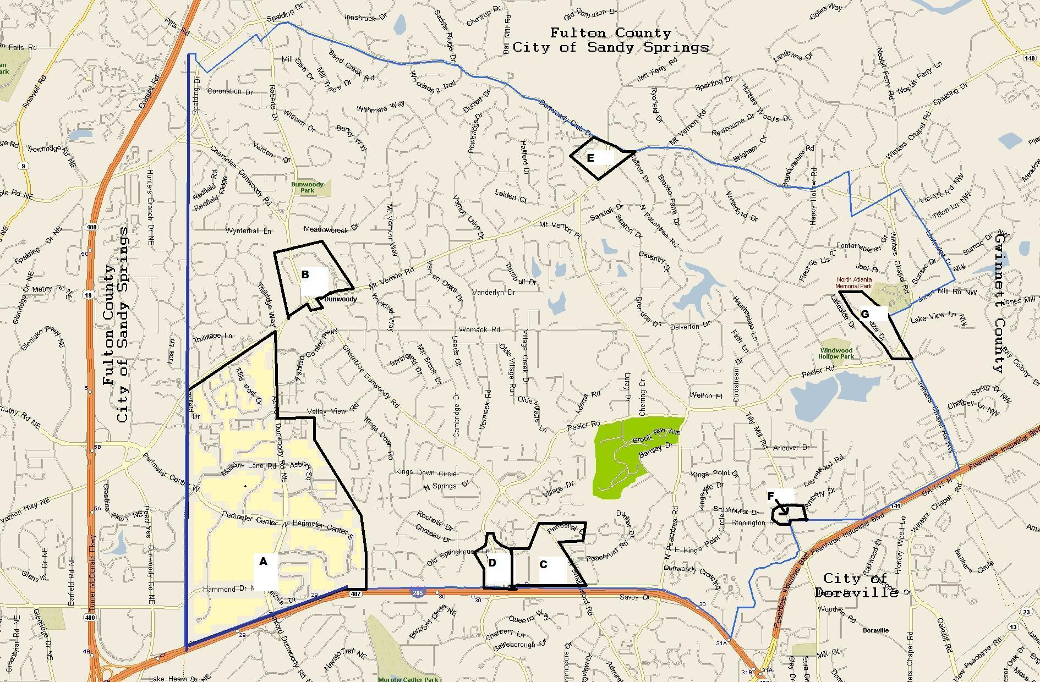
Land Use and Zoning
DeKalb County map on the CD
Comprehensive Land Use Map

Slide 10
Land Use and Zoning
Residential Densities and Uses of Current LU categories
Perimeter Center: Regional Activity Center
  120 Units per acre --- old plan VHR 35+
  Concentration of regionally marked commercial and retail centers, office and employment areas. Higher education facilities recreational facilities and higher density residential
Shallowford/Georgetown: Town Center
  60 Units per acre --- old plan HDR 30 units
  A focal point for several neighborhoods with a concentration of activities such as retail, service commercial, professional office, higher density housing and open space

Slide 11
Land Use and Zoning
Residential Densities and Uses of Current LU categories
Dunwoody Village: Neighborhood Center
Jet Ferry/Mt. Vernon: Neighborhood Center
  24 Units per acre ---old plan MHR 18 units
  A neighborhood focal point with a concentration of activities such as general retail, service, commercial, professional office, higher density housing and appropriate public and open spaces
Residential: Suburban
  0-8 Units per acre --- old plan LDR 0-4 units

Slide 12
Land Use and Zoning
Zoning and The Zoning Process
  All of the property in Dunwoody is currently zoned and we deal with re-zonings
  Re-zonings can be done to change a use such as Office to Residential
  Given the rate of development we have experienced the re-zonings are almost always for higher density or a change of conditions of a previously zoned property

Slide 13
Land Use and Zoning
Zoning and The Zoning Process
  Property owners rezoning when:
    Owner suffers a substantial economic detriment not outweighed by public welfare interests
    Entitled to” highest and best use”
Factors to consider
  How neighboring property is zoned
  How long a property has been vacant
  How long property had been on the market

Slide 14
Land Use and Zoning
GENERAL PURPOSE OF ZONING
  To guide and regulate the orderly growth, development, redevelopment and preservation of The City of Dunwoody in accordance with a well-considered comprehensive plan and with long-term objectives, principles and standards deemed beneficial to the interest and welfare of the people.
  To protect the established character and the social and economic well-being of both private and public property.
From DeKalb County Code 27-2

Slide 15
Land Use and Zoning
GENERAL PURPOSE OF ZONING
  To promote, in the public interest, the wise utilization of land.
  To reduce or prevent congestion in the public streets.
  To promote, in the public interest, the wise utilization of land.
  To provide for protection of the constitutional rights and obligations of all citizens within the county.
From DeKalb County Code 27-2

Slide 16
Land Use and Zoning
Process
  Application filed with City
  ARC review if applicable
  Citizens review ( Community Council)
  Staff review, comments, recommendation
  Planning Commission – Public hearing
  City Council- Public hearing and final decision

Slide 17
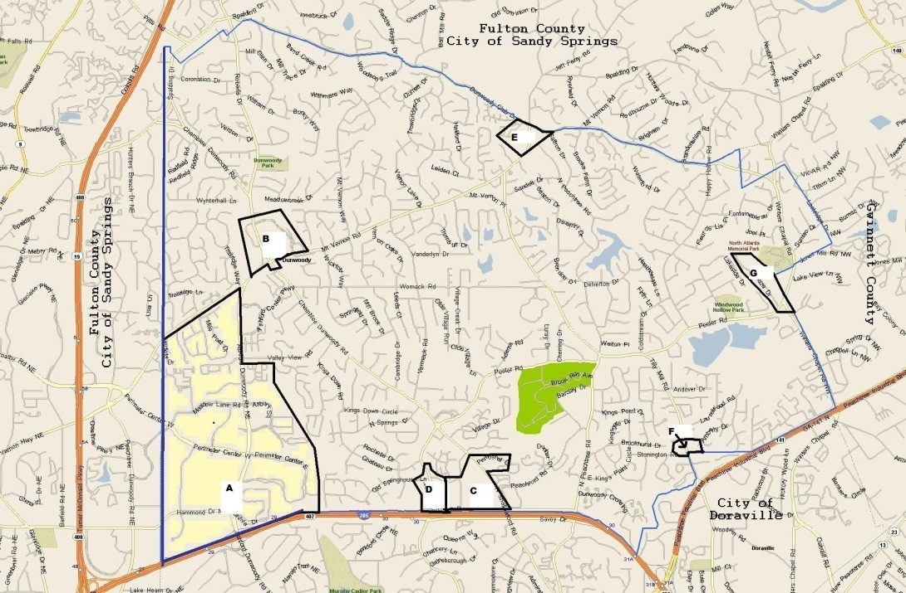
Land Use and Zoning
Task Force Review
City Map Highlighted
  A: Perimeter Center
  B: Dunwoody Village
  C/D: Shallowford-Georgetown
Areas of Interest
  E: Tilly Mill (Dunwoody North)
  F: Winters Chapel/Peeler

