Slide 1


Slide 2
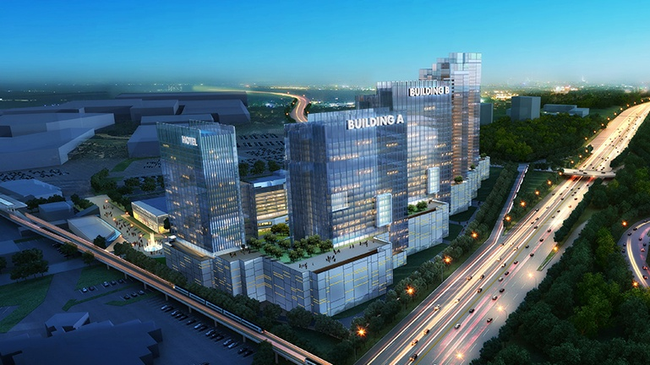
244 Perimeter Center Parkway – Site B
RZ 16-041: Rezone O-I to CR-1
SLUP 1: Crown Tower 1 Height
SLUP 2: Crown Tower 2 Height
SLUP 3: Multi-Unit Residential in CR1

Slide 3
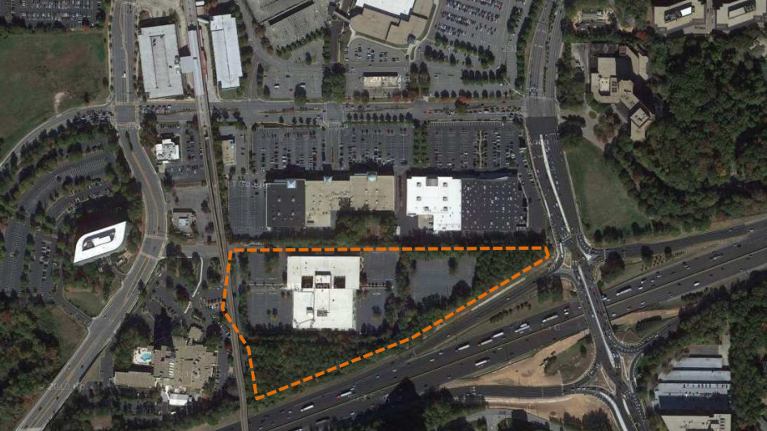
244 Perimeter Center
Existing Condition

Slide 4
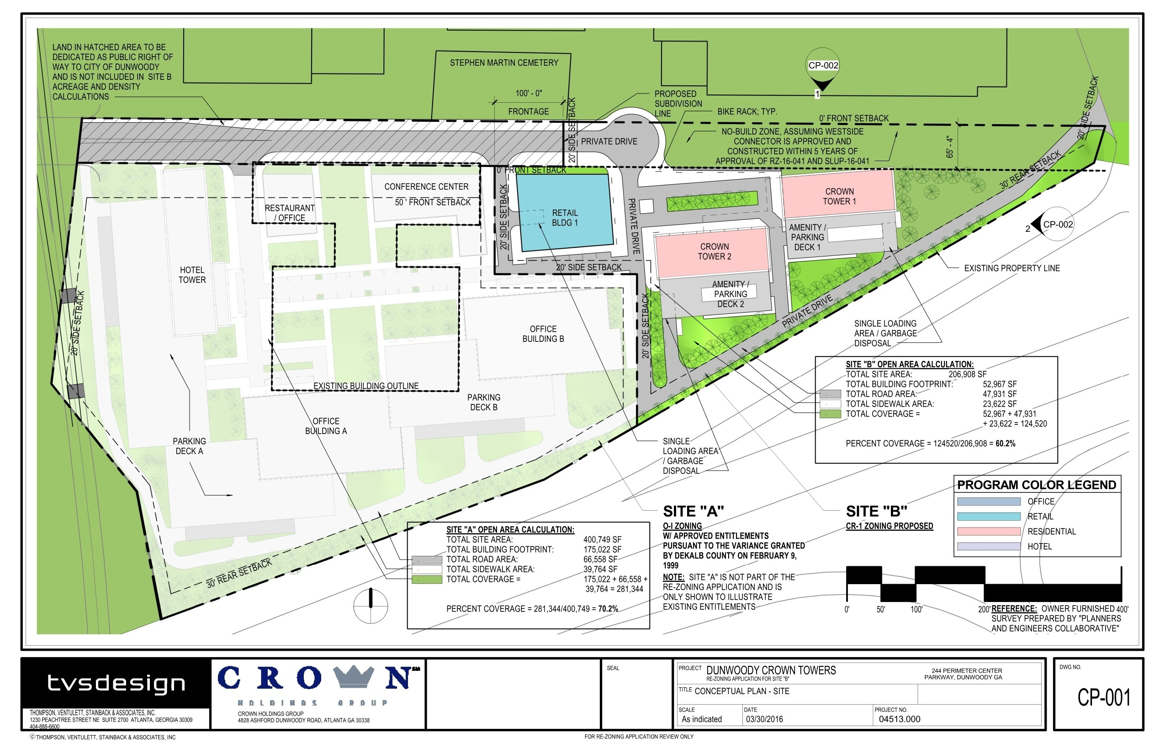
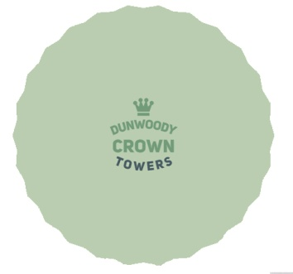

Slide 5
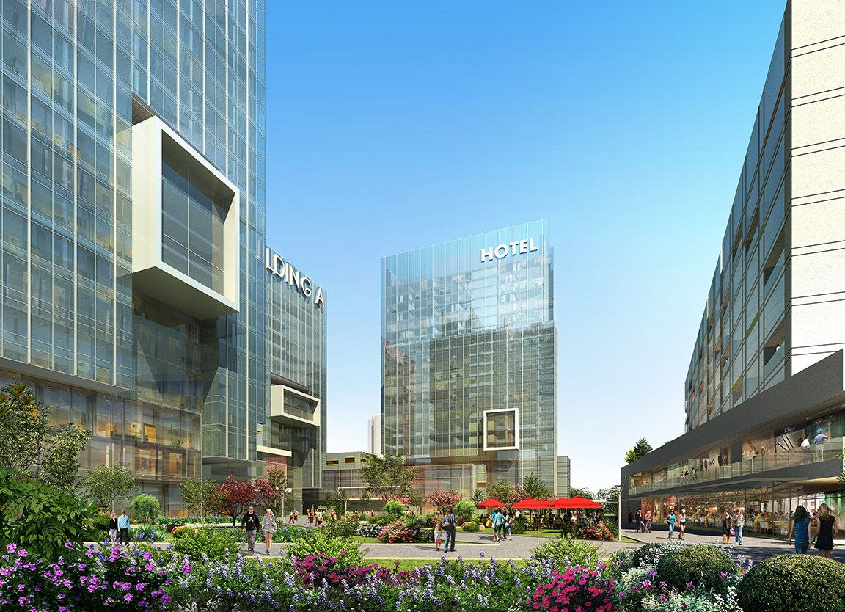
244 Perimeter Center Parkway – Site B
Team Introduction:
Pursley Friese Torgrimson (legal)
tvsdesign (architecture)
Moreland Altobelli & VHB (traffic)
Planners & Enginners (civil)
Berkshire Hathaway (marketing & finance)
Community:
Dunwoody Preservation Trust

Slide 6
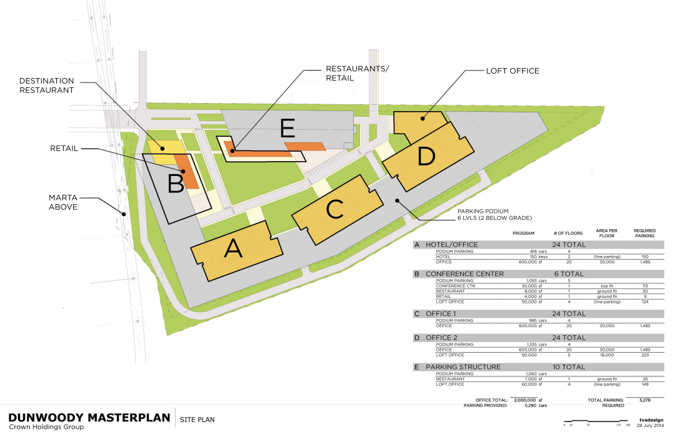
244 Perimeter Center
Entitlement Maximum Density

Slide 7
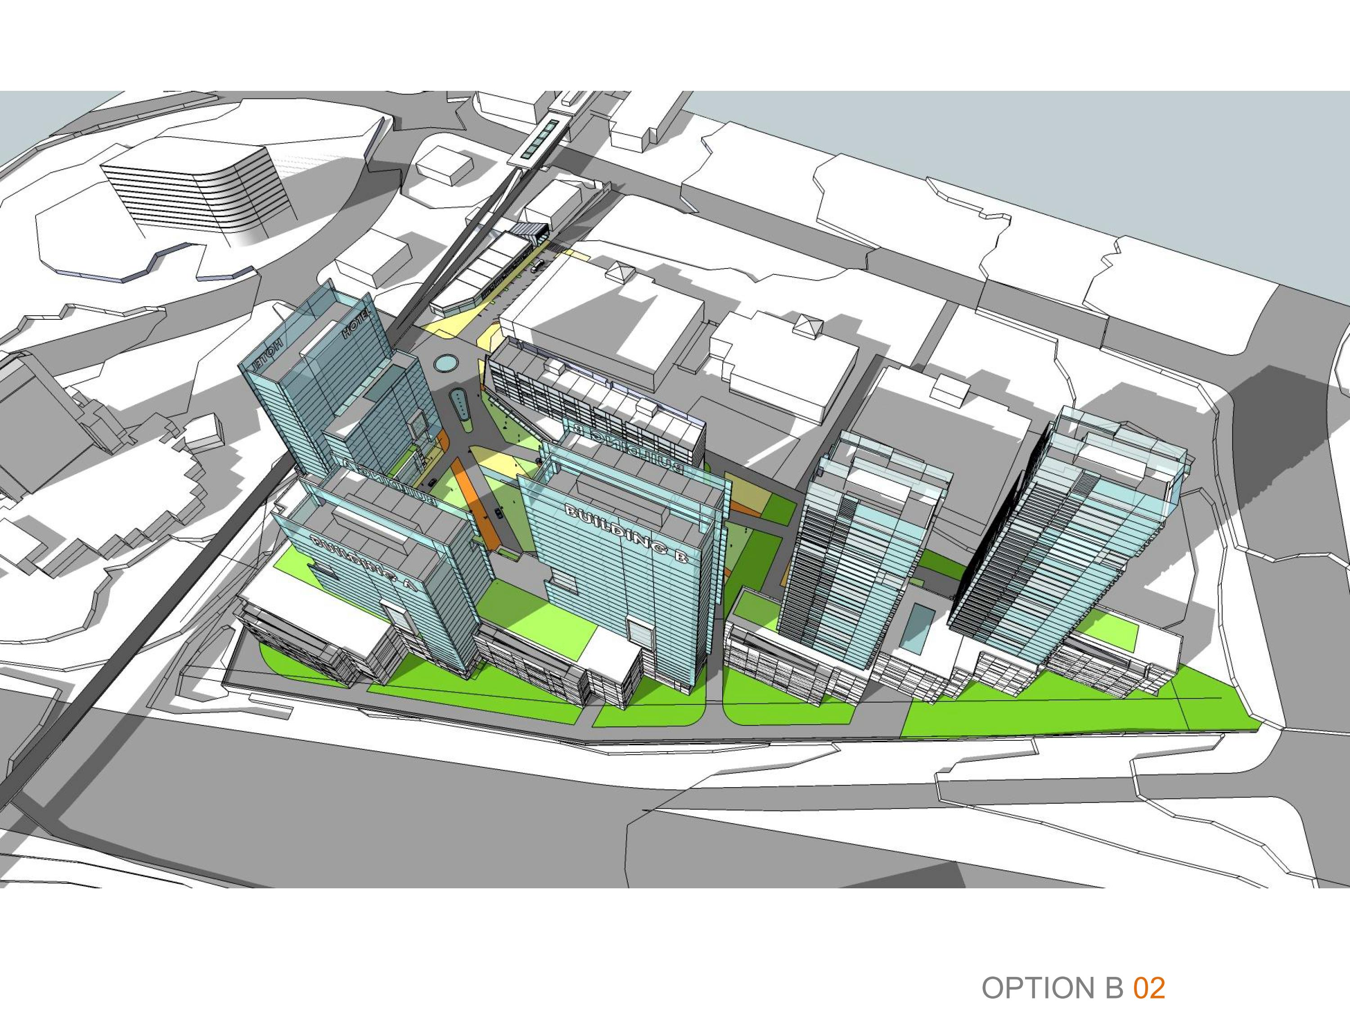
244 Perimeter Center
Conceptual Massing

Slide 8
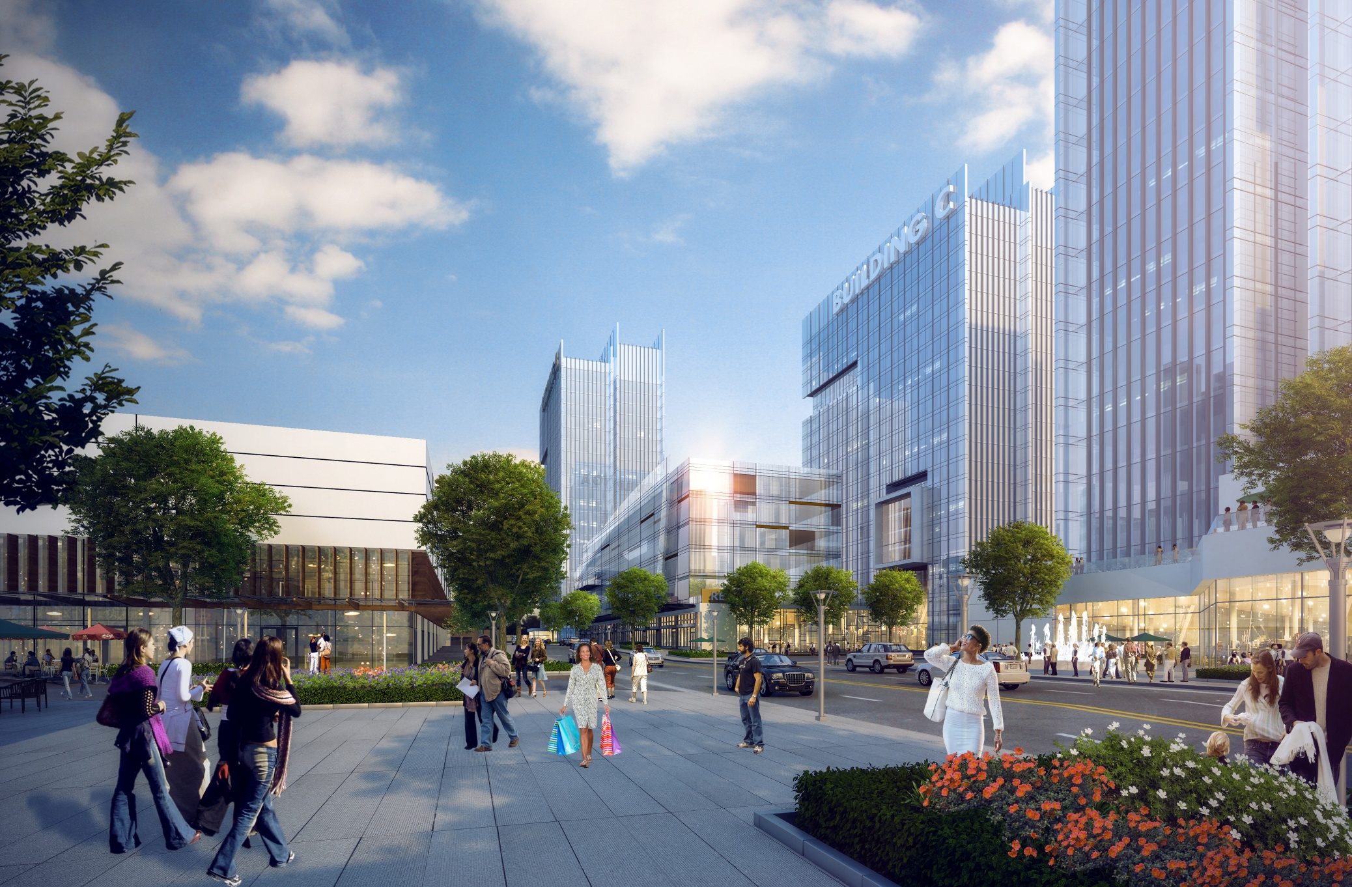
Vision
People, Connectivity & Transportation

Slide 9
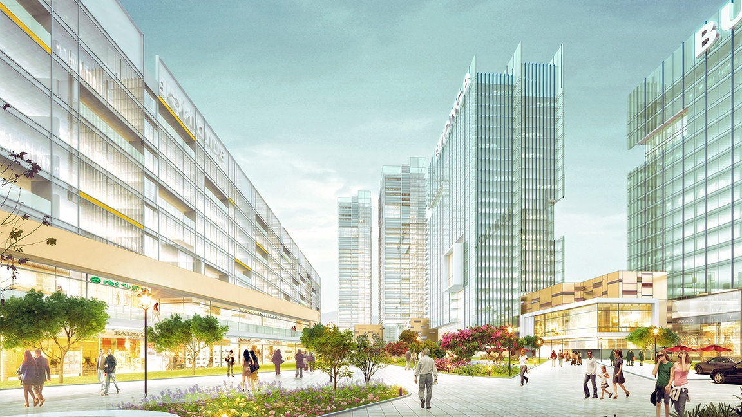
Central Green Space
Looking East

Slide 10
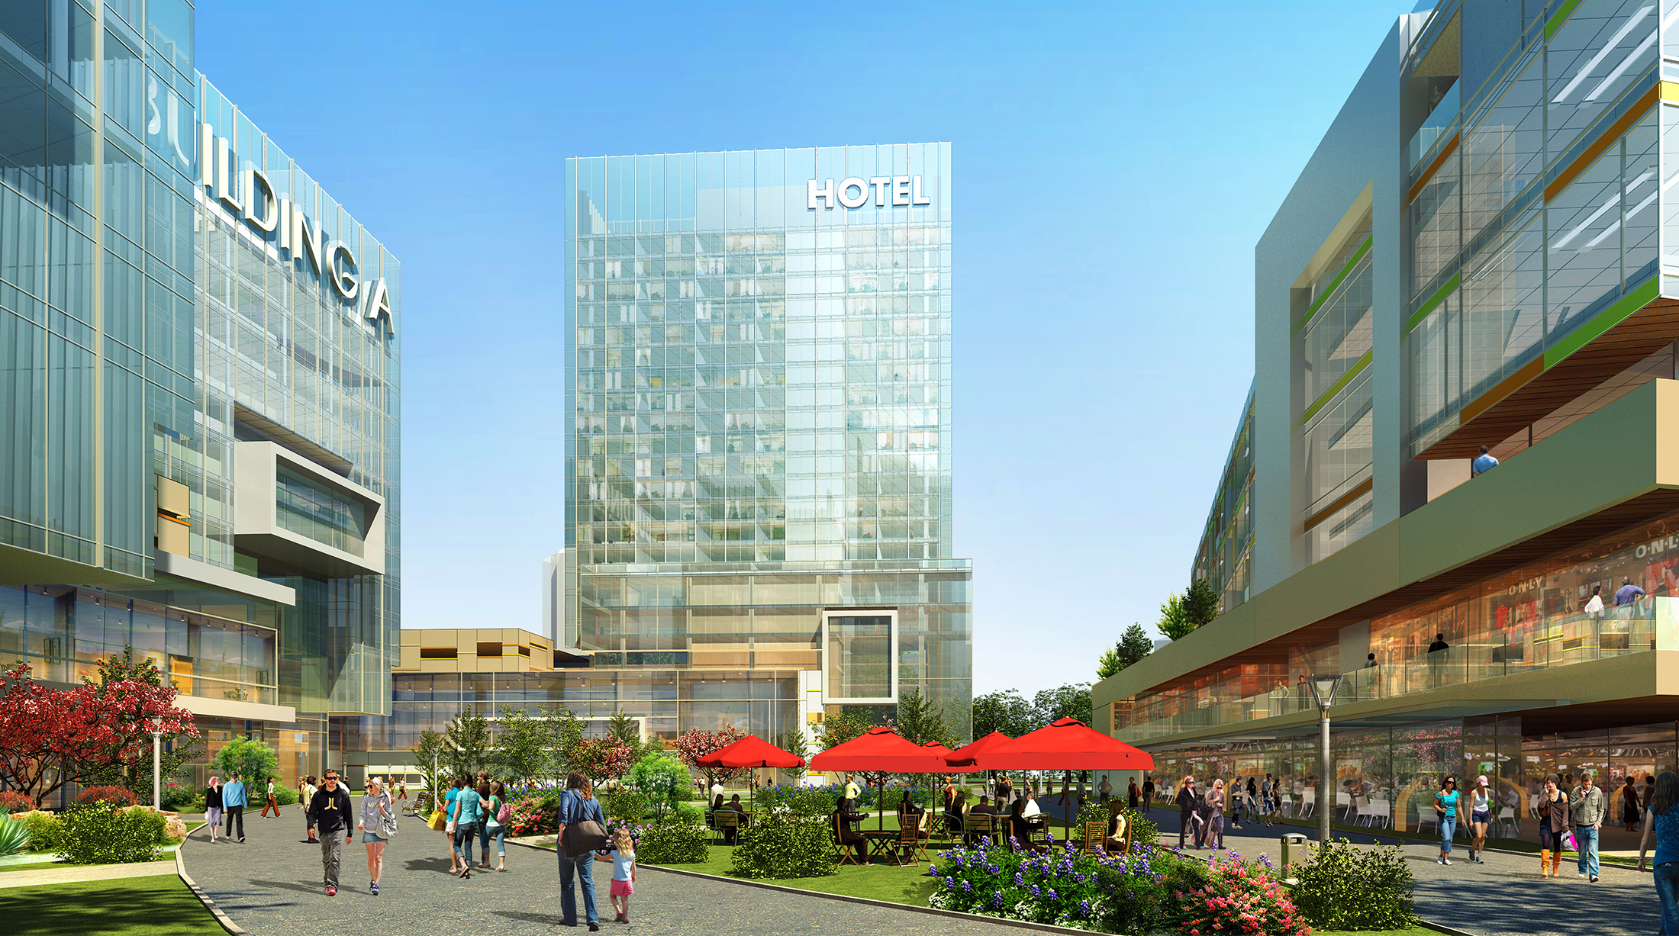
Central Green Space
Looking West

Slide 11
Gateway to Dunwoody
Skyline

Slide 12
244 Perimeter Center Parkway – Site B
Rob Svedberg, tvsdesign

Slide 13
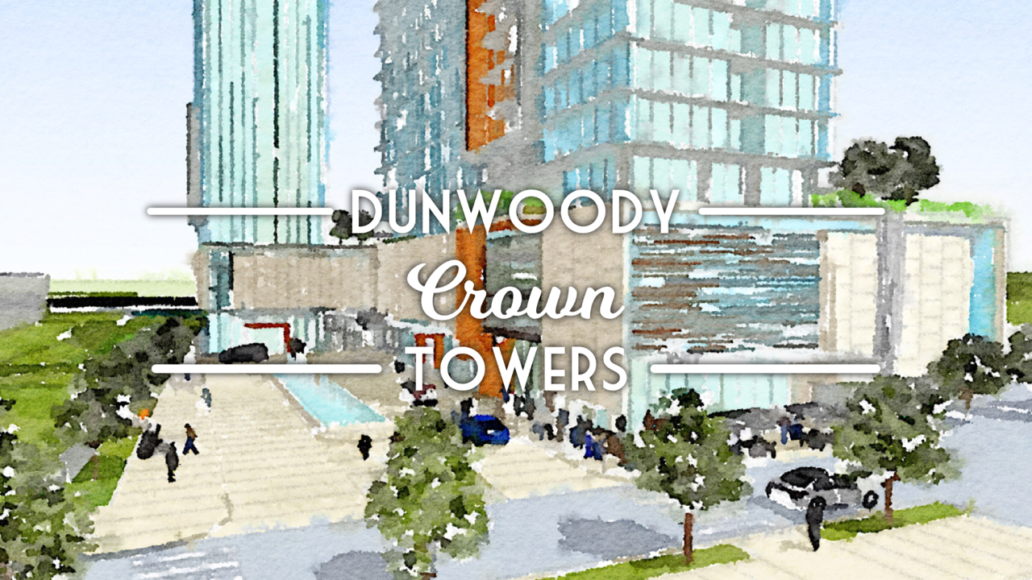
Design
tvsdesign

Slide 14
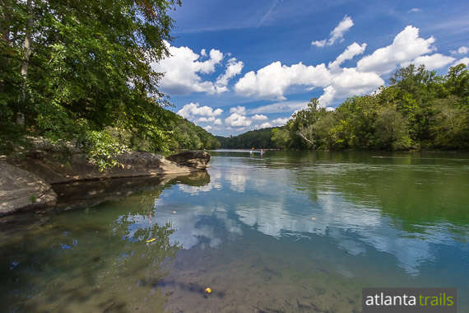

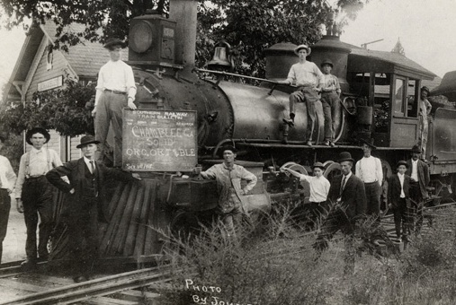
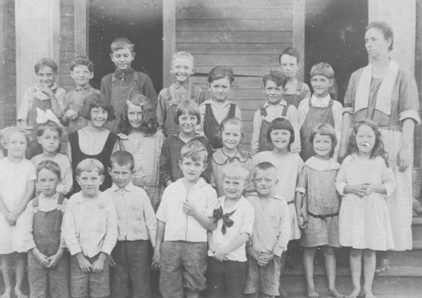
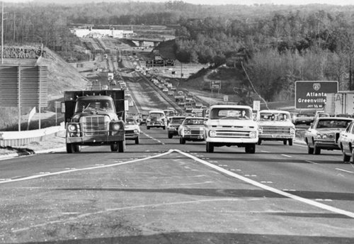
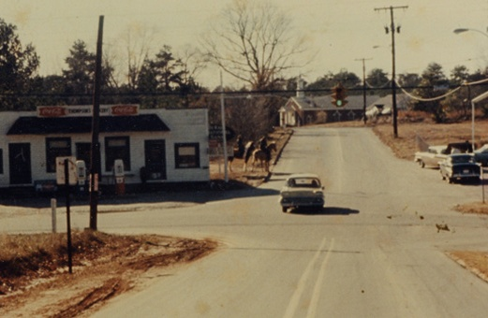
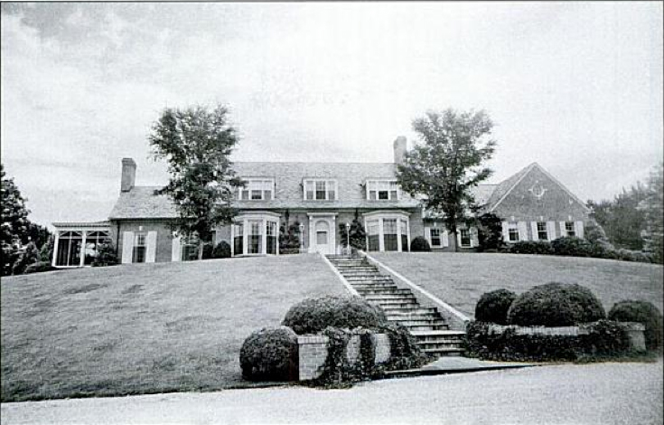
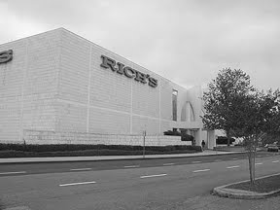
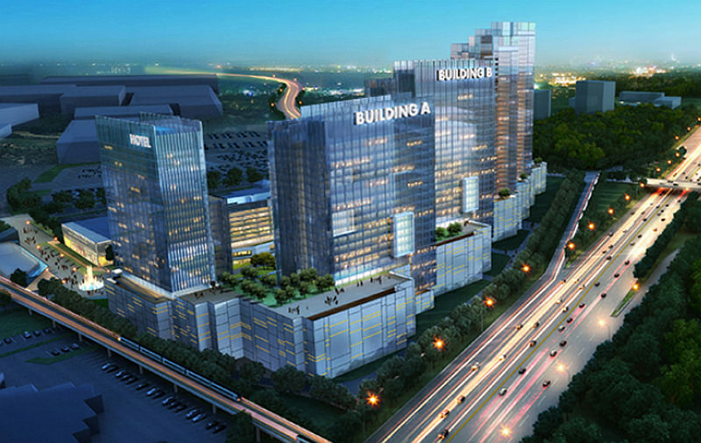
Chattahoochee River
Settlement
Chamblee Roswell RR
First School
Development
285
Community of Choice
Commercial Center
Crown Towers

Slide 15
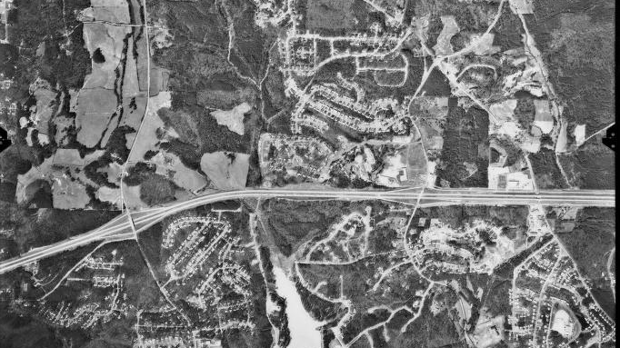
Dunwoody
1966

Slide 16
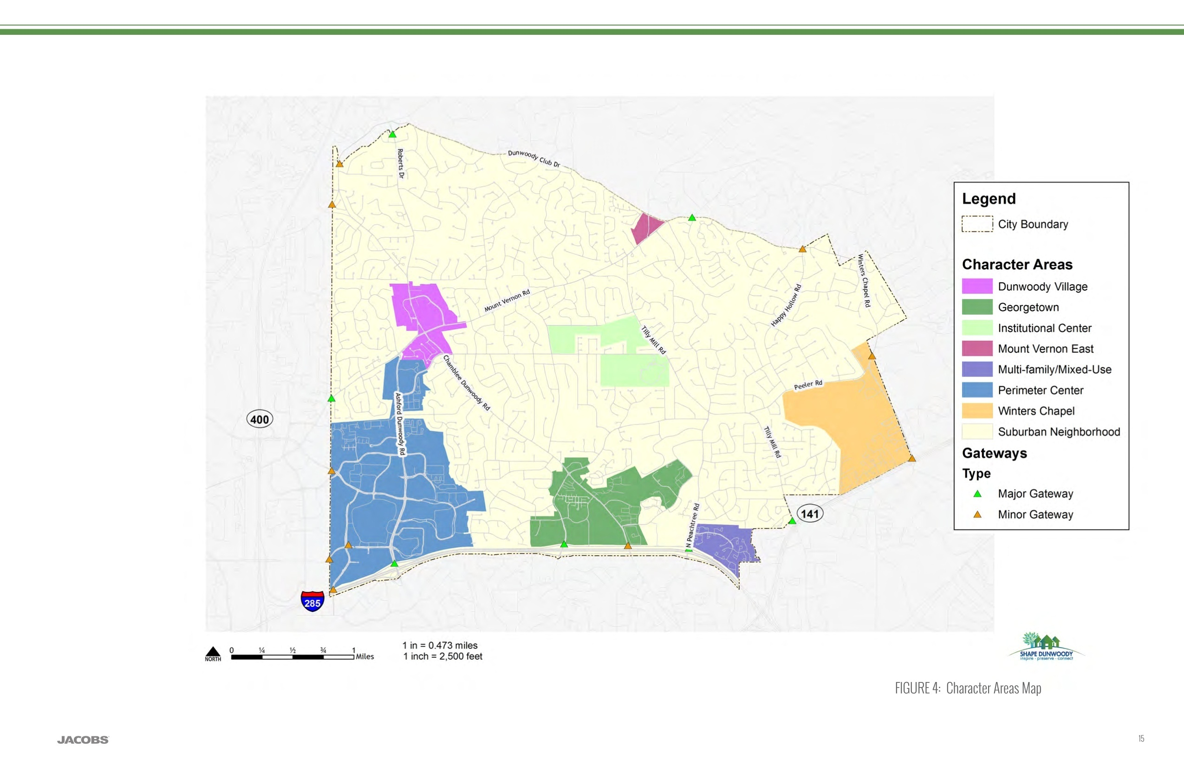
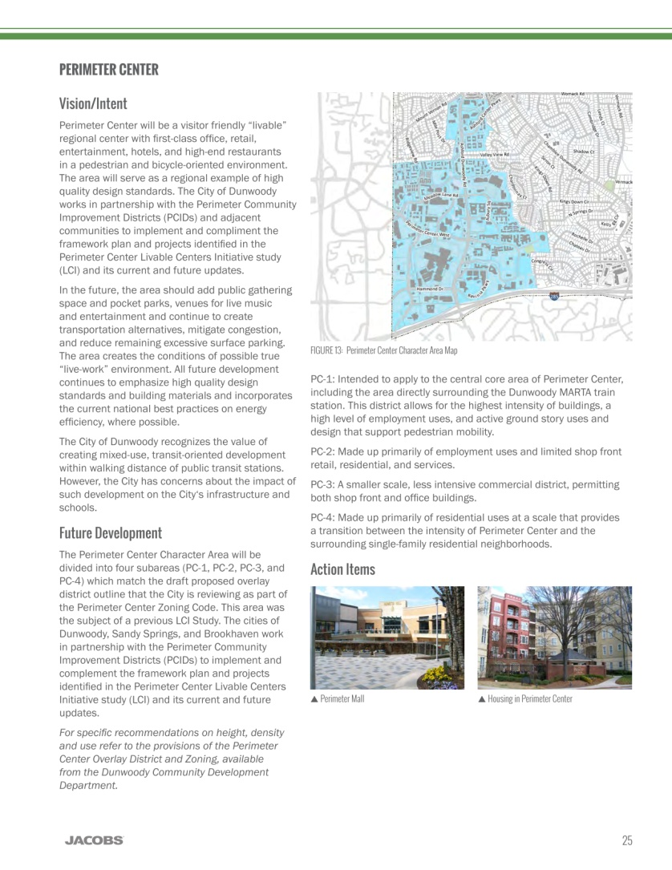
Dunwoody
2015 Comprehensive Plan

Slide 17









Goals
2015 Comprehensive Plan

Slide 18
Gateway to Dunwoody
Master Plan

Slide 19
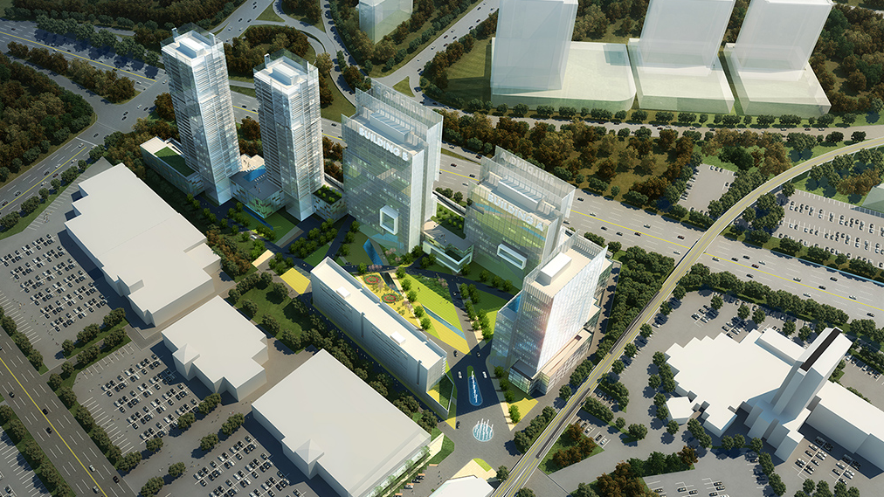
Early Rendering
Master Plan

Slide 20
Central Green Space
Master Plan

Slide 21
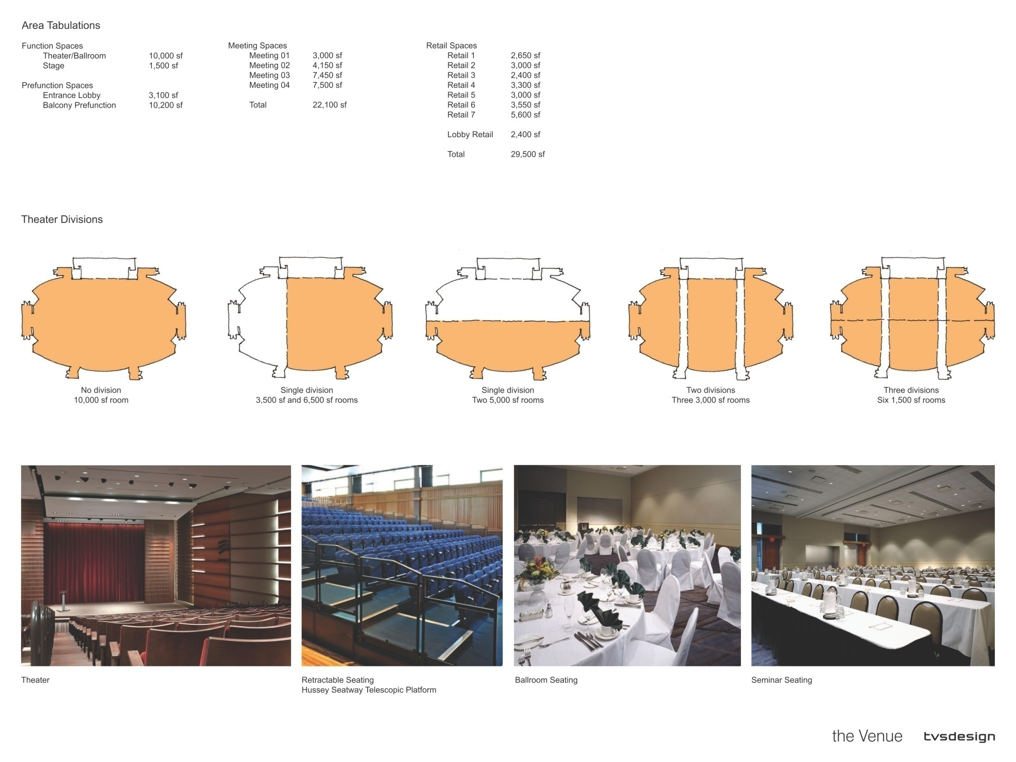
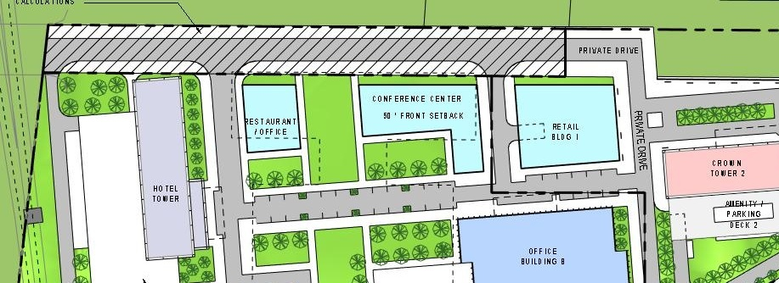
Conference Center
Master Plan

Slide 22
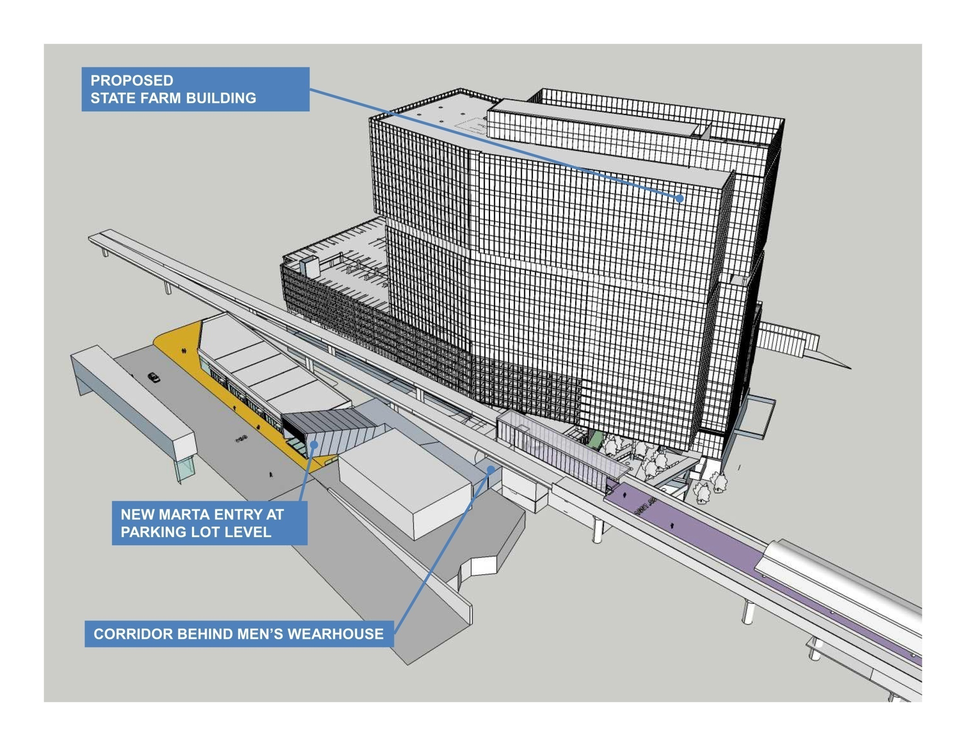
Connectivity
Master Plan

Slide 23
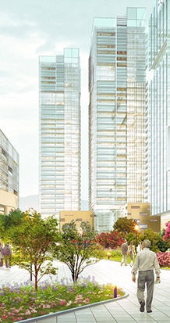
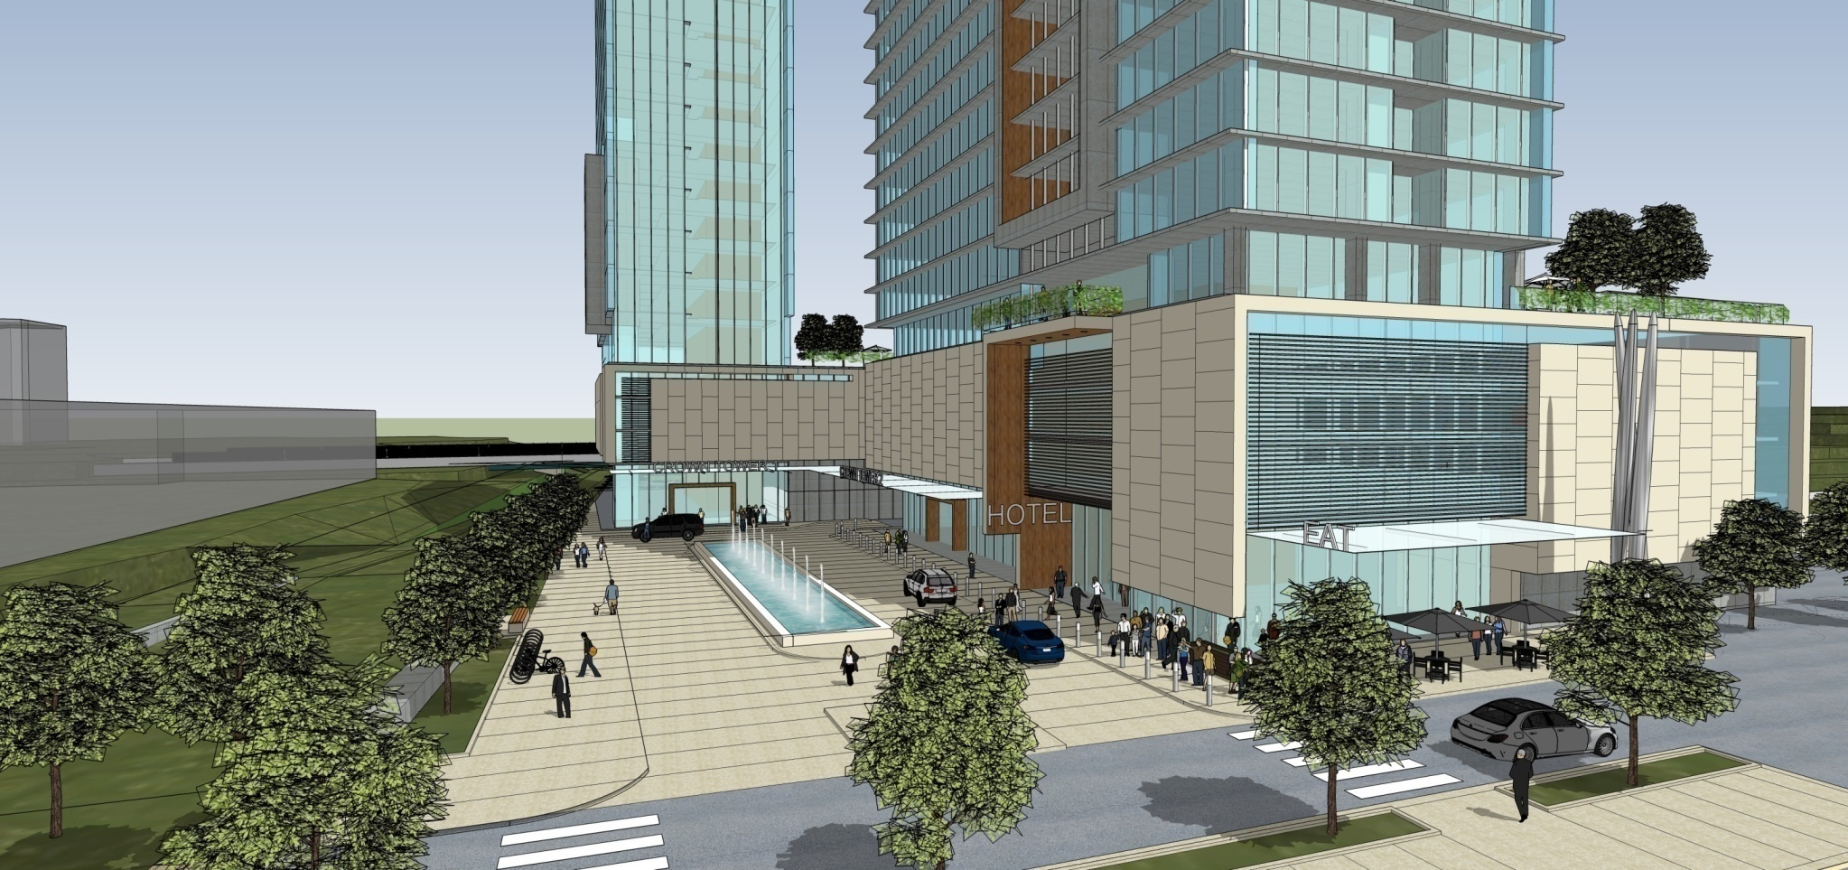
Dunwoody Crown Towers
Concept Design

Slide 24
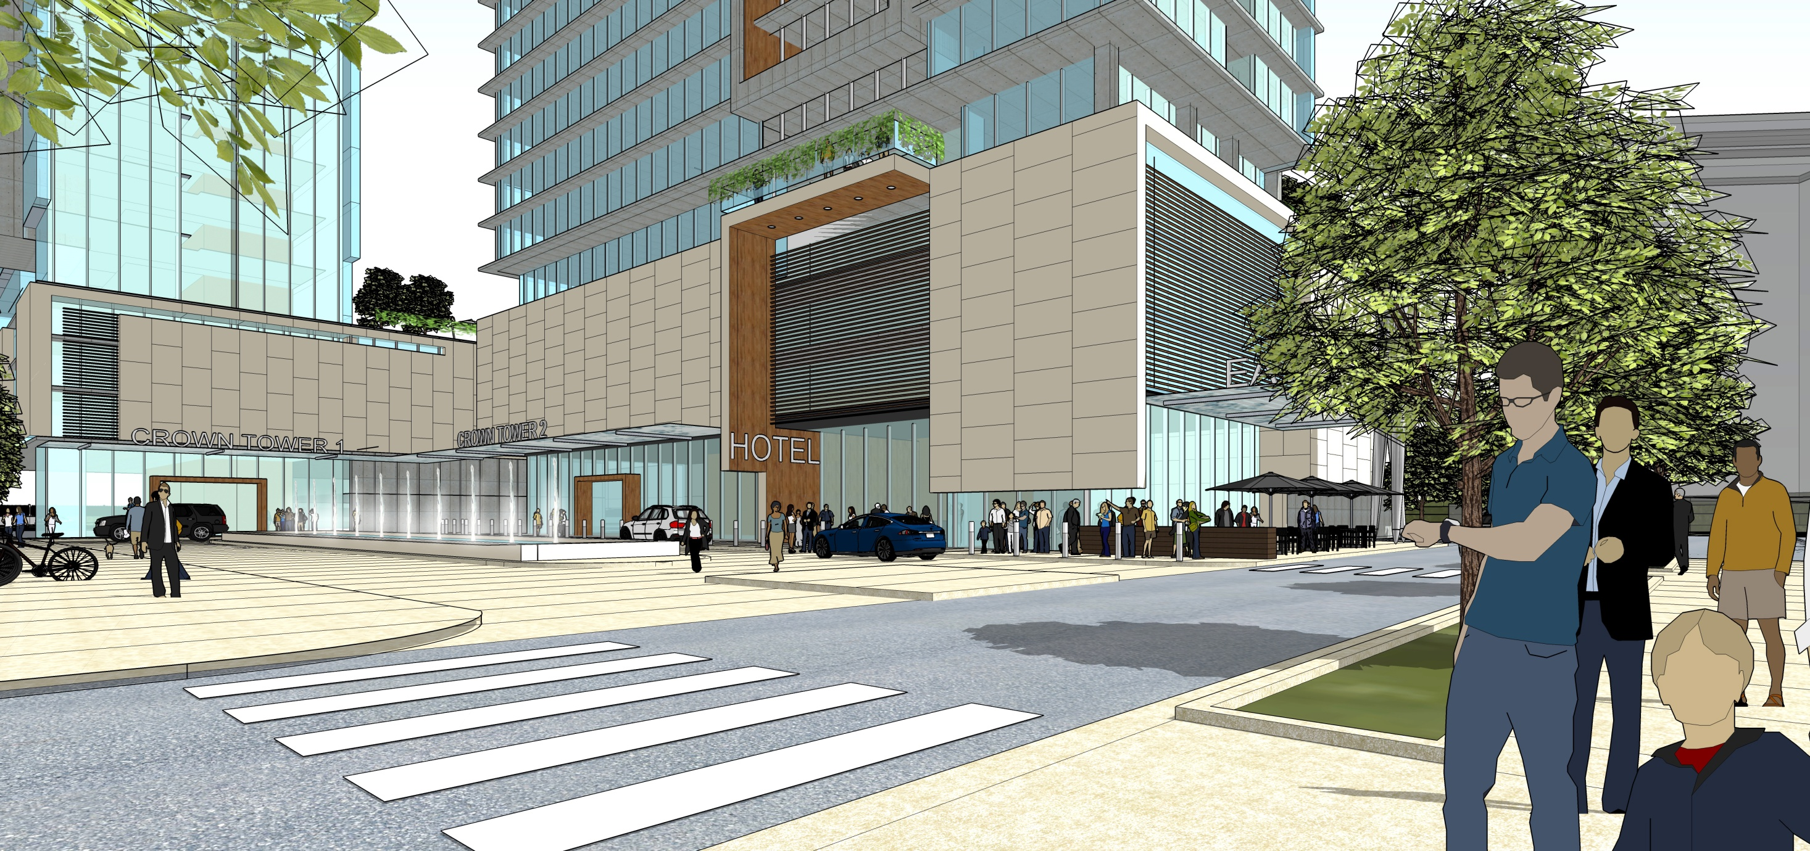
Dunwoody Crown Towers
Concept Design

Slide 25
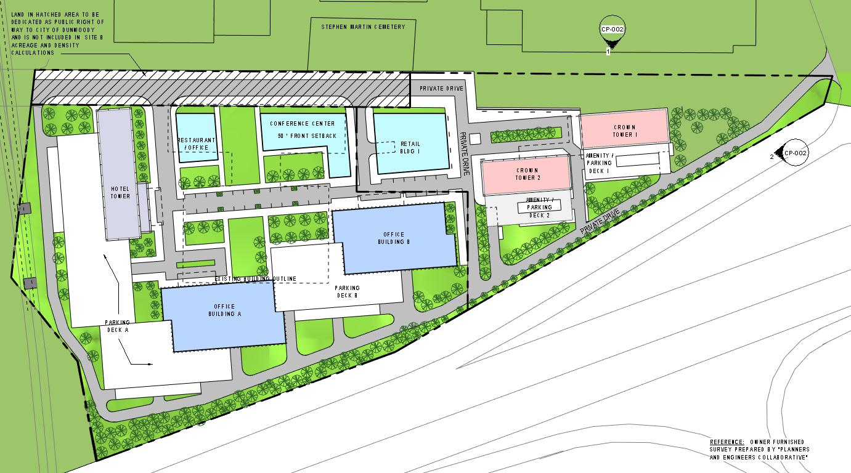
Site Plan
Master Plan

Slide 26
02.15.2016
244 Perimeter Center presented by:
Charles Brown, Crown Holdings Group

Slide 27
244 Perimeter Center Parkway – Site B
Jill Arnold, Pursley Friese Torgrimson

Slide 28
Applicant’s Proposed Revisions to Zoning Conditions
This Ordinance shall take effect upon the property being subdivided in accordance with all of the ordinances, rules, and regulations of the City of Dunwoody in effect at the time of the subdivision application, but in any case, not later than May 9, 2021. If the Subdivision is not accomplished by May 9, 2021, this Ordinance shall be null and void. Nothing in this Ordinance shall be construed to require, compel, or obligate the property owner to subdivide the property. Any subdivision of the Property will be at the specific written election of the property owner.(this verbiage to be included in the body of the ordinance, rather than a condition).
Development of the site shall be in substantial compliance with the above Exhibits.
The recordation of the final plat in order to complete the subdivision shall take place within 120 days of the completion of site development improvements, unless an extension for unforeseen circumstances is approved by the Community Development Director.
Site is limited to a maximum of 380 “” residential units and 150 rooms for a hotel. Other uses and structures permitted as of right in the CR-1 district are also permitted.
Any buildings on Site B shall be setback a minimum of 68 feet from the north property line or as necessary to provide for the Westside Connector. All other setbacks shall be in accordance with the CR-1 zoning district.
Access to the Spruill cemetery shall be maintained from Gold Kist Drive. As conditions currently exist, the site shall not use the existing curb cut at Ashford Dunwoody Road or the attached driveway on the adjacent property for vehicular access. Such notation and revisions to be made on the Site Plan. However, the owner shall retain any and all access rights to the curb cut until such time as set forth in the Development Agreement.

Slide 29
Applicant’s Proposed Revisions to Zoning Conditions
Entitlements for the site under the February 9, 1999 variance decision shall be maintained on Site A.
8. Covenants shall restrict non-owner occupied units to a maximum of 50% of the units for the first 5 years, which shall increase to 75% after the first 5 years. The 5 years shall commence upon issuance of a Certificate of Occupancy for the final residential unit. A unit shall not be considered "owner occupied" if it includes any partial owner who pays another party (except the mortgagor) for the right to live there.
9. The site is considered one development, and as such, plaza areas and open spaces shall be provided on Sites A and B.
10. Show and label extension of proposed right-of-way on Site B as “No-Build Zone, Assuming Westside Connector is programmed for Construction by May 9, 2021”.
11. Provide plan for open space improvements and amenities for residential and commercial areas.
12. Provide documents for easements on this site granting access to the adjacent cemetery.
13. Provide pedestrian access easement and required sidewalk along northern edge of property from Gold Kist Drive to the western boundary of Site B.
14. Construct public streets in accordance with standards in Perimeter Center Overlay.

Slide 30
SLUP16-041
Staff recommends approval of Special Land Use Permit application a.) to increase the height of the multi-unit residential building (“Crown Tower 1” on enclosed conceptual drawings), subject to the following conditions:
  The multi-unit residential building shall be a maximum height of 35 stories.
  All road improvements required by the companion rezoning request and/or development agreement shall be provided.
Staff recommends approval of the Special Land Use Permit application to the height of the mixed used vertical building (“Crown Tower 2” on conceptual drawings), subject to the following conditions:
  The mixed use vertical building shall be a maximum height of 29 stories
  All road improvements required by the companion rezoning request and/or development agreement shall be provided.
Staff recommends approval of the Special Land Use Permit application to allow a multi-unit residential use in the Commercial-Residential Mixed-Use (CR-1) District, subject to the following conditions:
  1. All road improvements required by the companion rezoning request and/or development agreement shall be provided.

Slide 32
02.15.2016
244 Perimeter Center presented by:
Charles Brown, Crown Holdings Group

Slide 33
244 Perimeter Center Parkway – Site B
Kerman Haynes, Berkshire Hathaway

Slide 34

About Berkshire Hathaway – New Homes & Condominium Division
  Leader in new construction sales with 15% market share throughout Metro Atlanta
  22 Regional Offices
  1,400 Realtors
  Approximately 70 ”for sale” new home & condominium communities
  In-house mortgage services, HomeServices Lending – a Berkshire Hathaway Company
Financing Apartments vs. Condominiums
Apartments
  Construction financing can be obtained and the project can begin construction immediately
  Apartment homes will be constructed and interiors designed to condominium standards
  Can be converted to condominiums and the sales effort can begin during construction prior to completion
Condominiums
  Construction financing is difficult to obtain
  Lenders require 50% of the value of the building to be pre-sold prior to construction beginning
  The pre-sales phase can be slow and sometimes take up to two years to achieve – if at all
  Cost of construction is greater than the last condo cycle thus no comparable sales data exist at today’s pricing

Slide 35
Apartment Conversions
  Two notable projects are navigating the conversion process today
  Several conversions will be taking place over the next 6 months
    1065 Peachtree
    Residences Above The Loews Hotel
    Built as apartment rentals with interior finishes and amenities designed to condo standards
    The Atlantic
    Built as condominiums and completed in 2009
    Converted to apartment rentals during the recession
    Purchased by a developer and 50% of the units were converted back to condo in April 2014 – actively selling Phase 1

Slide 36
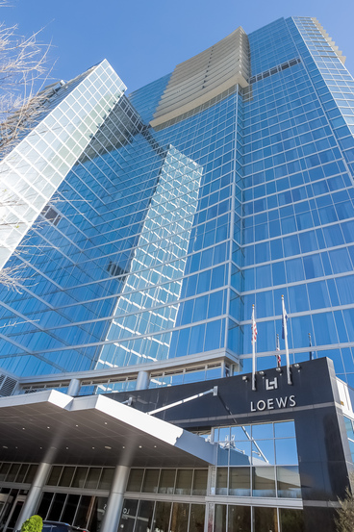
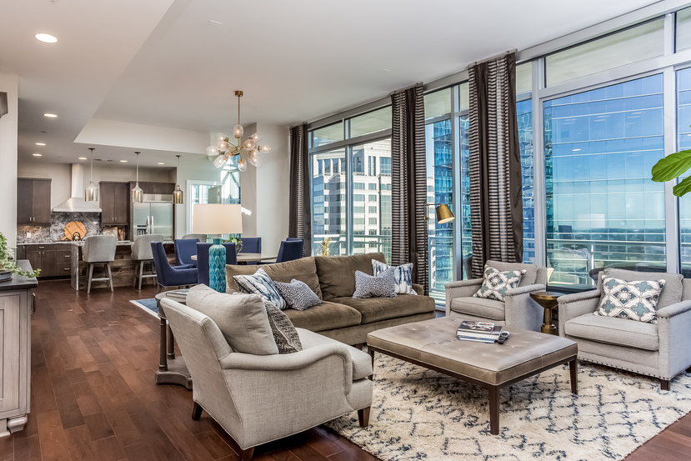
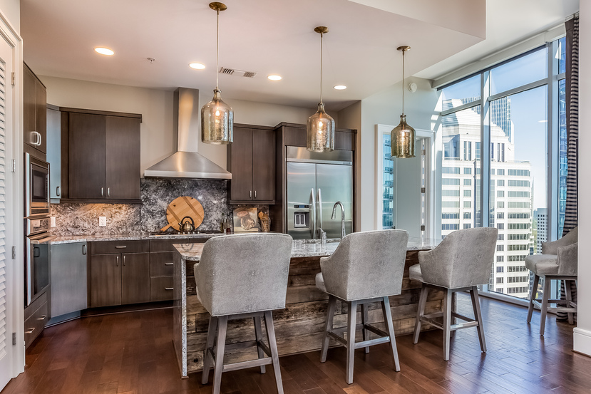
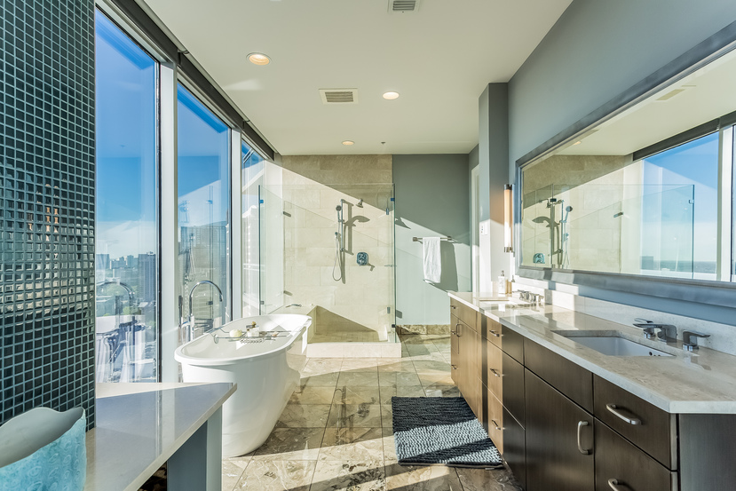
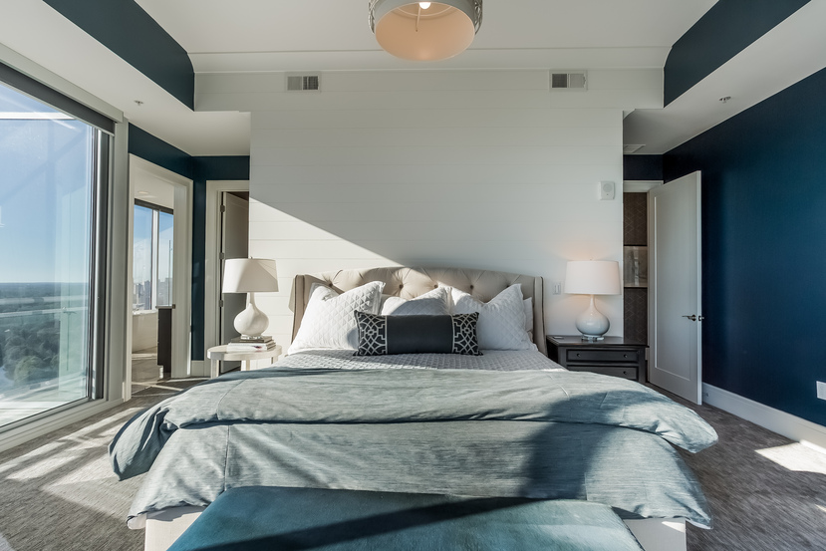
1065 Peachtree

Slide 37
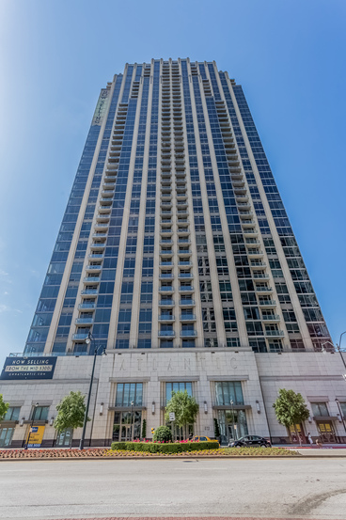
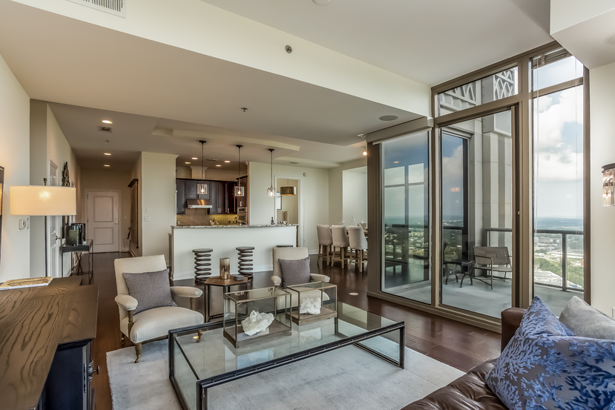
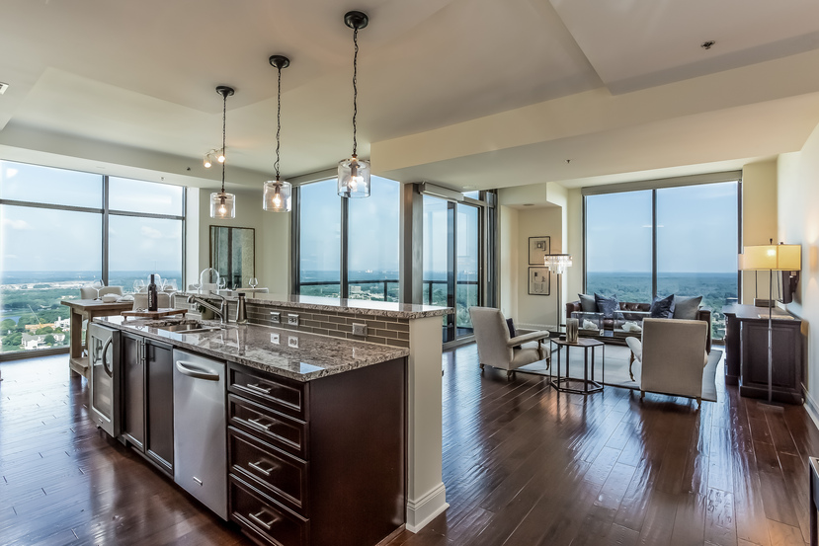
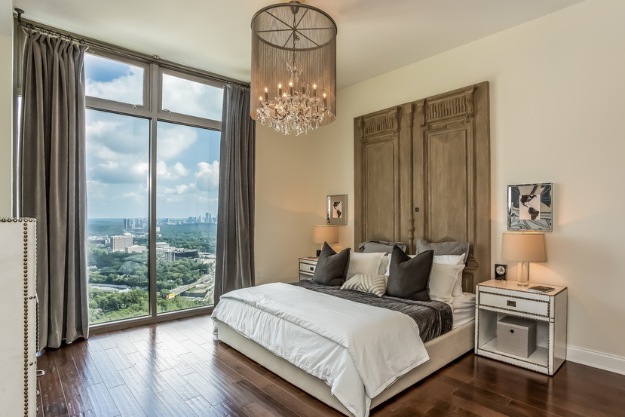
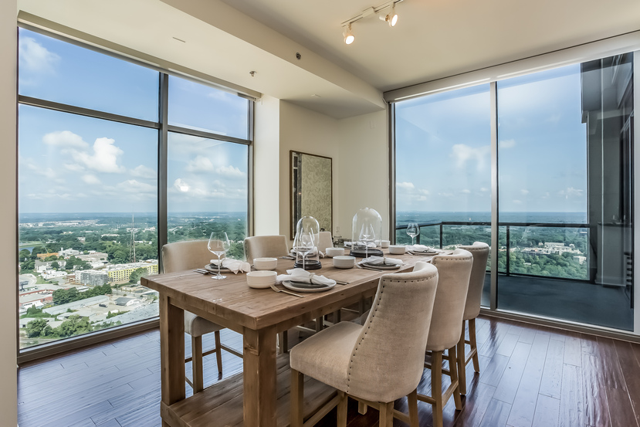
The Atlantic

Slide 38
The Case for Apartment Conversions
  Many high-rise apartment buildings have been constructed since the recession with condo conversion as the exit strategy as the market improves
  End-user financing is still difficult
    banks are lending on condos again, however the lending requirements for condominiums are subject to additional guidelines (FANNIE MAE & FREDDIE MAC)
    It is easier to obtain end user financing on a conversion project than new construction
  Buyers throughout Metro Atlanta
    See, touch, and feel – they want to see the home, finishes, views, lifestyle before they commit
    Need to move in now, not wait 18 to 24 months for pre-sales, then another 18 to 24 months to complete construction
    With more than 7,000 jobs coming to the Perimeter Center area over the next 5 years, many will want to live in the area to avoid Atlanta’s notorious morning and afternoon commute times
    Buyers today want – LIVE, WORK, PLAY environment

Slide 39
02.15.2016
244 Perimeter Center presented by:
Charles Brown, Crown Holdings Group

Slide 40
244 Perimeter Center Parkway – Site B
Wrapup

Slide 41
Dunwoody Crown Towers
Concept Design

Slide 42
Dunwoody Crown Towers
Concept Design

Slide 43
Gateway to Dunwoody
Master Plan

Slide 44
02.15.2016
244 Perimeter Center presented by:
Charles Brown, Crown Holdings Group

Slide 46
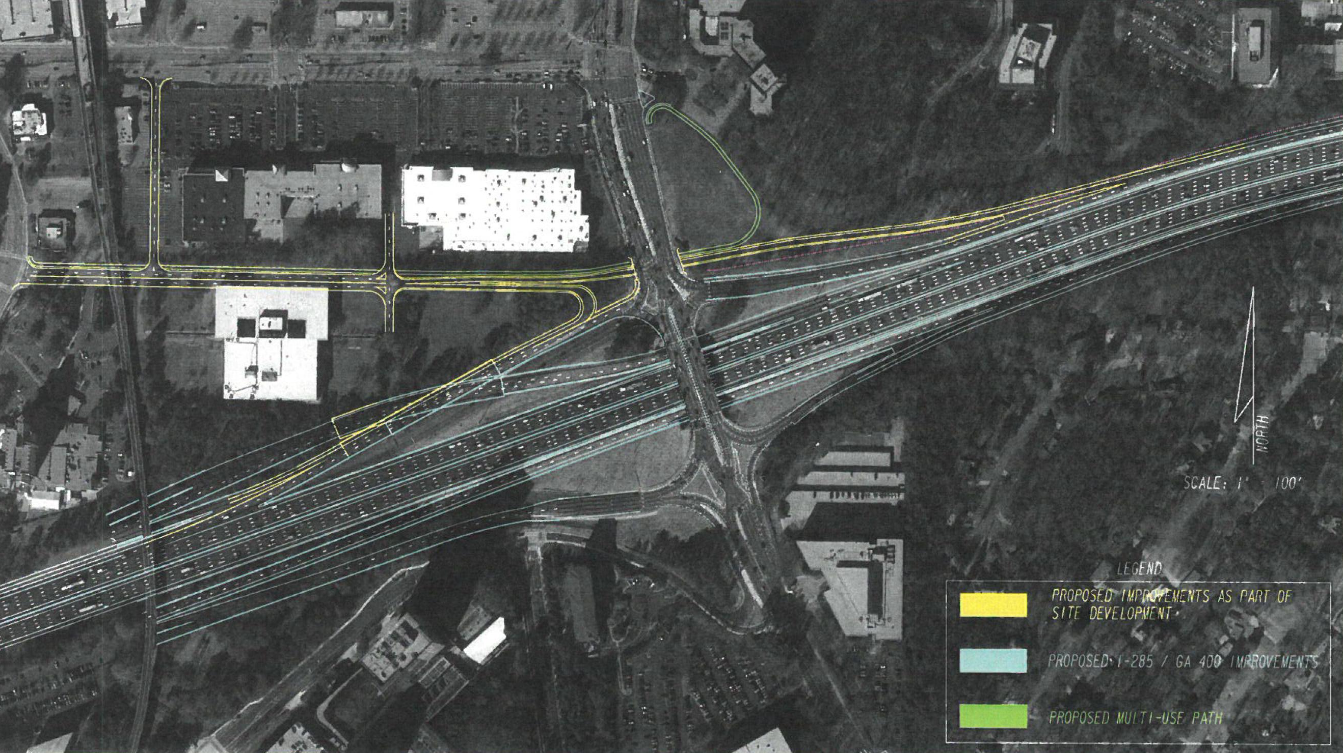
Traffic Solution
West Side Connector

Slide 47
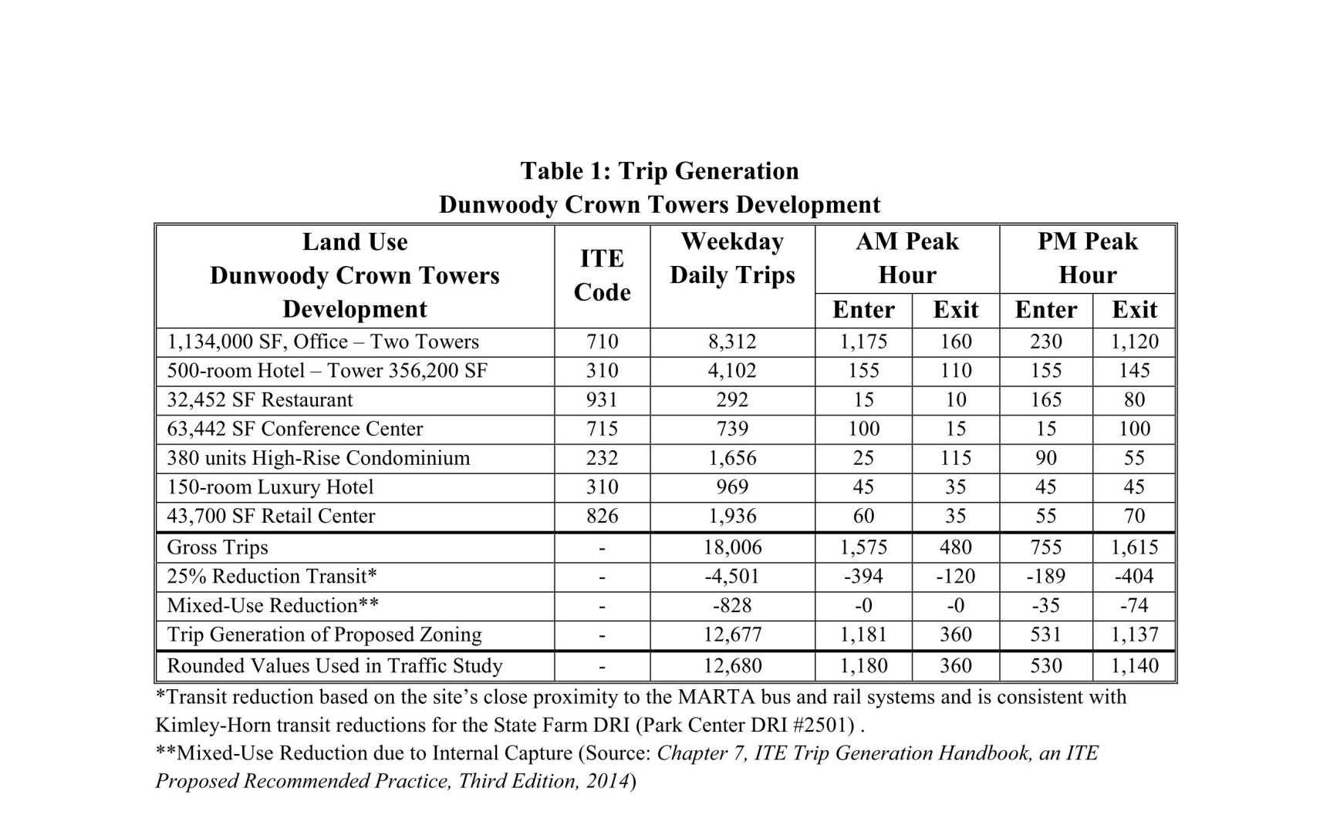
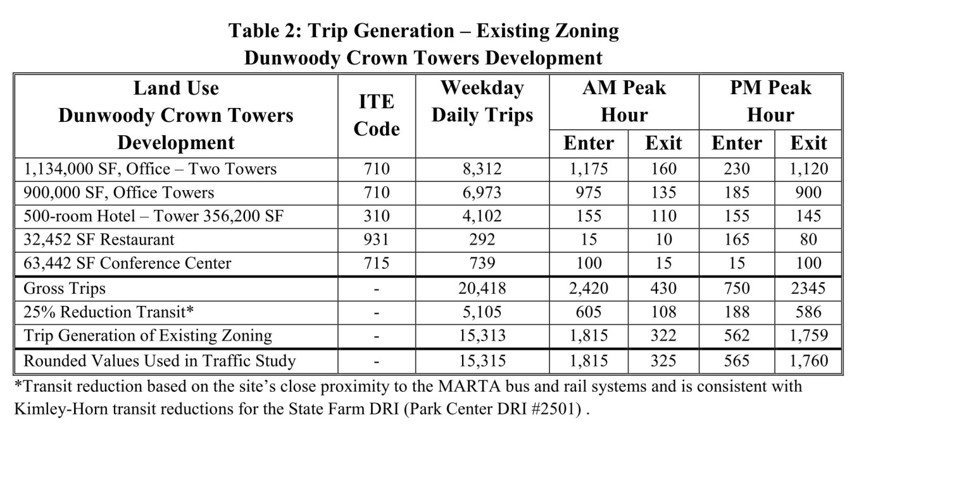

Slide 49
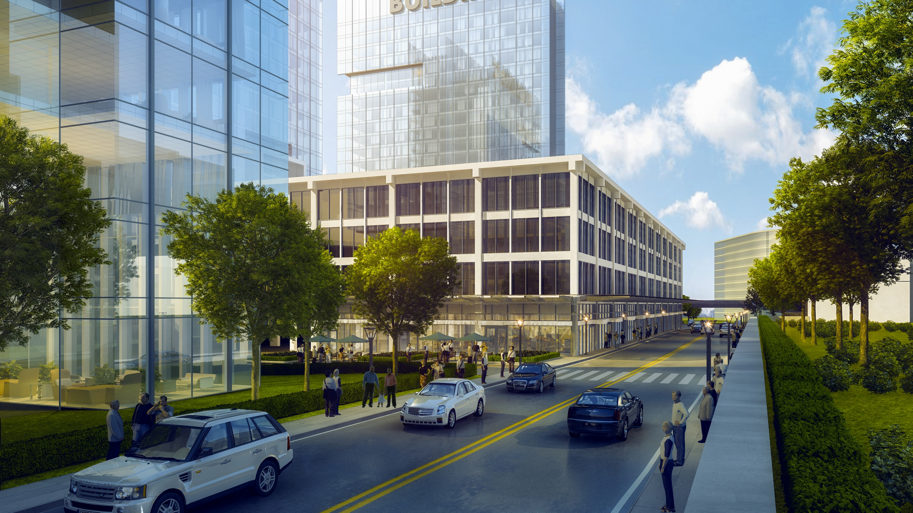

Slide 50
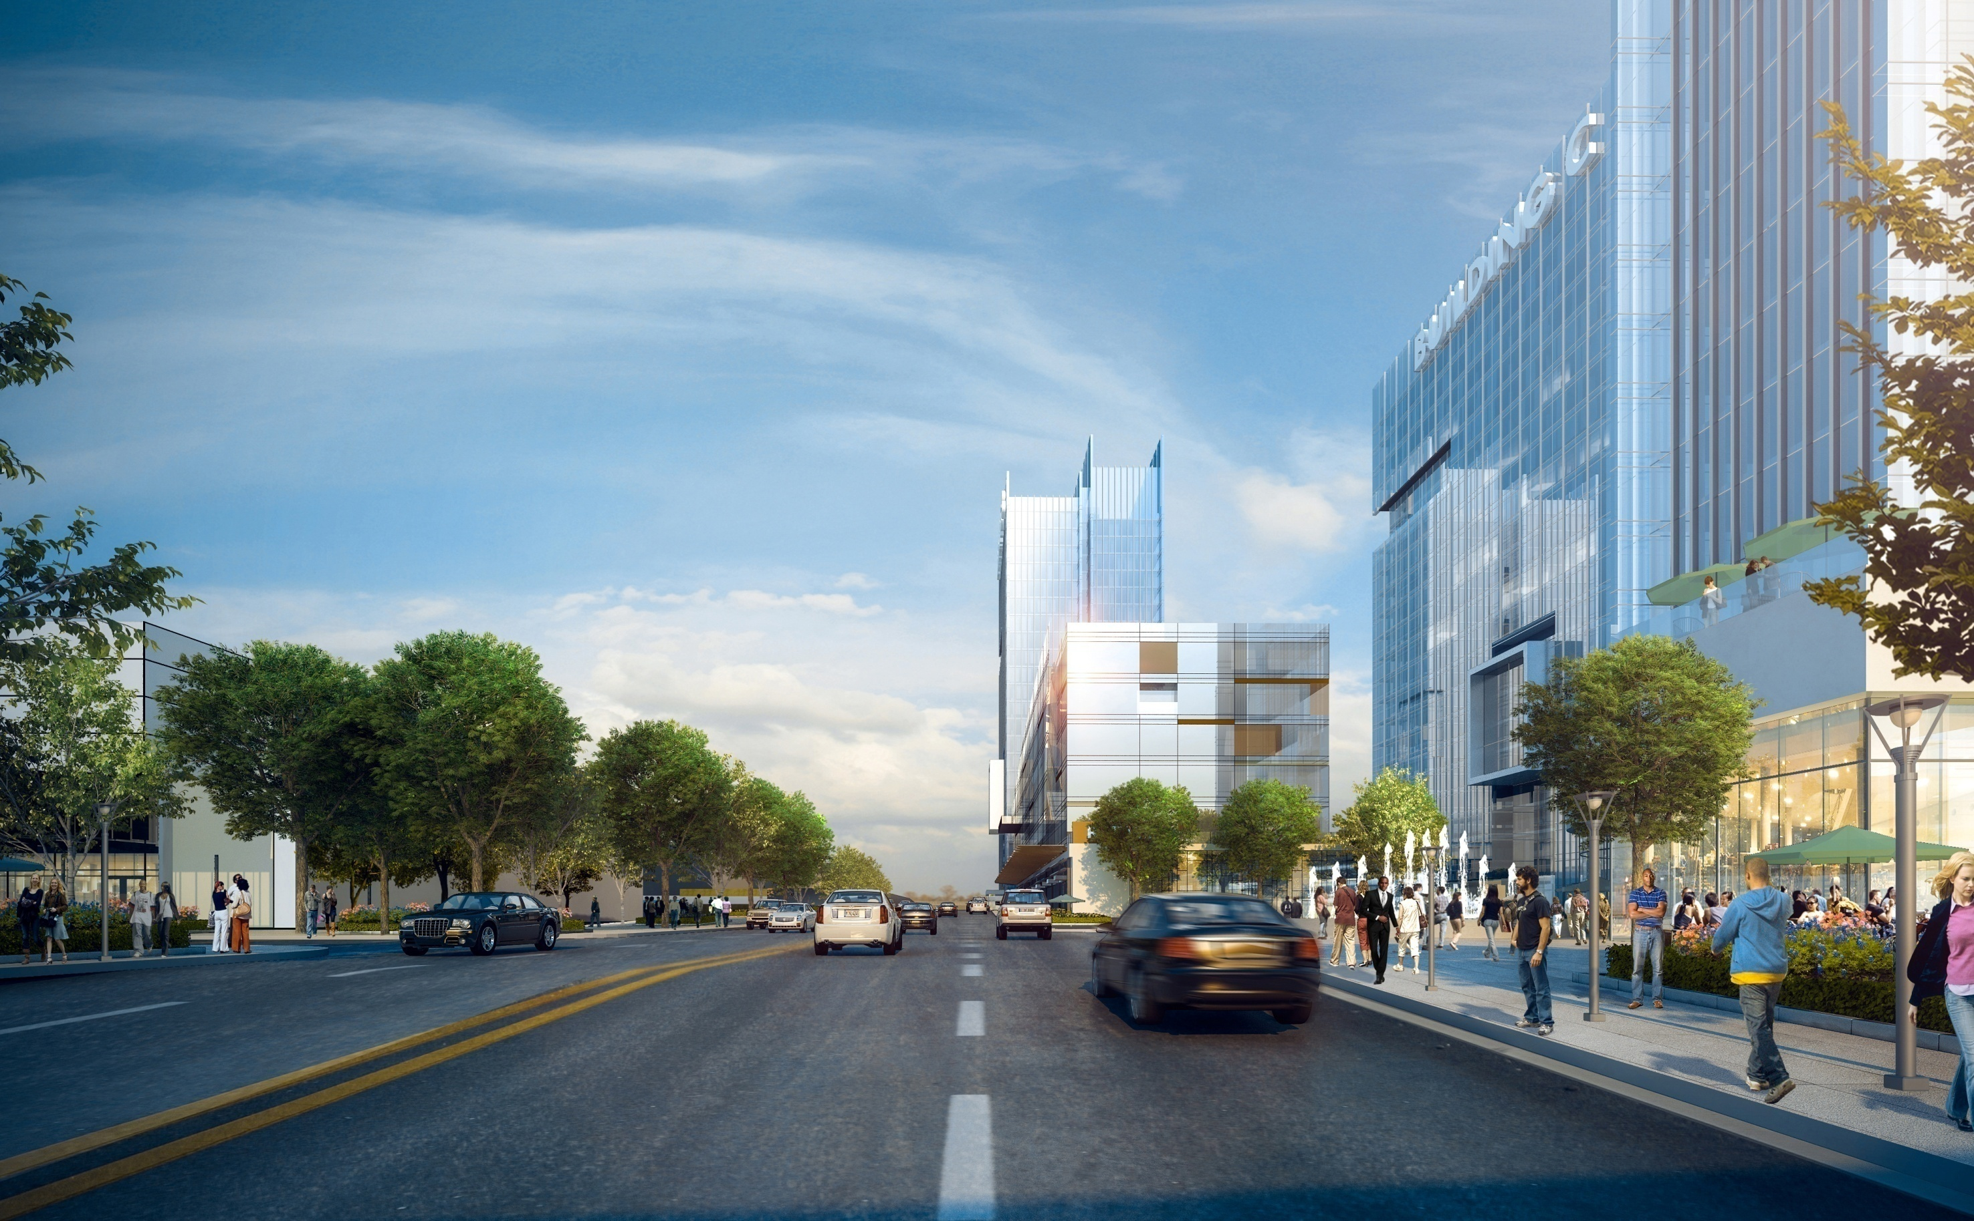

Slide 51
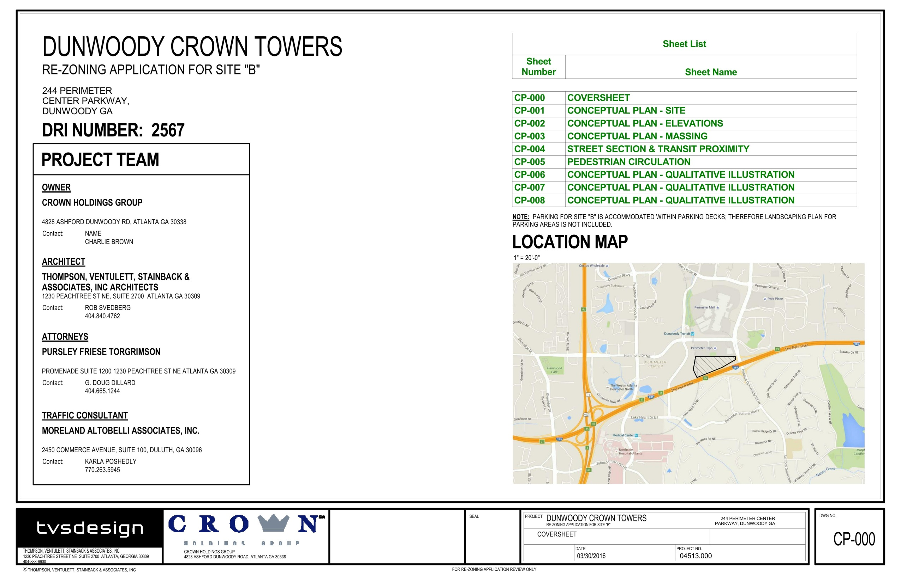

Slide 53
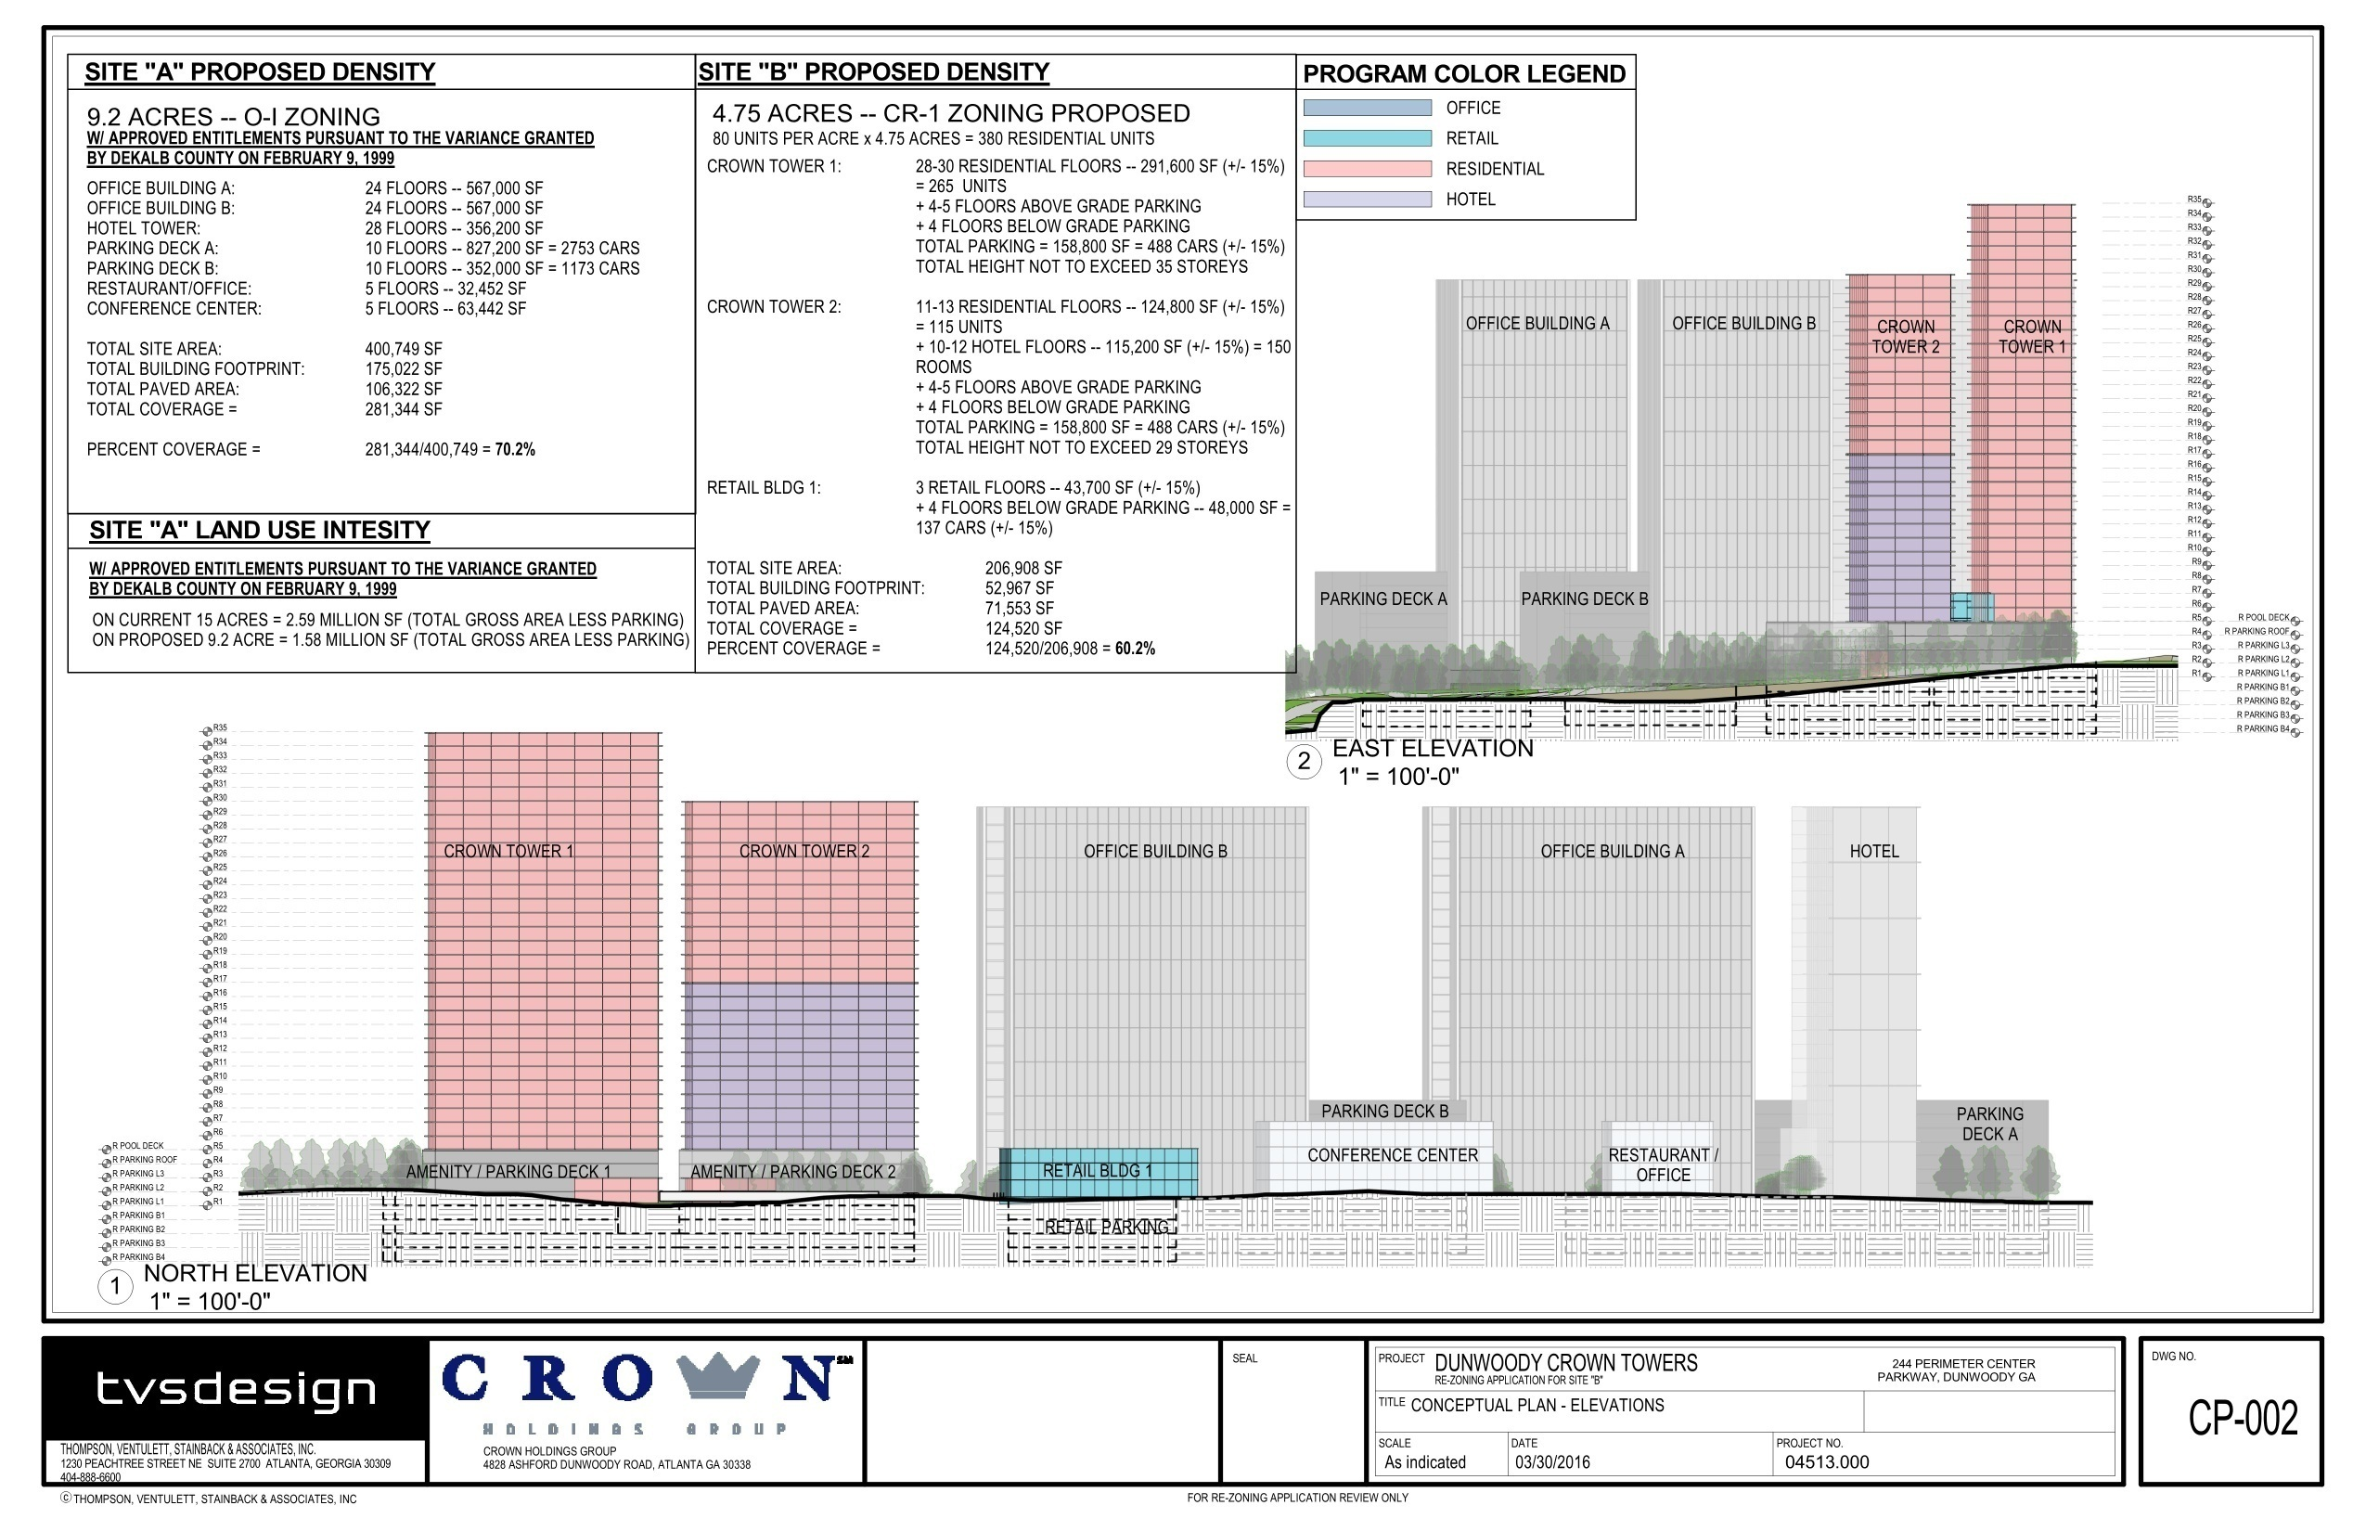

Slide 54
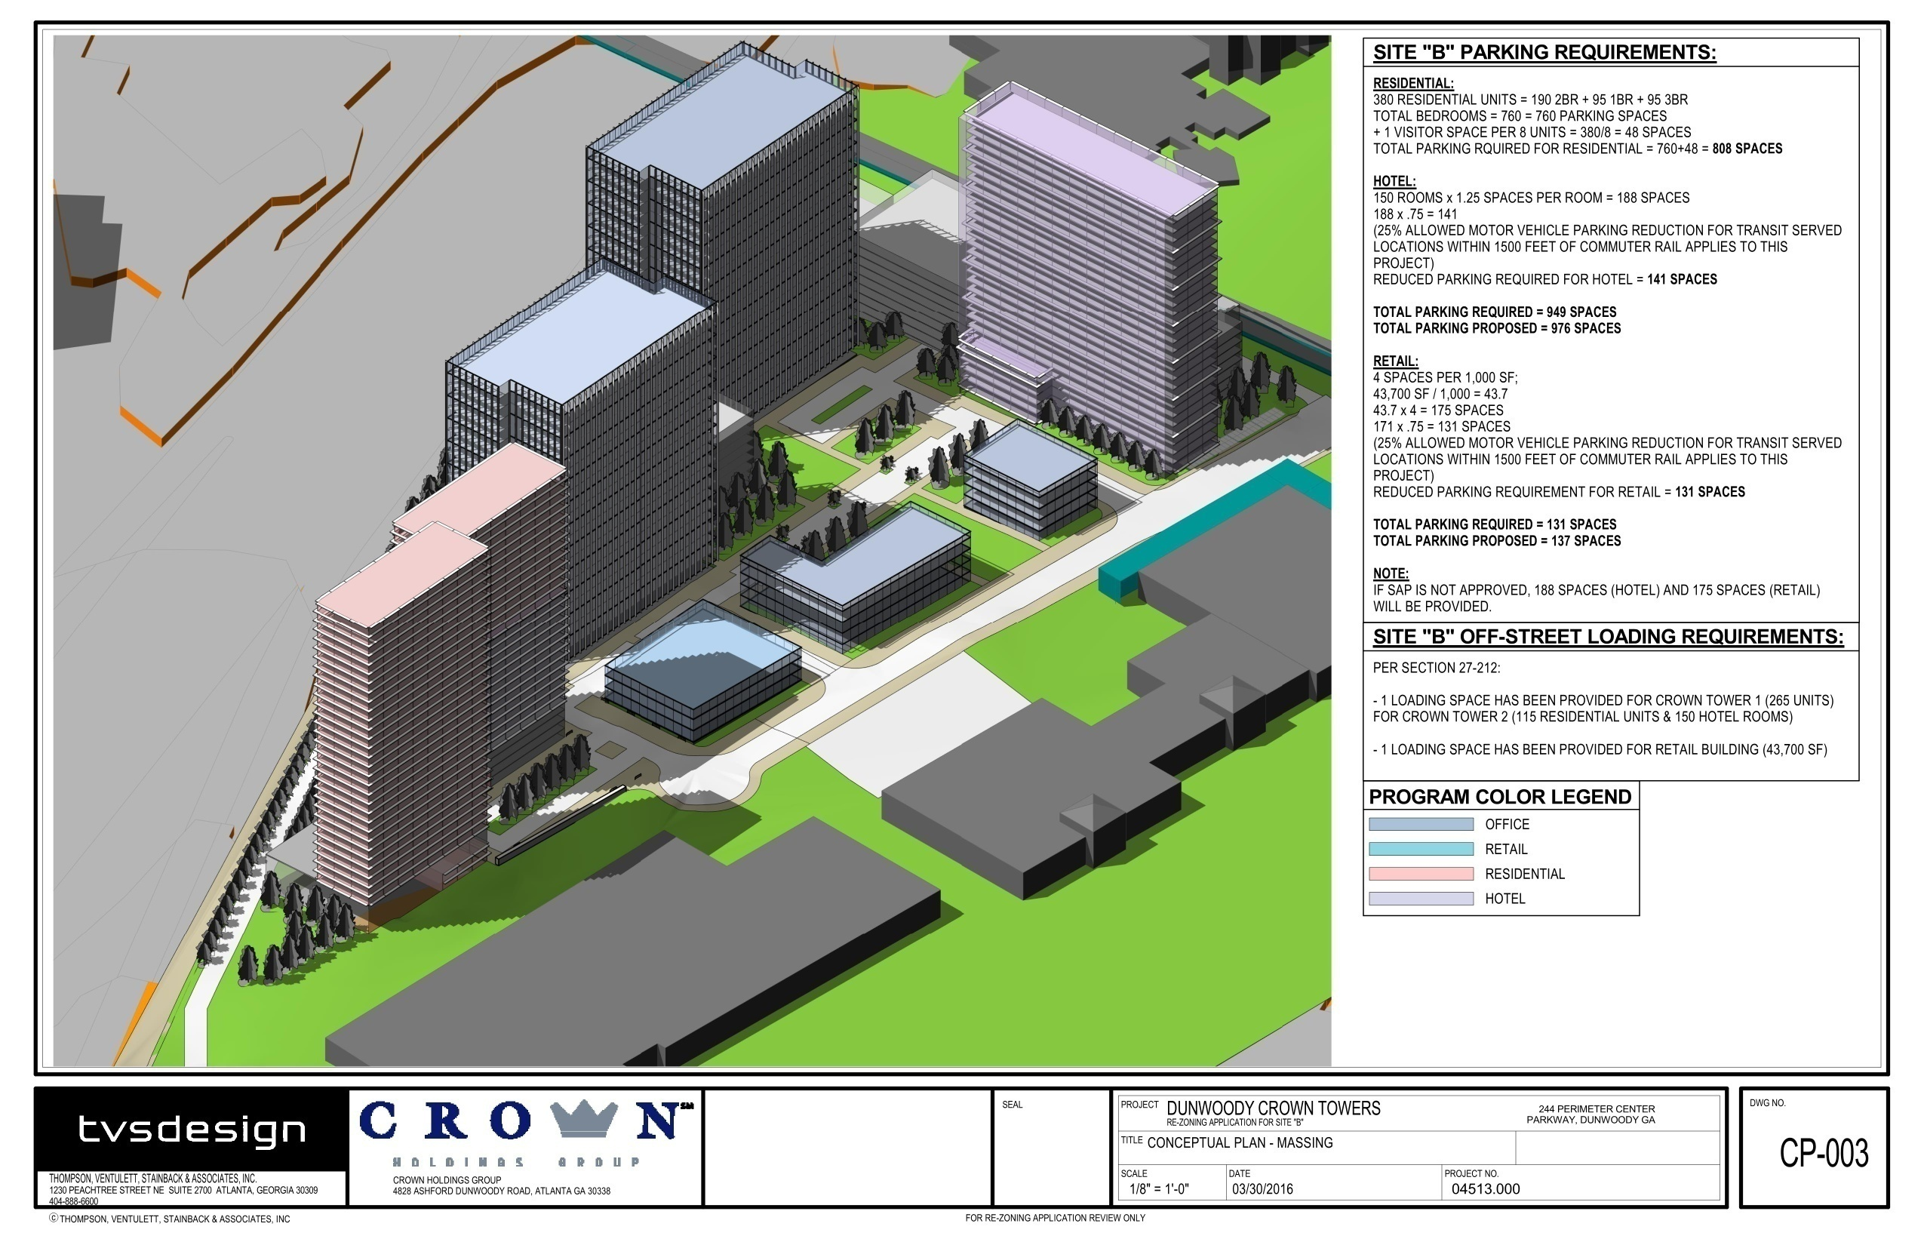

Slide 55
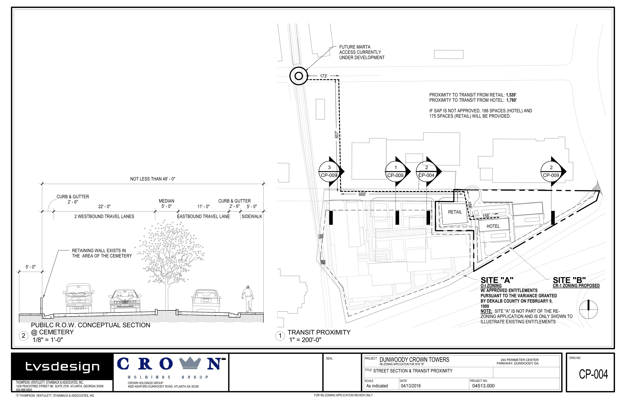

Slide 56
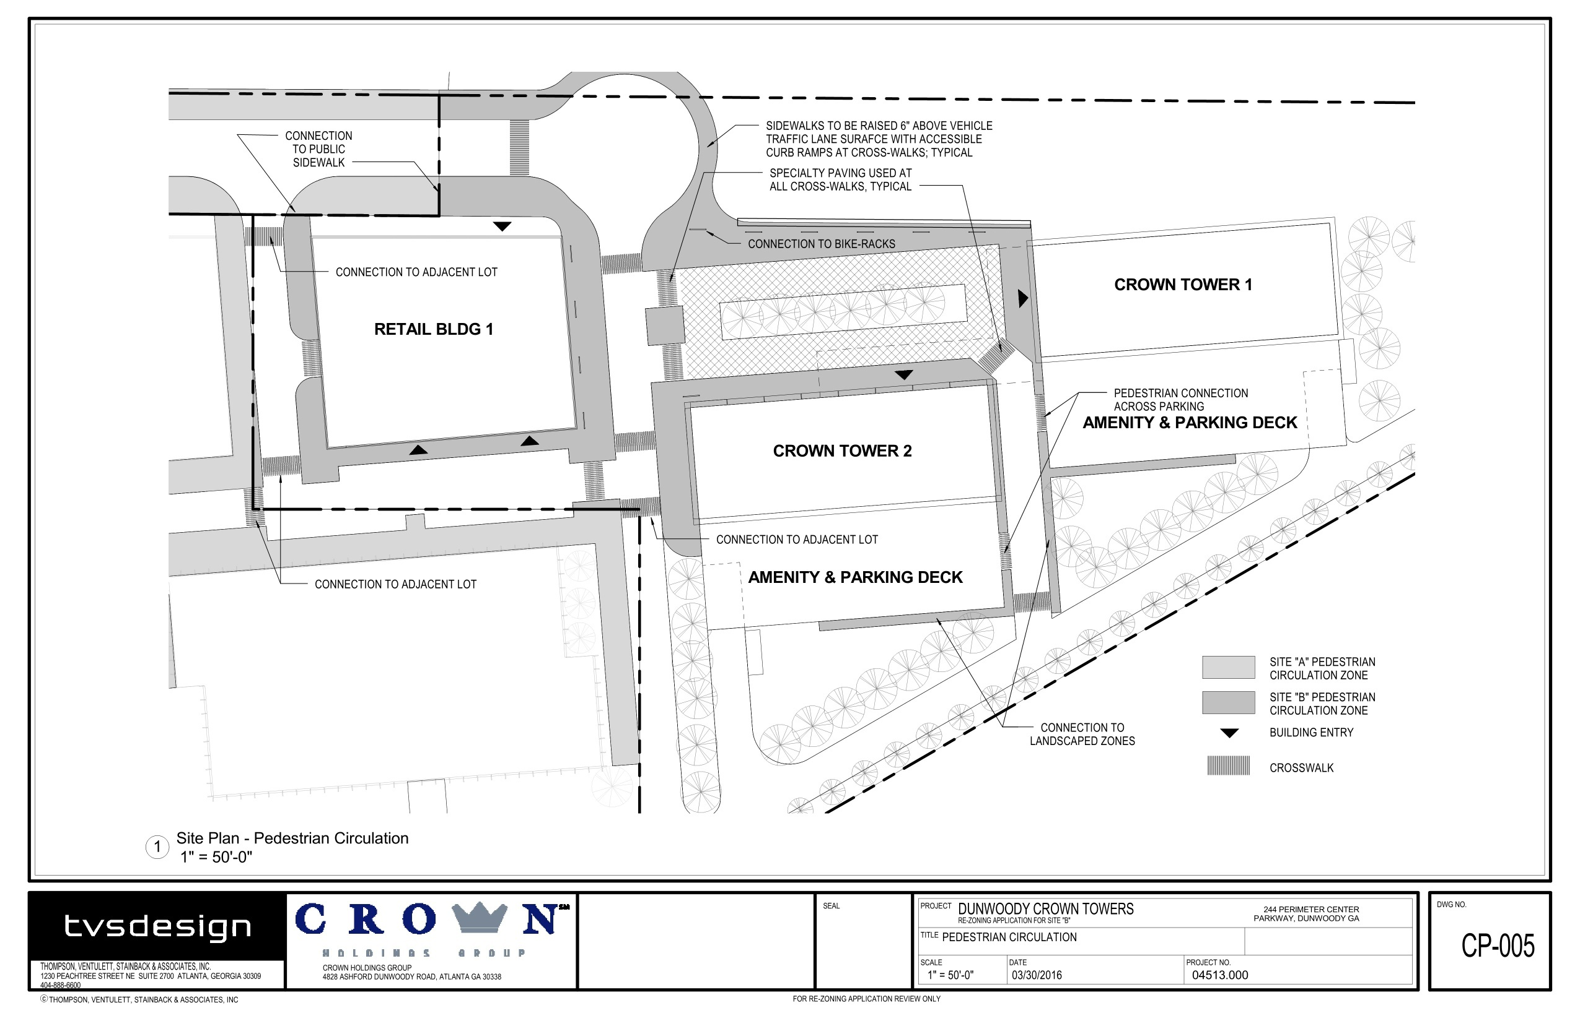

Slide 57


Slide 58


Slide 59


Slide 60


Slide 62
Looking Down Gold Kist Dr.
Master Plan

Slide 63
Central Green Space
Master Plan

Slide 64

244 Perimeter Center
Conceptual Site Plan

Slide 65


Slide 67


Slide 68
Site Plan
Master Plan

Slide 69

Condo Features
And Amenities

Slide 70



