Slide 1
02.15.2016 244 Perimeter Center presented by: Charles Brown, Crown Holdings Group

Slide 2
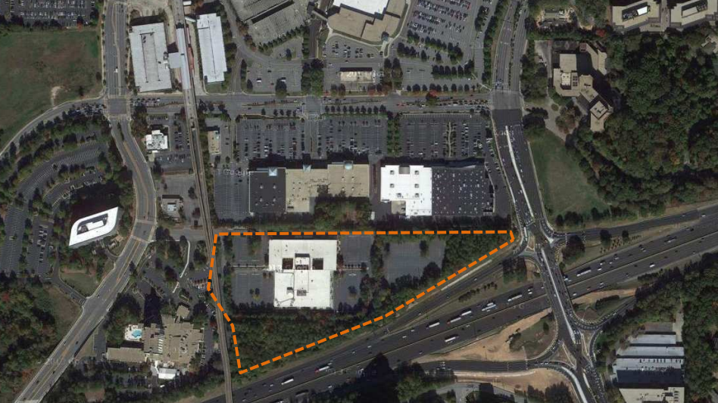
244 Perimeter Center
Existing Condition

Slide 3
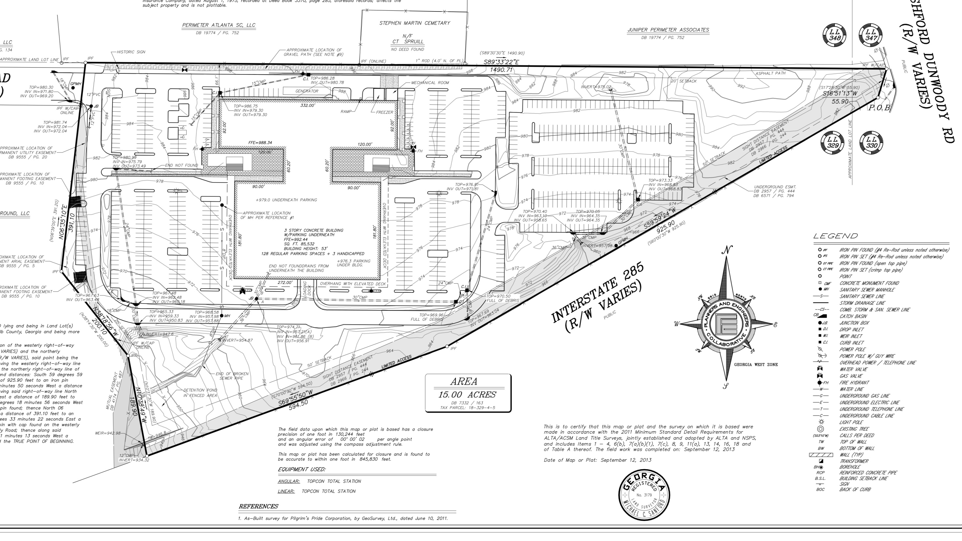
244 Perimeter Center
Survey

Slide 4
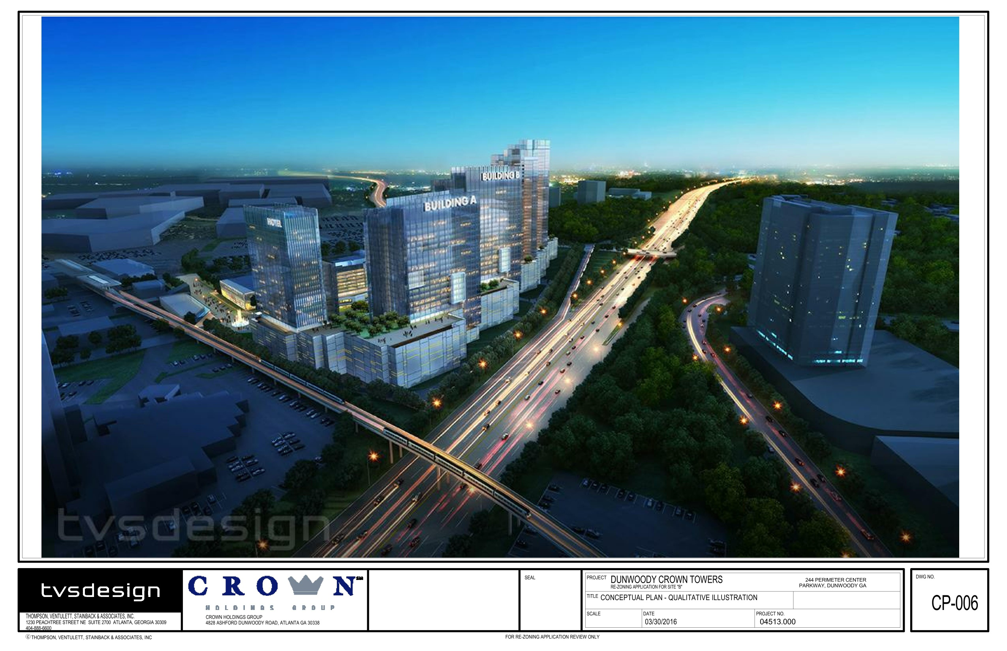
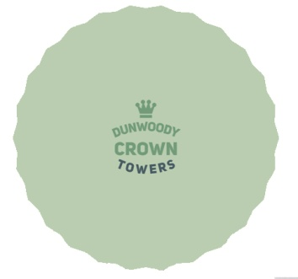

Slide 5
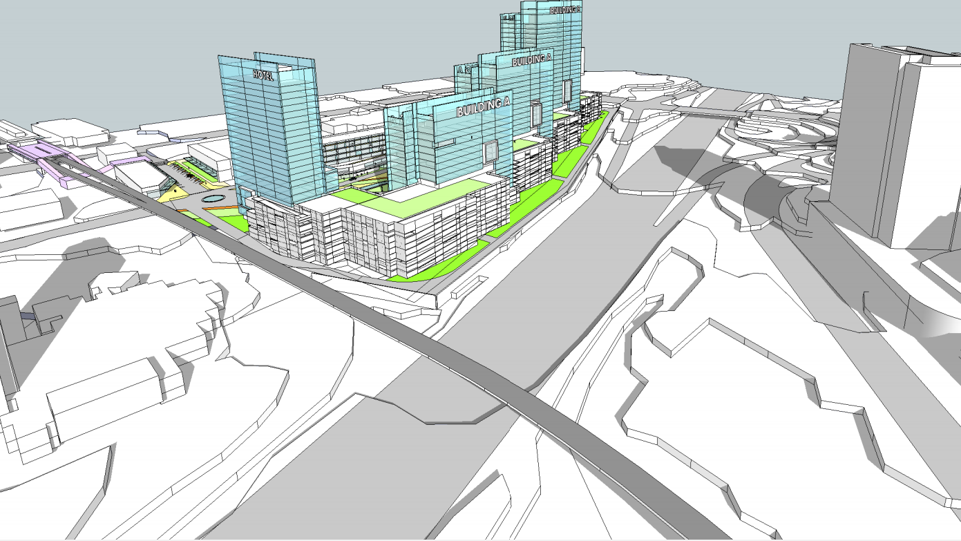
244 Perimeter Center
Conceptual Massing

Slide 6
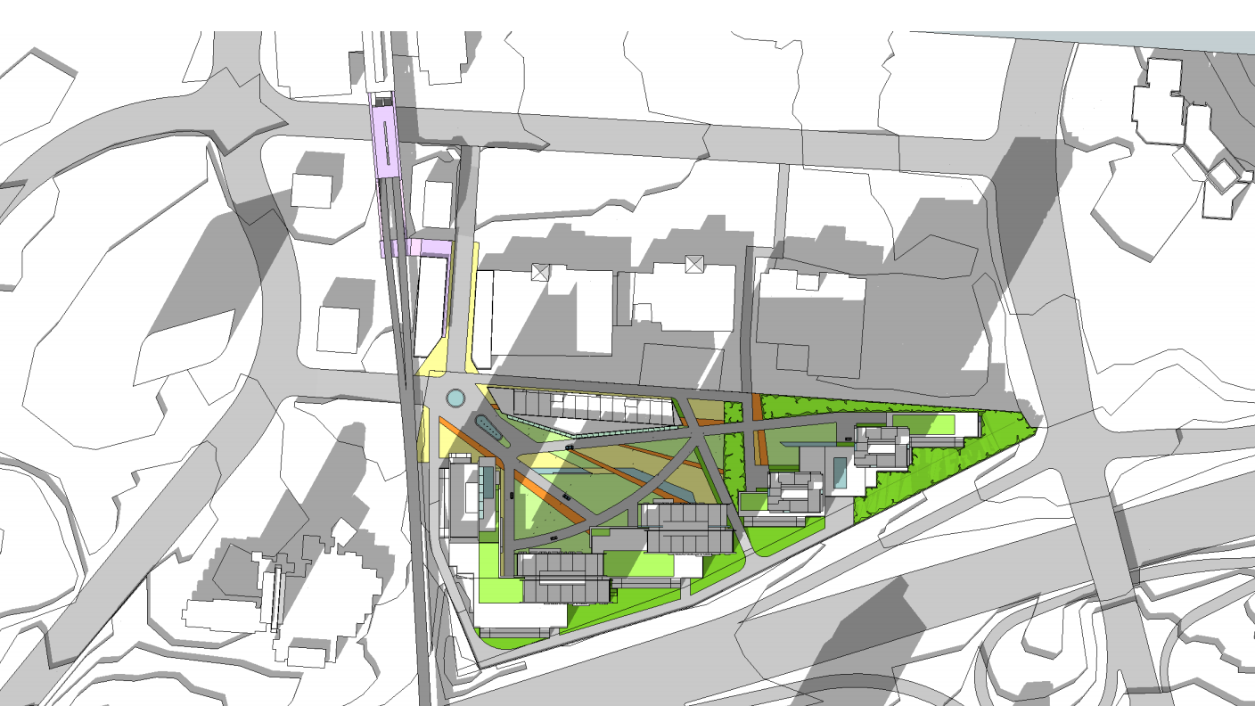
244 Perimeter Center
Conceptual Site Plan

Slide 7
Design
tvsdesign

Slide 8
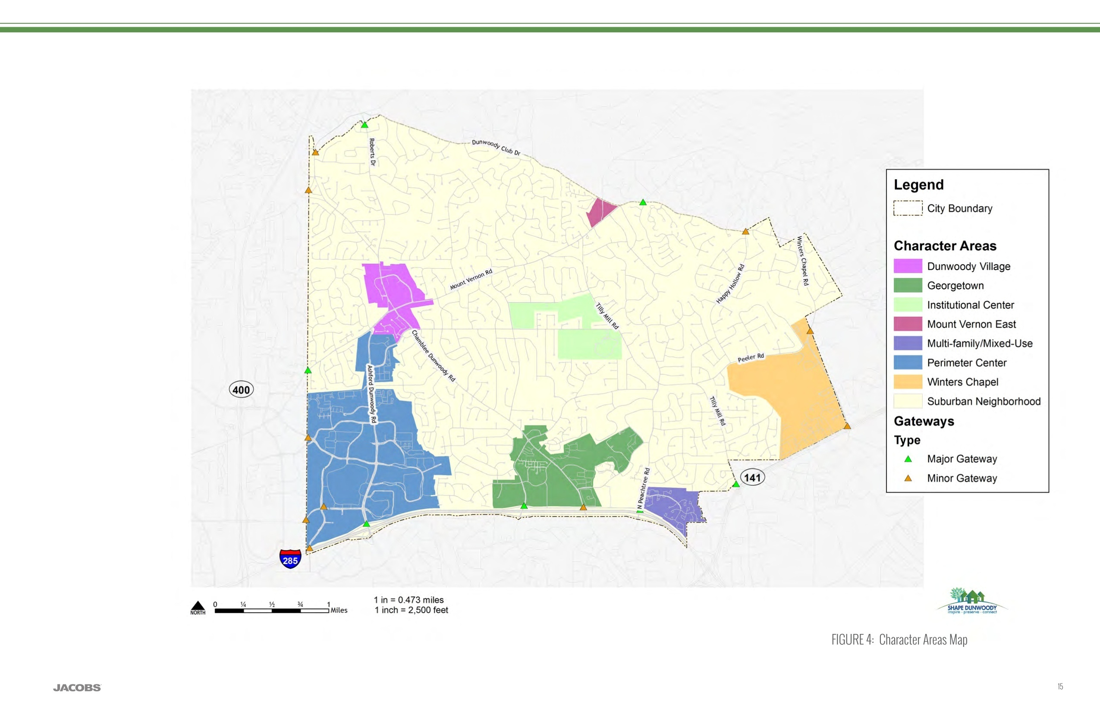
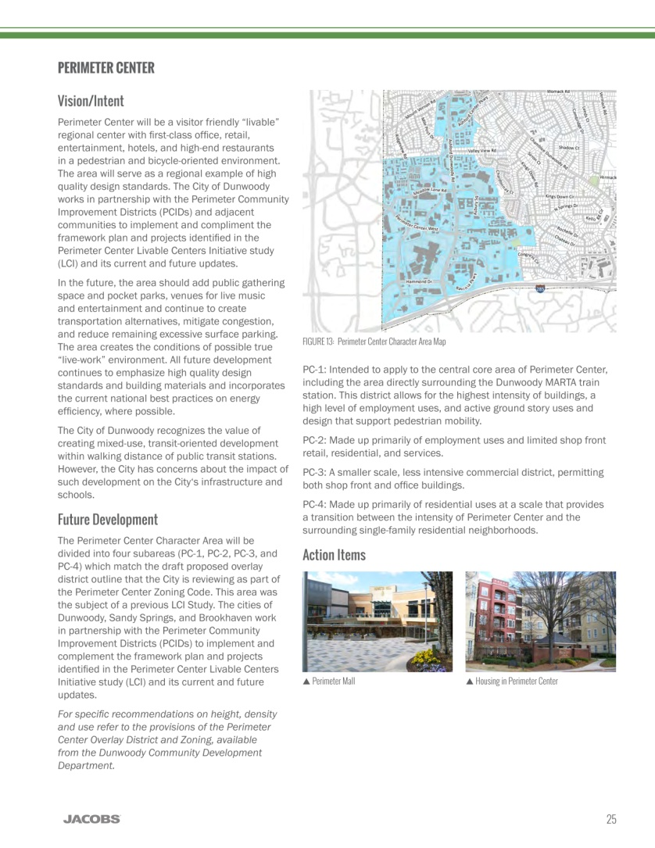
Dunwoody
2015 Comprehensive Plan

Slide 9
Goals
2015 Comprehensive Plan

Slide 10
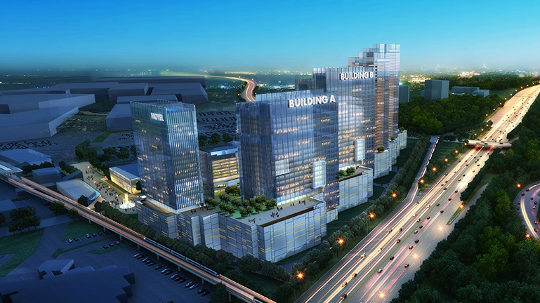
Height along 285
Master Plan

Slide 11
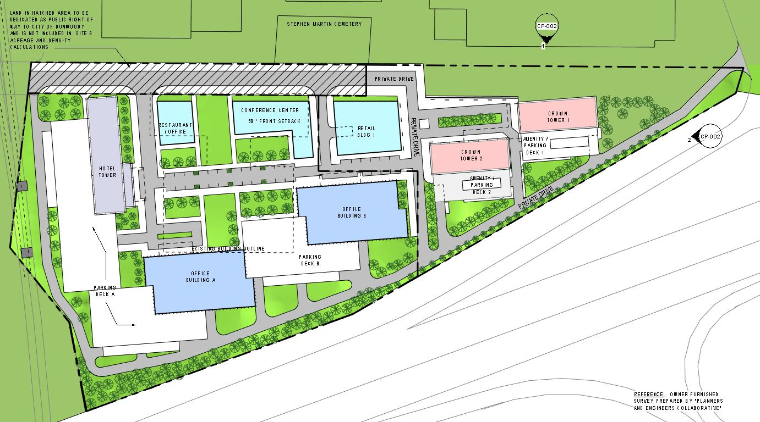
Site Plan
Master Plan

Slide 12
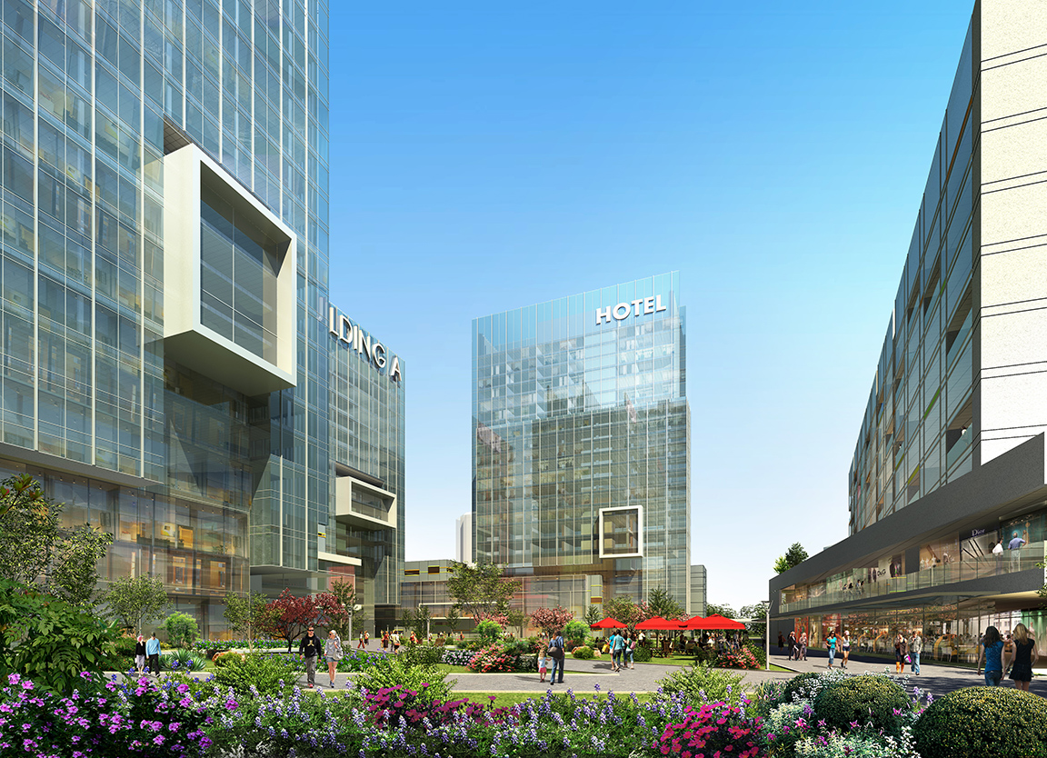
Central Green Space
Master Plan

Slide 13
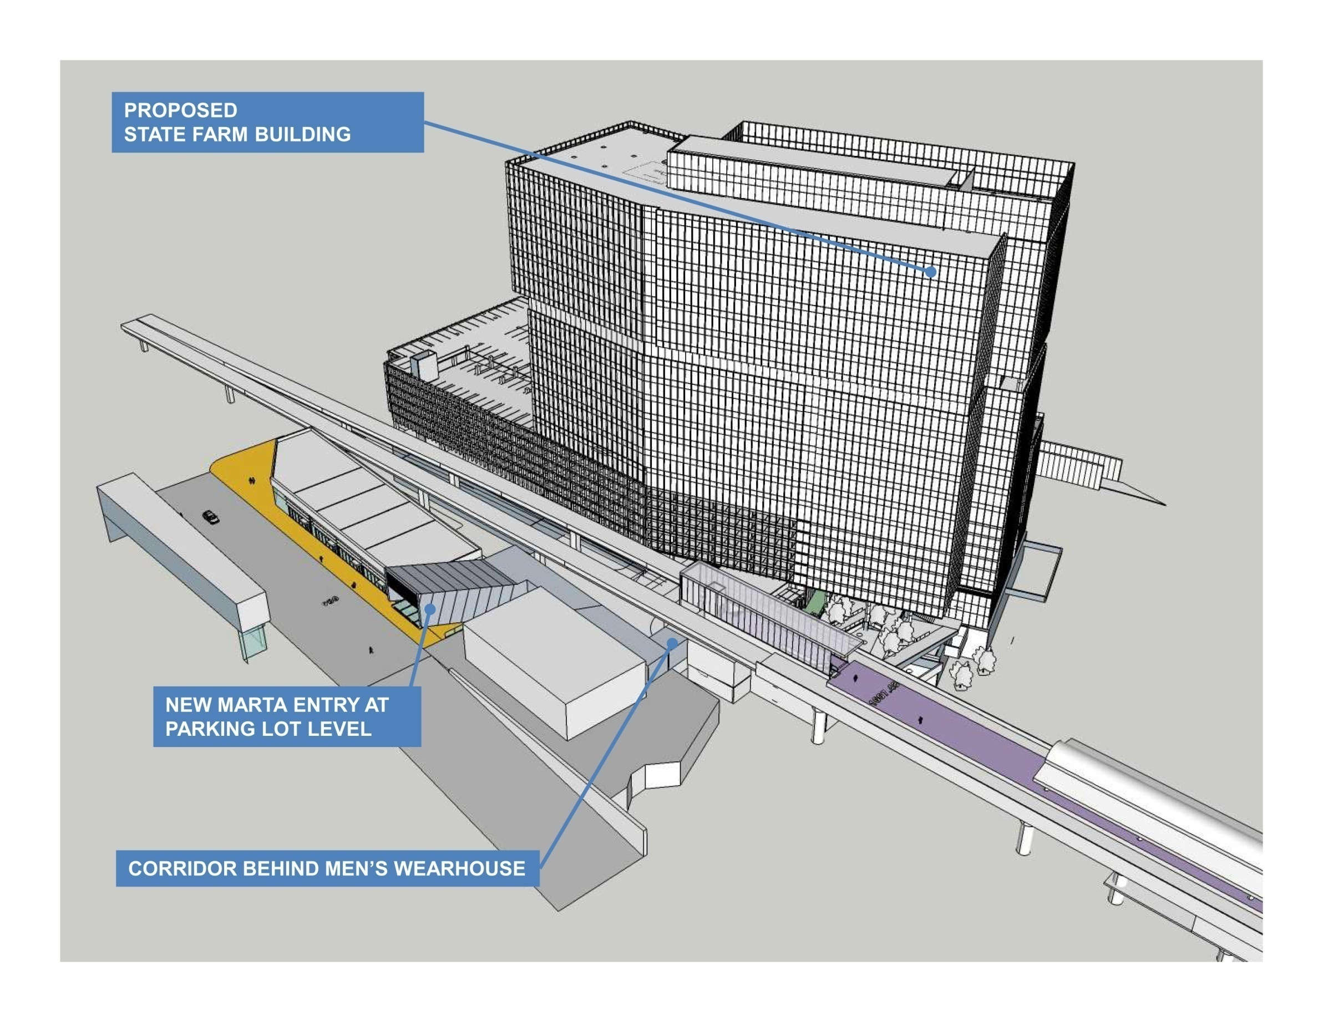
Connectivity
Master Plan

Slide 14
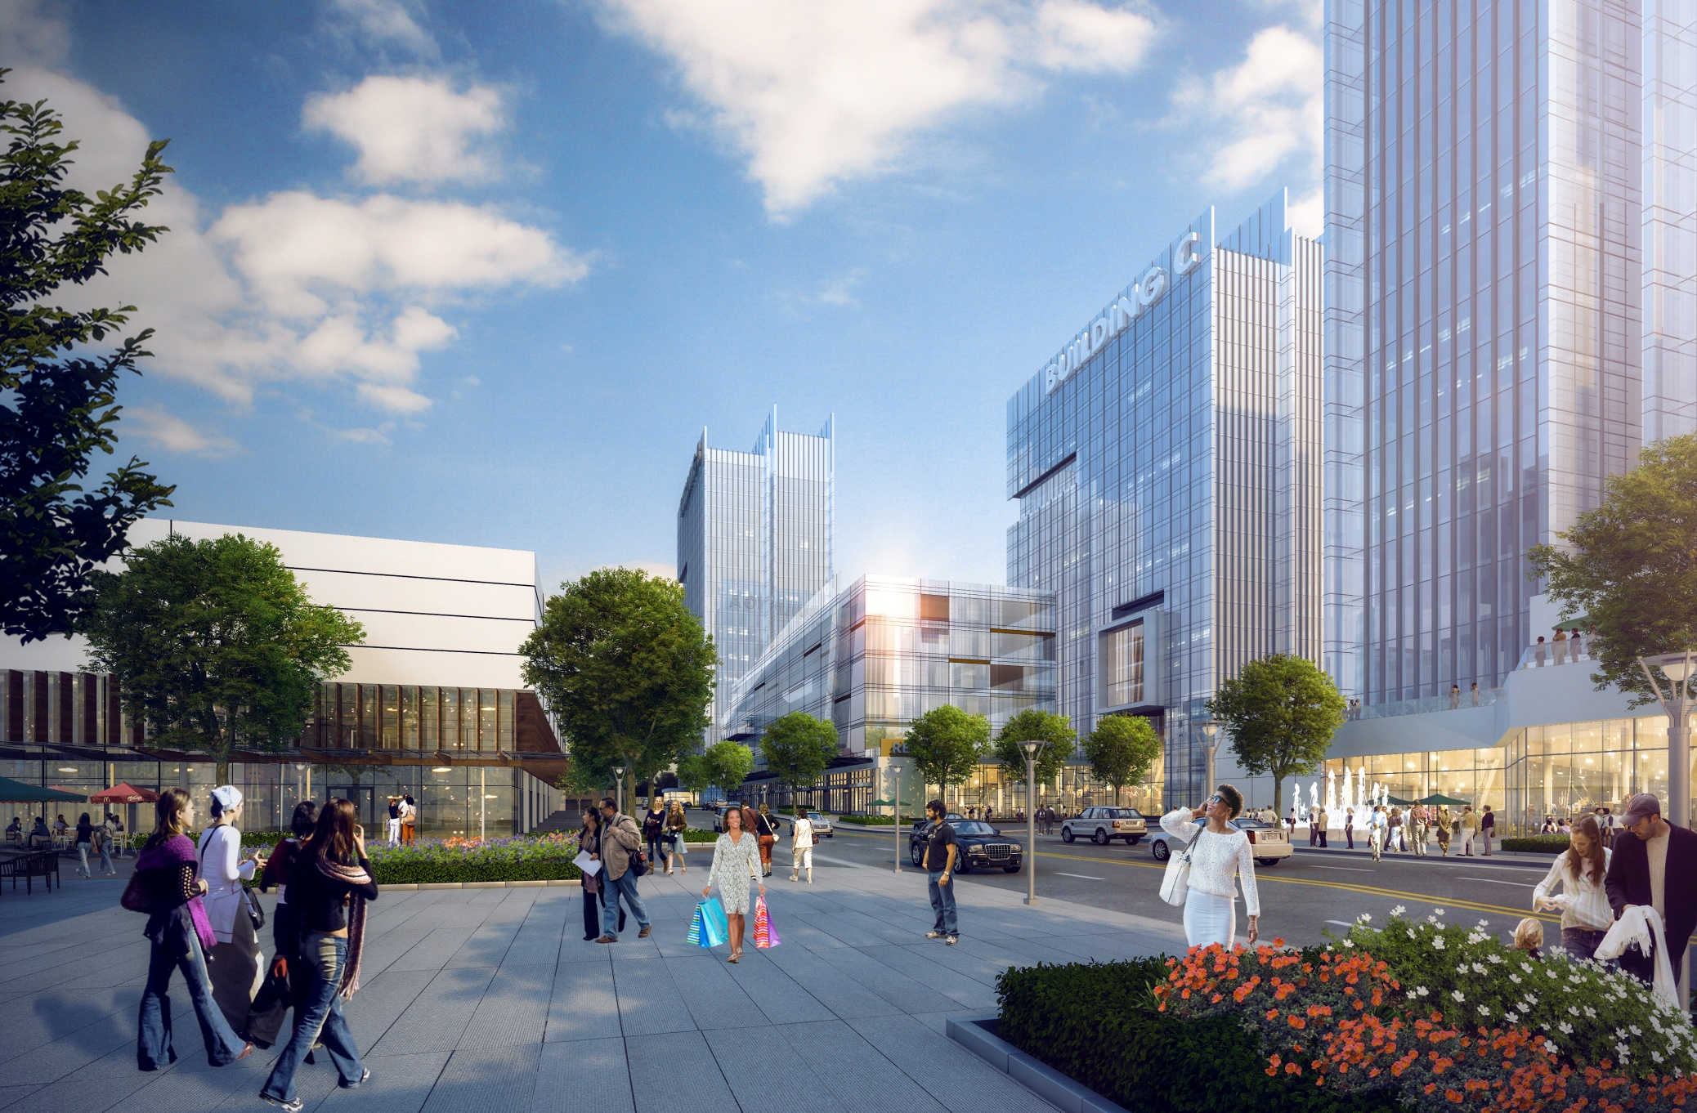
Looking Down Gold Kist Dr.
Master Plan

Slide 15
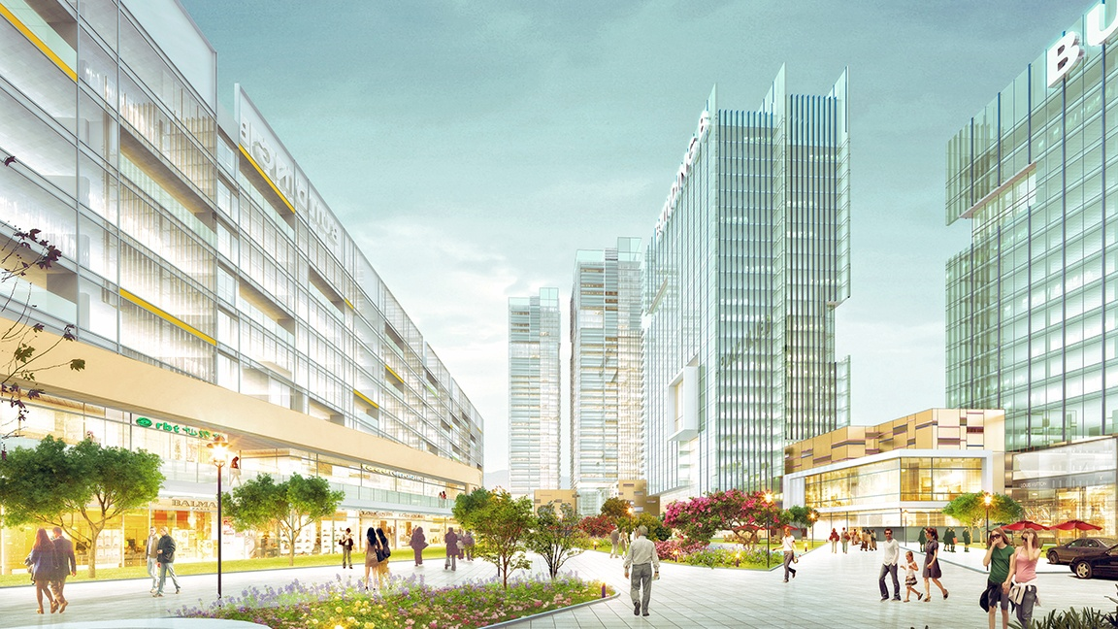
Central Green Space
Master Plan

Slide 16
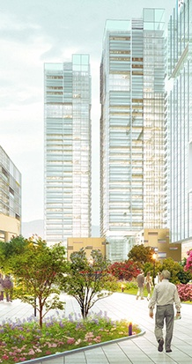
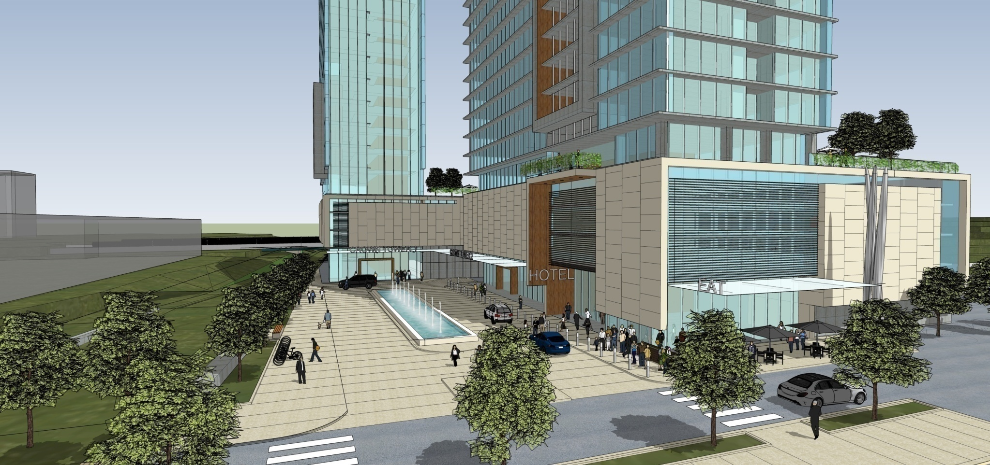
Dunwoody Crown Towers
Concept Design

Slide 17
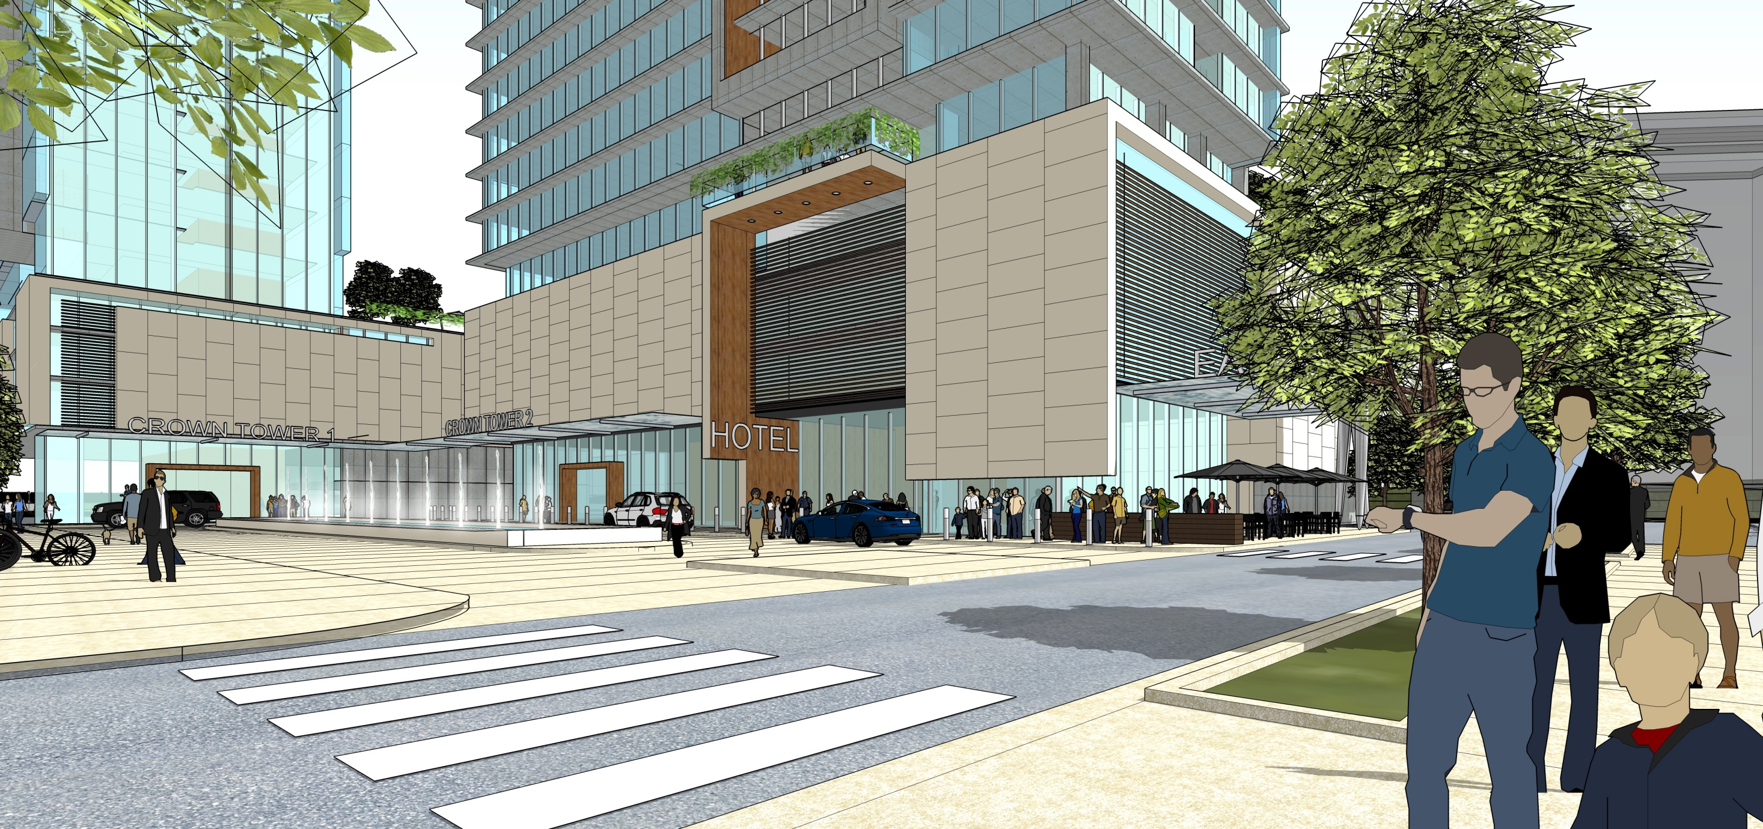
Dunwoody Crown Towers
Concept Design

Slide 18
Site Plan
Master Plan

Slide 20
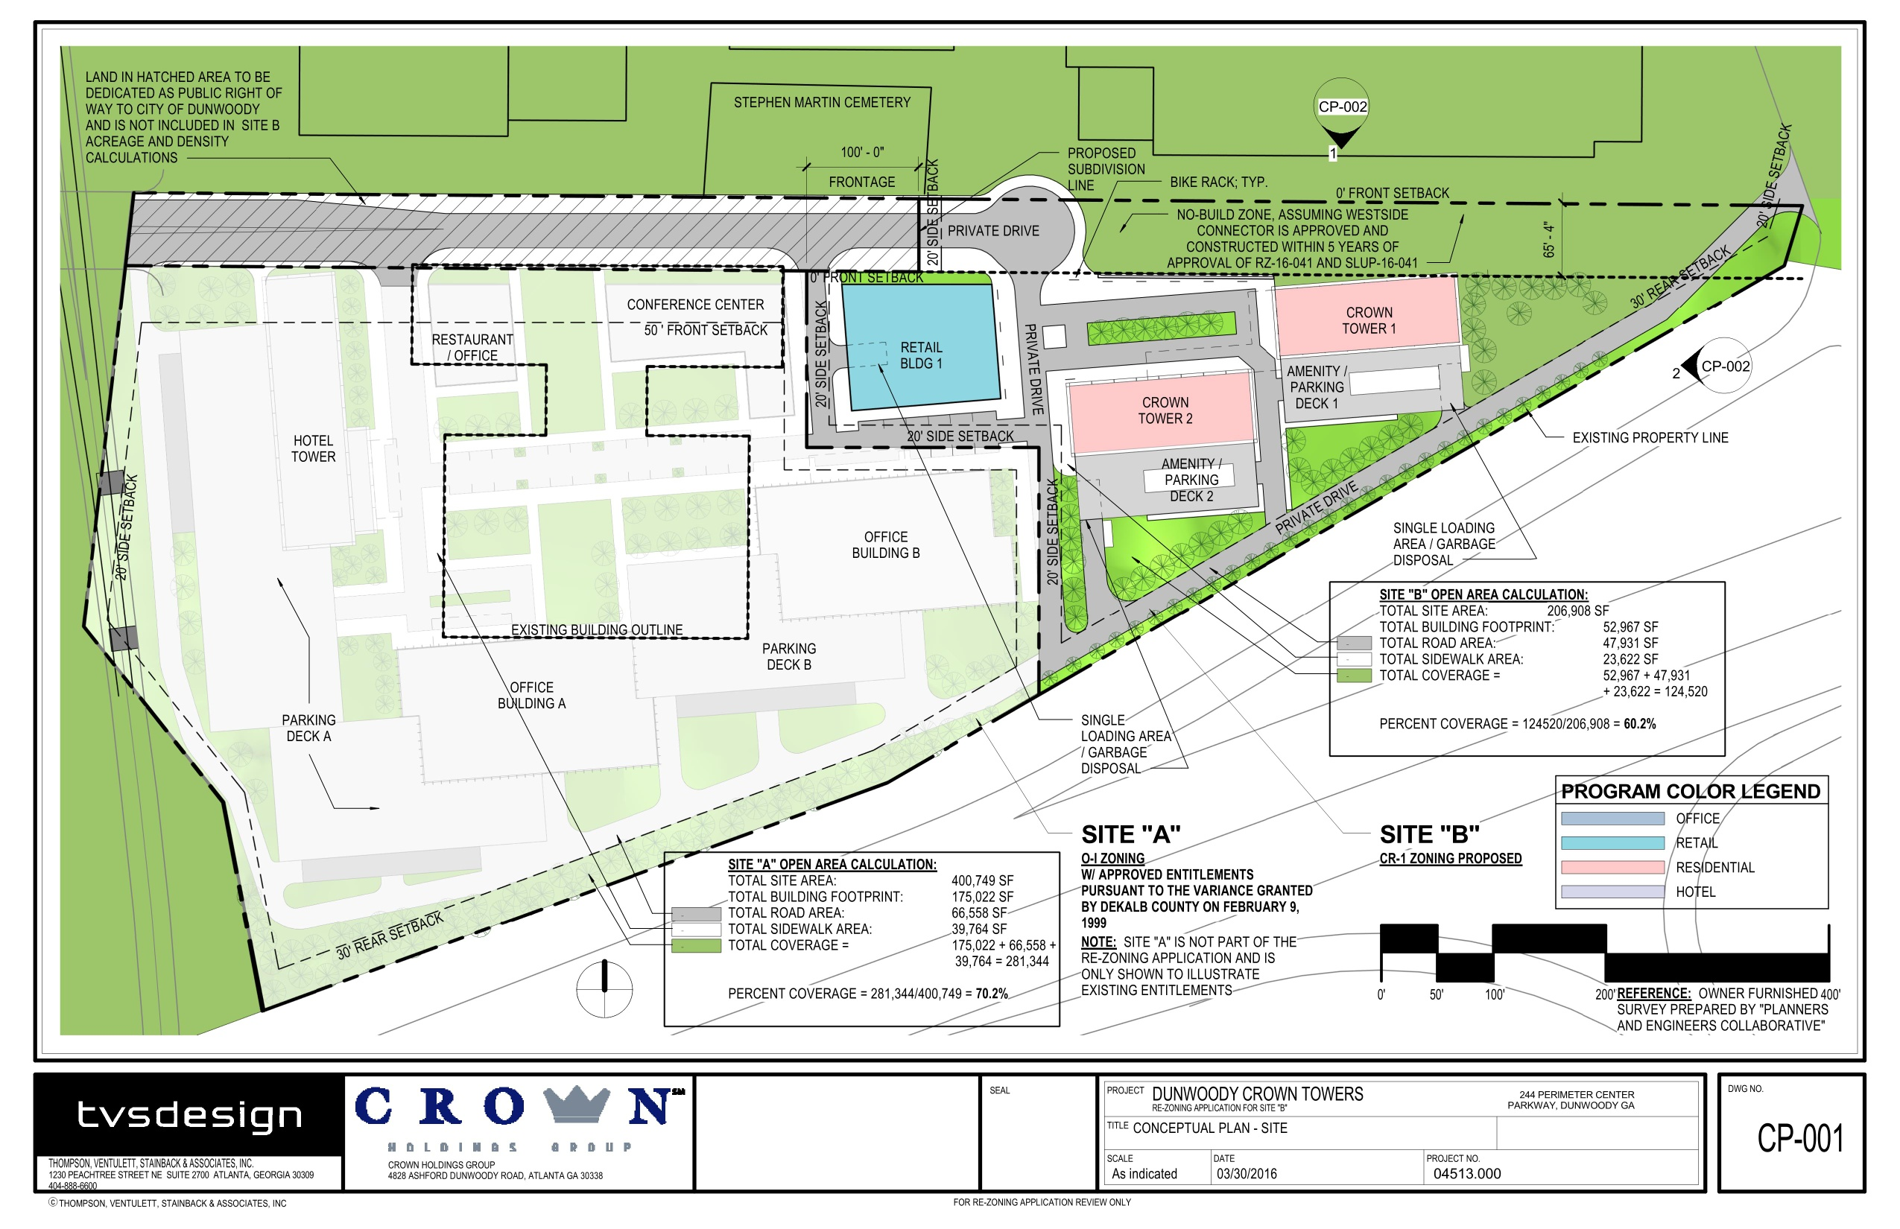

Slide 21
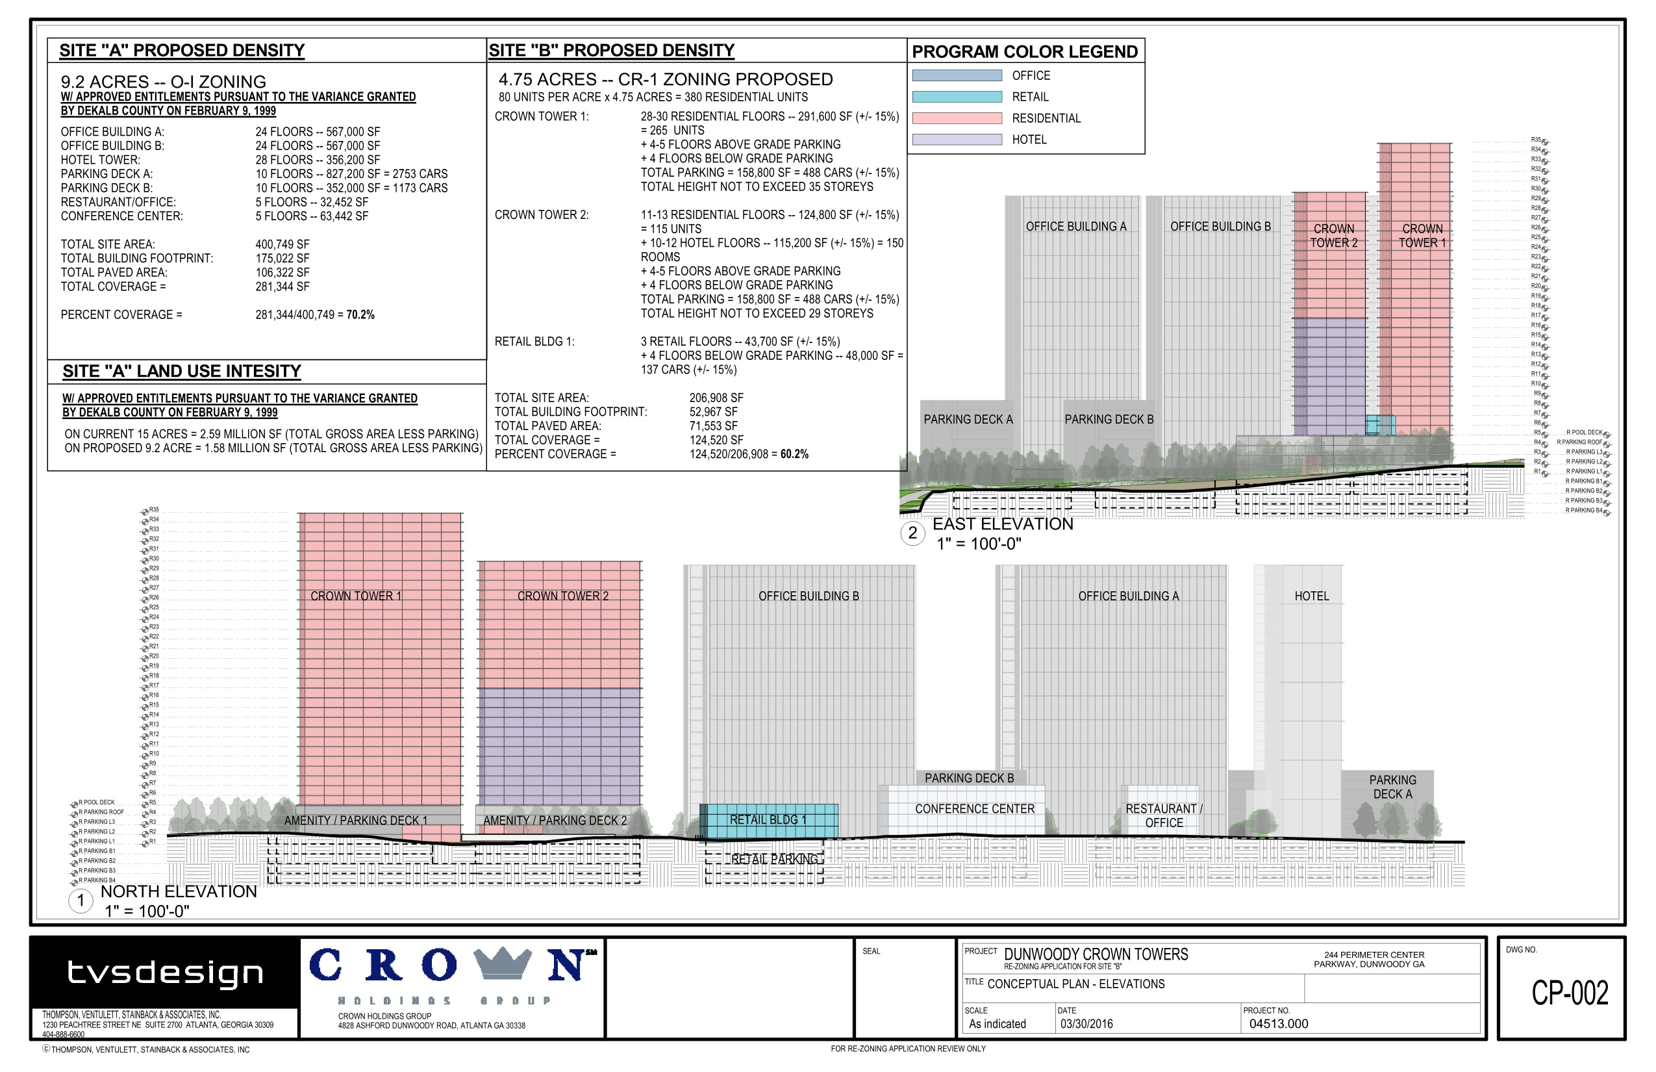

Slide 22
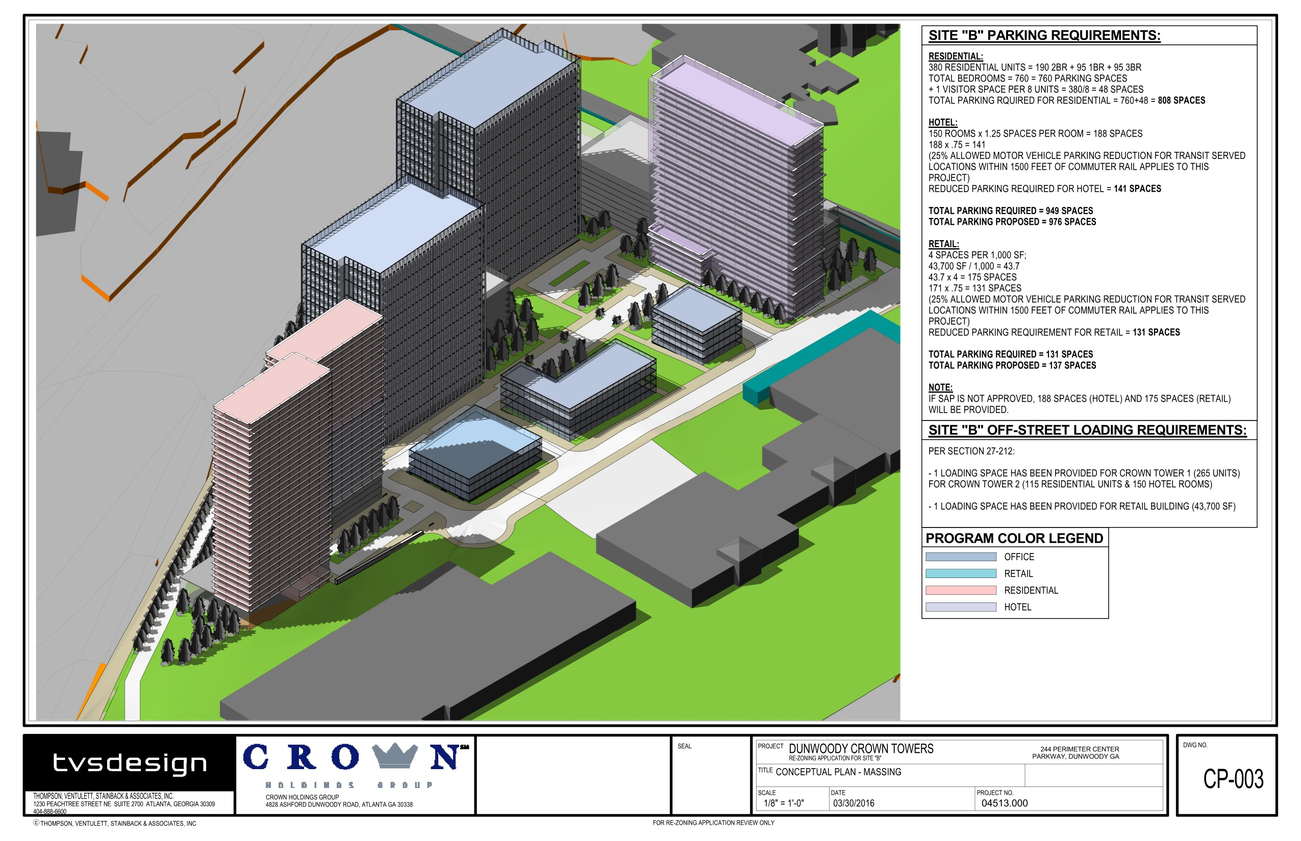

Slide 23
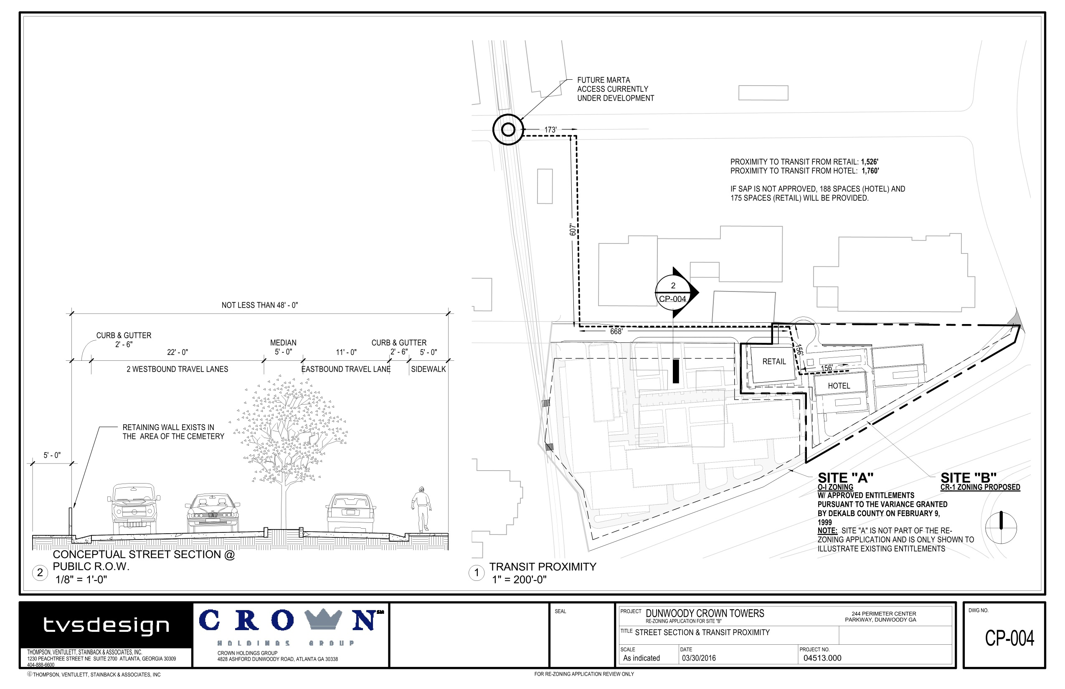

Slide 24
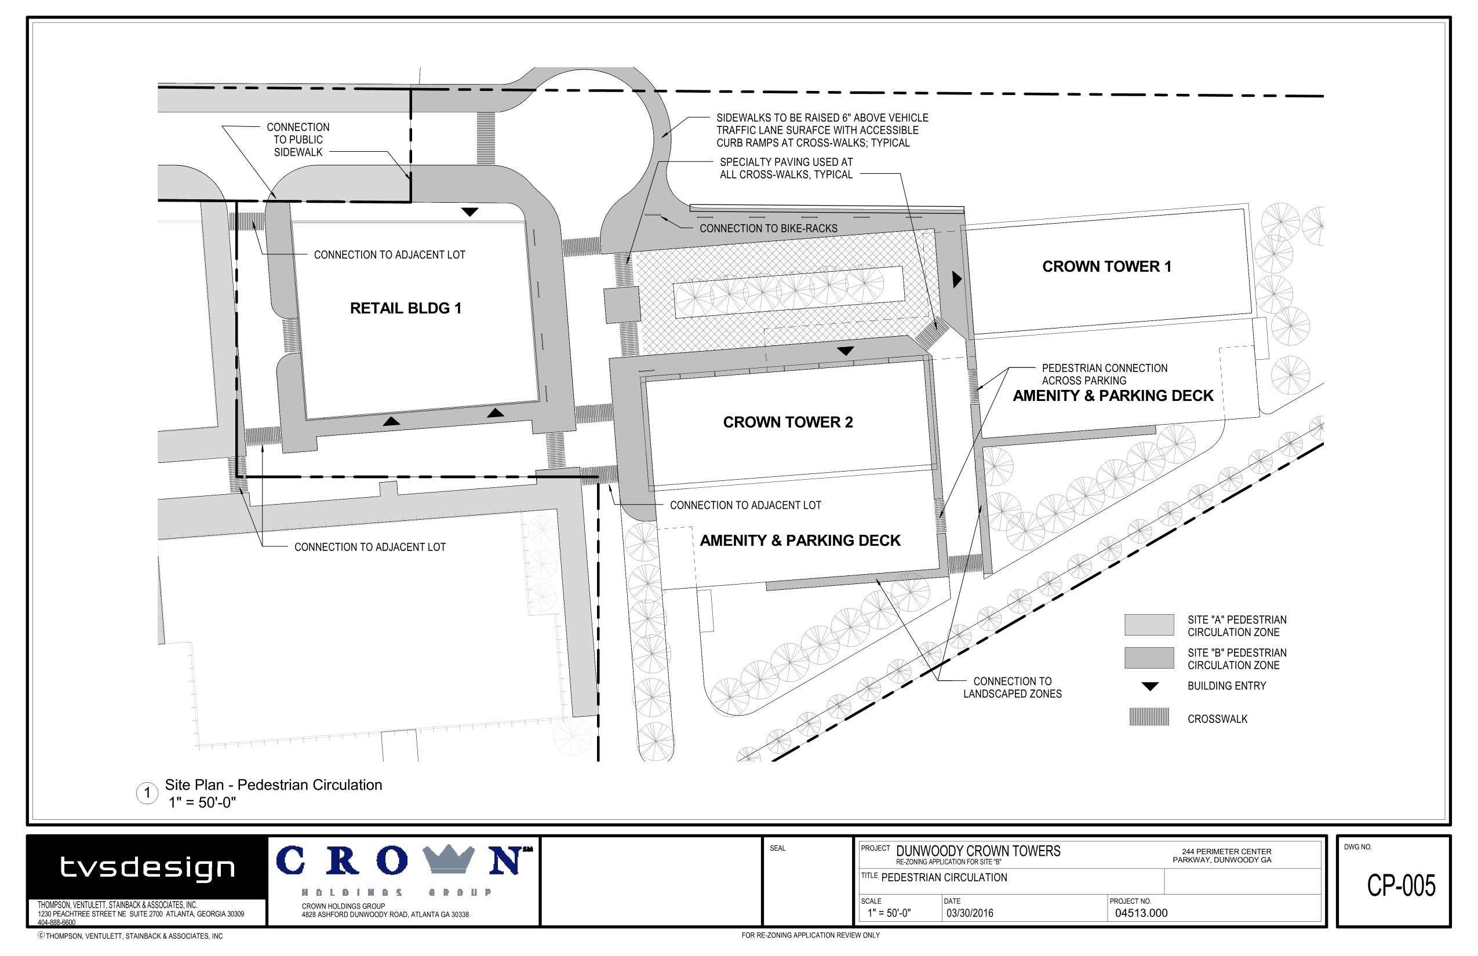

Slide 25
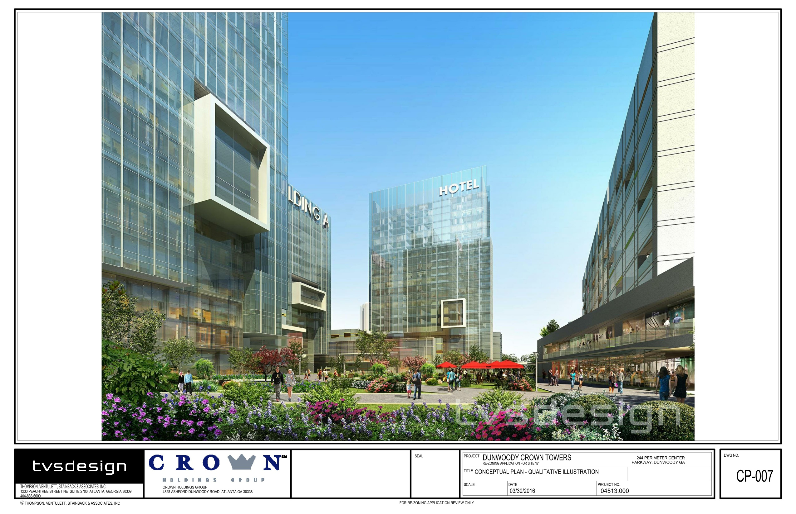

Slide 26
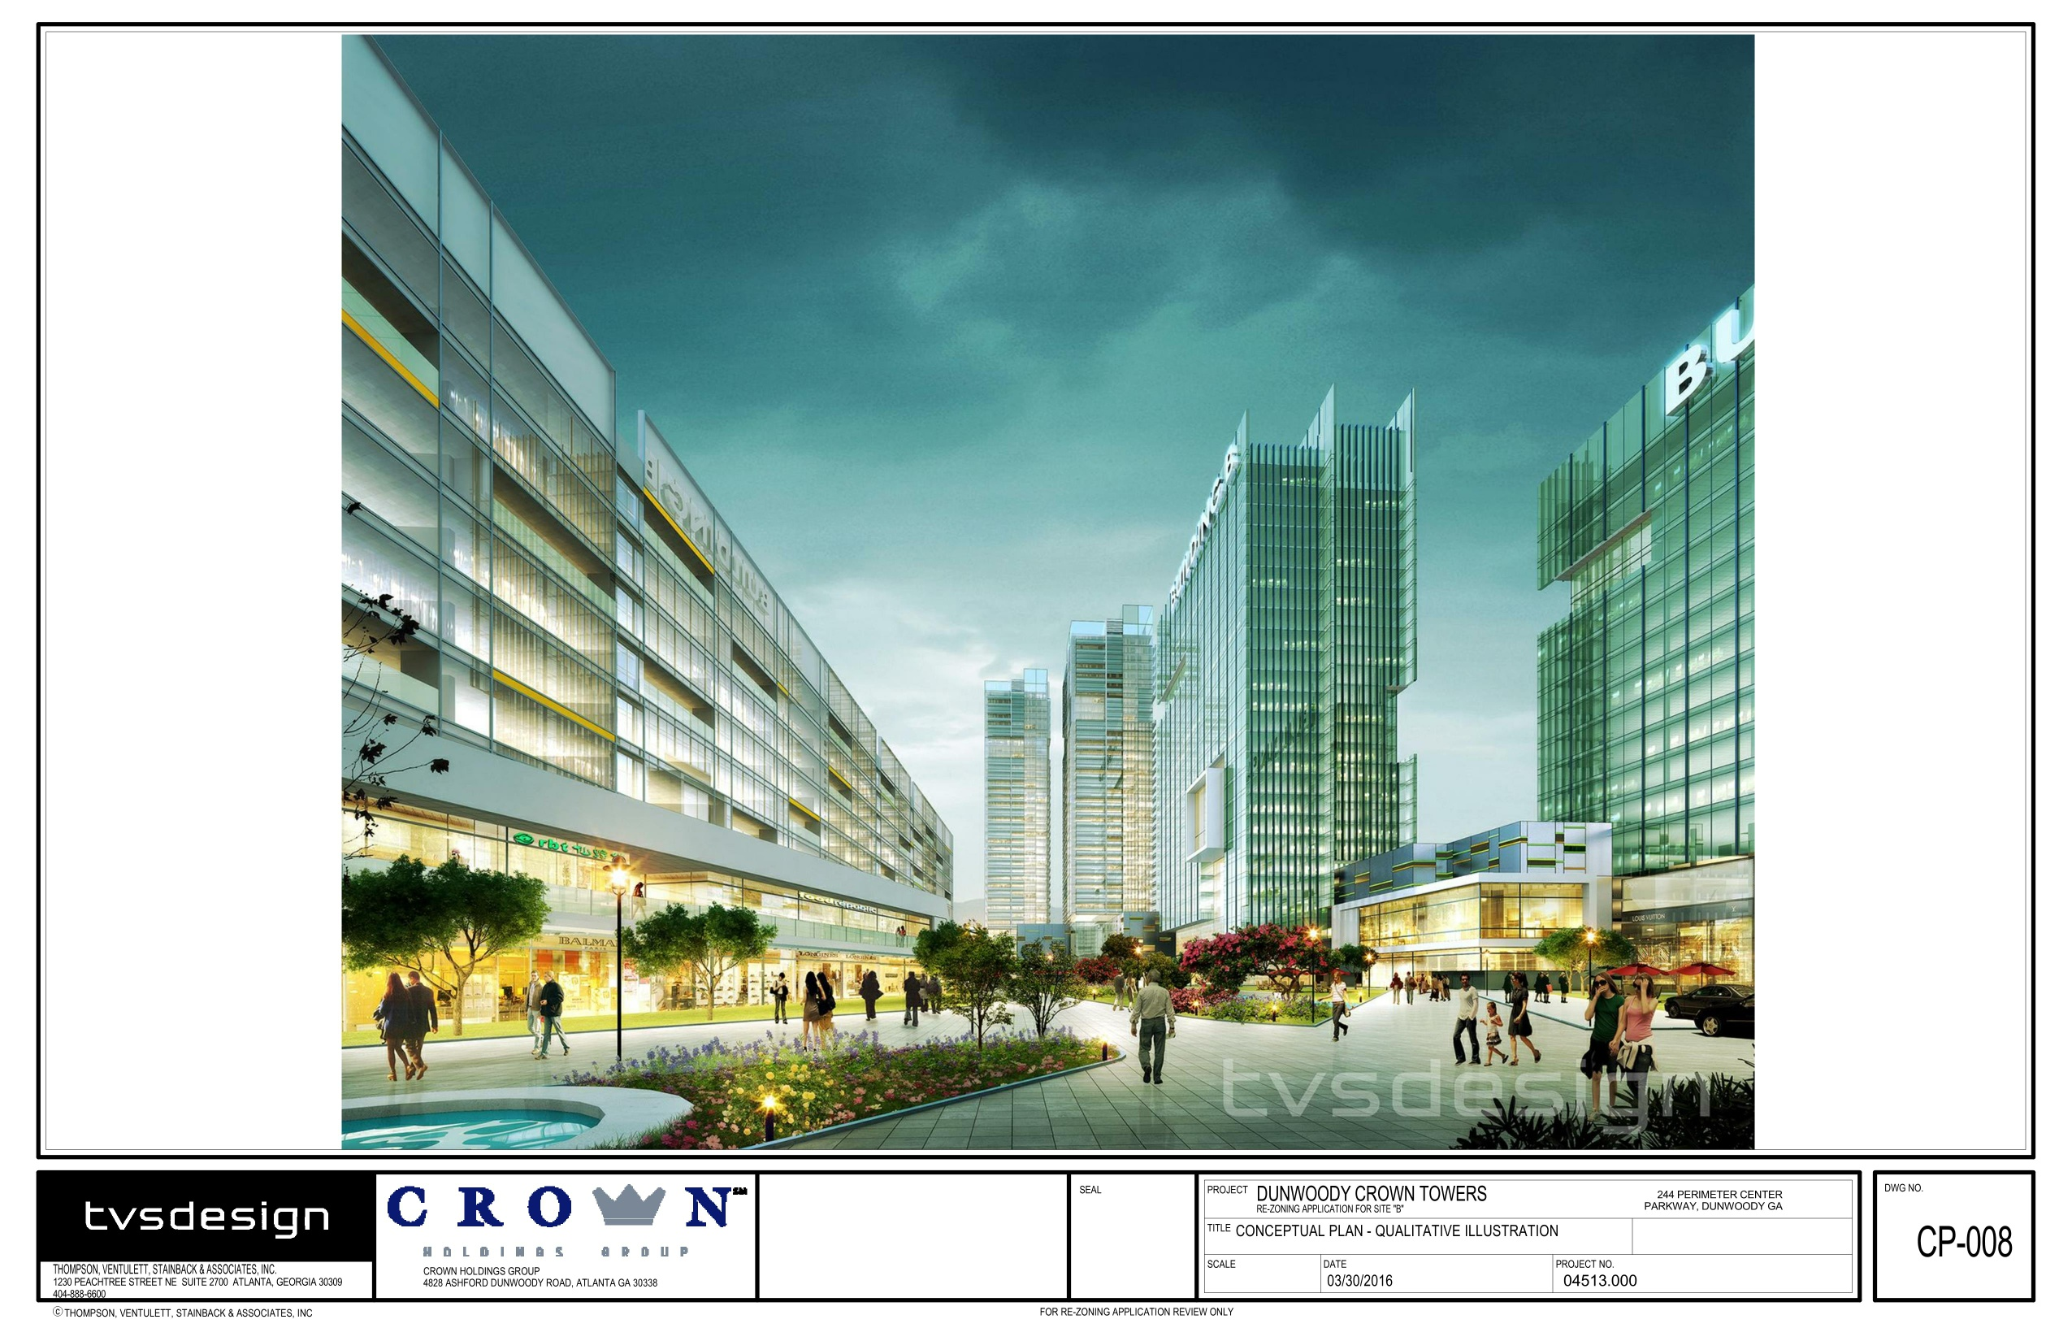

Slide 27
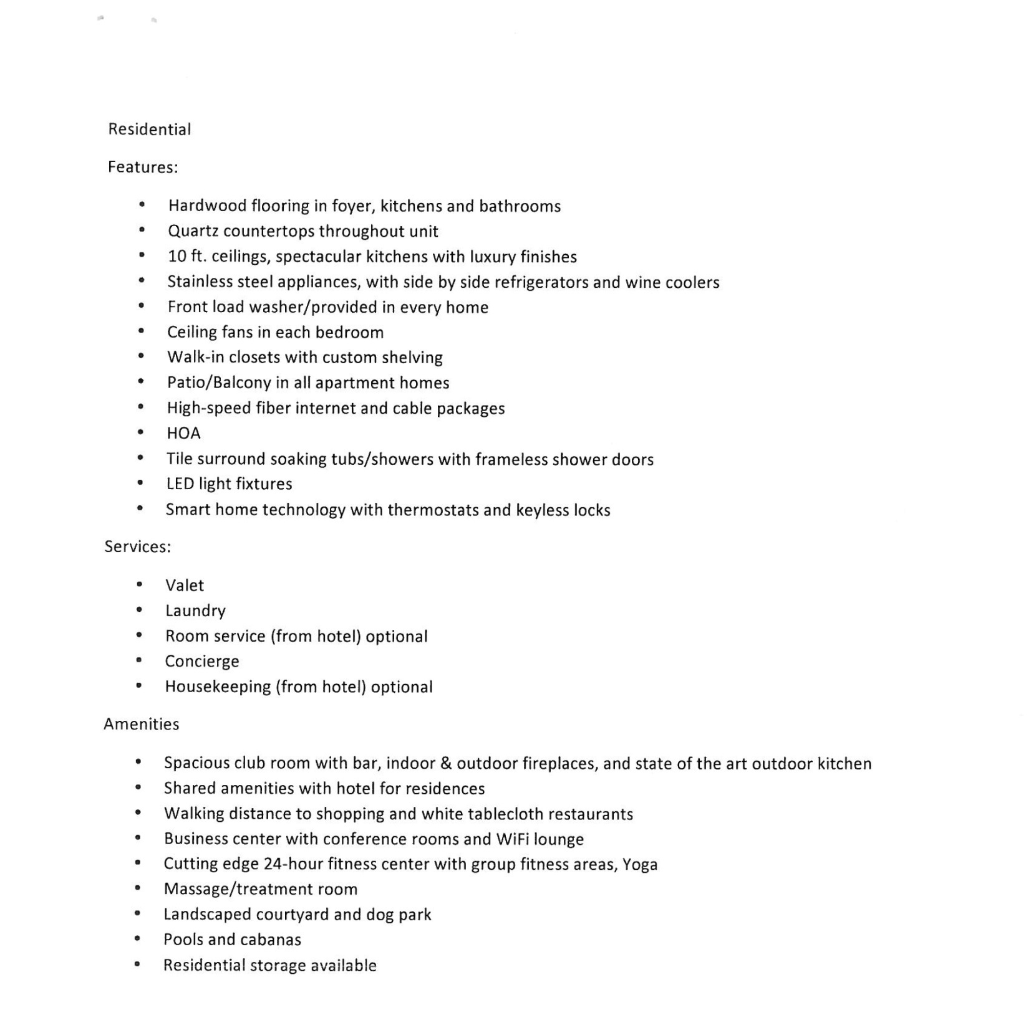
Condo Features
And Amenities

Slide 28
02.15.2016 244 Perimeter Center presented by: Charles Brown, Crown Holdings Group

Slide 29
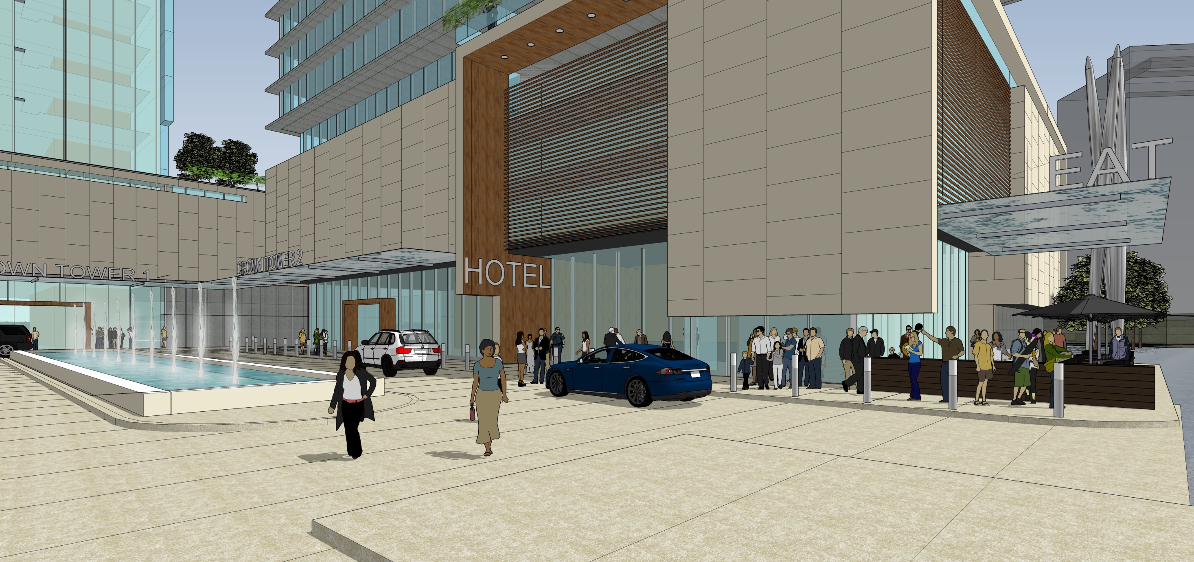

Slide 30
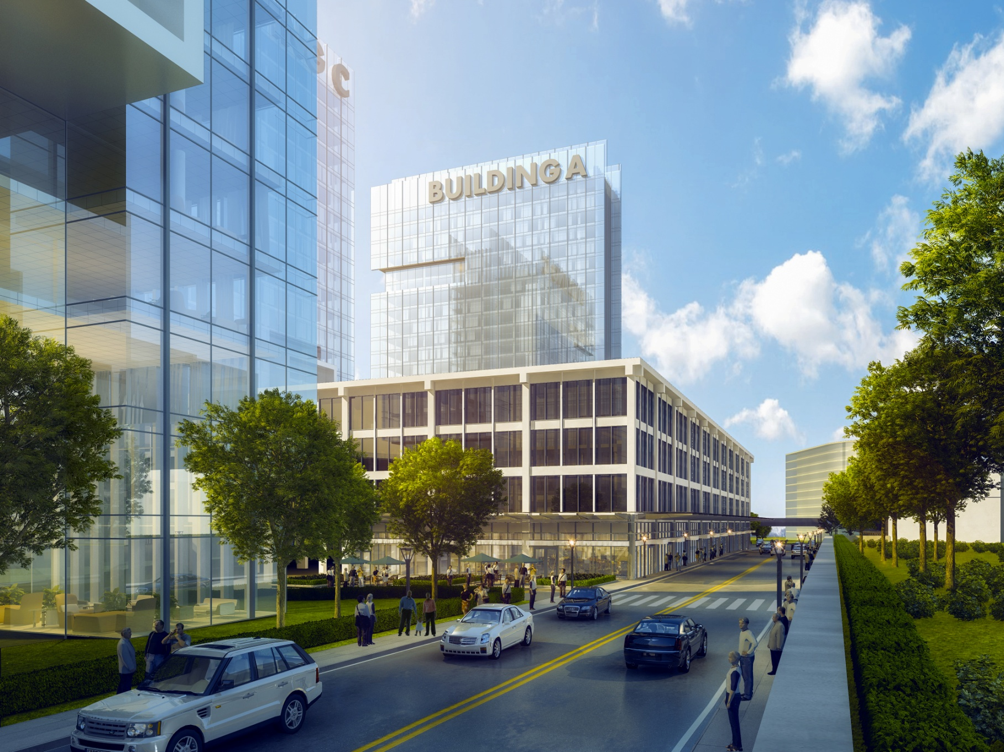

Slide 31
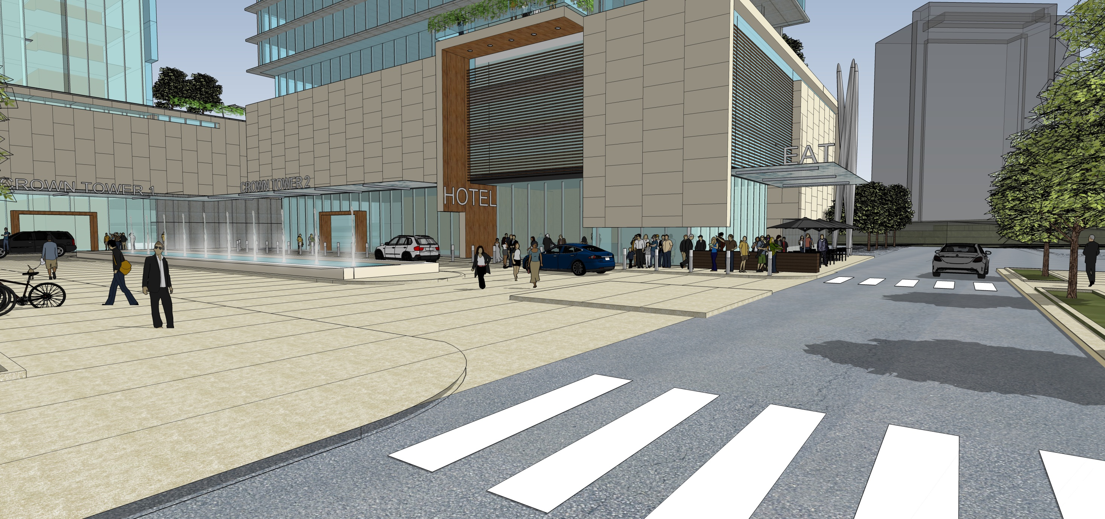

Slide 32
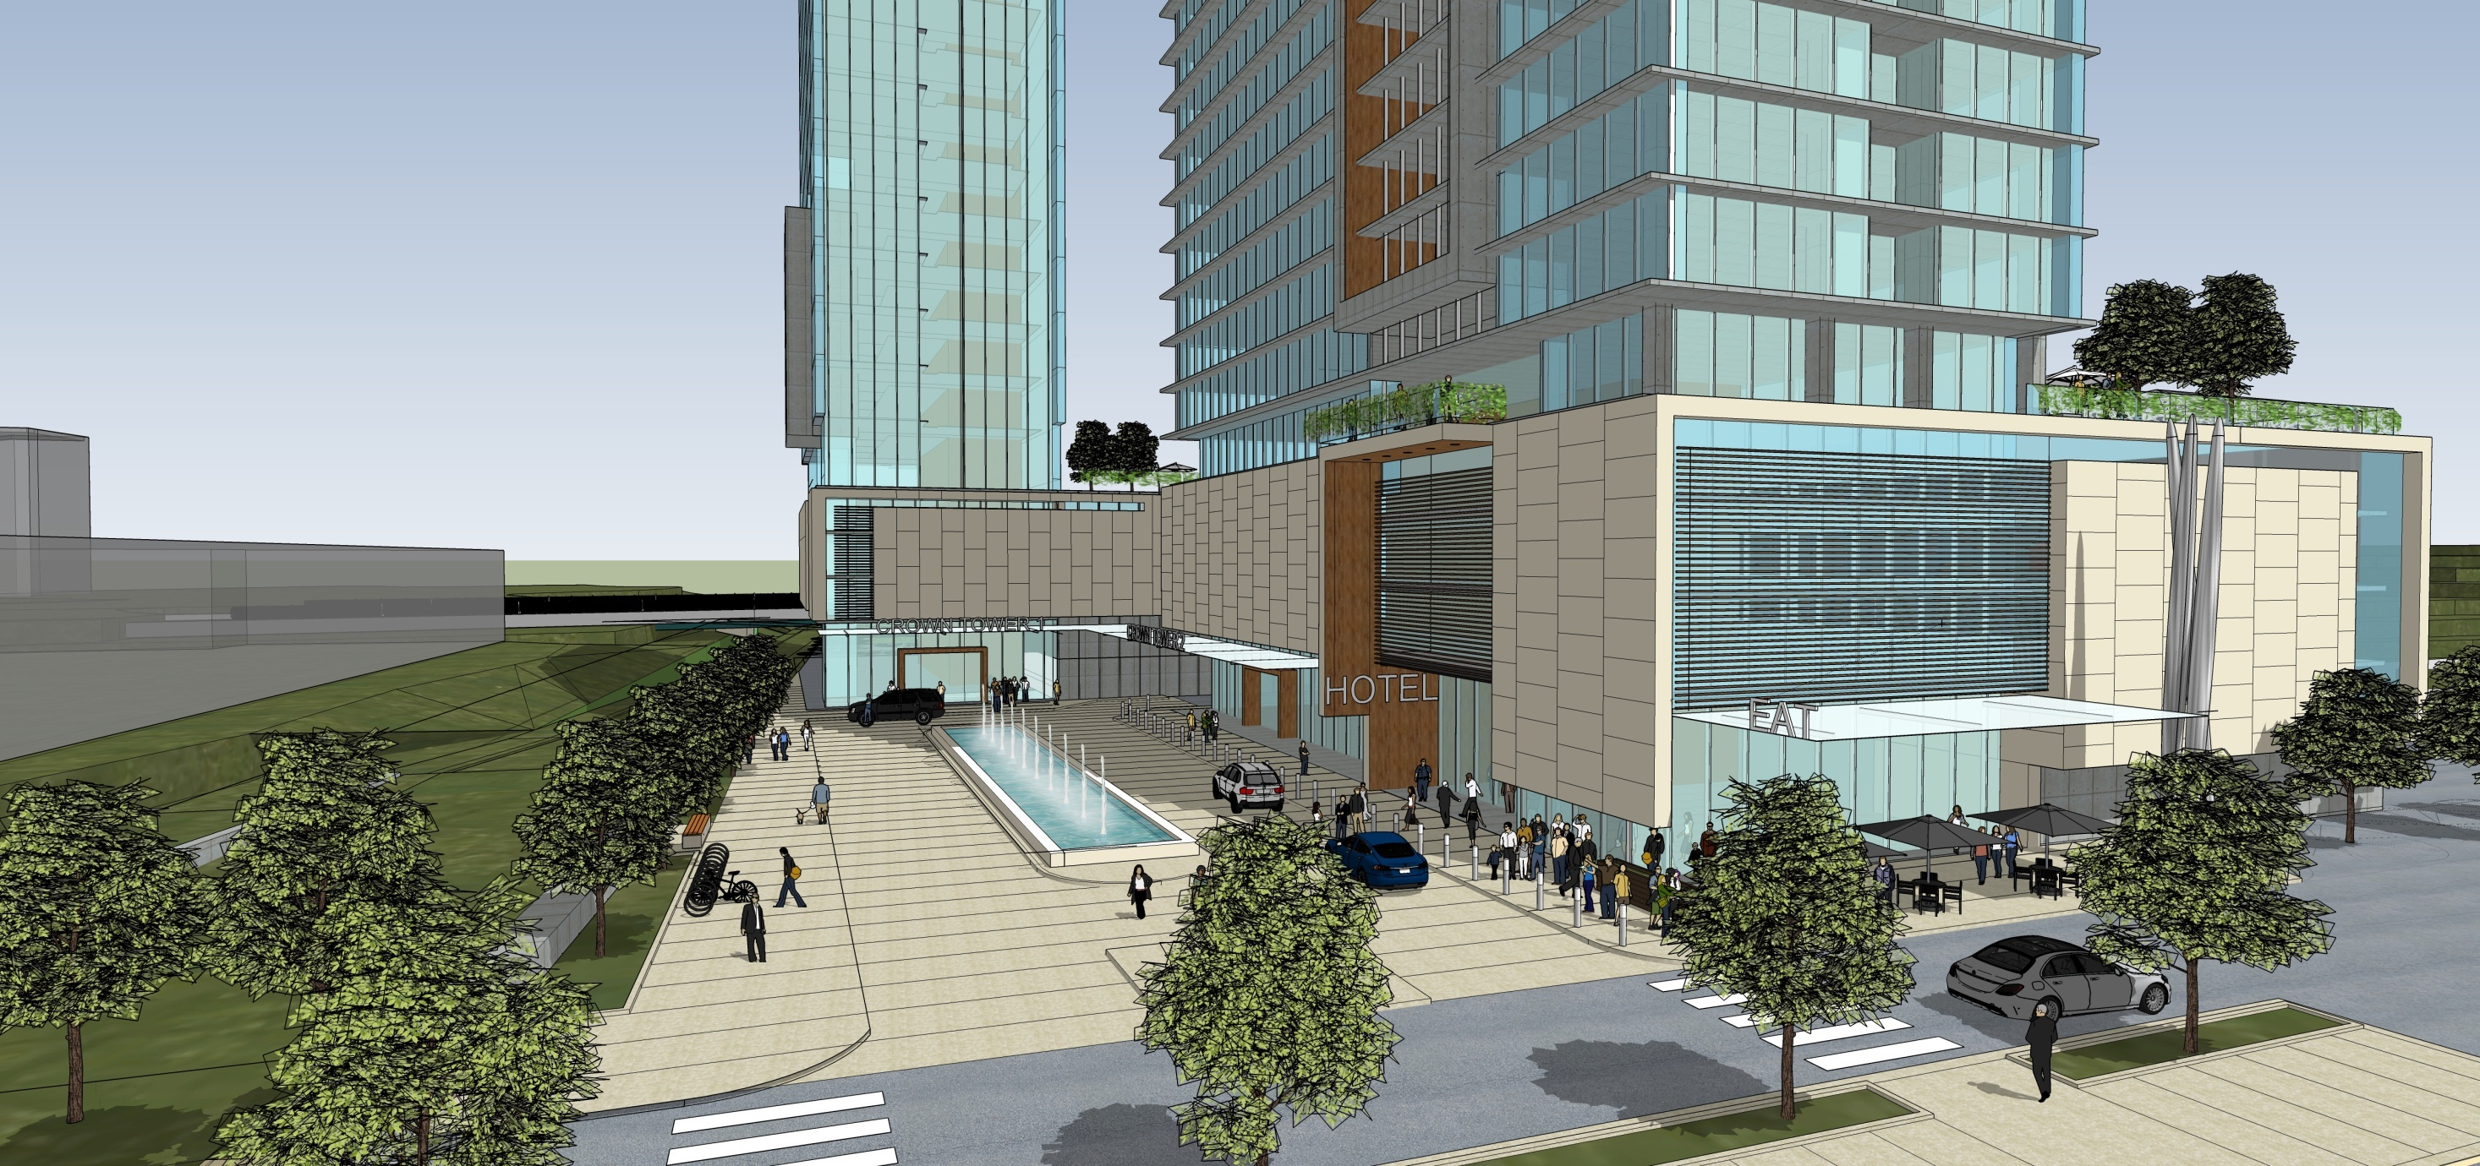

Slide 34
02.15.2016 244 Perimeter Center presented by: Charles Brown, Crown Holdings Group

