Slide 1
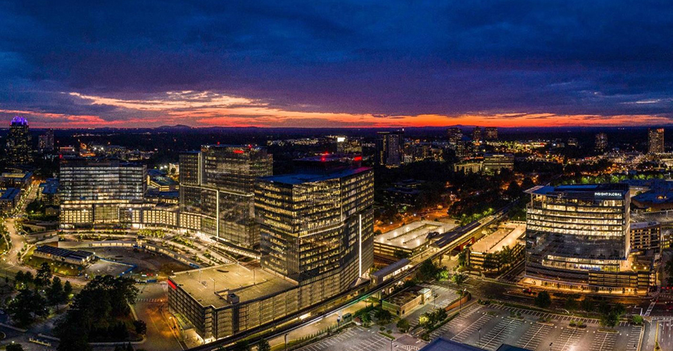
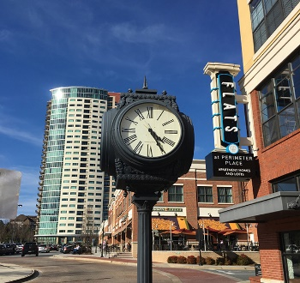
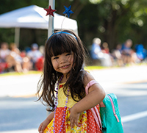
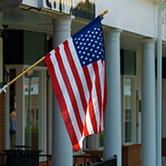
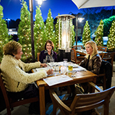
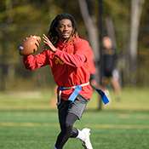

Mayor and Council Retreat
March 11, 2021

Slide 2
Agenda
Mission/Vision
Revisiting Connectivity
Unfunded Capital
Refresher on Planning / Zoning Processes
Parks Operations
Plans Review - Process
Mayor/Council Housekeeping

Slide 3
Mission/Vision

Slide 4
Mission
The mission of the City of Dunwoody is to provide the highest quality of life for those who live, work or play in our community and to foster an environment where business can prosper. We will serve all stakeholders in a transparent manner with resourceful, efficient, progressive and professional leadership.

Slide 5
Vision
The City of Dunwoody will provide quality service to its citizens and support the largest economic engine in the Southeast by planning in a careful and thoughtful manner. The City of Dunwoody will be inventive, transparent and embrace responsible progress, tempered by the city’s rich history and strong desire to maintain a close and vibrant community atmosphere that values family life and the entrepreneurial spirit. The City of Dunwoody will continue to support and nurture a community dedicated to the preservation of family, education, religious institutions, and the environment.

Slide 6
Revisiting Connectivity

Slide 7
One Year Later…
Dunwoody Mayor and Council had their annual retreat on March 5 and 6…
They set goals for the year intending to revisit them during the year and flesh them out…
The whole world changed about a week later….
Even with that, the City still got a lot of those tasks accomplished.

Slide 8
Connectivity…
Giving people a place to go to…
  Brook Run Park: It may have looked different, but the park was open for business this year. The Parks & Rec team was able to pivot to engage the community in new ways and enhance safety protocols.
Placing partners and the City on a long-term stable financial footing…
  Contractual Setup with Dunwoody Sr Baseball: Parks & Rec created an Athletic Association Manual which developed a template for all recreation and partner programs to follow.

Slide 9
Connectivity…
Planning for a future we can afford…
  Capital Budget: City adopted its first true funded Capital Improvement Program, showing what can actually be afforded in the next five years.
Taking what was old and making it new again…
  Austin Elementary: Council amended the capital budget at passage to fund demolition and planning for Austin ES, including incorporating a community survey about future uses of the site.

Slide 10
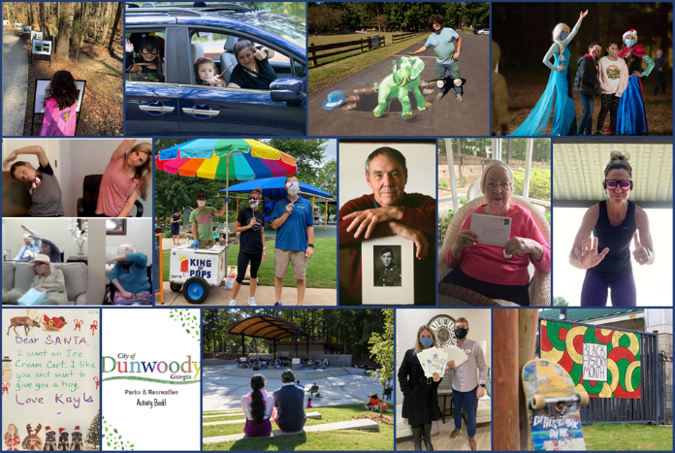
Connectivity…
Engaging in new ways…
  Drive-thru Halloween SPOOKTACULAR- 1,500 cars
  Holiday Lights at Brook Run Park
  Letters to Santa- 148 letters sent
  Pen Pal Program- 105 participants
  Holiday Letters to Seniors- 400 letters sent
  Virtual senior exercise classes
  Skate Park murals
  Parks & Rec Activity Book
  Story Walk with Dunwoody Library
  Virtual Memorial Day & Veterans Day tributes

Slide 11
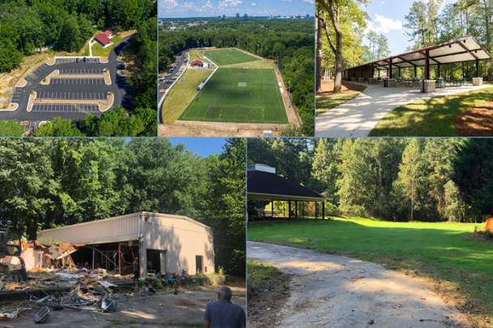


Connectivity…
Creating other communal spaces…
  Demolished the Waterford Property and started site improvements.
  Completed the concept plan for the Park at Perimeter Center East Property.

Slide 12
Connectivity…
Developing a way to showcase talent…
  Arts Plan: Adopted a master arts plan so that the richness of the city and its artisans can create a destination showcase.
Building an identity…
  Wayfinding Signage: Brought forward a plan so that citizens and visitors have a sense of where they are and a sense of how to get where they are going.

Slide 13
Connectivity…
Making sure citizens can address items…
  See Click Fix Audit: Completed a review of one of the most accessed city phone applications to ensure that it fits the needs of the public.
Businesses helping spur connections with amenities…
  Finished/Ongoing Projects: Twelve24, AC Hotel, Perimeter Marketplace, State Farm Complex

Slide 14
Connectivity…
Assisting businesses with attracting customers…
  Local Campaigns: Economic Development assisted with creating local campaigns, like the Picnic Table Project.
Informing citizens of what’s going on…
  New City Website: Keeps residents, businesses & visitors connected with a more intuitive layout, easy search function, mobile-friendly view and eNotifications.

Slide 15
Connectivity…
Reaching out to the public in different ways…
  Mayor’s Meetups / On-Line Info Videos: Back-to-School, Strategies for Coping, Austin Elementary Re-use; Mt Vernon Improvements.
Having areas of the community relate to each other…
  Dunwoody Village Rewrite Completed: Even though completed, there are still some parcels to be addressed in 2021.

Slide 16
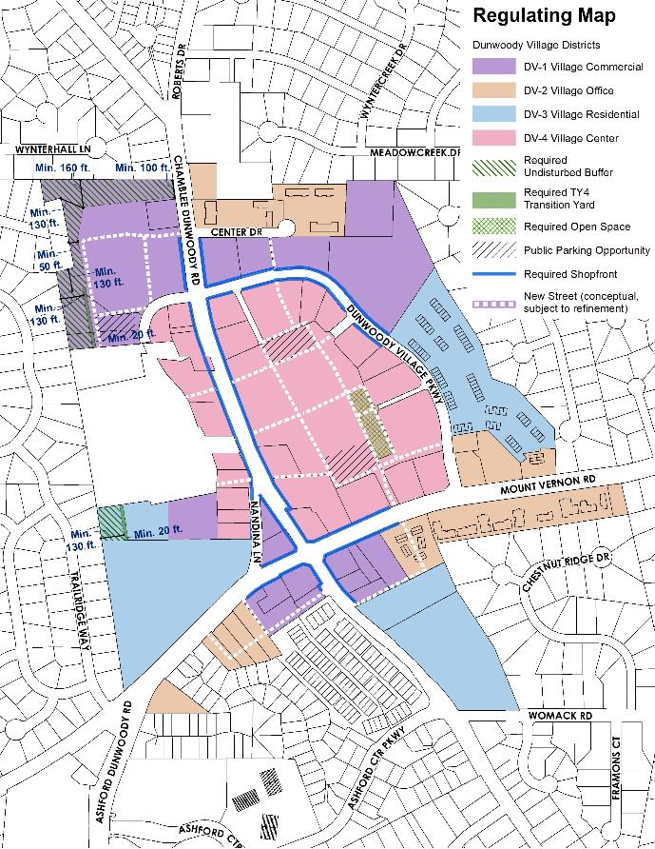
The current Village plan.

Slide 17
Connectivity…
No matter what, connectivity is transportation…
  Transportation Projects:
    Completed construction of a shared-use path on North Shallowford Road that will connect to the Georgetown Gateway project.
    Began construction of sidewalk and bicycle lanes on Tilly Mill Road from North Peachtree Road to Georgia State campus. Completion projected for spring 2021.
    Began construction of sidewalk and bicycle lanes on Peeler Road between Equestrian Way and North Peachtree Road. Completion projected for spring 2021.
    Began easement acquisition for Winters Chapel Road Path Phase I between Dunwoody Club Drive and Charmant Place.

Slide 18
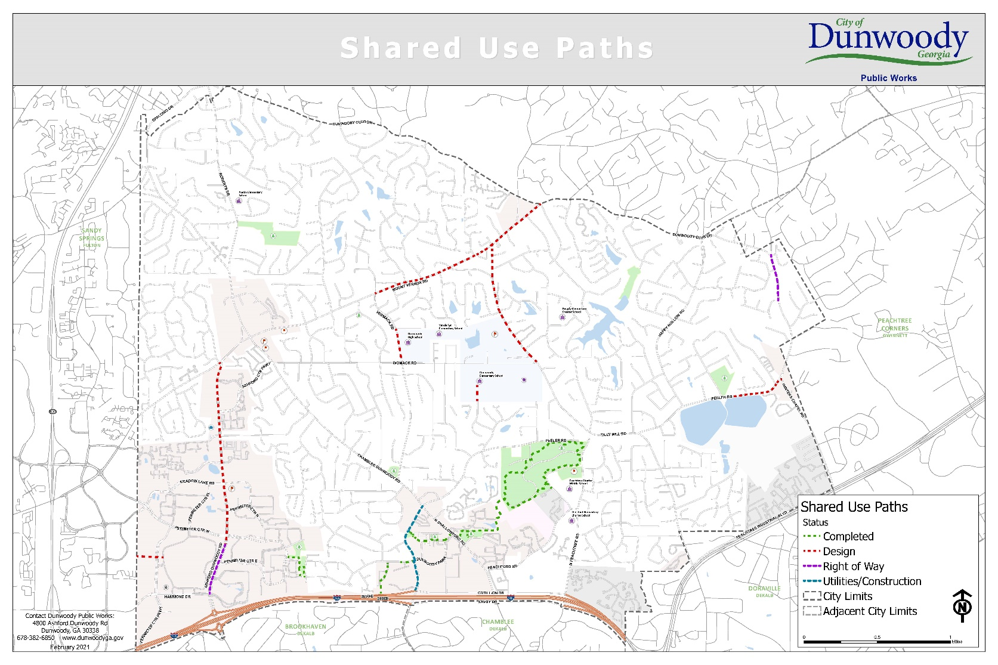
Connectivity…
No matter what connectivity is transportation…

Slide 19
Connectivity…
No matter what, connectivity is transportation…
  Transportation Projects:
    Completed crosswalk improvements on Tilly Mill Road at Andover Drive to improve connectivity between neighborhoods
    Completed over 500 sidewalk repairs to replace broken sidewalk and remove trip hazards
    Planned 2021 budget for emphasis on connectivity with funding allocated to 17 different projects that will improve pedestrian and bicycle connectivity
    Presented a bicycle facility and pedestrian and bicycle policy recommendations to Council

Slide 20
Connectivity…
Making government accessible…
Council Meetings:
  At the start of the pandemic, Mayor and Council held eleven virtual meetings where the public could still stay at home and watch.
  Staring in July, Mayor and Council created a hybrid meeting structure with both in-person (using safety protocols) and virtual attendance.
  This situation is consistently being reviewed to see if the need to go all virtual again is needed based on community virus numbers.

Slide 21
Connectivity…
Making government accessible…
Remote Working:
  Staff started working with IT in late February on testing the ability to work remotely. Effective Friday, March 13, most all staff took laptops home thinking of being remote “for a while.”
  With only a few little hiccups at first because of the volume of users, city staff were effectively up and running for business by the next Monday.
  Staff adapted business practices for those citizens that had to come in person to complete what they needed, but pretty much everything was pushed virtually almost immediately.

Slide 22
Connectivity…
Making government accessible…
Day-to-Day Operations: Even with City Hall closed to the public most of the year, city staff still….
  Maintained full police operations throughout all of 2020.
  Reopened Municipal Court with social distancing and safety measures in place.
  Completed its annual re-paving in record time.
  Re-bid all municipal contracts.

Slide 23
Things Deferred…
Plans for a Hotel/Motel Tax Bond to implement related park and trails. Shelved until the industry recovers.
Ashford Dunwoody Trail Phase I due to ongoing right-of-way negotiations.
Exploration of improved broadband access and connectivity throughout the City.

Slide 24
Unfunded Capital

Slide 25
Unfunded Capital
The Mayor unveiled the 2021 proposed budget, subsequently passed by Council, with the City’s first true-funded Five Year Capital Improvement Plan.
A byproduct of this creation was a full list of unfunded projects. Now, this list is never adopted, but it’s a reference point for discussions involving needs of the City.
First for reference, here is the adopted CIP for 2021 forward.

Slide 26
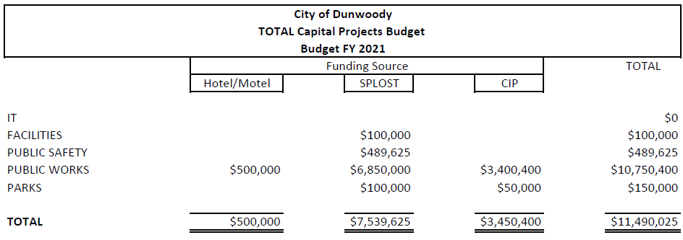
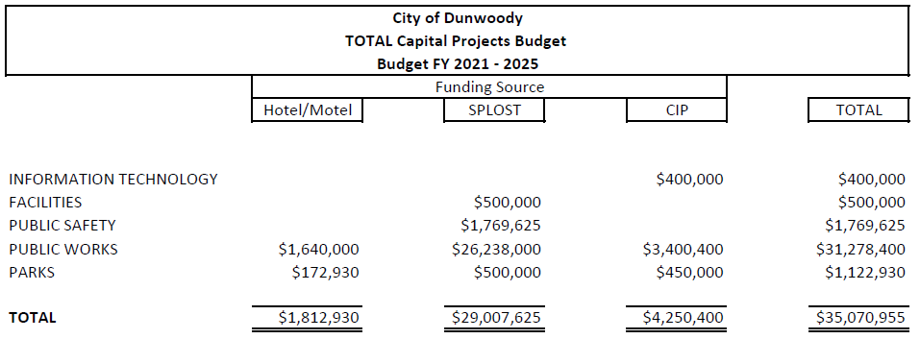
Approved ClP

Slide 27
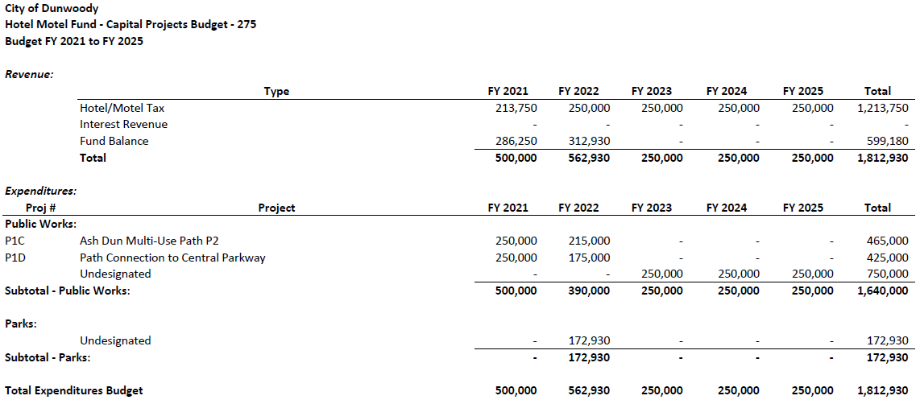
Approved ClP

Slide 28
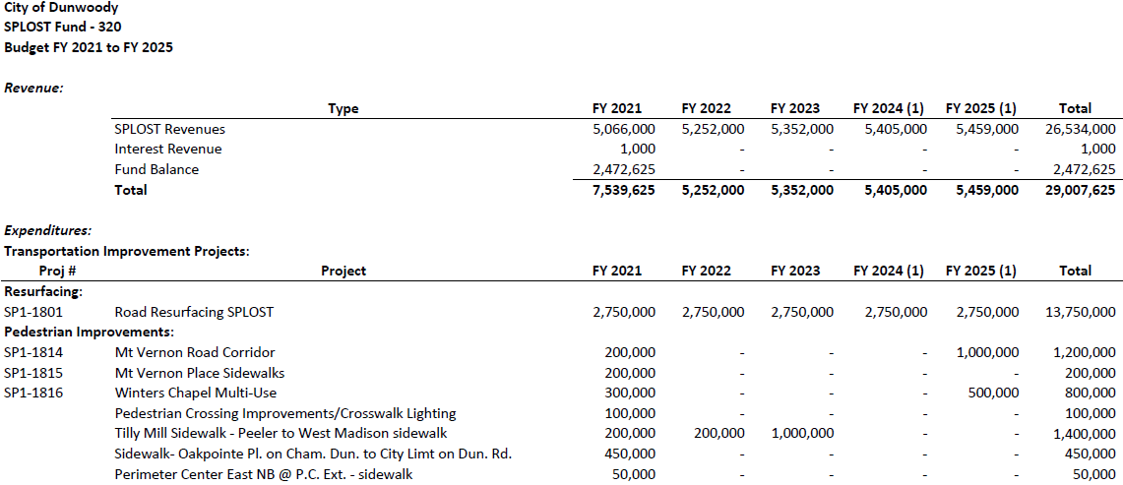
Approved ClP

Slide 29
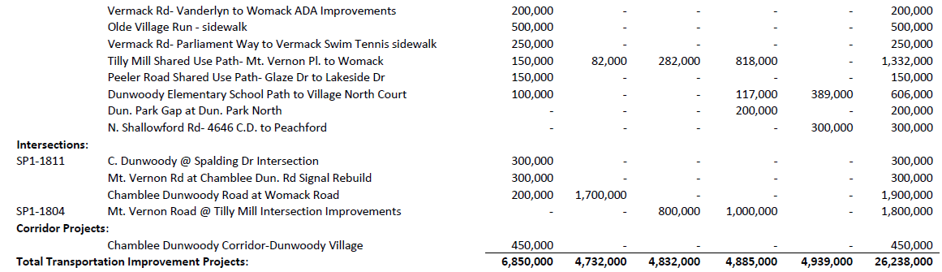
Approved ClP

Slide 30
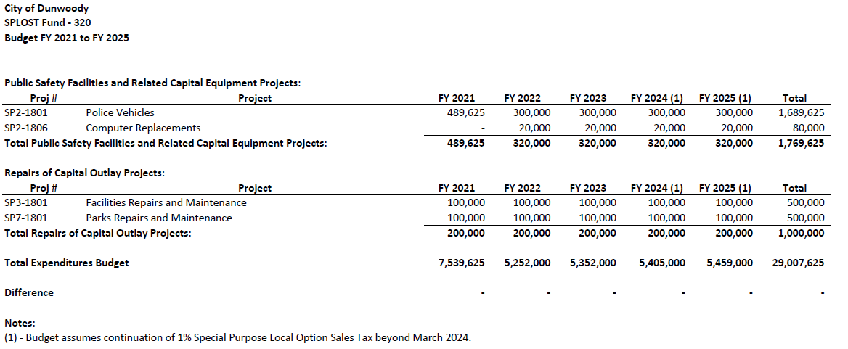
Approved ClP

Slide 31
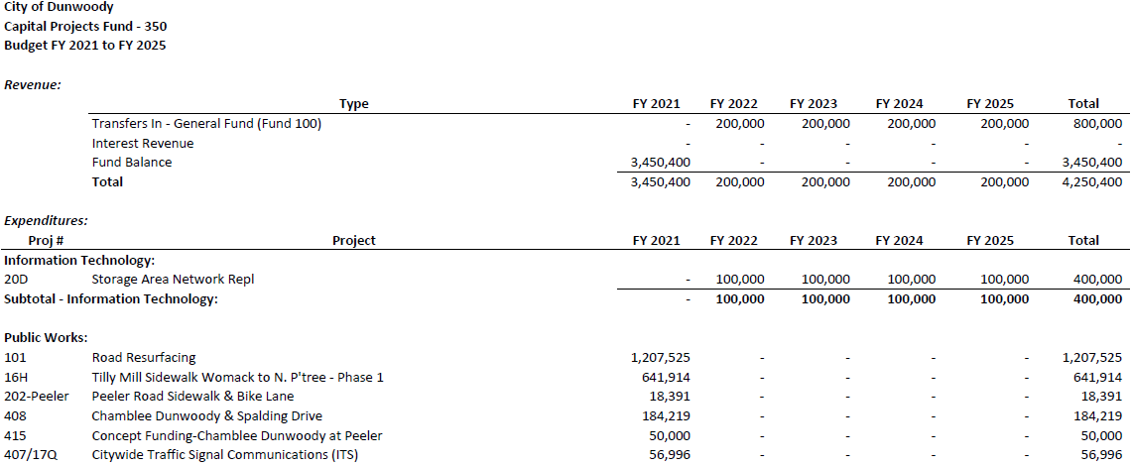
Approved ClP

Slide 32
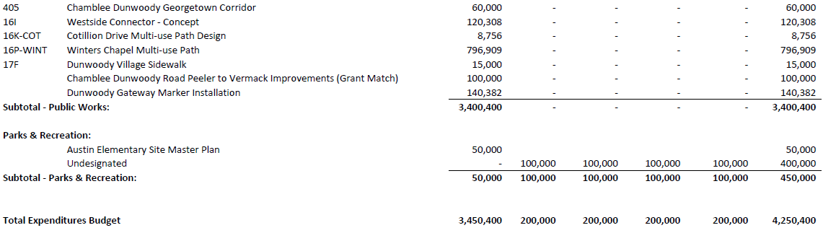
Approved ClP

Slide 33

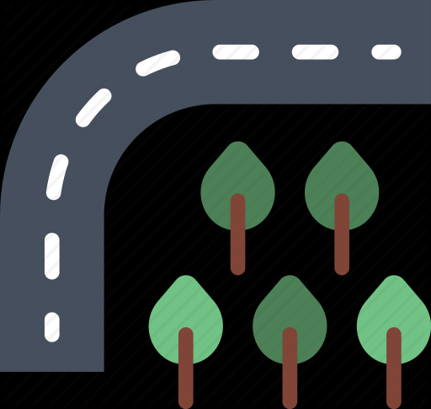
Unfunded Capital
This following informal list totals over $164M, primarily in public works and parks.
There are even grand ideas which aren’t on the list. Nothing on the list in front of Mayor and Council is a given, nor are things not on it not a given.

Slide 34
Unfunded Capital

Slide 35
Unfunded Capital

Slide 36
Unfunded Capital

Slide 37
Unfunded Capital

Slide 38
Funding
Conservative budgeting in 2020 after the pandemic made the “funded” list conservative, itself.
However, sales tax (SPLOST) came in at the original projection of $6.8M so multiple factors now come into play:
  Projects in 2020 were slowed down until a better feel for the economy developed. They were approved already, so they can now start to proceed at the previous pace.
  The CIP adopted revenues at a drastically reduced number, so there can reasonably be expected additional SPLOST above the approved CIP each year starting in 2021. That amount could be between $1.0 and $1.5M.
  However, it is not recommended to authorize this funding until there has been an extended stabilization of the economy.

Slide 39
Funding
Hotel/Motel is a revenue source staff recommends waiting before doing any future commitments of unearned funding:
  As of today, there is about $500K of uncommitted revenue for capital uses.
  No bonding or commitment of future revenues are recommended at this time.
  This funding should be used to fund only short term projects or shortfalls elsewhere until vast economic improvement.
  Uses of this funding are still limited to related projects.

Slide 40
Funding
The timing of the pandemic and the economic uncertainty throughout most of 2020 caused certain actions with the General Fund:
  Unaudited revenues came in close, but slightly under, the original pre-COVID estimates for 2020.
  Department’s budgeted spending was cut roughly 4% at mid-year. They restrained spending another 1.6% during the year.
  This has created an expected funding in excess of six months fund balance after the books are closed.
  For reference, departments’ 2021 operating budgets still have about $1M reduced from their 2019 levels. Any capital considerations should take into account spreading this excess to mitigate those cuts.
  Normally, this money would be recommended for capital; however, given the economic uncertainty, it would be prudent to wait until mid-year or later before using that excess.

Slide 41
Refresher on Planning / Zoning Processes

Slide 42
Zoning Refresher
Bill Ross will present.

Slide 43
Park Operations

Slide 44
Park Operations
Current Dunwoody Park Acreage
  Brook Run: 109.93
  Dunwoody Park Nature Cent/Ballfields: 22.29
  Windwood Hollow: 11.1
  Austin School Site: 9.8
  Pernoshal Park: 8.2
  Waterford Property: 7.16
  Perimeter Center East: 6.68
  N. DeKalb Cultural Arts: 6.2
  Georgetown: 3.0
  Donaldson-Bannister: 2.9
  Dunwoody Trail Easements: 2.0
  Dunwoody Trail Connector: 1.99
  Vernon Oaks: 0.6
  Total: 191.85 acres, thirteen sites, and 2.3% of Dunwoody’s land mass is parks.

Slide 45
Park Operations
There are now only five positions overseeing the previously mentioned 13 sites and 2.3% of the City.
Parks also is not an 8-5, Monday through Friday operation. It’s more like a most of the day, every day of the week operation. Run by five people and expanding year by year.

Slide 46
Park Operations
Possible operational expansion:
  Weekend/night staffing; park administrative manager and associated operators are needed any time the facilities are being actively used. To give an idea of the tasks that are increasing as park space and amenities are increasing:
      • Parking assistance for athletic programs and special events.
      • Permit verification for groups using field and pavilion facilities.
      • Rental inspections to verify cleanliness of facility and adherence to park regulations
      • Monitor N Shallowford Annex to include opening facility for users and assisting with room set up
      • Assist with Parks and Recreation Program Partners for weekend and evening programs
      • Assist with Parks and Recreation Instructors for weekend and evening programs
      • Assist with Parks and Recreation staff with weekend and evening events
      • Implement and run department leagues, classes and programs.
      • Update park kiosks and post rental schedules at all facilities.
      • Conflict resolution between groups utilizing facilities.
      • Report any illegal activity to DPD or contact them in an emergency situation.
      • Report any vandalism or facility damage to Parks Operation Staff
      • Assist maintenance crew with stocking bathrooms and monitor trash at park facilities.

Slide 47
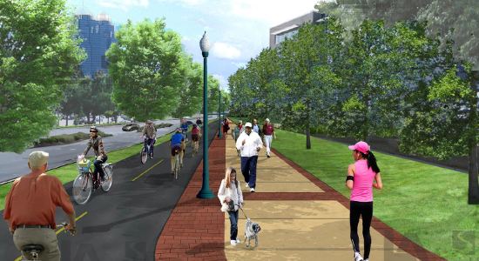
Park Operations
Ashford Dunwoody Commuter Path
  Discussion still ongoing with Perimeter Mall.

Slide 48
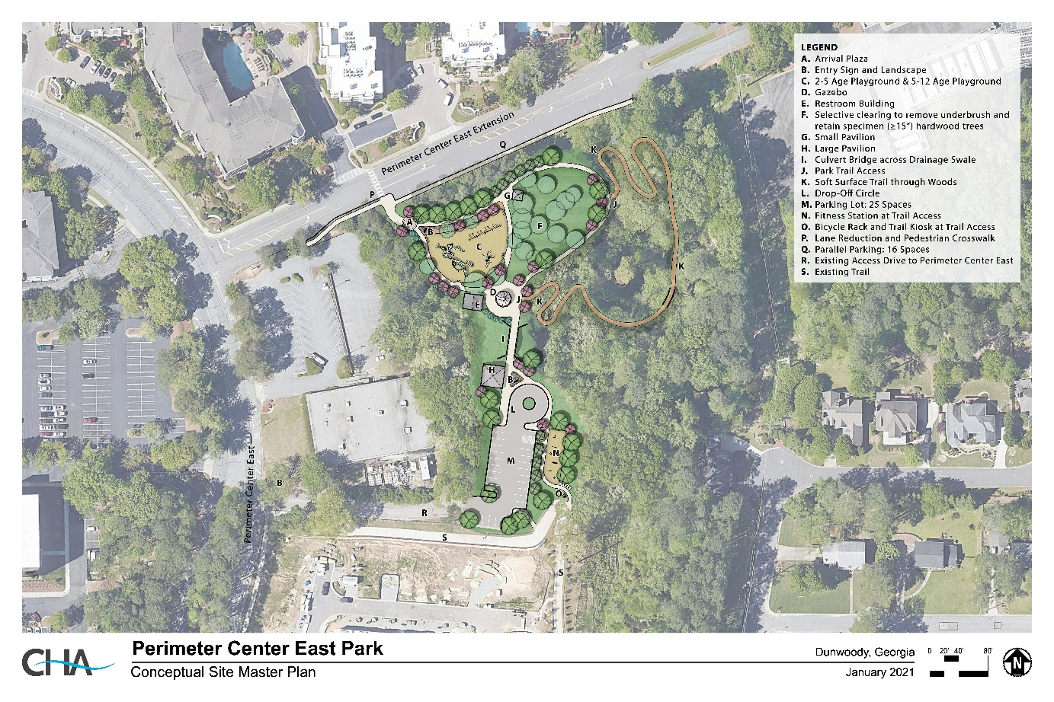
Park Operations
Perimeter Center East
  Any excess in the General Fund at mid-year could be loaned to the Hotel/ Motel Fund.

Slide 49
Park Operations
Austin ES Survey (2021, city administered)
5- Very Important, 4-Important, 3-neutral, 2-Not Important, 1-Definetly Not Important

Slide 50
Plan Review - Process

Slide 51
Plan Review - Process
How do we review plans?
When do we review them?
What else is involved?
Are some plans needed to be reviewed now and some later?

Slide 52
Mayor and Council Housekeeping

Slide 53
Housekeeping
Time for miscellaneous topics not covered elsewhere.

