Slide 1

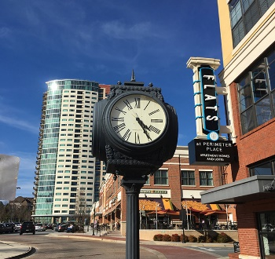

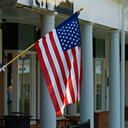

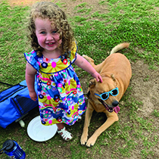



Pedestrian Safety
March 22, 2022

Slide 2
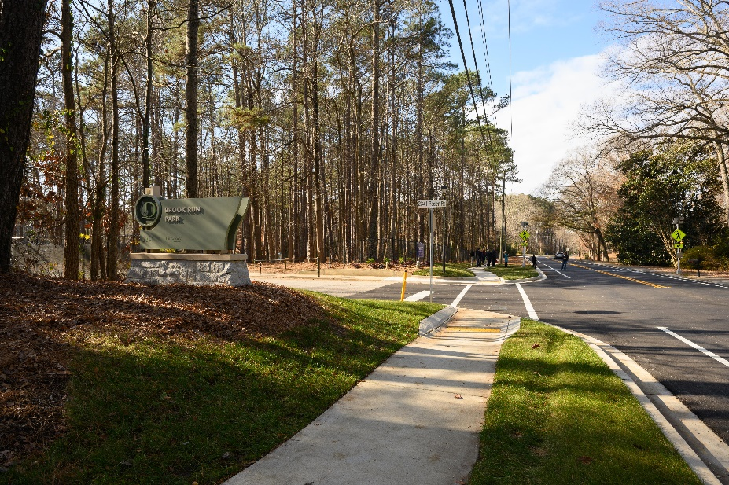
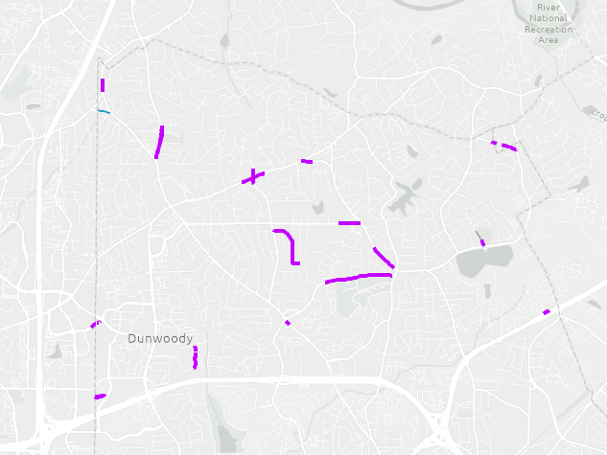
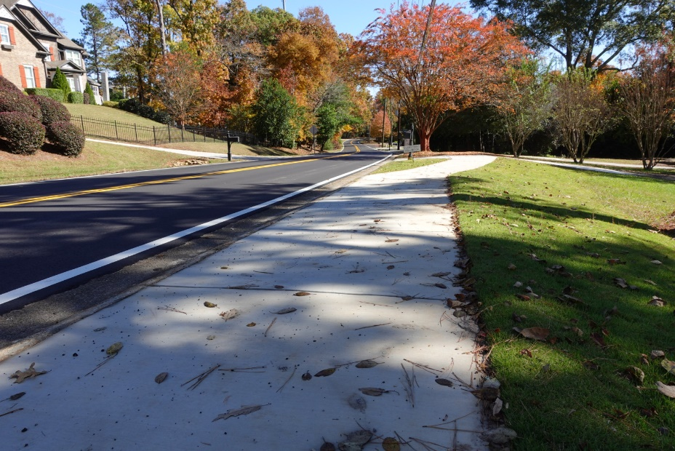
Sidewalks Added Since SPLOST 2018-2021
3.7 miles
Pedestrian Safety- Infrastructure

Slide 3
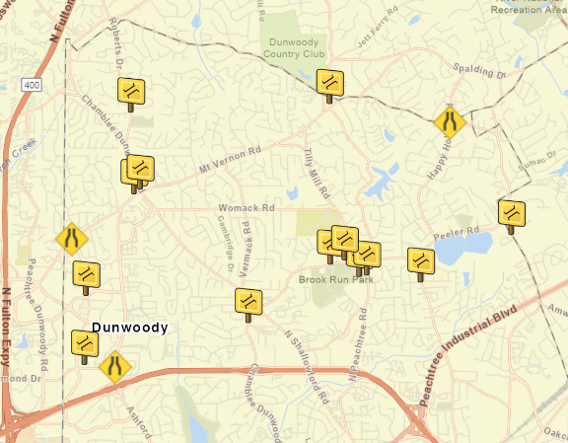
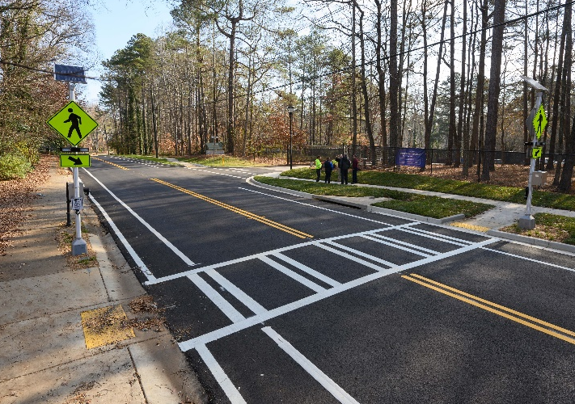
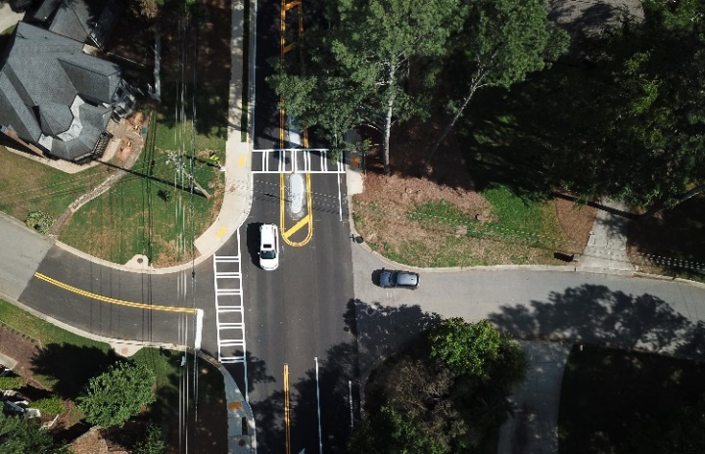
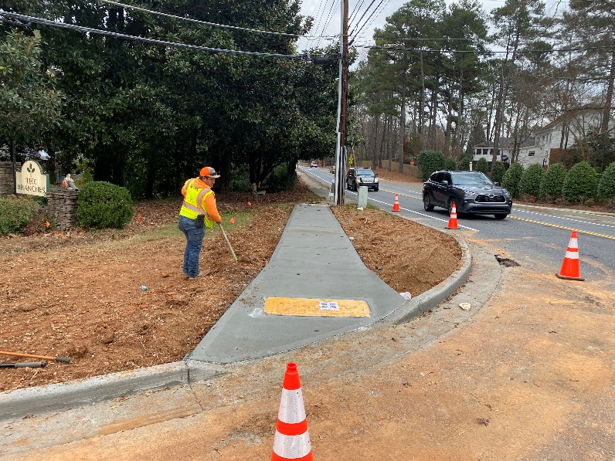
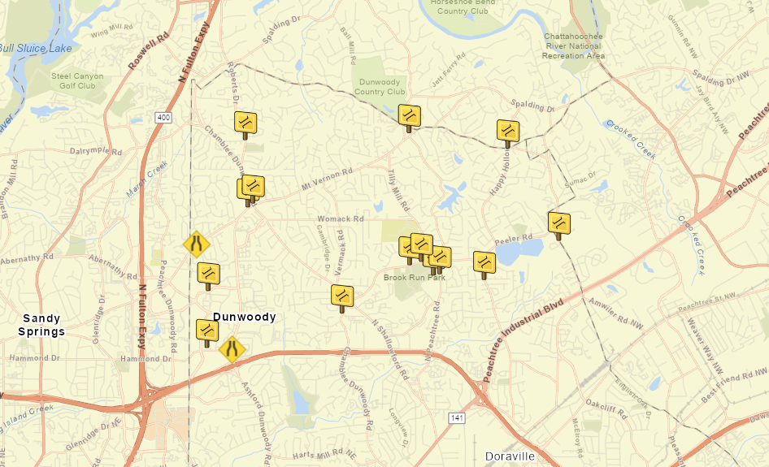
2018-2021 Crosswalk Additions/Improvements such as Rapid Flashing Beacons, Refuge Islands, Signage, Pedestrian Signals, Audible Signals
Curb adjustments to shorten crossing length, meet ADA standards
Pedestrian Safety- Infrastructure

Slide 4
152 Sidewalk Repair Maintenance Work Orders Completed (2018-2021)
1541 Trip Hazards Removed (2018-2021)
Pedestrian Safety- Maintenance

Slide 5
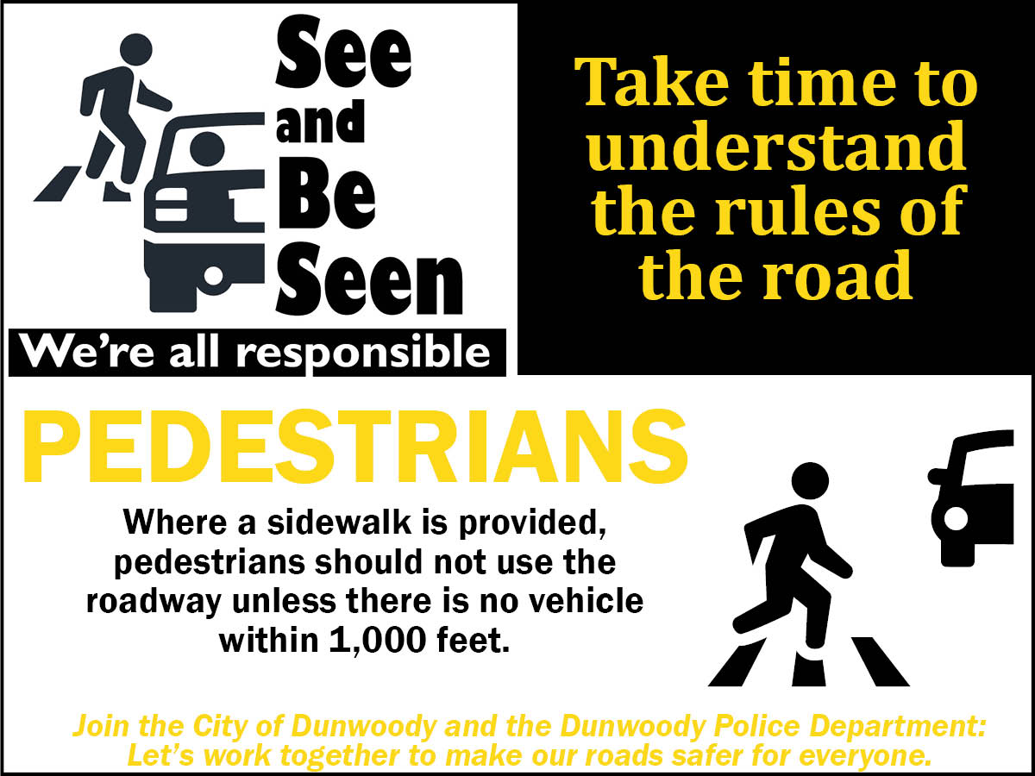

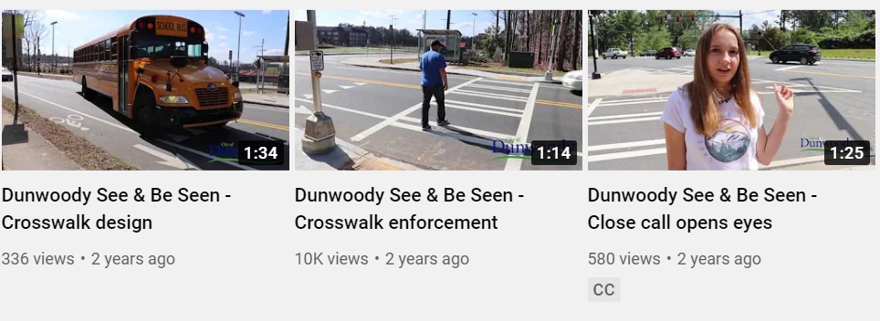
See and Be Seen Campaign
  August 2019
  Ads, social media
  39,000 + video views
Pedestrian Safety- Education

Slide 6
Pedestrian Safety- Enforcement

Slide 7
City Adopted Policies
Complete Streets Policy
Sidewalk Improvement Policy
Vulnerable Road User Ordinance
Traffic Calming Policy
Pedestrian Safety Action Plan
Pedestrian Safety- Policy

Slide 8
Design Element | Standard | Source Document
Sidewalk Width | 5 feet minimum 6 feet preferred 6-8 feet, Master Plan Areas | Comprehensive Transportation Plan, Dunwoody Code Chapter 16 City Council Directive Georgetown, Village and Perimeter Plans and Zoning Overlay Chapter 27 Dunwoody Code
Road Buffer Width Arterial and Collector Streets | 0 feet constrained areas 2 feet minimum 4 feet preferred 6+ feet in Master Plan Areas | Comprehensive Transportation Plan, NACTO Urban Street Design Guide Comprehensive Transportation Plan Dunwoody Code Chapters 16 and 27
Crosswalk Design | Varies based on pedestrian and vehicle traffic, speed, number of lanes | Pedestrian Safety Action Plan, FHWA Guidance, Manual on Uniform Traffic Control Devices
Shared-Use Path | 10 feet minimum 12 feet preferred | AASHTO Standard, Comprehensive Transportation Plan
Travel Lane Width | 11 feet on 2-lane truck & bus routes 14 feet on 2-lane arterial & collectors w/raised median 10-foot minimum elsewhere | Dunwoody Code Chapter 16 City Council NACTO Urban Street Design Guide, AASHTO
Pedestrian Safety- Policy

