Slide 1
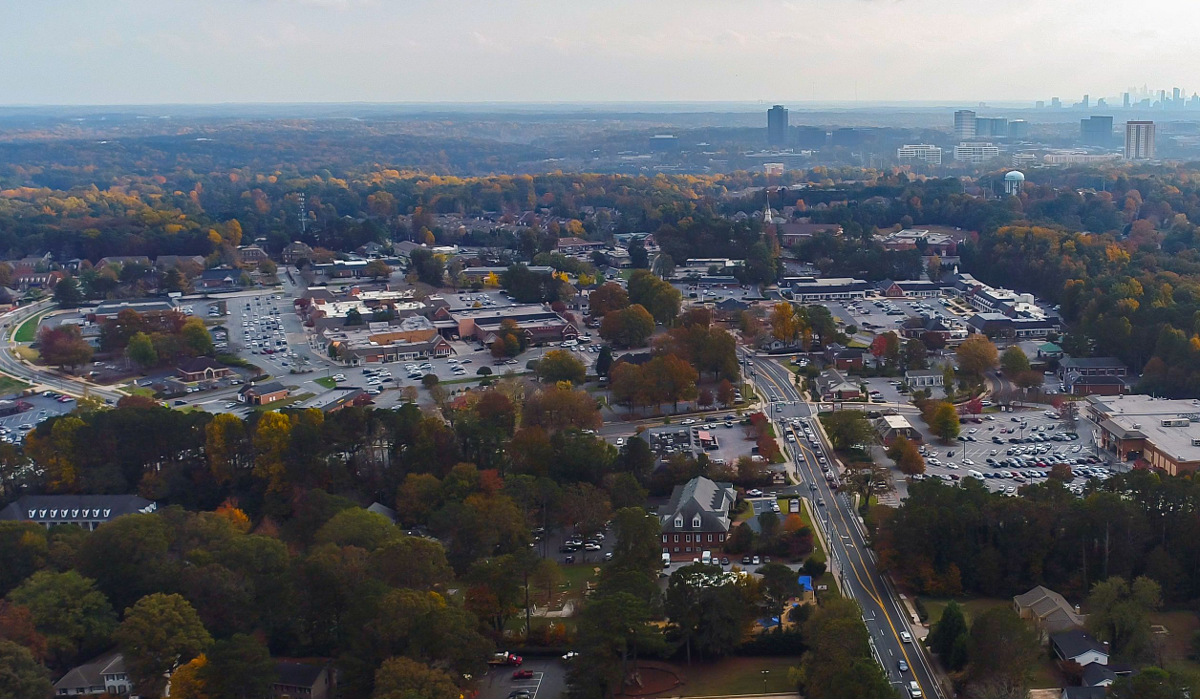

Dunwoody Village
City Council Retreat

Slide 2
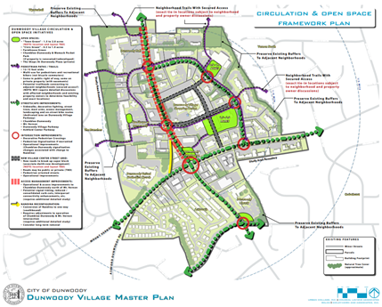
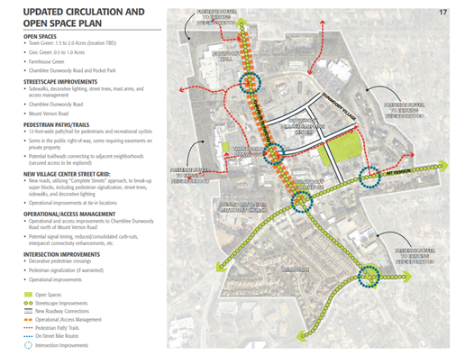
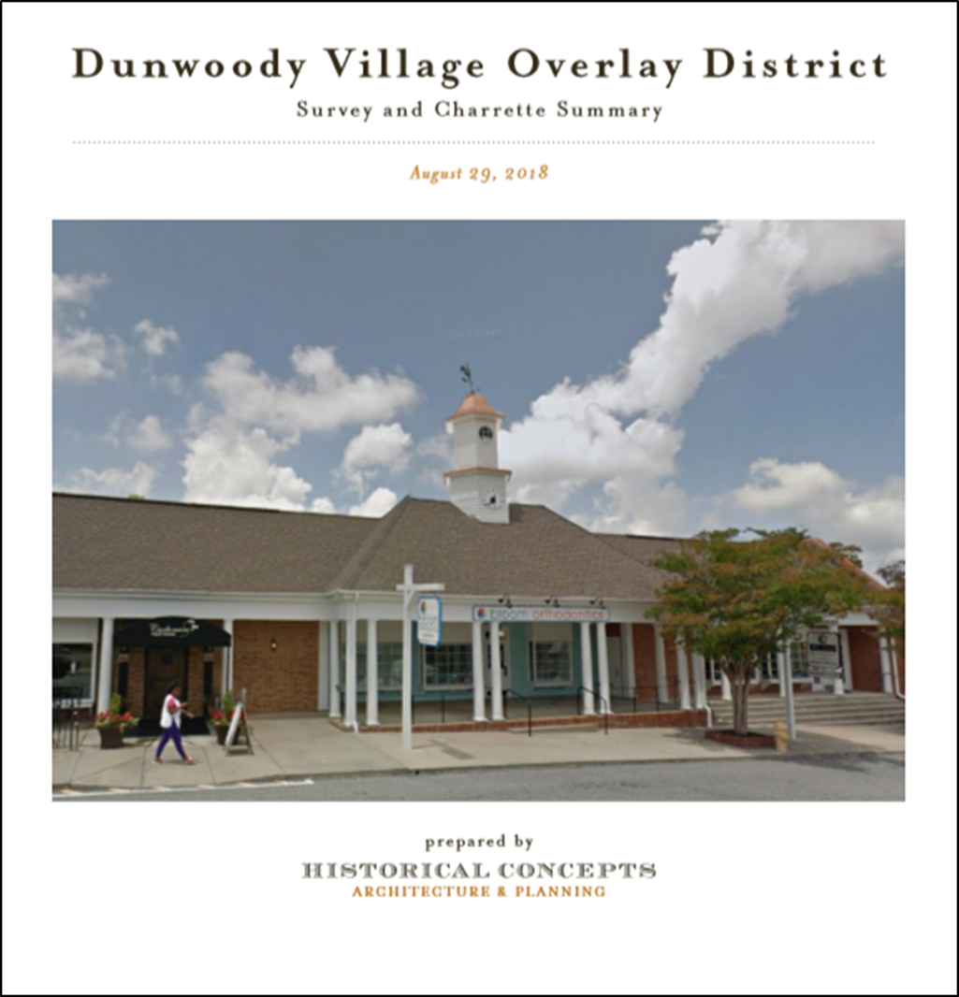
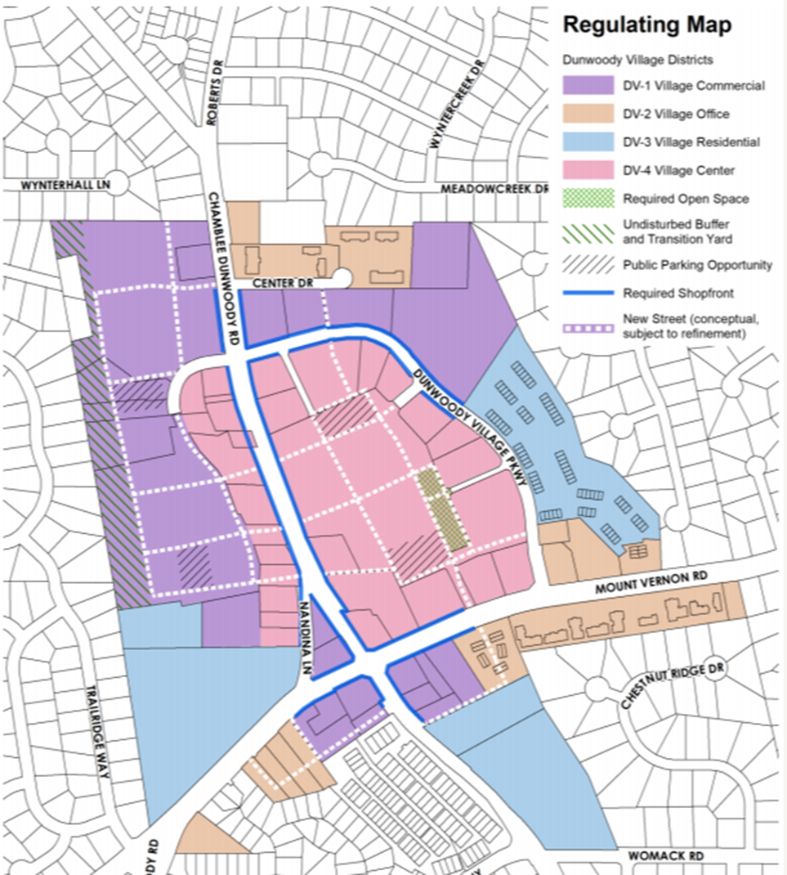
Master Plans
2011 LCI Master Plan
2016 LCI Update
2018 Survey & Charrette
2020 Master Plan Update

Slide 3
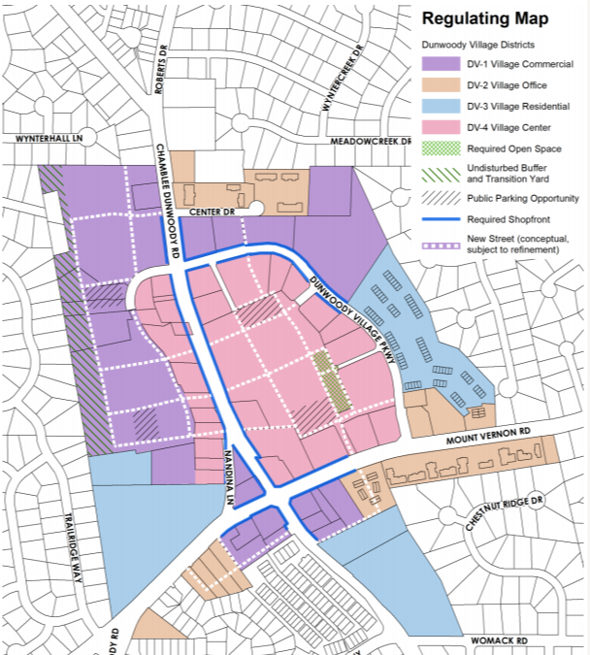
Priority Projects
Pedestrian Improvements
Street Grid
Parking Solutions
Park / Green Space / Plaza
Placemaking & Activation

Slide 4
Questions
Momentum in the Village is at an all time high. How does the City keep the momentum moving forward?
Prioritize Public Investments that leverage current and future Private Investments.
The vision for the scale of redevelopment of Dunwoody Village will shape the direction for public improvements:
  Incremental versus Sweeping Redevelopment

Slide 5
Next Steps
$75,000 Budget for Public Works to design Pedestrian and Street Grid projects
Joint full-day retreat with Dunwoody Development Authority
2023 Budget for Street Grid and Pedestrian Improvements
Create Dunwoody

