Slide 1
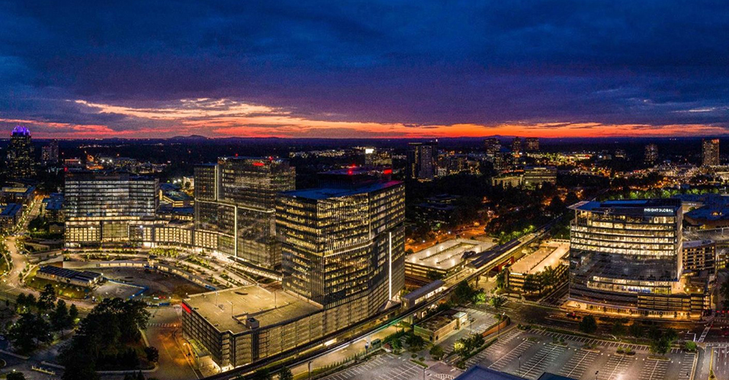
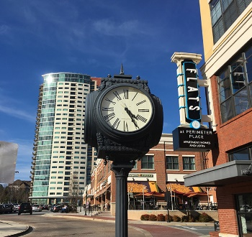
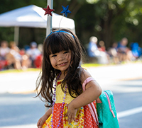
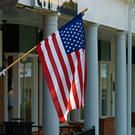
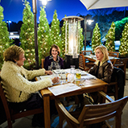
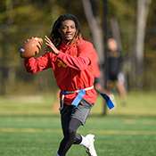

City Council Retreat
Dunwoody’s Own Direction
March 22-23, 2023

Slide 2
Dunwoody’s Own Direction
The 2020 Comprehensive Plan has nine embedded goals:
  Maintain and enhance residential amenities and housing types within neighborhoods.
  Foster a business-friendly climate.
  Redevelop target areas with a vibrant mix of uses, transportation options, high quality design, and amenities.

Slide 3
Dunwoody’s Own Direction
The 2020 Comprehensive Plan has nine embedded goals:
  Promote connectivity and choice for all modes of travel, including, transit, biking, and walking.
  Expand parks and greenspace in more locations across the city, and improve recreational opportunities.
  Expand housing choice and make aging-in-place an achievable reality for residents.

Slide 4
Dunwoody’s Own Direction
The 2020 Comprehensive Plan has nine embedded goals:
  Cultivate and expand access to arts and culture as part of what makes Dunwoody special.
  Maintain and strengthen the City’s commitment to sustainable practices.
  Leverage Dunwoody’s location at the heart of growing job centers, transportation systems and neighbor communities.

Slide 5
Maintain and enhance residential amenities and housing types within neighborhoods.
Making it happen….
  Implemented front yard tree planting program.
  Create simplified instruction handout for fence construction and permitting including graphics.
  Perform monthly code enforcement apartment sweeps to maintain status of upkeep and livable conditions for tenants.
  Maintain infrastructure by keeping sidewalks and road up to quality standards.

Slide 6
Maintain and enhance residential amenities and housing types within neighborhoods.
Making it happen….
  Protect existing property owners’ interests by ensuring enforcement of city codes.
  Expanded right-of-way maintenance efforts to keep a pleasant looking environment throughout the city.
  Clarify permissible places cars can park in residential front yards.
  Created standards for residential driveways.

Slide 7
Foster a business-friendly climate.
Making it happen…
  Supported new businesses with official city ribbon-cutting promotional events.
  Initiated conversations with property owners and managers in the Dunwoody Village to focus on long-term goals.
  Expanded economic development staffing by on FTE to focus on business retention efforts.

Slide 8
Foster a business-friendly climate.
Making it happen…
  Create and expand entertainment districts to stimulate business activity.
  Broaden the range of uses that can sell liquor drinks, including personal services and entertainment uses, to allow a more diversified business inventory.

Slide 9
Foster a business-friendly climate.
Making it happen…
  Allocated almost half of all CARES 2 funding to small business grants, entrepreneurial support, and other business efforts.
  Created a local incentive program to recruit larger businesses.
  Maintain quick permitting (10 days for initial submittal) and inspection turnaround time (next-day).

Slide 10
Foster a business-friendly climate.
Making it happen…
  Implementing the Entrepreneurship & Innovation Strategy in collaboration with Sandy Springs.
    Planning for an Innovation District in Perimeter to support start-ups
    Developing support programs for entrepreneurs and underserved small businesses
    Working with TiE Atlanta to host monthly training, mentoring sessions, and venture capital pitch competitions
  Updated sign code to allow for more development-wide flexibility.

Slide 11
Redevelop target areas with a vibrant mix of uses, transportation options, high quality design, and amenities.
Making it happen…
  Created entertainment districts within the city to promote vibrant areas where patrons stay for longer times.
  Developed and re-wrote the city code for the Dunwoody Village area to give it a sense of community.
  Plan to update areas of the city code that still have basis in previous times, economies, and populations, as bandwidth allows.

Slide 12
Redevelop target areas with a vibrant mix of uses, transportation options, high quality design, and amenities.
Making it happen…
  Used CARES funding to support outdoor dining amenities.
  Hosted a joint planning retreat between City Council and Development Authority to prioritize Dunwoody Village implementation projects.
  Georgetown Gateway project.

Slide 13
Redevelop target areas with a vibrant mix of uses, transportation options, high quality design, and amenities.
Making it happen…
  Developing plans for transportation and streetscape improvements on Chamblee Dunwoody Road in Dunwoody Village.
  Establishing street standards for Jett Ferry area. Deliverables due soon from consultant.
  Developing plans for pedestrian corridors and parks in Dunwoody Village.
  Designing path for North Shallowford Road.

Slide 14
Promote connectivity and choice for all modes of travel, including, transit, biking, and walking.
Making it happen..
  Developing a citywide trail master plan to be completed this Spring.
  Advanced completion of the Ashford Dunwoody trail by acquiring right-of-way and working with property owners on building trail portions during development.

Slide 15
Promote connectivity and choice for all modes of travel, including, transit, biking, and walking.
Making it happen..
  Ongoing efforts... Currently constructing ½ mile of sidewalk and 1 mile of path.
  Use the new Safe Street Program to identify quick fix areas for bicyclist and pedestrian safety efforts.
  Completed 14 miles of sidewalk, improved 17 pedestrian crossings, added 12 miles of bike lane and 3 miles of path since incorporation.

Slide 16
Expand parks and greenspace in more locations across the city, and improve recreational opportunities.
Making it happen…
  Excelled in operations demonstrated by winning:
    The 2021 and 2022 GRPA District 6 Agency of the Year
    The 2022 GRPA Marketing Award for Groovin’ on the Green Series
  Ensure financial stability by:
    Adjusting rental revenues for park pavilions and athletic fields.
    Increasing program sponsorships for large special events.

Slide 17
Expand parks and greenspace in more locations across the city, and improve recreational opportunities.
Making it happen…
  Excelled in operations demonstrated by winning:
    The 2021 and 2022 GRPA District 6 Agency of the Year
    The 2022 GRPA Marketing Award for Groovin’ on the Green Series
  Ensure financial stability by:
    Adjusting rental revenues for park pavilions and athletic fields.
    Increasing program sponsorships for large special events.

Slide 18
Expand parks and greenspace in more locations across the city, and improve recreational opportunities.
Making it happen…
  Activate the city’s first park splash pad in May of 2023
  Renovate the Veteran's Memorial at Brook Run.
  Improved patron accessibility to the Vermack Road park property by construction of a gravel parking lot in Q1 2023
  Begin construction on the Brook Run Park Arboretum in summer of 2023. Expected completion in the fall of 2023.

Slide 19
Expand housing choice and make aging in place an achievable reality for residents.
Making it happen…
  Encouraged residential building development to allow all walks of life by adopting Universal Design.
  Maintain a senior/income-based housing exemption.
  Change the zoning to allow a property to become a 55-year and older rental facility.
  Created a process that allows accessory dwelling units to remain after original use is gone.

Slide 20
Cultivate and expand access to arts and culture as part of what makes Dunwoody special.
Making it happen…
  Partnering with MARTA and PCID to install large-scale Mural on MARTA Station parking deck.
  Collaborated with Discover Dunwoody and Dunwoody Development Authority to financially support Create Dunwoody.
  Incorporating public art into wall on Womack Road and at Georgetown Gateway.

Slide 21
Cultivate and expand access to arts and culture as part of what makes Dunwoody special.
Making it happen…
  Expanded Economic Development efforts to include Arts, Culture and Placemaking.
  Approved the Public Art Implementation Plan and Public Art Ordinance.
  Installing public art on traffic signal boxes.

Slide 22
Maintain and strengthen the City’s commitment to sustainable practices.
Making it happen…
  Complete soon the expansion of electric vehicle (EV) posts at city facilities.
  Created the Front Yard Tree Program.
  Support community partnerships for pursing sustainable practices like the Nature Center talks.
  Setting an example of sustainable practices by winning the Tree City award for the 11th year and being a Bee City since 2020

Slide 23
Maintain and strengthen the City’s commitment to sustainable practices.
Making it happen…
  Host both e-recycling and household hazardous waste events.
  Planting one new tree for every tree removed on a city project.
  Prioritizing projects that facilitate alternative modes of transportation.

Slide 24
Leverage Dunwoody’s location at the heart of growing job centers, transportation systems and neighboring communities.
Making it happen…
  Created a 20-year vision for economic development in the Perimeter market thorough a Livable Centers Initiative – Edge City 2.0. a.k.a. Edge City
  Leveraged the Development Authority’s ability to support High Street and Campus 244 adding mixed-use developments in the Perimeter area.

Slide 25
Leverage Dunwoody’s location at the heart of growing job centers, transportation systems and neighboring communities.
Making it happen…
  Advocating for co-location of Top End transit station at Dunwoody MARTA station.
  Partnering with the PCID to enhance transportation infrastructure in Perimeter.

