Slide 1
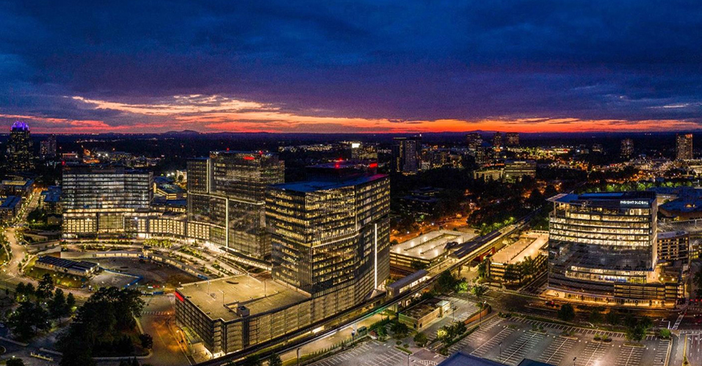
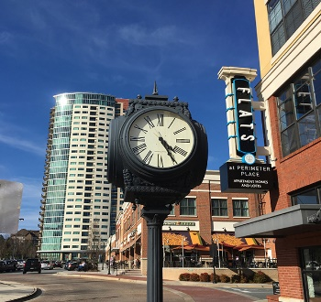

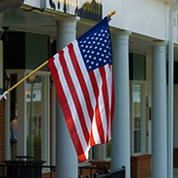

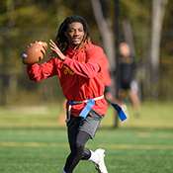

Final Review of 2022
City Council Retreat
January 9, 2023

Slide 2
Update
Proposed operating millage rate increase reviewed and approved by City Council. July 2022.
Special Tax District for Parks and/or Police reviewed. Decision on creation of districts postponed. Earliest date funding could be received would now be October 2024.
Draft calendar for General Obligation Bond developed by staff. Decision on call for election postponed. Discussions morphed into Citizen Capital Committee.
Issue RFQ for delivering ARP funds to not-for-profits. Done through current staff at no additional cost (staff time only), currently, $1.3M of the $2.0M allocated.

Slide 3
Update
Prepare updated unfunded capital list. This tasks evolved after the retreat and became the Citizen Capital Committee which developed lists for Parks and Transportation in October 2022, postponing a Trails list until the PATH Study is completed in Spring 2023.
Finish Waterford Restrooms. Bathroom/water hooked up, some concrete work and power to be done shortly.
Perform organizational assessment of Police Department. Ongoing. Study expected to be finished first half of 2023.

Slide 4
Update
Identify additional lighting in locations and install lights to be funded by ARP. Brook Run Park Multi-Use trail lighting complete. Remaining lights to be completed in Q1 of 2023
Twenty-seven additional license plate reader cameras were added along surface streets.
Review current areas of code concerning nuisances. Dunwoody’s abatement ordinance tracks state nuisance abatement law.
Mental health responder program. Contract entered into Summer 2022. Provider had to back out of contract. Alternatives being researched.

Slide 5
Update
Address ambulance services with DeKalb County. County spoke on that and Sanitation in August 2022. Draft cost proposal for EMS given to City by County. Under review.
Prepare bike/pedestrian plan. Staff was instructed to do an east/west plan from the retreat and worked on that, but was then redirected by Council to focus on a full trail plan which will be completed in early 2023.

Slide 6
Update
Have corridor walk about. Was scheduled for Summer 2022 but canceled. Possibly reschedule for spring of 2023 with PATH.
Have discussions with PCID Connects. Evolved into workshop on safe streets hosted by the City in November 2022.
Prepare Dunwoody Village action plan. Initial plan shown to Council in October 2022. Update upcoming.
Hold Joint Development Authority Retreat. Held in November 2022 about Dunwoody Village.

Slide 7
Update
Create Dunwoody – Completed in fall of 2022. Create Dunwoody funding has been approved and the new Board is in place.
Prepare public art locations in GIS. Completed Spring 2022.
Staff asked to address adding sewer at Vermack. Staff reviewed and recommended holding off until location of facilities at Vermack are complete. Updated Council Spring 2022.
Review naming of public parks. Process reviewed and first park named in August 2022.

Slide 8
Update
Staff instructed to ask County about building a park at Scott Candler Water Treatment. Staff discussed with County, too many safety issues to recommend proceeding. Council updated Spring 2022.
Adopt the Roberts Dr. and Vermack Rd Park Master Plans. Roberts Dr. plan adopted on 10/24/22. Vermack Rd. plan will return soon for discussion.

Slide 9
Update
Revise Council Standing Rules and Procedures. Still being reviewed by Council.
Revise Mission and Vision Statements. Approved by Council October 2022.
Review MARTA agreements with bus shelters. Options on January agenda. MARTA extended the contracts until June 30, 2023.

