Slide 1

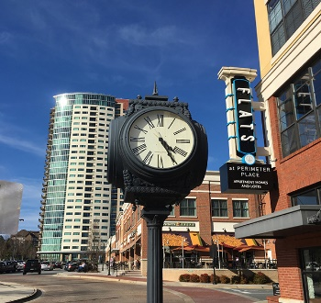





City Council Retreat
CARES/ARP Update
March 22-23, 2023

Slide 2
Jan 31, 2023 Status – CARES 2
There is some funding still available most of which is in economic development areas.

Slide 3
January 31, 2023 Status – ARP 1 and 2
Some of these figure are low – particularly mental health and license plate reader costs because of delays in the city being invoiced. LPR.

Slide 4
Current Status
As of early March, one agency has spent its allotment, four have been through their first audit. Staff plans to review everything after the first quarter and come back to Council in May with recommendations for the additional funding.

