Slide 1
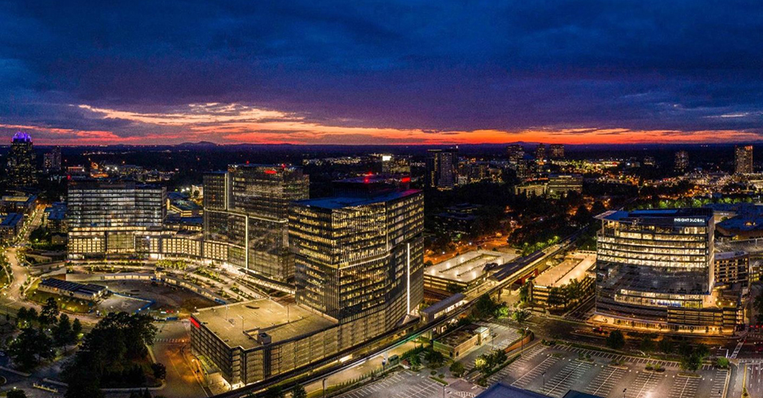
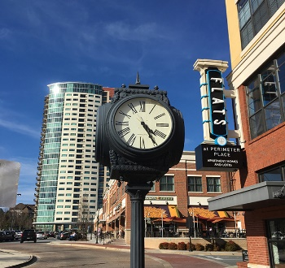

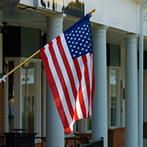



City Council Retreat
Capital Needs Update
March 22-23, 2023

Slide 2
The Focus
Bonds
SPLOST
Hotel/Motel
Surplus General Funds

Slide 3
The Question of the Day
What is the next step for the Dunwoody City Council to address the growing capital needs of the city?

Slide 4
Background
In 2022, the City hosted dozens of meetings and events to determine and identify needs for new capital construction.
Conclusions following numerous town halls, meetings of the City Council and meetings of the Citizen Capital Improvement Committee, identified need for capital improvements to the City’s park system, trail system, and transportation system, as well as repair of current assets.

Slide 5
Today’s Recommendation
Staff recommends the following:
City Council consider three separate ballot questions for issuing bonds:
  Parks and Greenspace Acquisition
  Citywide Trail System
  Transportation Improvements
Each separate question should consider an issuance of $10 to $50 million each.
City Council should support SPLOST renewal (endorsing a law change to let SPLOST include park development), but limit city projects to the current list of transportation and public safety.

Slide 6
Today’s Recommendation
Staff recommends the following:
City Council should take funding from the sale of the Shallowford property, along with any excess above the six-month reserve in the General Fund, and create the following:
  A $2 million project for improvements and major repairs at existing city facilities. This project would be fully funded, but planned out over the next few years.
  A project to be designated at a later date to future capital projects.
City Council examine options for bonding the hotel/motel tax in 2024 for eligible projects.

Slide 7
Bonds – The Numbers
The 2022 net digest of the city is about $4.4 billion dollars, meaning a 1.000 mill levy would generate about $4.4 million.

Slide 8
Bonds – The Numbers
Using a $500,000 house with a frozen value of $400,000 as the base example, here are the annual increase in costs compared to other taxes:
The E-Host credit is where the county uses sales tax to reduce county property taxes only. The rate the year before E-Host (2017) was 9.433. The proposed 2023 rate is 10.543. If that rate had not increased, Dunwoody’s taxes would also receive this credit.

Slide 9
Bonds – Disclaimer
The City is considering financing the types of projects listed in this presentation. Any specific projects listed are meant to be illustrative of the types of projects that may be financed. The City may or may not finance the specific project. Furthermore, the order of the projects does not indicate priority. The City may finance the projects in any order or not at all. Should the City decide to call a referendum on the issuance of general obligation bonds to finance all or a portion of the projects, Citizens should not vote for the issuance of general obligation bonds on the assumption that any of the listed projects will be financed with the proceeds of such bonds.

Slide 10
Bonds – Specific or General
“Shall general obligation bonds in an aggregate principal of up to $XX,000,000 be issued by the City of Dunwoody, Georgia to finance the design, acquisition, construction, equipping and/or improvement of parks and recreational areas, the costs of issuing the Bonds and capitalized interest on the Bonds? / finance (a) the design, acquisition, construction, equipping and/or improvement of (i) _________________, (ii) _______________, (iii) ___________________, (iv) __________________ (v) _____________, (b) the costs of issuing the Bonds and (c) capitalized interest on the Bonds?]”
“Shall general obligation bonds in an aggregate principal of up to $XX,000,000 be issued by the City of Dunwoody, Georgia to [_________________]?”

Slide 11
Bonds – Citizen Input

Slide 12
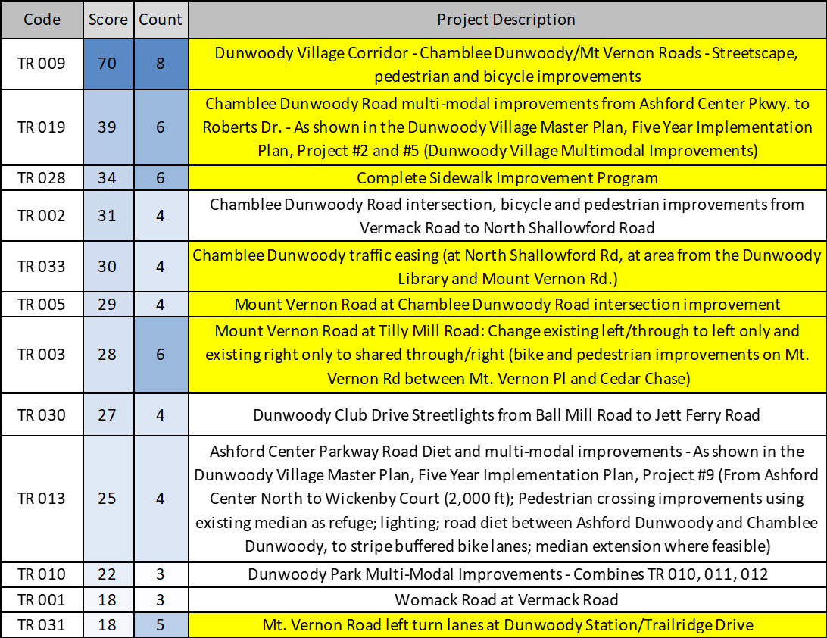
Bonds – Citizen Input

Slide 13
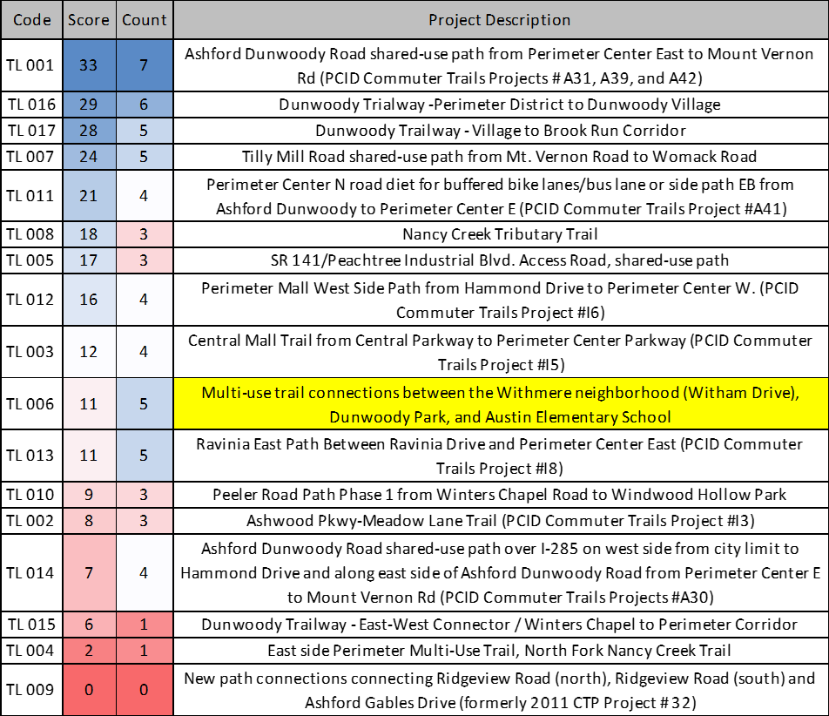
Bonds – Citizen Input

Slide 14
Bonds – Timeline
August 2023 - Call of Election by Dunwoody City Council. Tentative August 14, but could be earlier.
August 2023 - Subsequently called by Board of Elections.
September/October 2023 - Various publications of call of election and notice of election.
November 7, 2023 - Election for both potential bond and potential SPLOST renewal.
November/December – Validation process, creation of Preliminary Offer Statement.
January 2024 – Conversations with rating agencies.
February 2024 – Pricing of bonds.
March 2024 – Closing, funds available.

Slide 15
Bonds – Council Decision
Which one, if any, of the three questions are to be put on the ballot?
Will the question be general or specific?
What will the amount be? Not to Exceed Amount, Interest Rate, Maximum Principal, Final Maturity.

Slide 16
SPLOST – The Numbers
From April 2018 through December 2022, the city has earned about $36.2 million and spent $25.2 million from SPLOST.
That averages to about $7.7 million raised during that time for transportation and public safety.
Current forecasts have the value of a second SPLOST to rise to approximately $9.5 to $8.6 million annually.

Slide 17
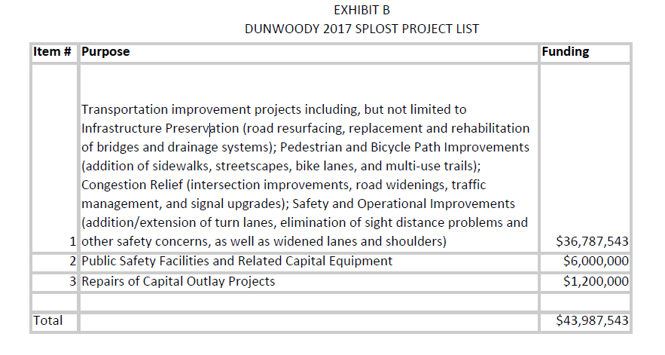
SPLOST – The Numbers
Previous Project List by Dunwoody for 2017

Slide 18
General Fund – The Numbers
The sale of the Shallowford property will net the city approximately $7.0 million.
The city could have approximately $2.0 million or more in the General Fund reserves above the six-month level at the end of 2022 once the audit is finalized.
In a non-COVID economic uncertainty world, this excess fund balance would have been appropriated for capital over 2020, 2021, and 2022.

Slide 19
General Fund – The Numbers
Both of these amounts should be properly transferred into a Capital Fund Project labeled Undesignated with $2 million
Council action is needed to authorize this. Only further Council action will allow this money to be spent by designating it to another new or existing capital project.

Slide 20
Hotel/Motel – The Numbers
In the last pre-COVID full year (2019), Dunwoody hotel/motel tax generated $4.2 million.
Unaudited 2022 figures, show the total revenue generated to be $4.8 million.
To ensure stability, it would be prudent to let 2023 complete and look into issuing revenue backed bonds in 2024.
The city could generate a twenty-year bond of approximately $8.3-10.5 million with the current amounts.

Slide 21
Summary
Bonds
SPLOST
Hotel/Motel
Surplus General Funds

