Slide 1
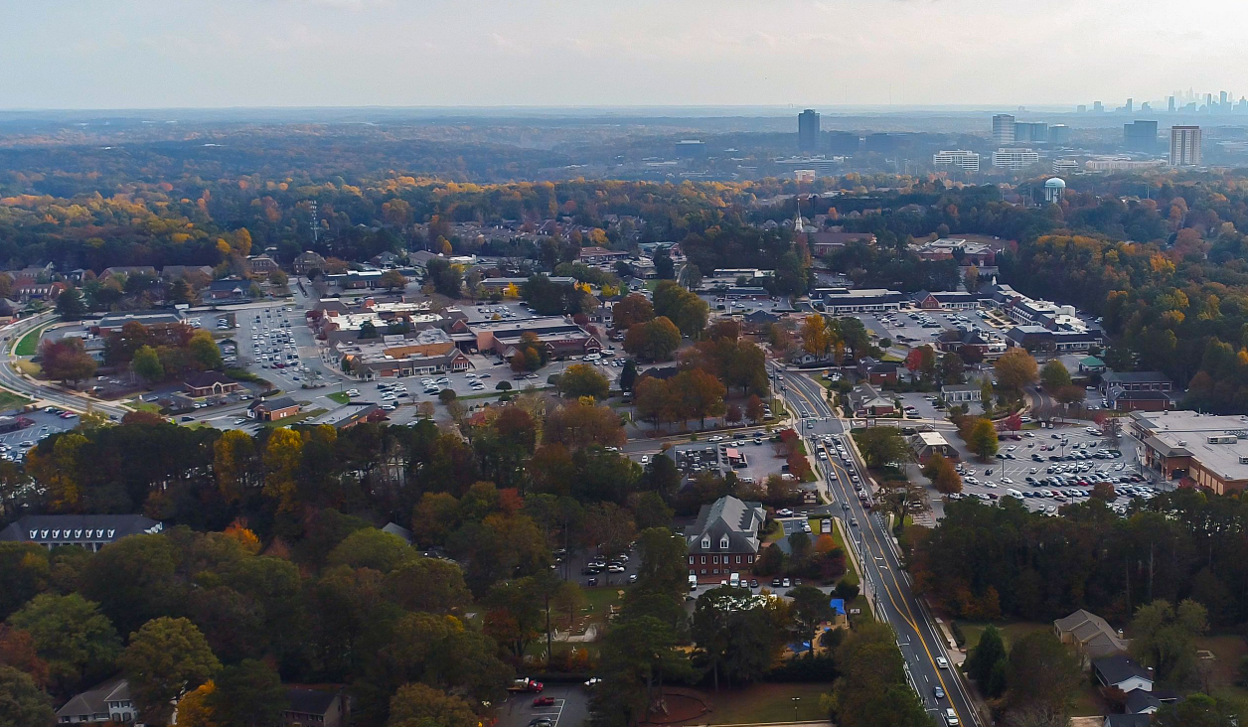

Dunwoody Village
Implementation Plan - 2023

Slide 2
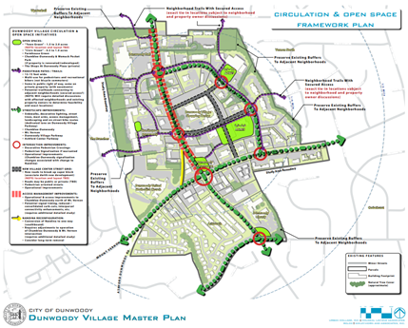
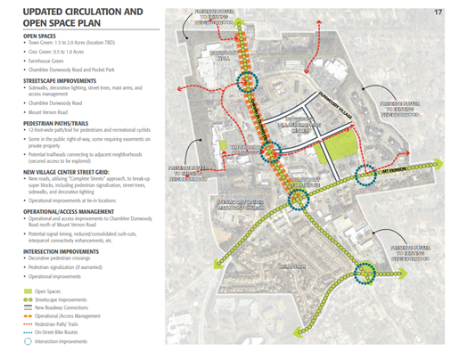
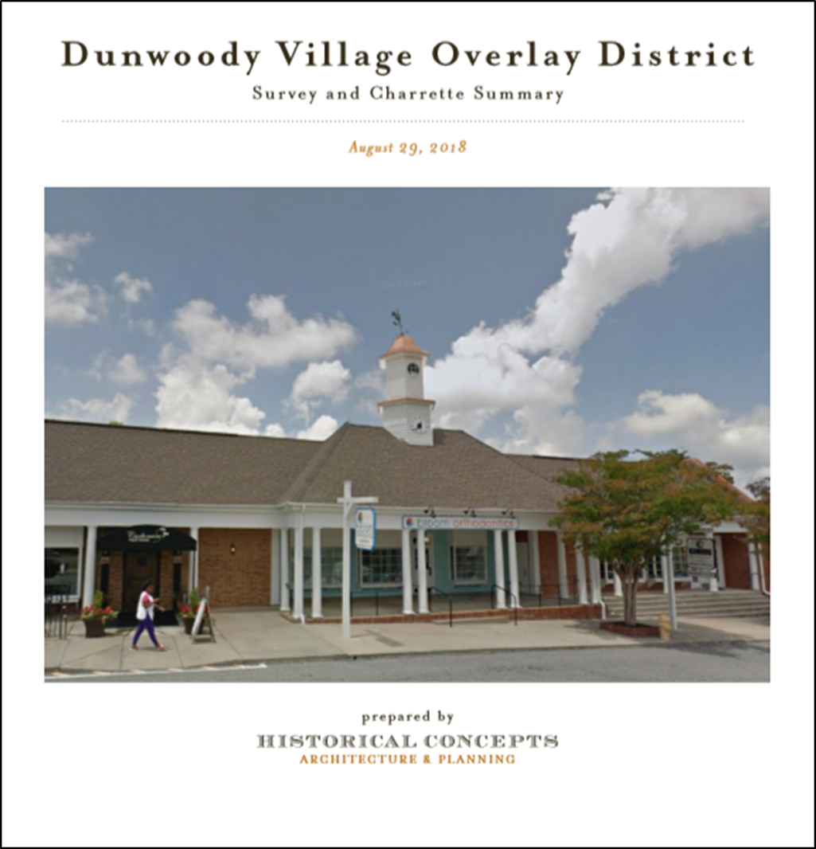
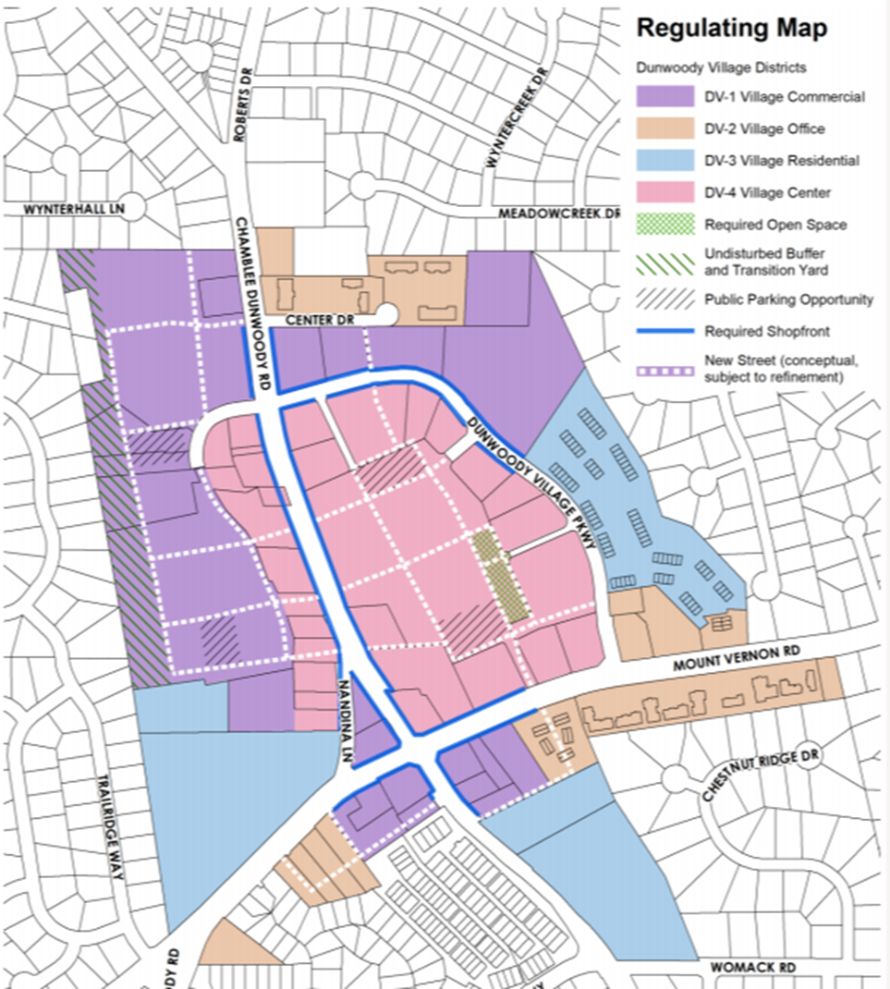
Master Plans
2011 LCI Master Plan
2016 LCI Update
2018 Survey & Charrette
2020 Zoning Update

Slide 3
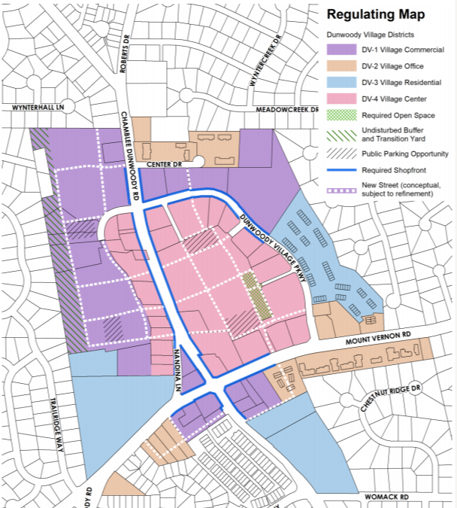
Pedestrian Grid
The City has conducted numerous Master Plans that were publicly vetted by citizens and approved by City Council and all of them identify creating a system of “pedestrian grids” through the market as a priority. Breaking up the super blocks helps create a more walkable and connected commercial district.
Phase I of this plan is to create an east-west connection between Dunwoody Village Parkway and Chamblee Dunwoody Road and a north-south connection between Mount Vernon Road and the new east-west connection.

Slide 4
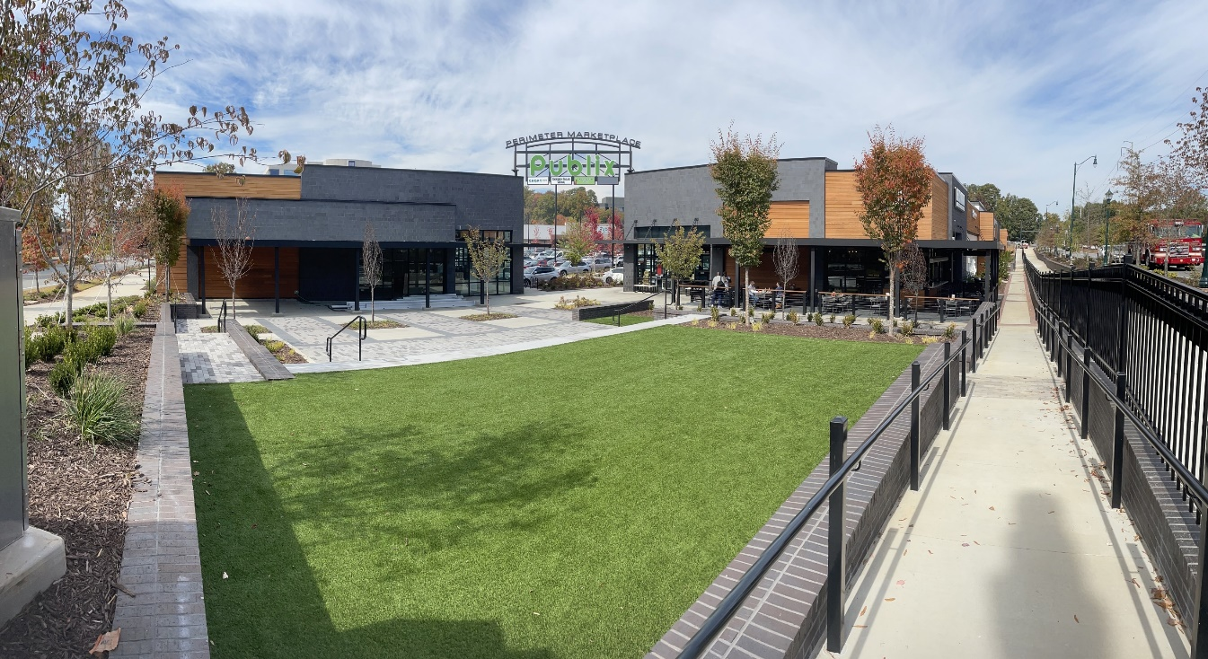
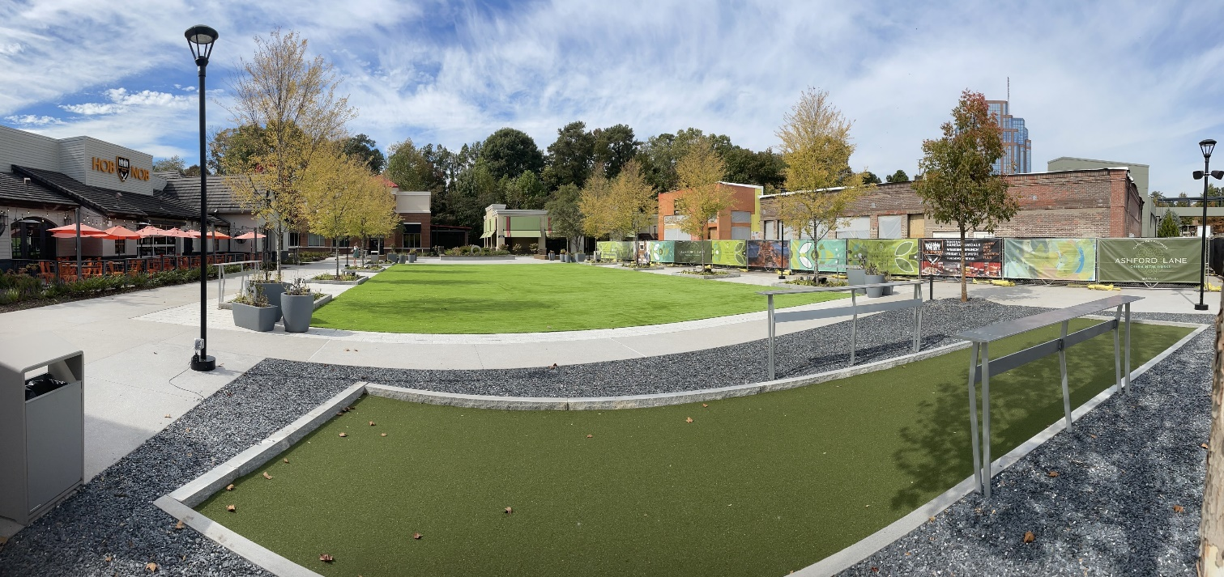
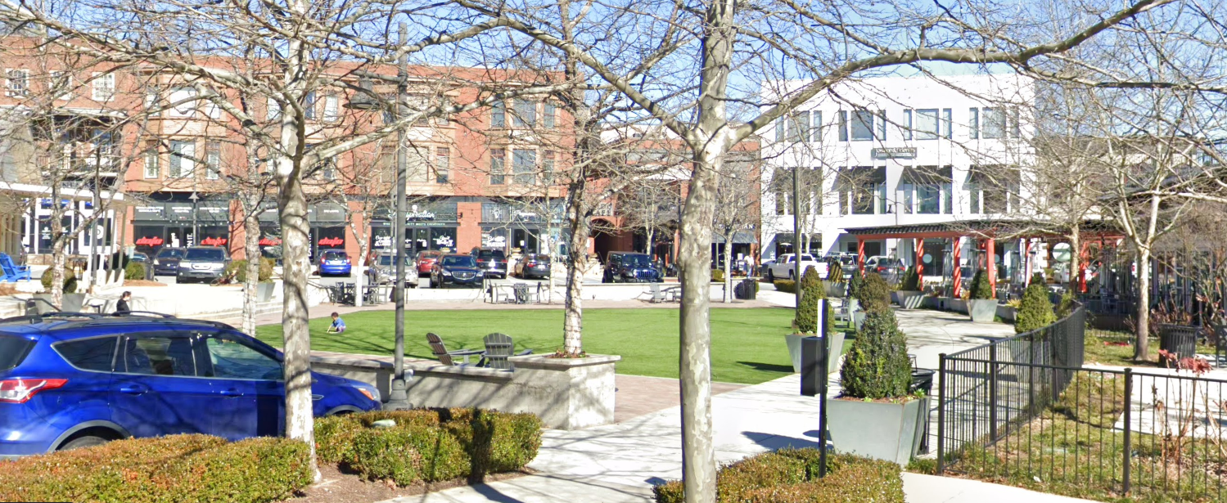
Parks & Greenspace
Perimeter Marketplace (.11 acres)
The Master Plans call for parks, greenspace, and parklets spread throughout the Village. Trees and greenspace will improve people’s comfort and will be an invitation to spend more time in the Village.
We are working with numerous property owners to identify projects of all types.
Ashford Lane (.23 acres)
Vickery Village
(.25 acres)

Slide 5
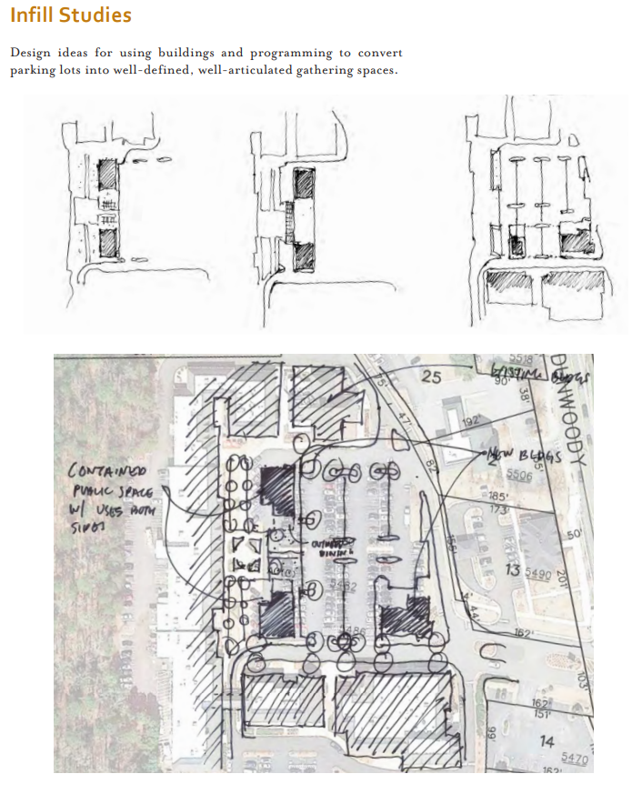
Parking & Infill
40% of the total land area within the Village is paved. This predominance of asphalt facilitates driving and parking, but is a tremendous hindrance to biking, walking, or simply relaxing.
Conducting a parking demand analysis for the entire Village will allow the City to begin discussions with property owners on how to better share parking to meet peak demands while maximizing future development sites.

Slide 6
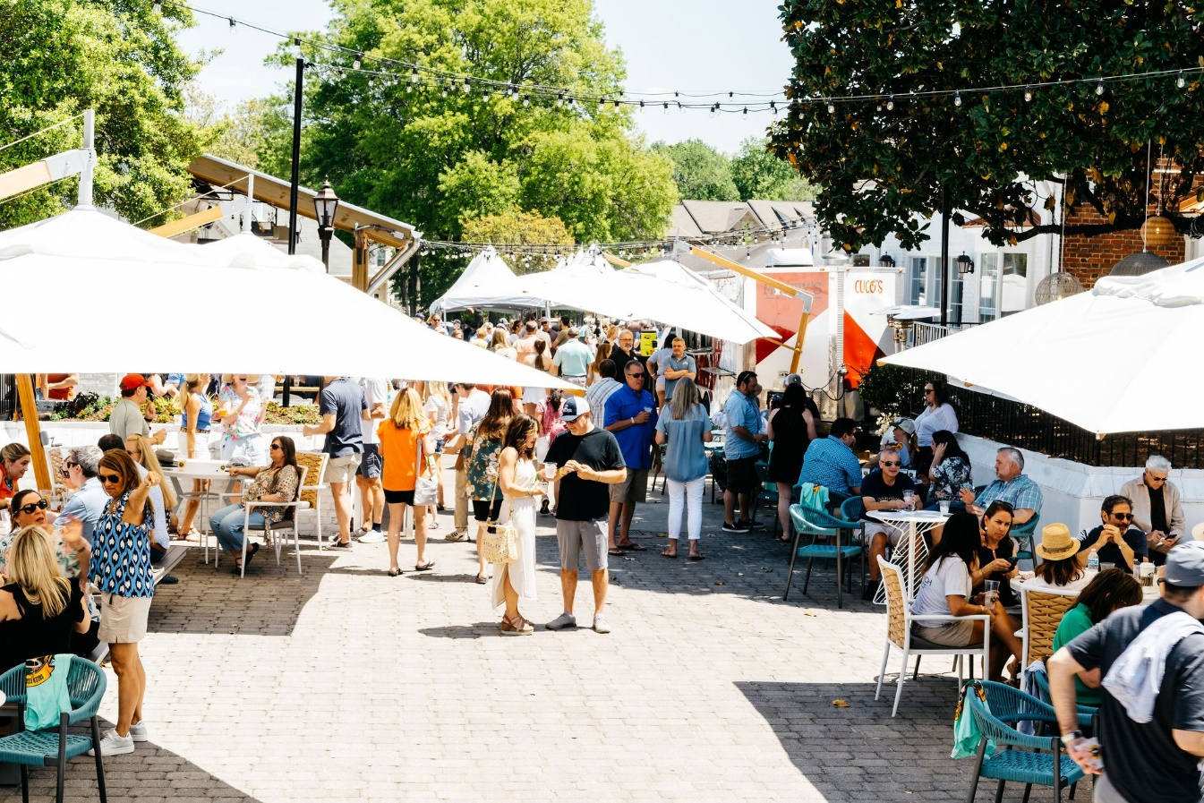
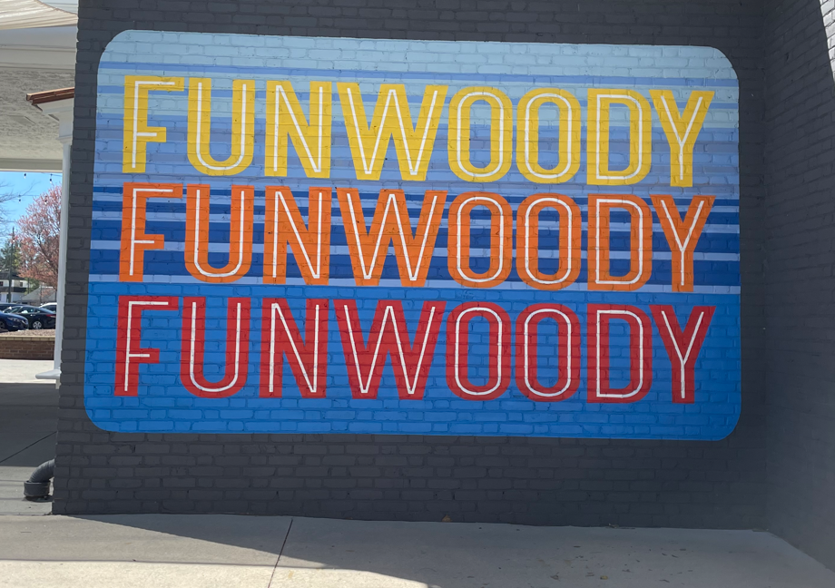
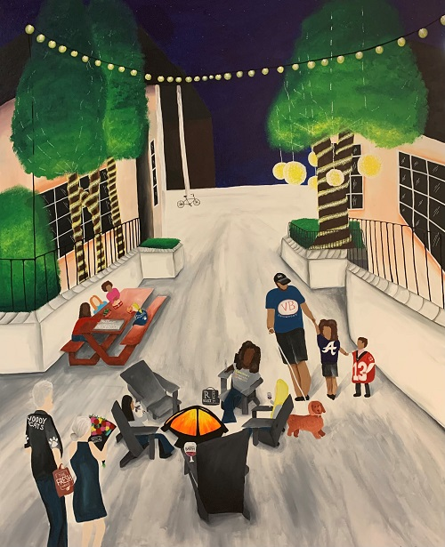
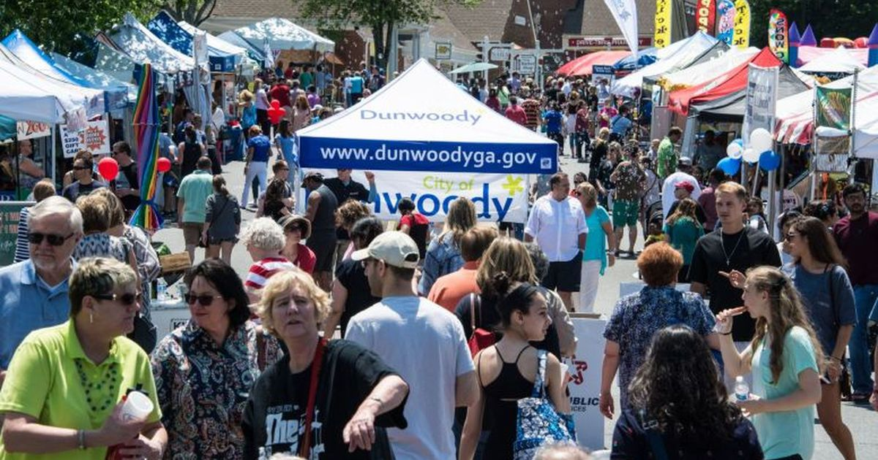
Placemaking
Placemaking, promotion, marketing, and active management of the Village is critical to establishing the area as “the place to be” with things to do, rather than a place to pass through or run errands.
The Village should become a unique cultural destination through the intentional cultivation of arts and events that draw people in and connect people to each other and place.

