Slide 1
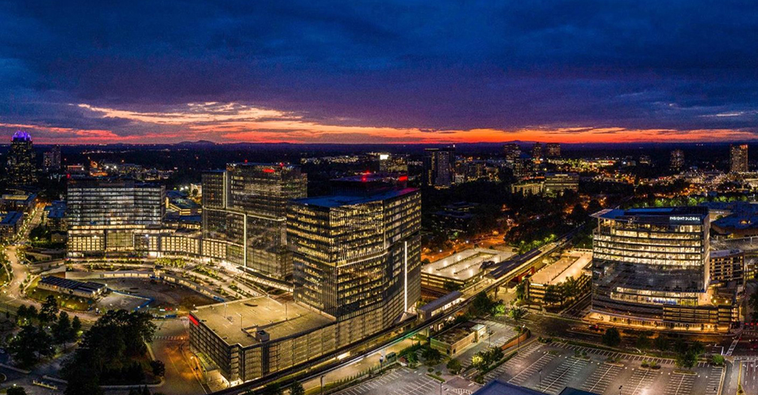
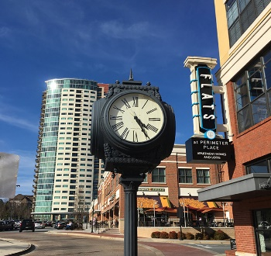





City Council Retreat
Communications
March 23, 2023

Slide 2
Goals & Outreach
Goals:
Share information
Support engagement
Build enthusiasm
How do we reach people?
D-news
Dunwoody Digest
Website
Calendar ads
Press releases
Social media + Dunwoody app

Slide 3

D-news & Dunwoody Digest
D-News – 13K subscribers, 50% open rate
  According to MailChimp, the highest open rates are found in government-related emails, but the average is lower at 28.7%.
  Peachtree Corners, Sandy Springs & Kennesaw produce monthly newsletters
Dunwoody Digest
  23K issues mailed quarterly to residents and businesses
  Only consistent direct mail, includes apartments
  The design is coffee table-worthy
  We focus on calendar, economic development,
  parks, police, public art, fun things to do & see
  Our only chance to dive deeper
    Police LPRs
    Tornado Anniversary
    Overdoses & NARCAN
    Apartment Sweeps
    GIS
Dunwoody L.E.A.F

Slide 4

Calendar ads & website
With a limited advertising budget, we’re making the most of our space with monthly calendar ads in the Dunwoody Crier & Reporter – no other cities are doing this
Our “new” website is easy to
keep fresh
Most-visited pages:
  Home page
  Brook Run Park
  Police
  Permits & Inspections
  Police Open Records
  Open Records
  Parks & Rec
  Jobs
  Agendas & Minutes
  Municipal Court

Slide 5
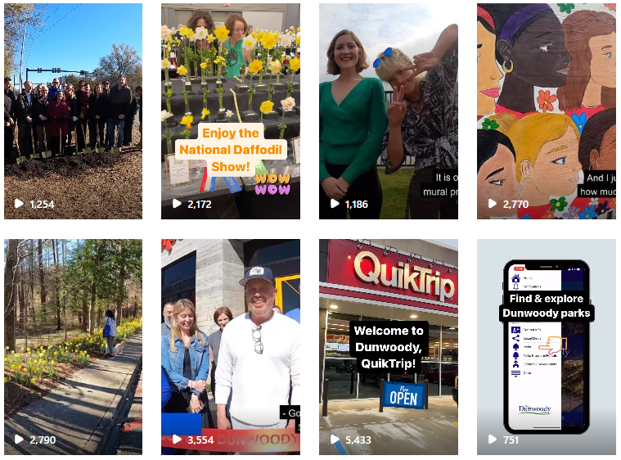
Social media
Video improves engagement – we do more, higher-quality videos than our neighbors
2022 stats: 2.5K posts, 2.7M impressions, 2.4M users (this includes the City’s Instagram & Twitter accounts + Facebook accounts for the City & Parks & Rec)
LinkedIn – ranked #1 this week for engagement compared to Atlanta, Sandy Springs, Marietta & more; ranked #3 for new followers, behind Atlanta & Cobb, ahead of Alpharetta & Sandy Springs

Slide 6

City of Canton Communications
Rebranding in 2018/19 – new logo,
colors, font, signature, etc.
“Coolest Small Town in America” – Mayor’s saying, communications uses it sparingly
No video – only one person in the department
Recently launched mass communications texting service through Civic Plus
  NOT for emergencies
  100 + languages offered, can choose email or automated voicemails
  Distribution lists: general communications, downtown, parks & rec, utilities
  Allows for geofencing
  400 people signed up so far (vs. 3,000 newsletter subscriptions)
  $6,000 annually
  Used sparingly; weekly texts at most – not daily

