Slide 1
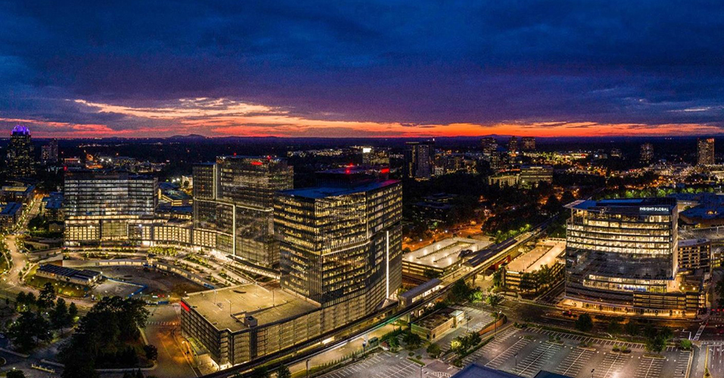
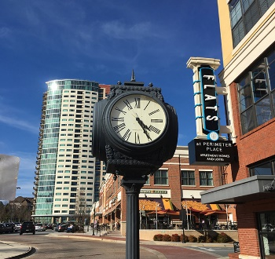

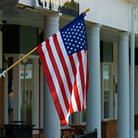



City Council Retreat
Demographics
March 22-23, 2023

Slide 2
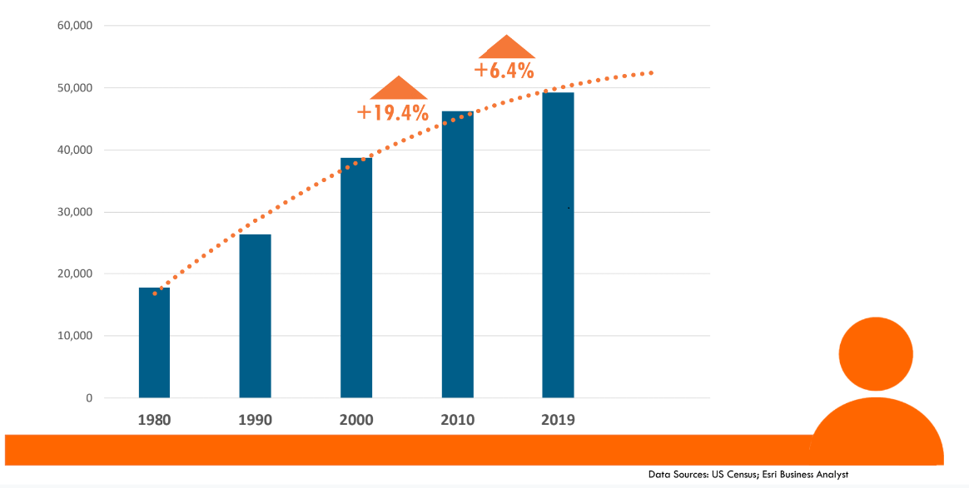



Population Change
2010 | 2020
46,164 | 51,676

Slide 3
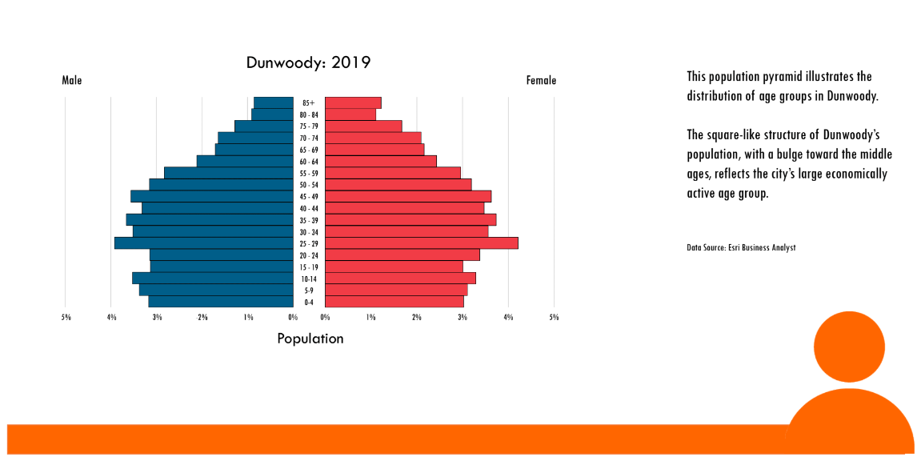
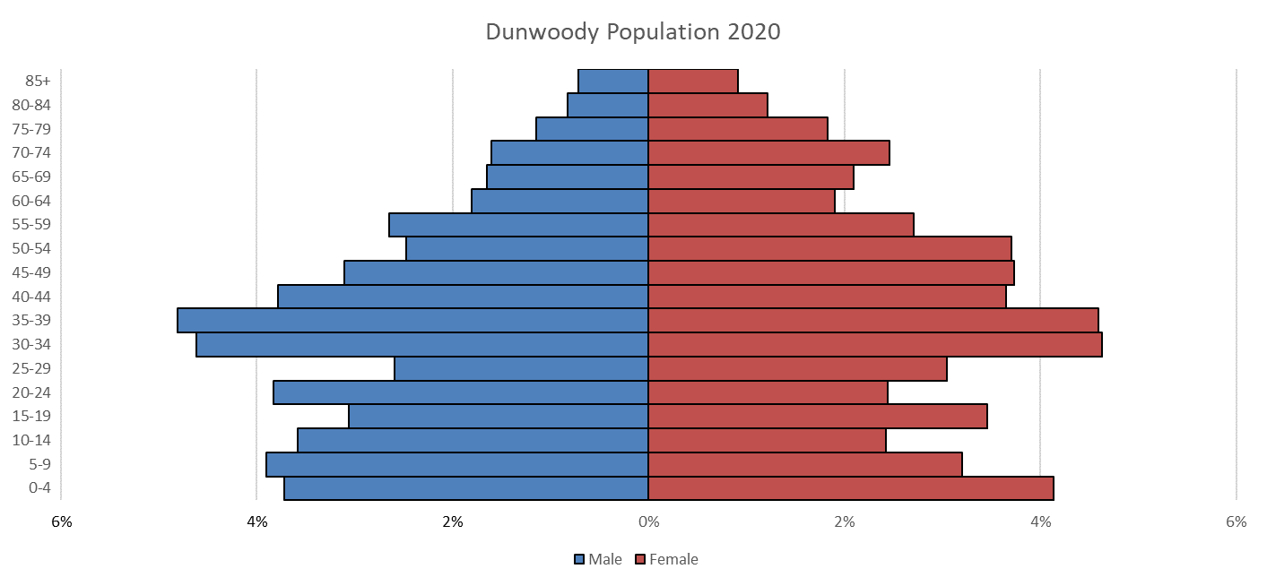
Age Distribution
% of Dunwoody population over 50 – 1.1% increase
% of Dunwoody population over 65 – 1.7% increase
2010 | 2020
27.9% | 29.0%
2010 | 2020
12.4% | 14.1%

Slide 4
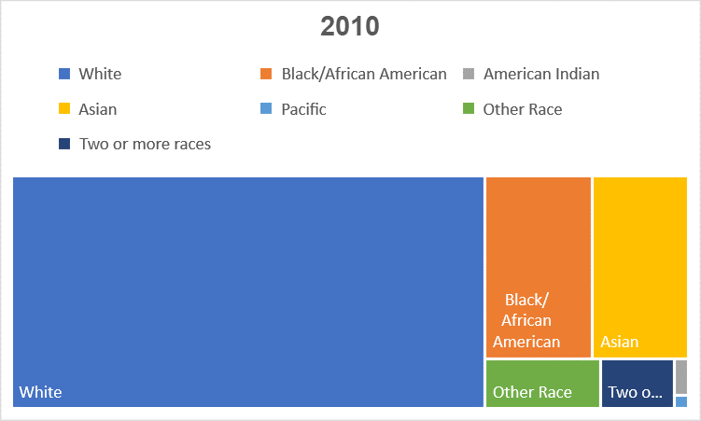
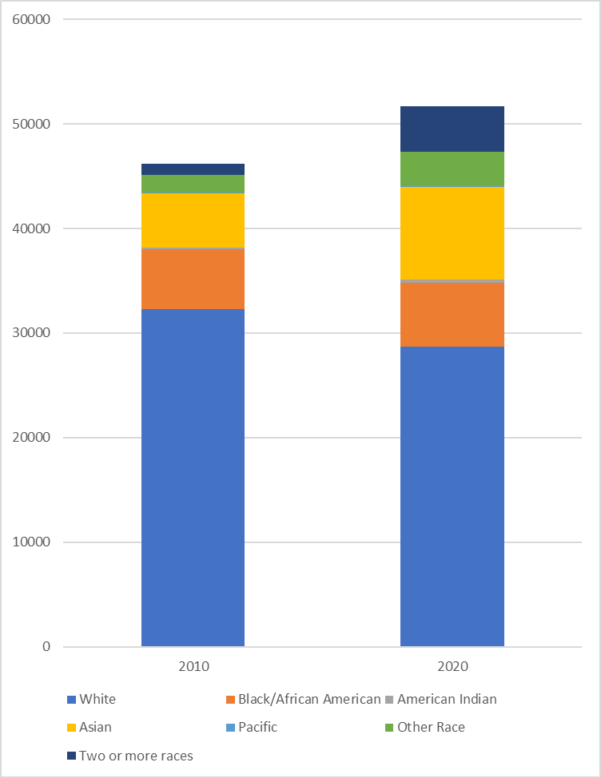
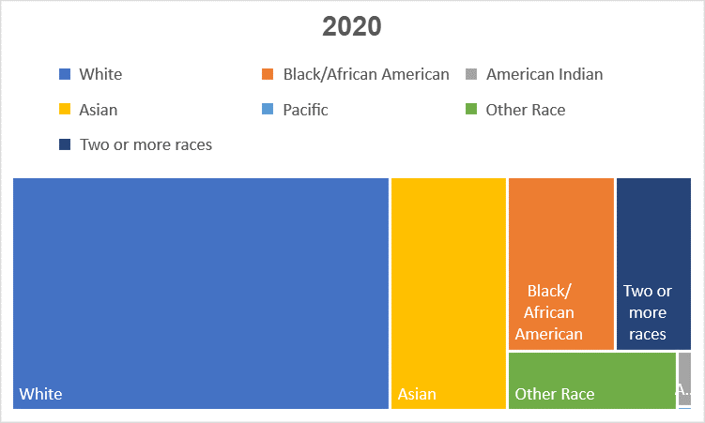
Racial Breakdown

Slide 5
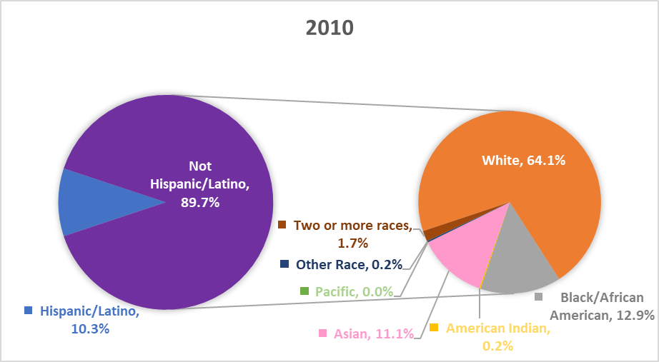
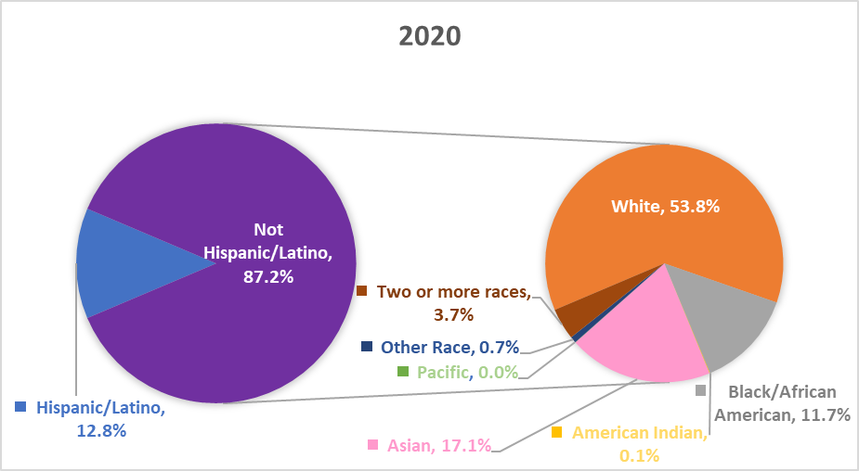
Ethnicity Breakdown

