Slide 1
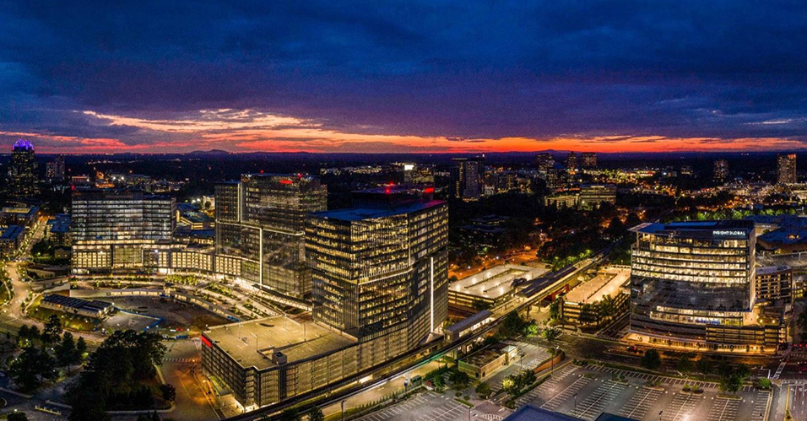
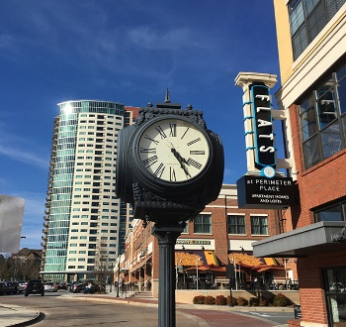
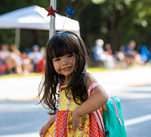
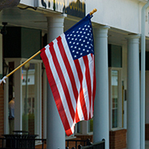

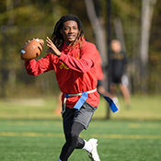

2027 Mayor & City Manager Proposed Operating & Capital Budget
September 30, 2026

Slide 2
2027 Budget Calendar
Date | Item
Early July 2026 | 2027 Budget Kick off
Late July 2026 | Departments submit 2027 budget requests
Sept 1, 2, & 3 | Department Review Team Meetings
September 25 | 2027 Mayor & City Manager Proposed Budget released
September 30 | City Council Budget Retreat
November 16 | First Public Hearing
November 30 | Final Public Hearing and Budget Adoption

Slide 3
2027 Operating Budget Assumptions
Following are included in the 2027 budget:
  Revenue growth of 0.9% from 2026 budget (2026 Net Digest growth = 0.1%; 2027 Net Digest growth = 2.0%)
  3.6% pay increase effective July 1, 2027 ($232k in salaries plus $50k in retirement)
  Include full year of funding for the pay raises that took effect July 2026 ($715k in salaries plus $180k in retirement)
  8.0% health insurance increase ($520k)
  10% increase in General Liability Insurance ($90k)

Slide 4
2026 Operating Budget Assumptions (cont.)
  Fund annual municipal contract agreements with Lowe and Nova for $2.5M ($71k increase from FY2026)
  Fund annual Right-of-Way and Parks Maintenance contract with TriScapes for $2.8M ($85k increase from FY2026)
  Fund Debt Service payments for City Hall ($894,355) and Vermack Road ($464,785)

Slide 5
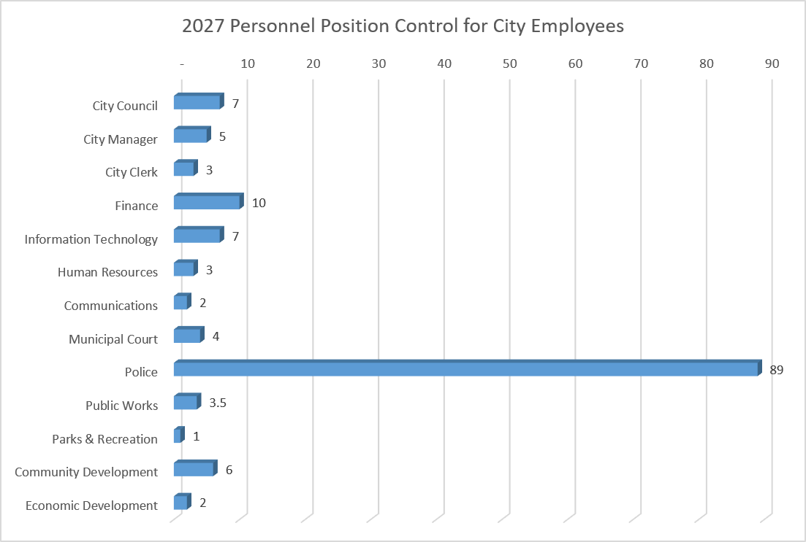
2027 City Headcount
Note: No change in personnel count from FY2026 to FY2027

Slide 6
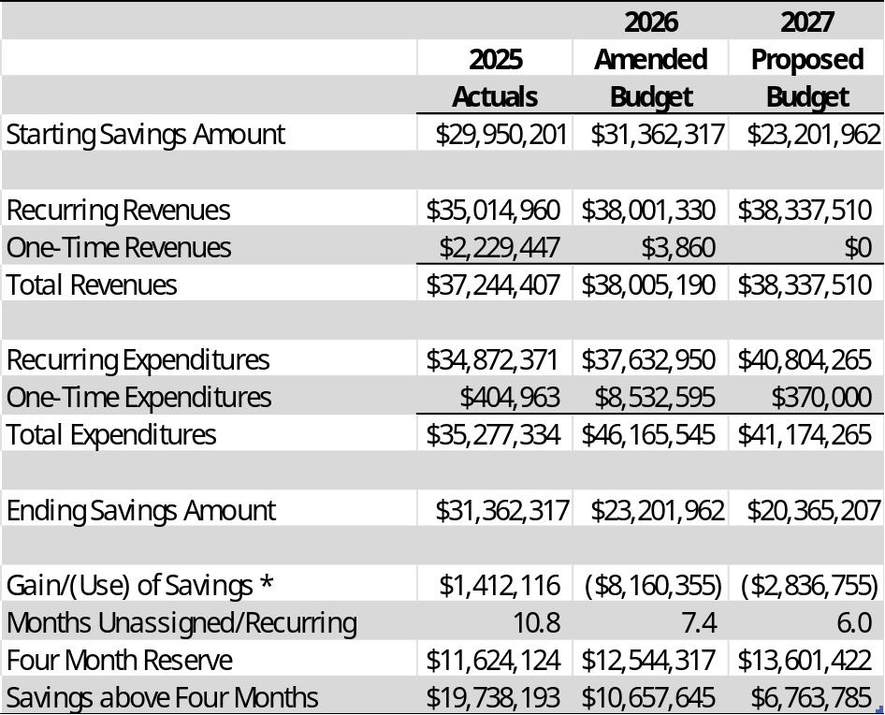
2027 General Fund Summary
* FY2026 Use of Savings:
Capital for Parks (Homecoming) - $5,000,000
Capital for Public Works (Pedestrian Safety) - $1,500,000
Capital for Police (Vehicles and Ballistic Windows) - $800,000
Capital for Facilities (MRI Renovation and DNC Wildcat Lab) - $662,595
General Fund operations - $197,760
The preliminary 2027 budget is currently showing a 0.9% increase in recurring revenues and 8.4% increase in recurring expenditures.

Slide 7
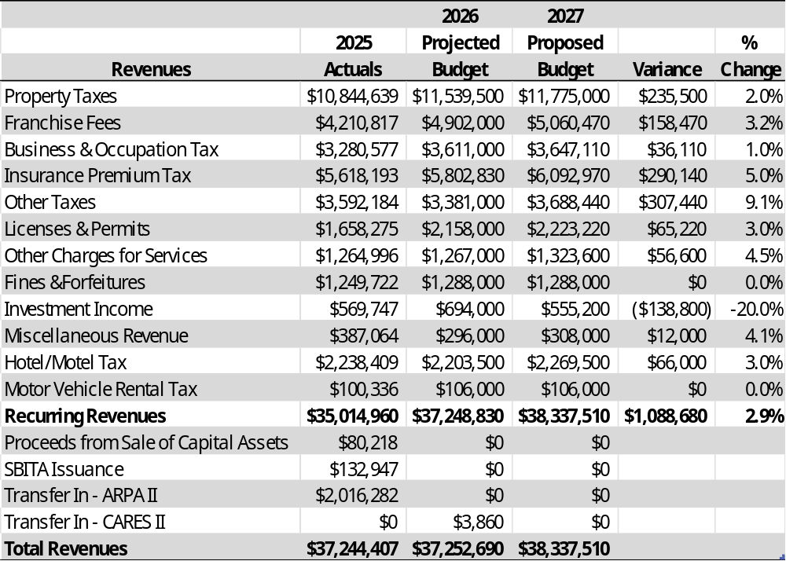
2027 General Fund Revenue

Slide 8
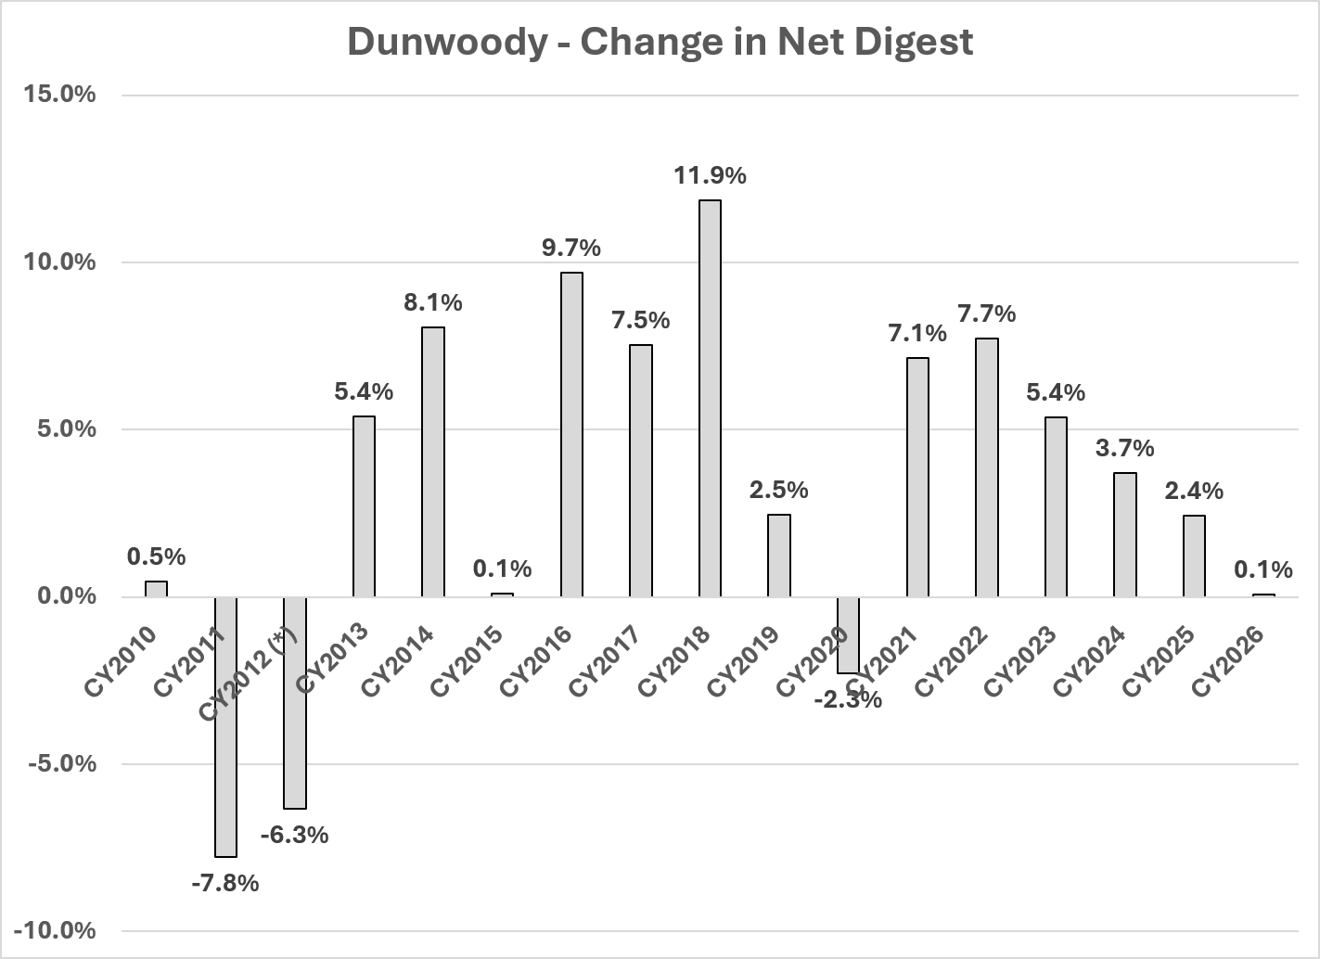
Digest Trends

Slide 9
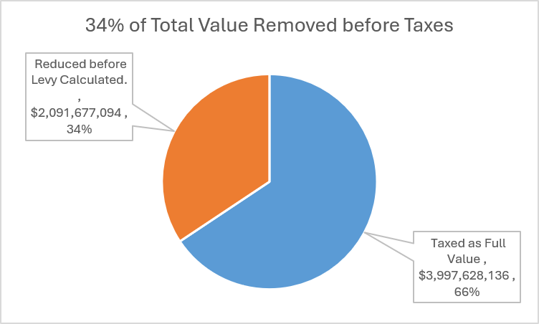
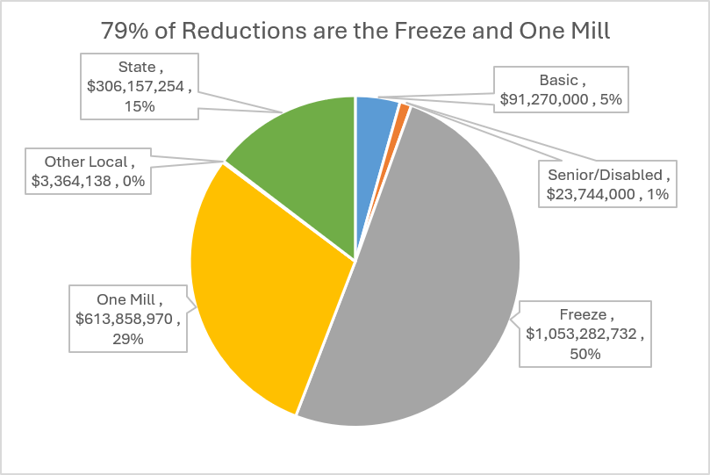
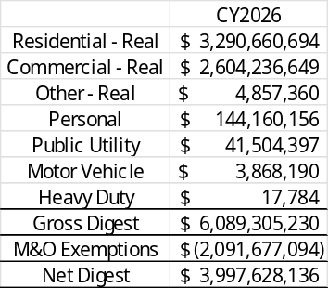
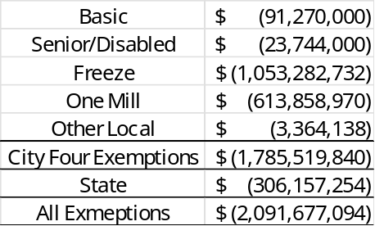
Where Property Taxes Change

Slide 10
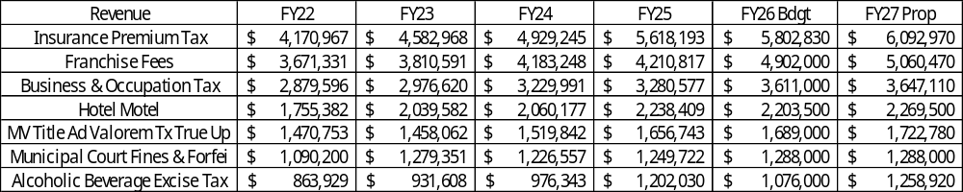
Other Major Sources
Property taxes are now about 1/3 of General Fund revenue, but these objects make up about 1/2 of the General Fund Revenue.

Slide 11
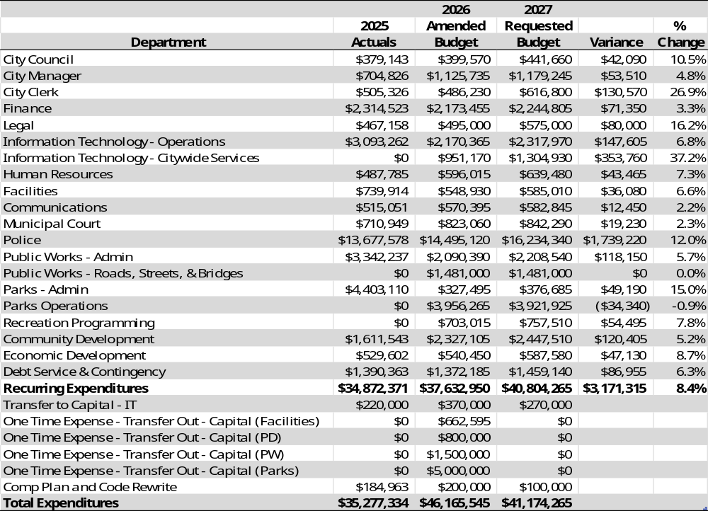
2027 GF Budget by Department
Police is 39.8% of the total 2027 Proposed Budget
The 4 largest departments (IT, Police, Public Works, and Parks) make up 70.1% of the total budget
Debt Service is 3.6% of total budget
Remaining departments represent 26.3% of total budget

Slide 12
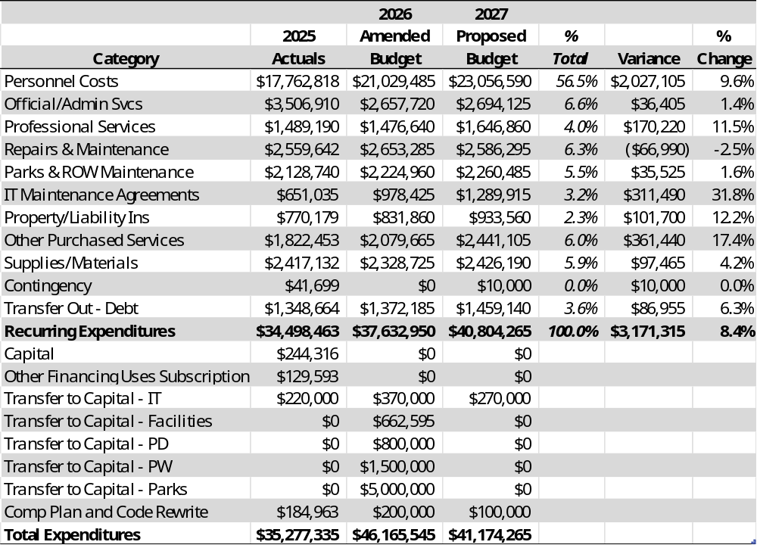
2027 GF Budget by Category
Personnel costs and Official/Admin Svcs is 63.1% of the total 2027 Proposed Budget
Property/Liability Ins and Debt Service is 5.9% of total budget
Remaining categories are 31% ($12.7M) of total budget

Slide 13
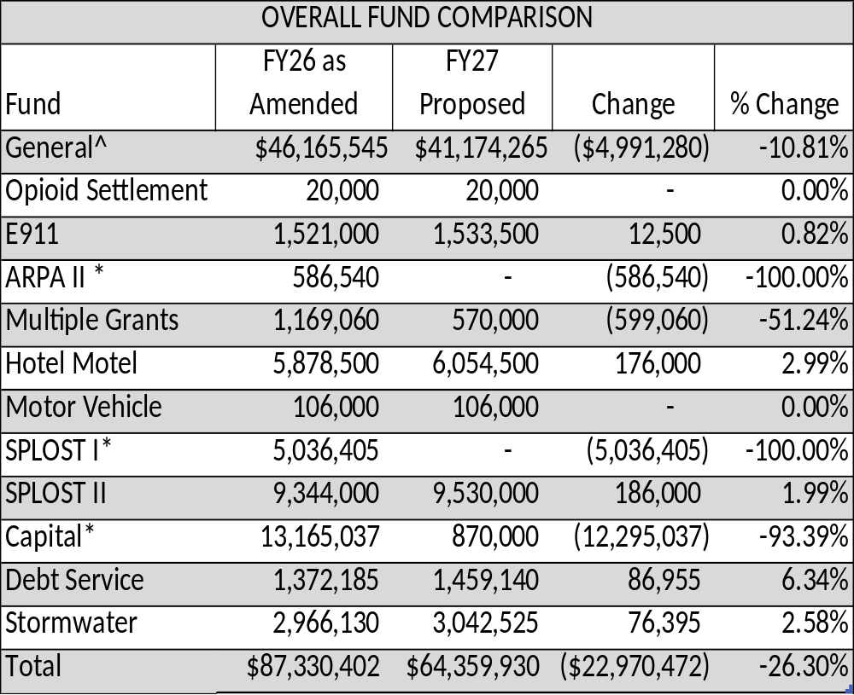
2027 Overall Budget
^ The FY2026 amended budget includes the $8.2M one-time use of reserves ($5M Parks, $1.5M Public Works, $800K Police, $662K Facilities, $197.8K General Operations).
* These funds were budgeted to spend all remaining proceeds in FY2026. However, any remaining funds will be carried over into FY2027 and the budget will be amended as needed.

