Slide 1
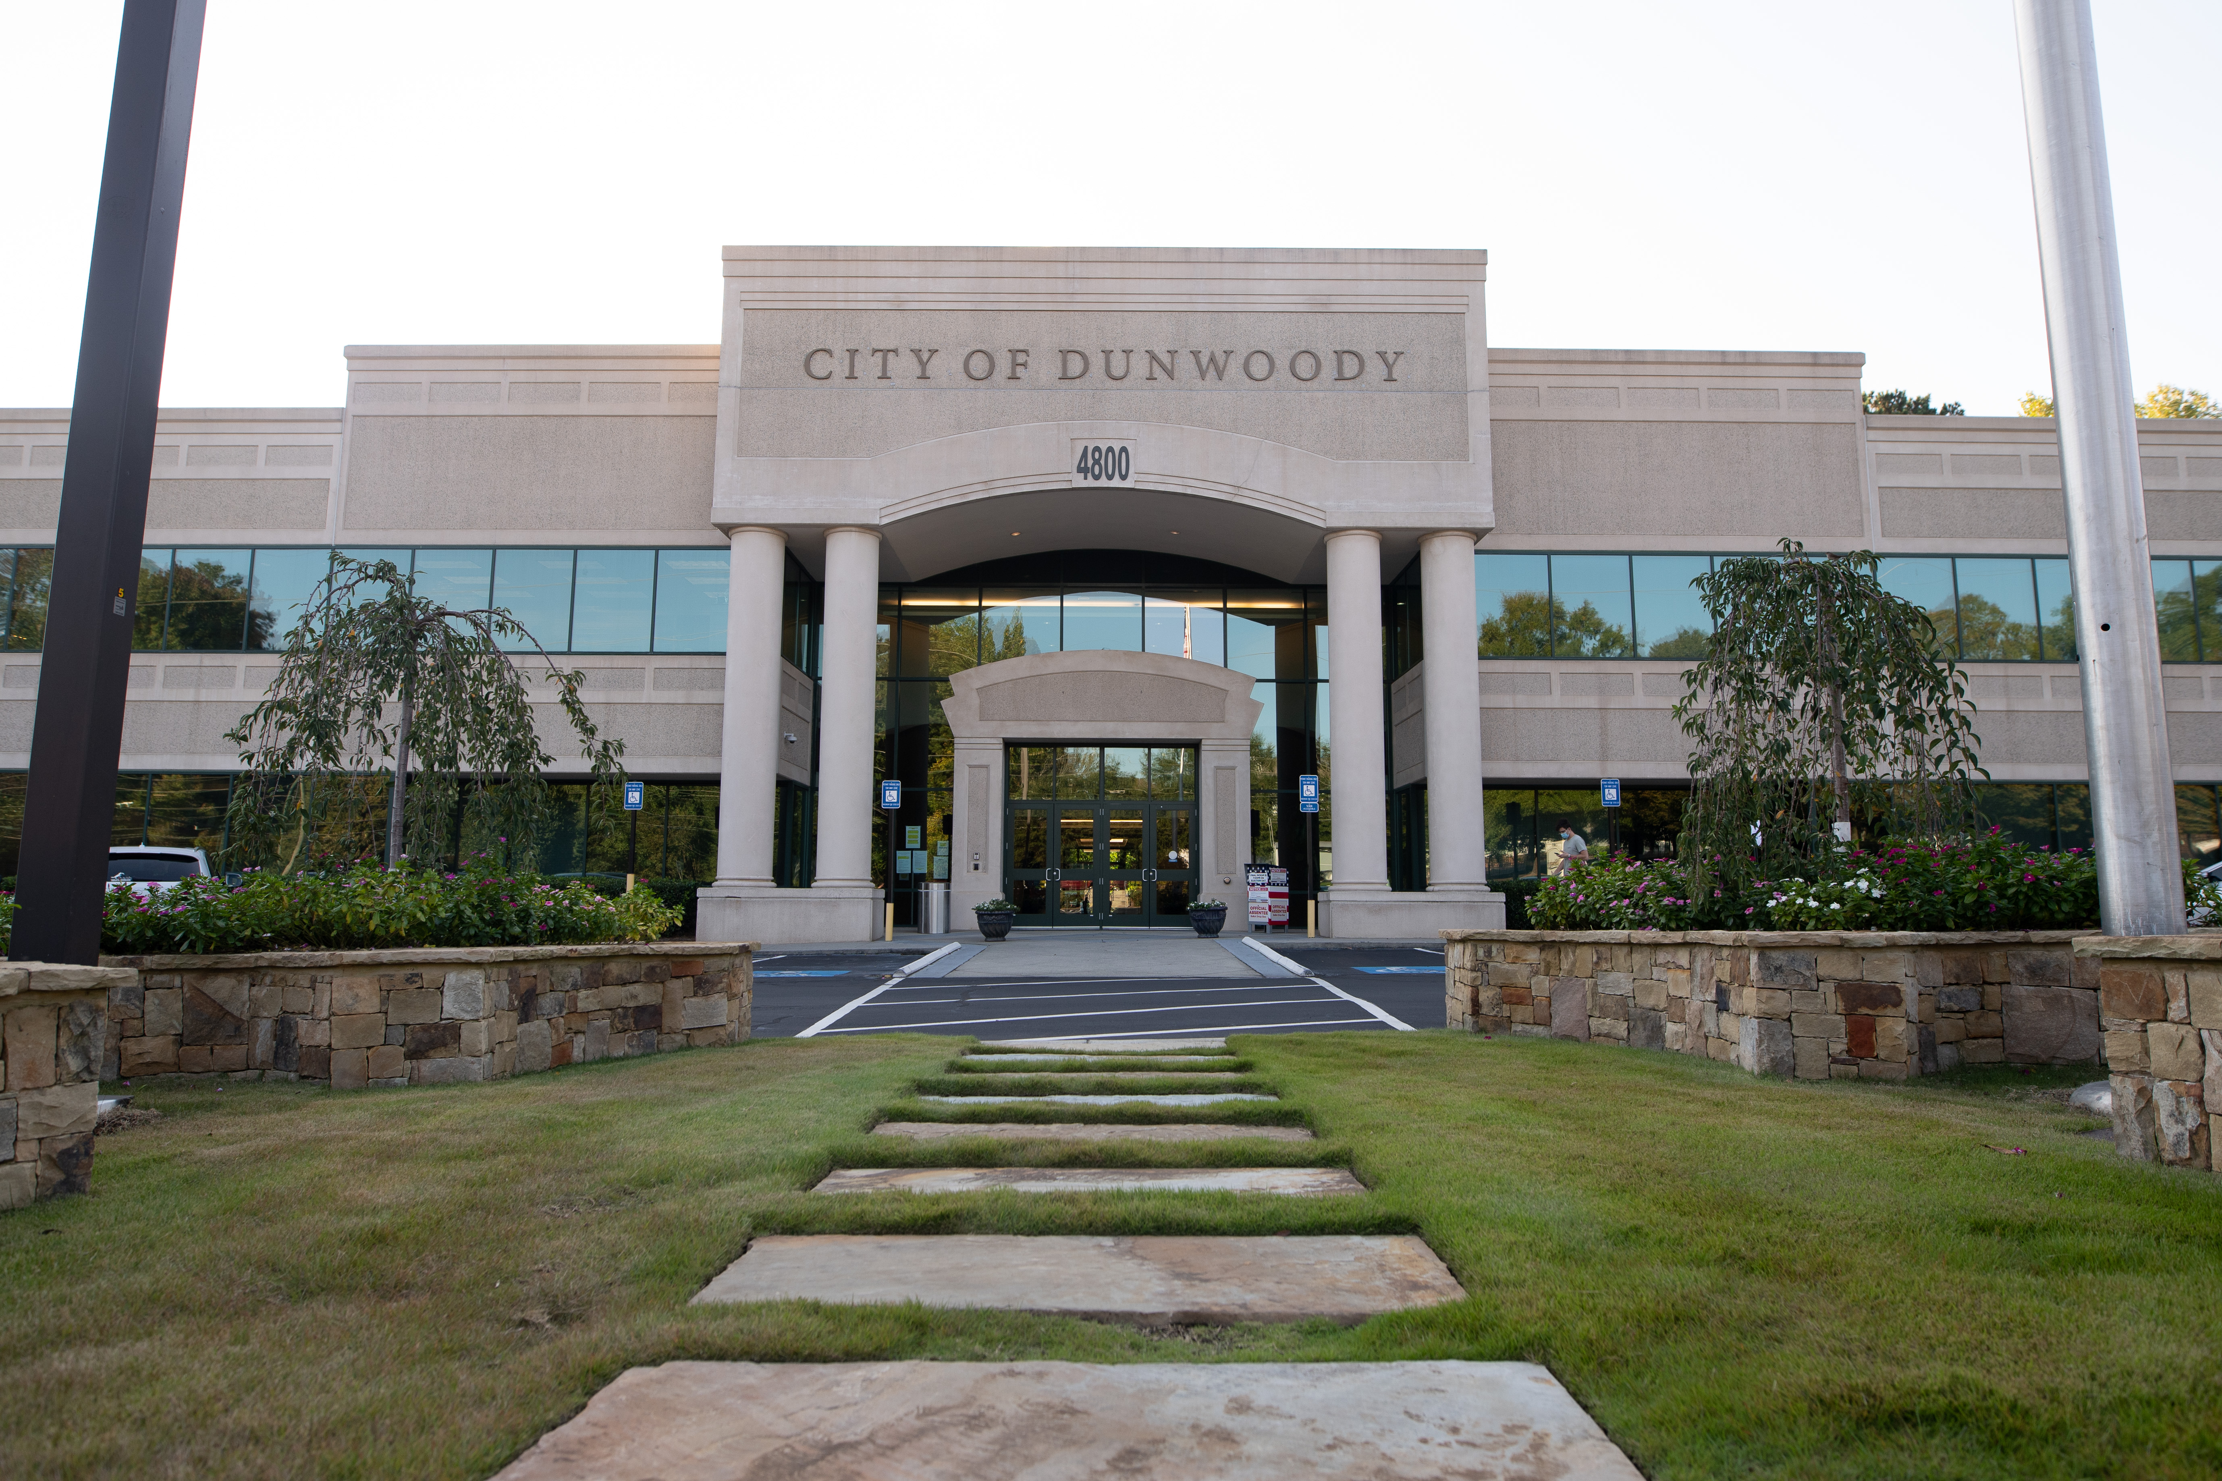
City of Dunwoody / Budget Retreat
Cities Overview
September 30, 2026

Slide 2
Today’s Run of Show
Budgets are boring when most of the discussion goes, “We need $200 worth of postage based on trend data.”
Today’s budget presentation will do 25K level views of departments.
Basically…
  How many people are proposed and who does what.
  Major expenditures on the operating side.
  Comparison against available information from other cities.
The run….
  City data, Police, Parks, Public Works, the rest in size order.

Slide 3

The How to Slice a Pizza Rule
For a great part of this retreat, staff will present comparisons between the City of Dunwoody and nearby jurisdictions. In all cases, the “how to slice a pizza rule” is in effect.
When you slice a pizza, the cut (the comparison) is officially made. A second person can ask for a different direction of cut (again a comparison), but you can’t always glue it back together that easily on the fly.
So, if you want to see a different cut of pizza during the retreat, we ask that you write those cuts down and we’ll get them back to the group post-retreat.

Slide 4
City Comparison
Dunwoody Affluent suburban community anchored by the Perimeter business district, with a strong mix of executive housing, retail, and office employment.
Alpharetta Affluent North Fulton suburb and major corporate/technology hub, combining high-value residential areas with significant employment centers.
Brookhaven Dense, mixed-use inner-ring suburb characterized by established neighborhoods, redevelopment activity, and proximity to Atlanta.
Chamblee Rapidly urbanizing, transit-oriented city with diverse neighborhoods, adaptive-reuse redevelopment, and growing mixed-use employment and residential districts.

Slide 5
City Comparison
Roswell Large, established suburban city with diverse residential areas, major commercial corridors, and a distinctive historic downtown core.
Sandy Springs Major regional employment center with significant office, healthcare, and corporate activity alongside established residential neighborhoods.
Smyrna Established, increasingly urbanized Cobb County suburb with a mix of residential neighborhoods and spin-offs from neighboring development.

Slide 6
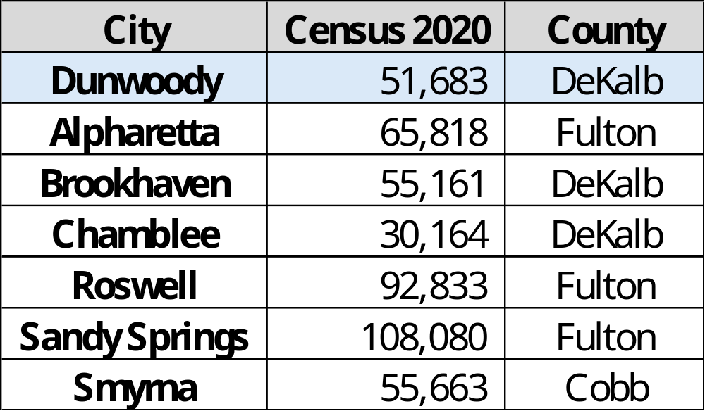
Population

Slide 7
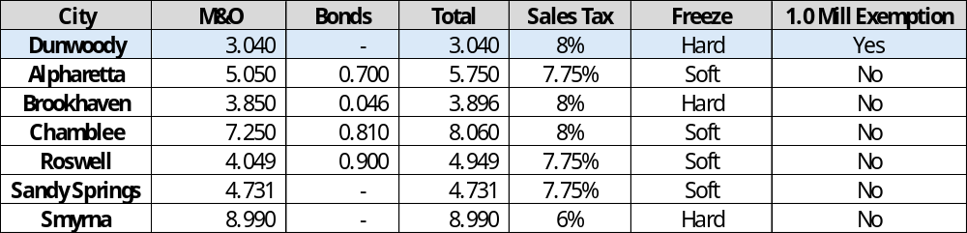
Property and Sales Tax Rates

Slide 8
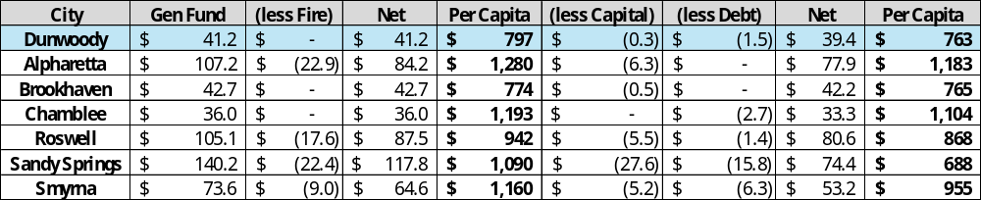
General Fund Budget

Slide 9
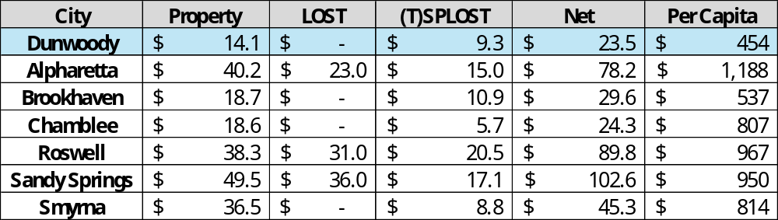
Property, LOST, (T)SPLOST

Slide 10
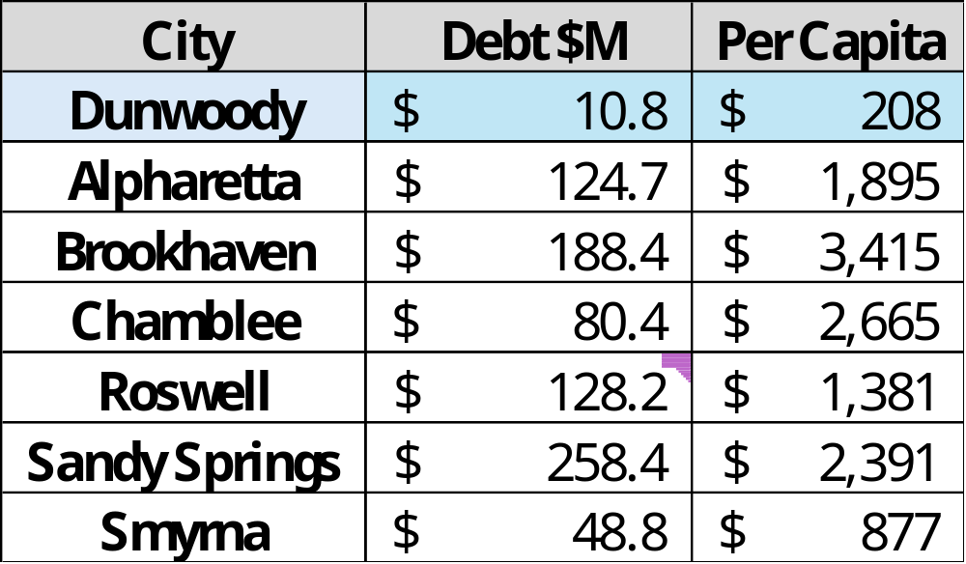
Debt

Slide 11
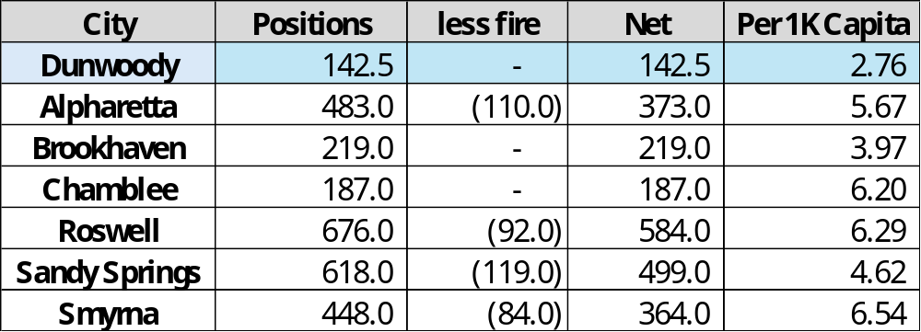
Positions

