Slide 1
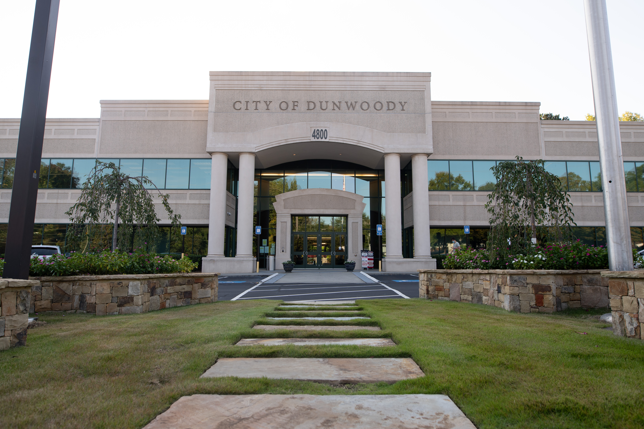
City of Dunwoody / Budget Retreat
Police Department
September 30, 2026

Slide 2
Police Department – Mission Statement
  To protect life and property by upholding the law through fair and impartial policing while being a trusted partner with our community in order to reduce crime and create a safer Dunwoody.

Slide 3
Police Department – Proposed 2027 Budget
Total Budget: $16,234,340
  Personnel Costs: $14,114,010
  Operational Expenditures: $762K
  Property/Liability: $505K
  Repairs and Maintenance Vehicle: $147K
  Gasoline: $240K
  Rentals: $466K

Slide 4
Capital/SPLOST – Proposed 2027 Budget
  Small Equipment: SWAT Helmets X 7 (EOL)-$10,045
  Mach. & Equipment: 6 Explorer Vehicles-$450,000
  Mach. & Equipment: 1 Ford F150 K9-$92,000
  Mach. & Equipment: 1 Surveillance Camera (SIU)-$7,750
  Small Equipment: 8 Gas Masks (EOL)-$6,232
  Infrastructure: PSR Front Desk Reconstruction-$45,000
  Infrastructure: Annex Reconstruction (Evidence Room)-$20,000
  Mach. & Equipment: SWAT EOTECH NVG X 4-$55,613
  *Mach. & Equipment: Motorola N70 Portable Radios-$957,150
  *(Conducting research on dead spots-N70 connects to cell towers)

Slide 5
Police Department Comparisons
Police Departments | 2026 Police Budget | Square Miles | Population | Sworn Positions | Sworn Positions Per 1,000 residents
Dunwoody PD | $14,500,000.00 | 13 | 52,000 | 68 | 1.3
Sandy Springs PD | $33,103,900.00 | 38 | 105,000 | 152 | 1.4
Brookhaven PD | $15,585,350.00 | 13 | 60,300 | 93 | 1.5
Alpharetta PD | $46,500,000.00 | 27 | 67,000 | 113 | 1.7
Chamble PD | $13,689,742.00 | 8 | 32,000 | 74 | 2.3
Roswell PD | $33,000,000.00 | 41 | 47,000 | 167 | 3.6
Smyrna PD | $11,100.000.00 | 15 | 57,000 | 90 | 1.6

Slide 6
Police Department Comparisons
Police Departments | Current Starting Pay
Dunwoody PD | $64,730.00
Sandy Springs PD | $68,216.00
Brookhaven PD | $59,410.00
Alpharetta PD | $61,000.00
Chamble PD | $67,371.00
Roswell PD | $65,582.00
Smyrna PD | $52,454.00

