Slide 1
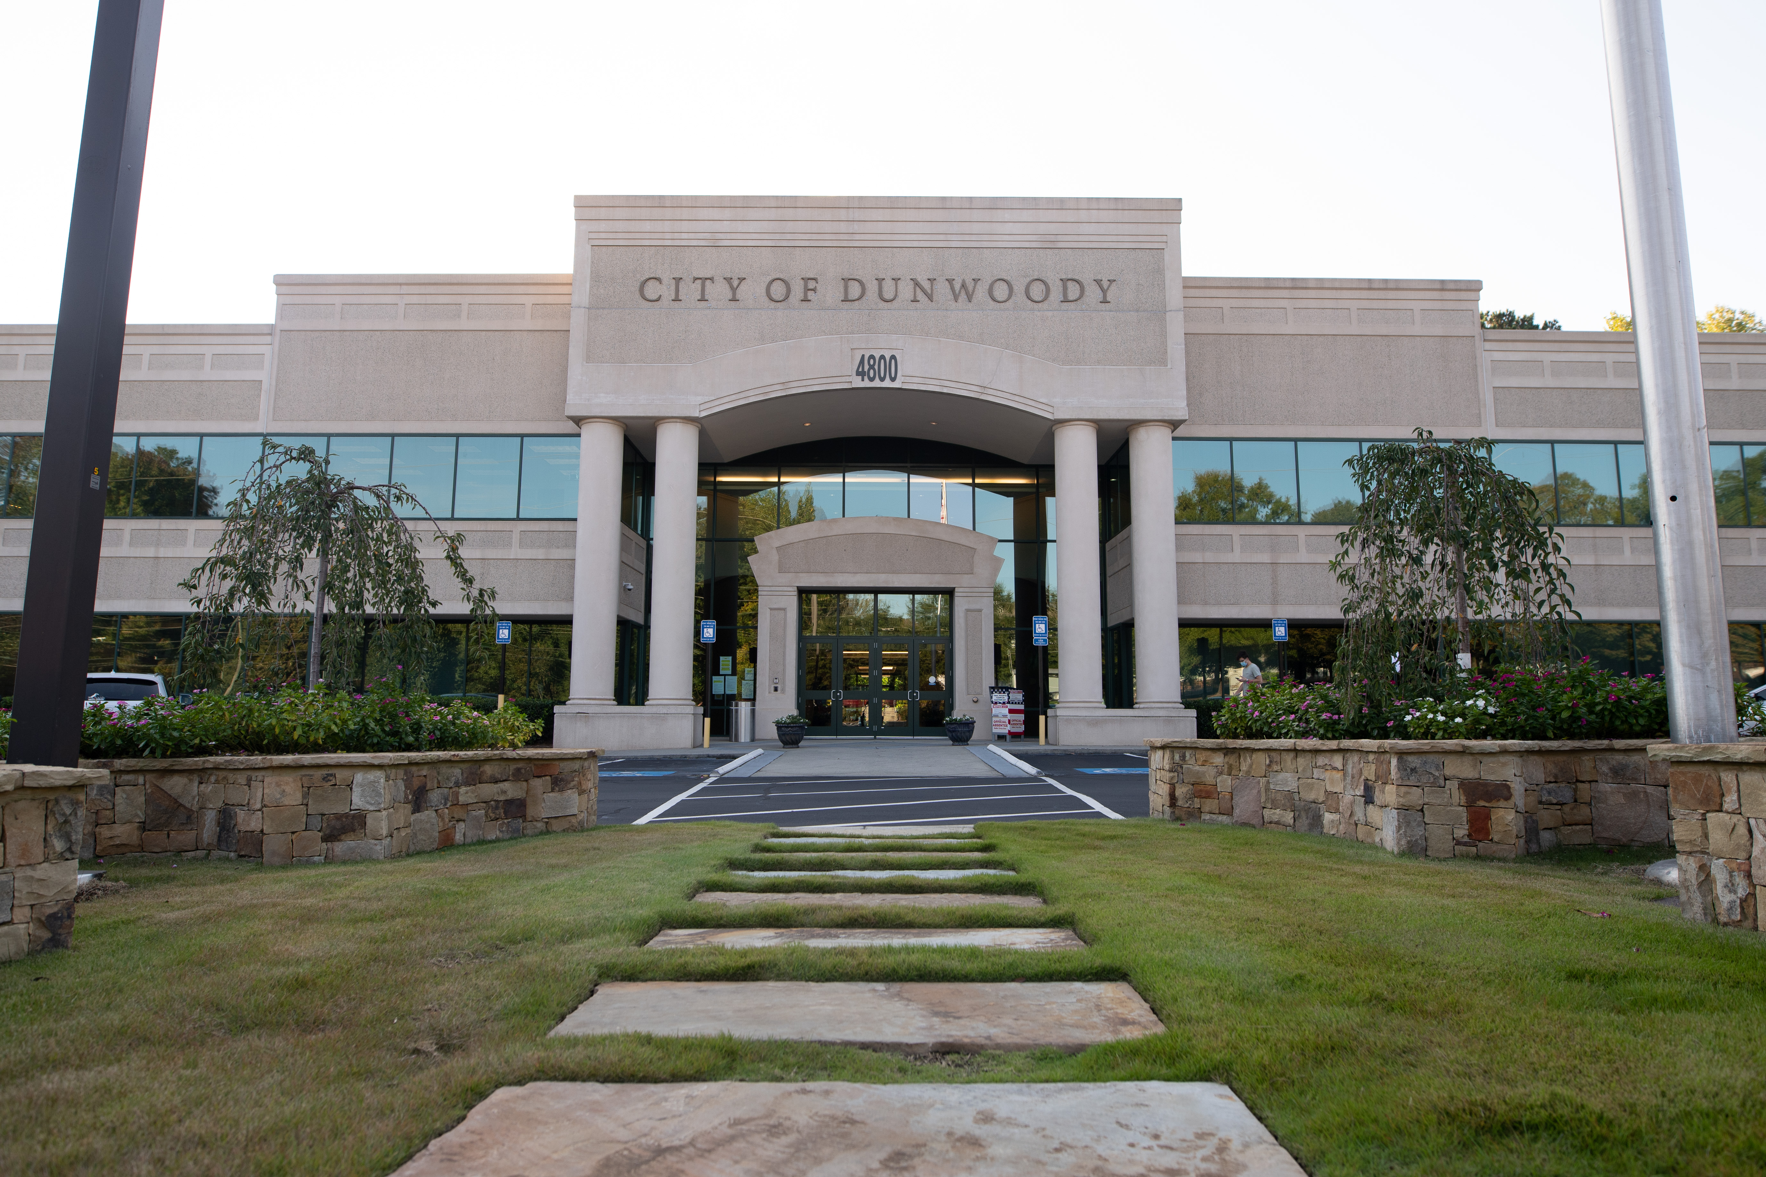
City of Dunwoody / Budget Retreat
Parks and Recreation
September 30, 2026

Slide 2
Parks and Recreation – Mission Statement
To provide essential services, facilities and programs necessary for the positive development and well-being of the community through the provision of parks, greenways, trails and recreational facilities while working in cooperation with other service providers in the community in order to maximize all available resources.

Slide 3
Parks & Rec – Proposed 2027 Budget
Total Budget: $5,056,120
  Personnel Services (1 City, 8.5 Contract): $1,198,405
    Parks and Recreation Director - Oversees parks and facilities operations.
    Recreation Program Manager - Manages seven athletic associations, outside field rentals, and oversees four staff.
    Capital Projects Manager - Manages capital projects, oversees Arts in the Park, and manages community programs.

Slide 4
Parks & Rec – Proposed 2027 Budget
Recreation Coordinator x 2- One focuses on park-hosted community events; one focuses on facility rentals and scheduling.
Grounds Coordinator - Maintains over 200 acres of greenspace and facilities; oversees ground maintenance/TriScapes.
Facilities Coordinator - Maintains 200K+ sq ft of infrastructure; manages 8-10 repair/maintenance requests per day and after hours/emergency calls.

Slide 5
Parks & Rec – Proposed 2027 Budget
Facilities Associate - Supports Facilities Coordinator with Emergency/After Hours Calls, repairs, and maintenance.
Recreation Leader- Supervises various fields, reports maintenance needs, communicates with user groups.
Part-time Recreation Leader - Assists Recreation Leader.

Slide 6
Parks & Rec – Proposed 2027 Budget
Operations - $3,432,415 (200 acres)
  TriScapes Contract (crew of 25): $1,811,485
  Repairs & Maintenance: $906,595
  Utilities: $420,000
  Supplies: $224,375
Facilities: $585,010 (200,000+ sq. ft of infrastructure)
Includes City Hall, Annex, Arts Center, buildings at each park
  Repairs & Maintenance: $375,000
  Utilities: $163,220

Slide 7
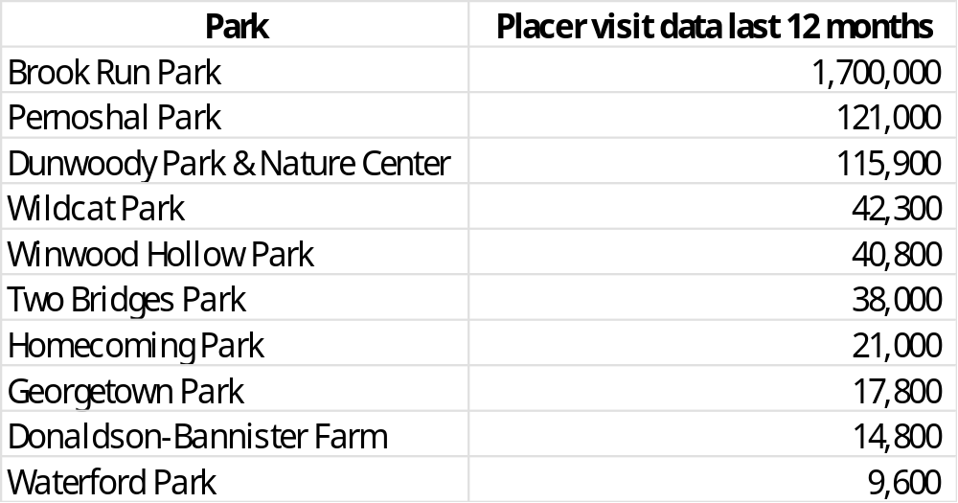
Parks & Rec – Park Visitation

Slide 8
Parks & Rec – General Capital Fund 350
This was a five-year $600K/yr project created in 2023 to repair and improve existing infrastructure.
FY2027 will be its last year of funding.
Before this project existed, repairs and improvements were delayed or not done at all.
If the FY2028 budget doesn’t have a replacement for this fund, staff will prioritize events as able, but it will be a drastic reduction.

Slide 9
Parks & Rec – General Capital Fund 350
Without Fund 350, these projects would not have been completed:
  Stage Door Theatre renovations
  Waterford Park playground
  Middle School resodding & fencing
  Donaldson-Bannister blacksmith shop
  Arts Center wheelchair lift, ADA push buttons
  Pernoshal Trail repairs
  Dunwoody Trailway lighting addition
  Arts Center windows
  Windwood Hollow playground resurfacing
  Arts Center HVAC

Slide 10
Rec Programming – Proposed 2027 Budget
Events: $231,450
  Holiday Lights- $93,000
  Groovin’ on the Green x 4- $38,000
  Pics in the Park x 3- $12,000
  Kids to Parks Day- $10,500
  Truck or Treat- $8,000
  MLK Day of Service
  Veterans Day
  Snap!Dragon’s Garden
  Touch-a-Truck new for 2027
  Memorial Day Ceremony
  Patriotic Concert new for 2027
  Broadway at Brook Run
  Goat Pumpkin Eating

Slide 11
Rec Programming – Proposed 2027 Budget
Programming: $10,000
  Dog Park Valentine’s Photos
  Women’s Health Expo new for 2027
  Georgetown Summer Drop-in
  Basketball tournaments/competitions
  Ride & Seek Art Tours
  Blessing of the Pets/Howling Halloween Photos
  Career Days
  Giveaway days/pop-ups
  Memorial brick and Adopt-a-Bench programs
  Storywalk with Dunwoody Library
  Contracted programs 10-30/season- $5,000

Slide 12
Rec Programming – Proposed 2027 Budget
Art & Placemaking: $44,500-74,500
  Permanent art installations 1-2x/year: $20,000-50,000
  Black History Month murals- $12,250
  Women’s History Month murals- $12,250
  Art for All Reception new for 2027

Slide 13
Parks & Rec Comparisons
City | Staff Size | Dept. Budget | Acres | Parks | Events/Year
Dunwoody | 9 FT + 1 PT | $5M | 202 | 11 | 18
Alpharetta | 22 FT | $15.3M | 775 | 25 | Unknown
Brookhaven | 7 FT | $3.9M | 352 | 19 | Unknown
Chamblee | 5 FT | $1.2M | 106 | 11 | 1
Roswell | 25 FT | $14.4M | 1,000 | 22 | Unknown
Sandy Springs | 13 FT + 50 PT | $5.1M | 253 | 27 | 13
Smyrna | 30 FT + 25 PT + seasonal | $5.2M | 312 | 31 | 14

