Slide 1
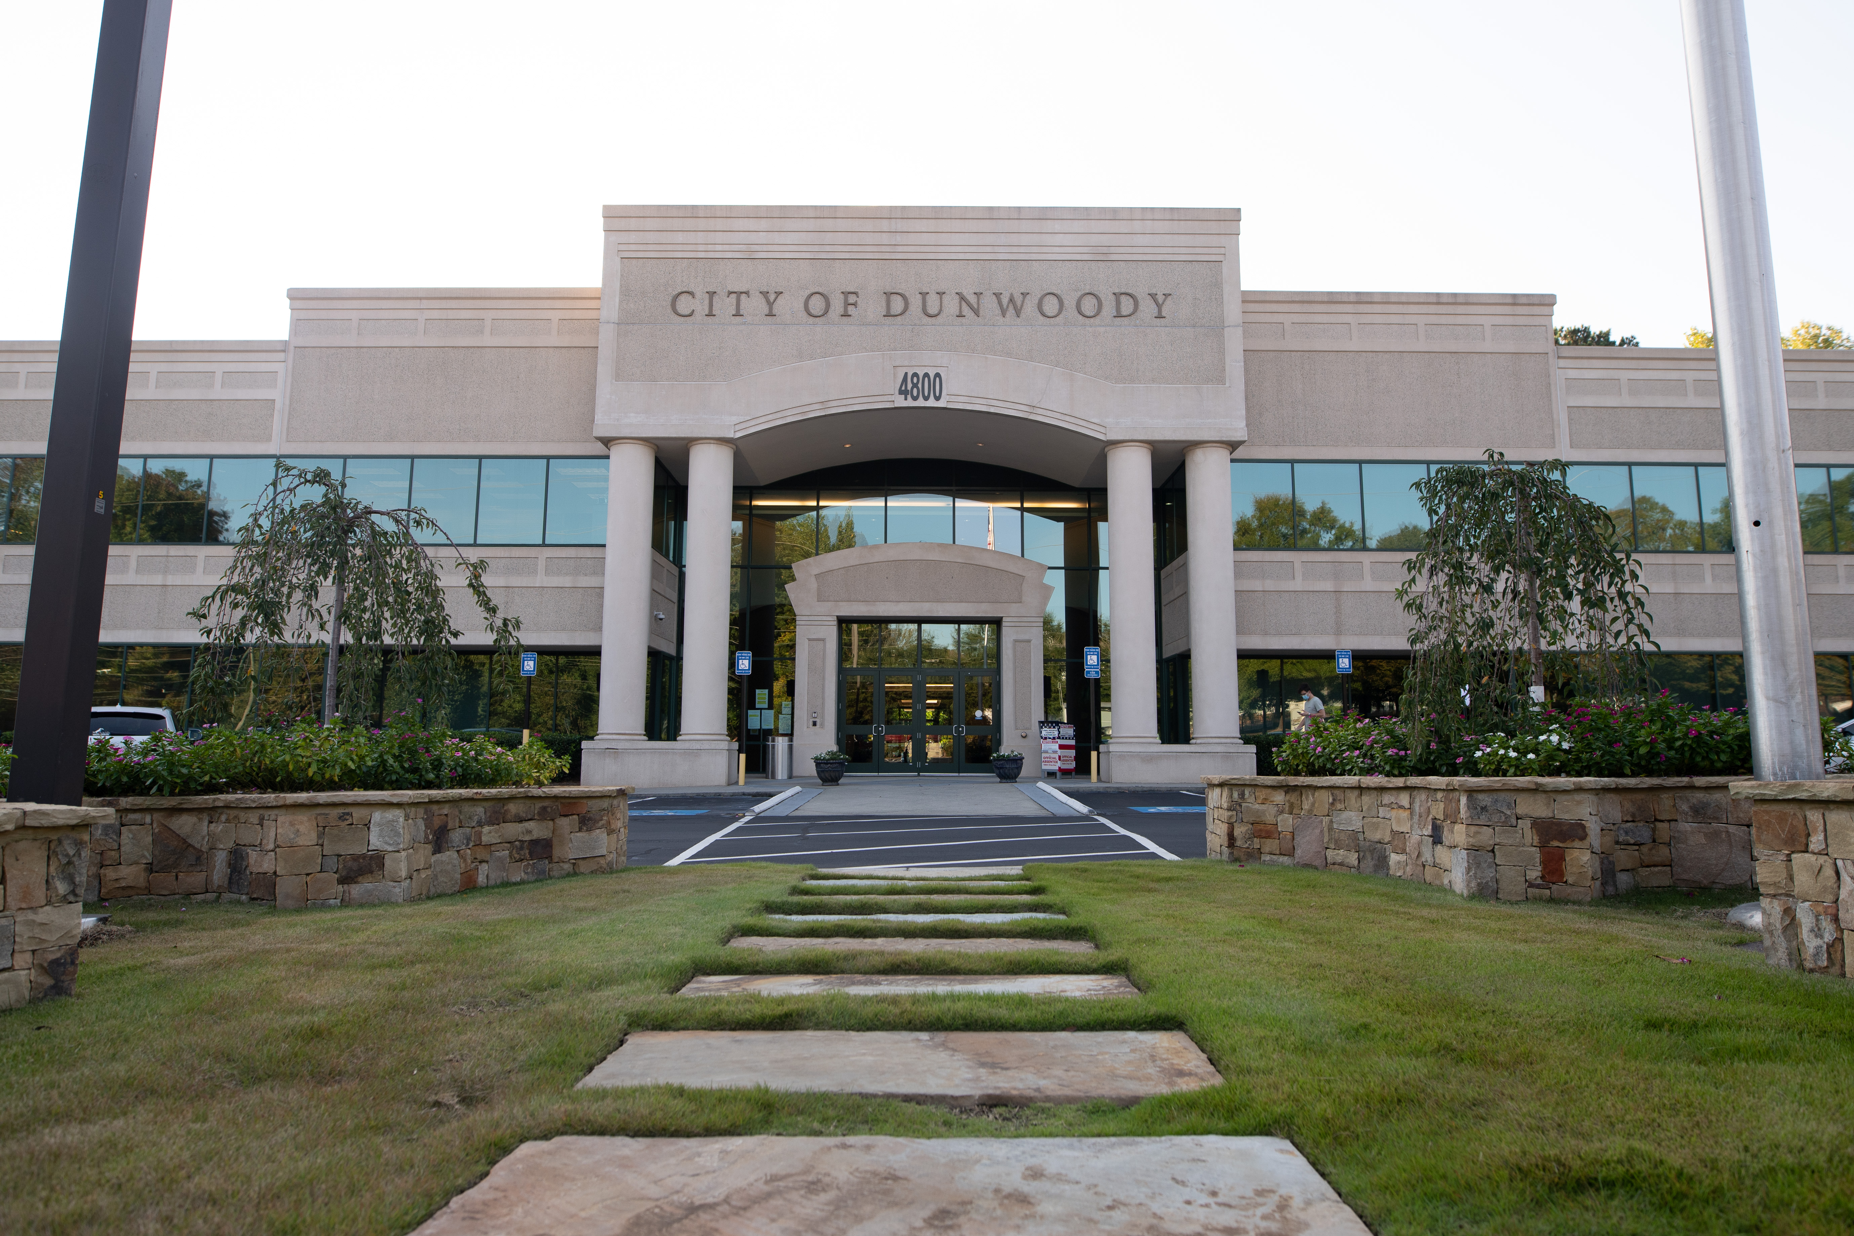
City of Dunwoody / Budget Retreat
Public Works
September 30, 2026

Slide 2
Public Works
Mission Statement
To provide high quality and responsive service to the residents and business owners of Dunwoody, with regard to management, development, safety and maintenance of the City’s roadways and storm water systems.

Slide 3




Public Works- Org. Chart
Headcount
City General Fund: 4.25
Contracted Gen Fund: 2.0
Contracted Strmwtr: 2.75
Maintenance Crews: 14
Capital: 2.5
Director
Michael Smith
Admin. Assist.
Debbie Wright
Intern
Angel Carillo-Valdes
Deputy Director
Michelle Hirose
Maintenance Mgr.
Michael Munson
Traffic Engineer
Eli Veith
Construction Mgr.
Todd Meadows
Capital Projects Mgr.
Tiffany Siegel
Stormwater Mgr.
Cody Dallas
Project Manager
David Ayers
Utility Coordinator
Alex Centis
Project Coordinator
Javier Sayago
Stormwater Eng.
David Elliott
Road/Strmwtr Maint
Triscapes
Field Services Rep.
Alan Christie
Compliance Coord.
Hailey Rinehart
Right-of-Way Maint.
Triscapes
Sign & Signal Maint.
Sunbelt
Part-time Positions
This Photo by Unknown Author is licensed under CC BY-SA-NC

Slide 4
Public Works – Staffing Comparison
Includes all Public Works positions except staff dedicated to Capital Projects
Notes:
Does not include staff dedicated to Capital Projects. Took that out and will present that separately because the size of capital programs by city varies widely.
Chamblee has more field maintenance positions- maintain cemeteries, also has least mileage
Generally 15 to 20 FTEs per 100 miles of roadway with Dunwoody being on the lower end of that

Slide 5
Public Works – Staffing Comparison
Includes all Public Works positions except staff dedicated to Capital Projects
Notes:
Similar story if we compare based on population. Dunwoody is at low end of range

Slide 6
Public Works – Capital Project Staffing
Notes:
Smyrna and Chamblee have a small enough program that it appears to be managed by 1 person. Brookhaven and Dunwoody essentially have the same headcout.

Slide 7
Public Works – 2027 Proposed General Fund
Total General Fund Budget: $3.7 million

Slide 8
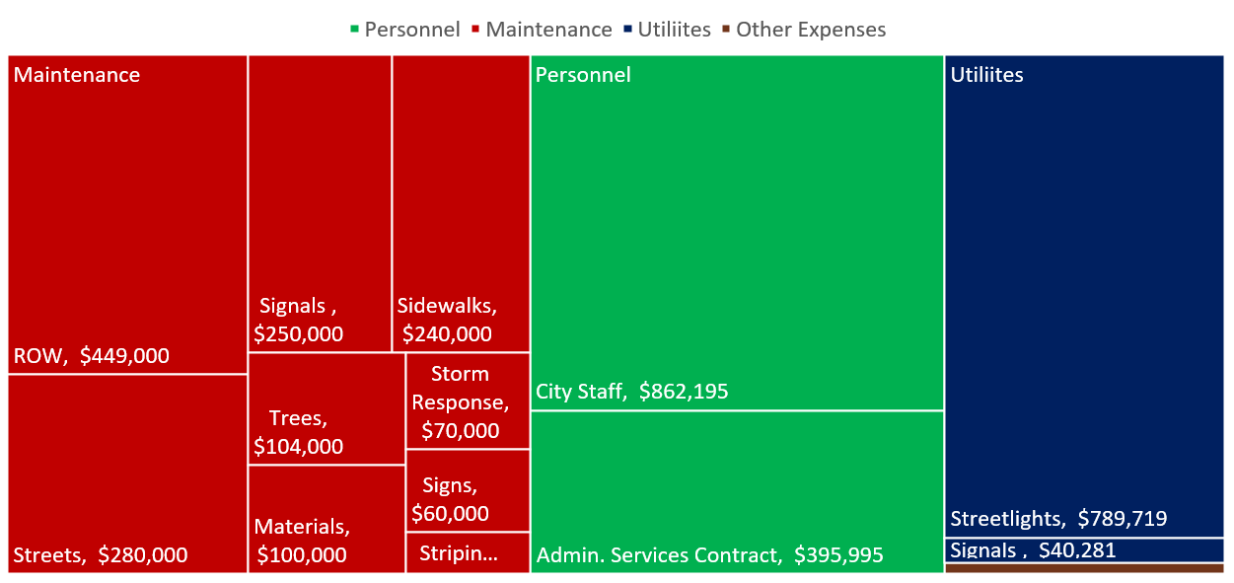
Public Works – Proposed General Fund

Slide 9
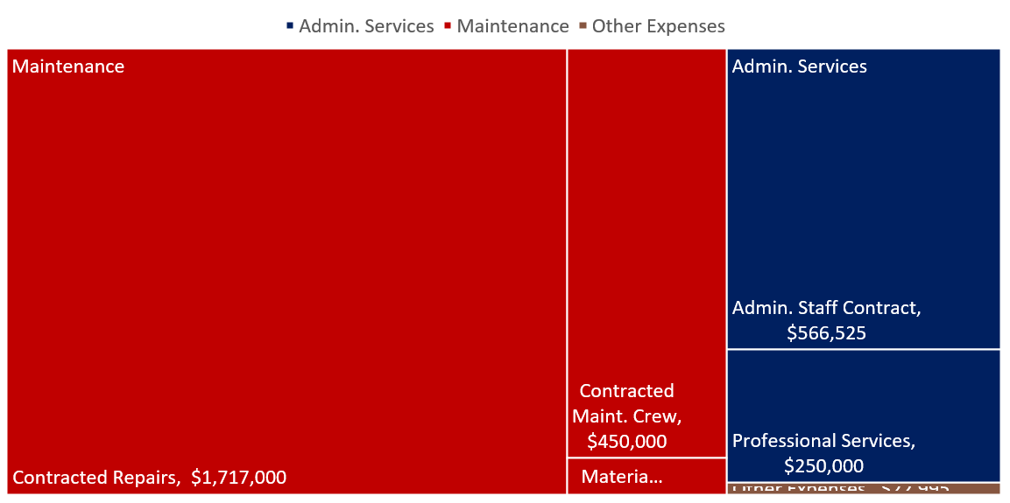
Public Works – Proposed 2027 Stormwater Utility Budget

Slide 10
Public Works – Maintenance Expense History

