Slide 1
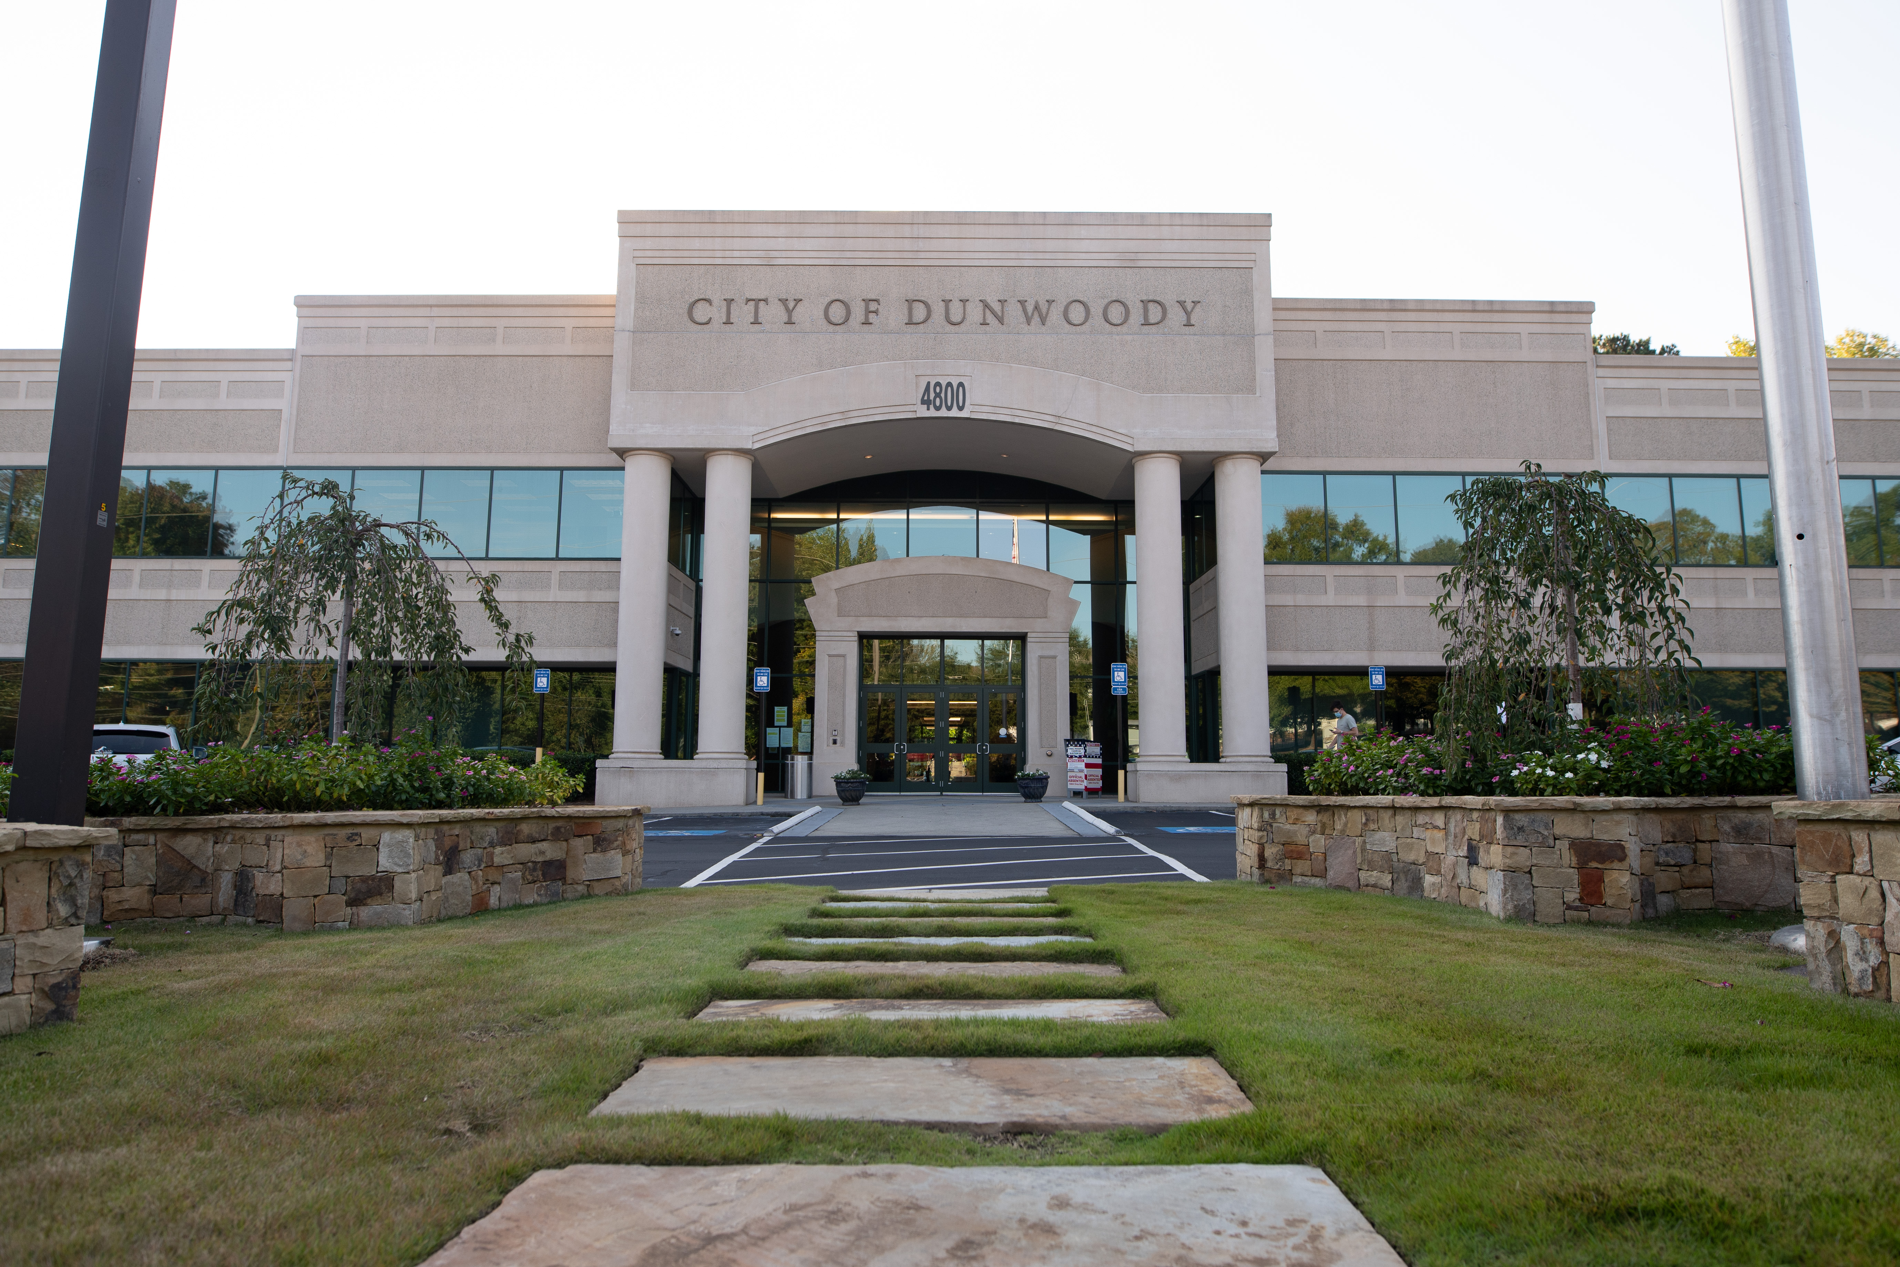
City of Dunwoody / Budget Retreat
Technology
September 30, 2026

Slide 2
Technology – Vision/Mission Statement
Vision Statement: "To provide robust technology solutions that are cost effective, improve the lives of our users, and help the City provide the best service to our citizens."
Mission Statement: "To be a good partner to all City Departments. To enhance productivity using progressive, yet stable, technology infrastructure. To provide leadership in making more cyber secure choices. To assist in selecting integrated technology solutions. To provide fiscally responsible solutions and exceptional service.”

Slide 3
Technology – Proposed 2027 Budget
Total Budget: $3,892,900
  Personnel Services: $1,209,735
    Technology Director
    Technology Manager
    GIS Manager
    Lead Systems Engineer
    Systems Administrator (x2) – 1 on hold
    Technology Support Specialist

Slide 4
Technology Department Responsibilities
Provides secure, reliable, and responsive technology services for all City operations, including Police Department systems;
Manages technology planning, purchasing, implementation, security, infrastructure, applications, networking, cloud services, GIS, project management, and staff support;
Provides hands-on, customer-focused service and training; manages helpdesk requests and escalations; maintains City and Police applications and equipment; conducts security and vendor risk assessments; and works with specialized vendors as needed.

Slide 5
Technology – Proposed 2027 Budget
Total Budget: $ 3,913,702
  1535 Technology: $1,126,233
    Official/Admin Services: $190,980
    Professional Services: $21,185
    Technical Services: $200,233
    Repairs/Maintenance: $390,985
    Communications: $277,000
    Other: $45,850
*1535 Includes:
escalation Services for security, GIS, networking, and cloud
replication and backup
technology infrastructure
cybersecurity tools
primary, secondary, and tertiary internet
access control and camera equipment

Slide 6
Technology – Proposed 2027 Budget
  Total Budget: $3,913,702
    1536 City Departments: $1,304,929
      Technical Services: $53,000
      Repairs/Maintenance: $898,929
      Rentals: $60,000
      Communications: $275,000
      Other: $18,000
*1536 Includes:
cloud storage
shredding
departmental applications
rental printers
phones

Slide 7
Technology – Proposed 2027 Budget
  Total Budget: $3,913,702
    Capital Improvement: $270,000
      Host/SANS
      Annual Laptop Replacements

Slide 8
Important changes:
2025 added Central Square CommDev app, completed Network Refresh
2026 added Council Chambers A/V, Placer AI, GIS Manager, 1536 reduced by $200,000
2027 added Docusign, GovAI, additional printers

Slide 9
Total
Departments: $960,231
Technology: $1,470,930

