Slide 1
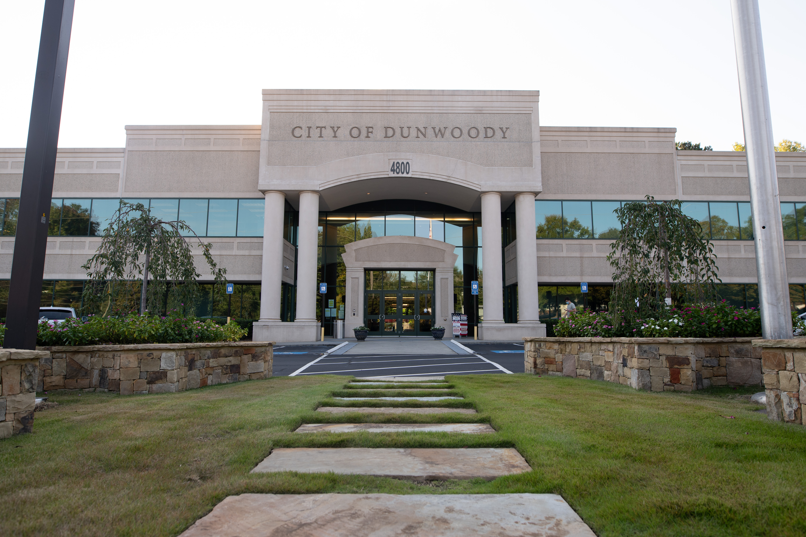
City of Dunwoody / Budget Retreat
Community Development
September 30, 2026

Slide 2
Community Development- Mission
The Community Development Department is responsible for working with the citizens of Dunwoody, Boards and Commissions, the development community and the elected officials while managing current and long-range planning, land development, building construction, and code compliance for the future.

Slide 3
Community Development
Community Development Director
Deputy Community Development Director
Building Official
Code Enforcement Manager
City Engineer
Building Inspector
Permit Technician
Permit Technician
Code Enforcement Officer
Code Enforcement Officer
Senior Planner
Planner
Arborist
Site Inspector

Slide 4
Community Development
Proposed Personnel 2027 Budget
Total Budget: $2,547,510
  City Personnel Services: $1,142,430
    Community Development Director
    Deputy Community Development Director/P&Z Manager
    Senior Planner
    Planner II
    Building Official
    City Engineer
In 2025, Department issued 1,172 permits, completed 4,828 inspections, and investigated 542 code enforcement complaints

Slide 5
Community Development
Proposed Personnel 2027 Budget
Total Budget: $2,547,510
  NOVA contract staff: $1,159,580
    Arborist
    Site Inspector
    Building Inspector
    Permit Technician (2)
    Code Enforcement (3)

Slide 6
Code Enforcement
Protect property values, environment, and public safety by enforcing compliance with the International Property Maintenance Code (IPMC), the city’s zoning laws, tree preservation rules, erosion control, and illicit discharge compliance per GSWCC, and sign ordinances.
The Code Compliance Division is responsible for ensuring that all existing residential and non-residential structures and premises are safe and secure according to the City of Dunwoody’s Zoning and some Building Code Standards
Dunwoody Multi-Family Code Compliance proactive policy. Exterior Inspections: Conducted by city's Code Compliance Team

Slide 7
Code Enforcement
Property Maintenance (Residential & Commercial)
Erosion control and illicit discharge
Overgrown grass/weeds
Trash and Accumulation
Swimming pools
Inoperable/Junk vehicles
Off-street parking

Slide 8
Code Enforcement
RVs and Trailers
Sign regulations
Fences
Short term rentals/party houses
Noise ordinance
Investigation and legal process
Enforce when business fail to obtain Occupational Tax Certificate

Slide 9
Fire Marshal/Fire Inspector
Lack of communication with DeKalb County fire marshal.
We cannot issue permits until the fire marshal signs off. The fire marshal is very slow in getting the plans reviewed and approved and it puts us out of compliance with a advertised time frame.
Inspections for alarm, fire suppression, fire rated construction, ADA.
Lack of follow through on fire activities.
Special events/film and tents inspection is slow or non responsive.
Annual fire inspections of businesses.

Slide 10
Community Dev – Quick Comparison
Number of community development staff and personnel cost.
City | Department Staff Size | Code Enforcement Staff Size | Dept. Budget | Population
Dunwoody | 14 | 3 | $2,291,425 | 51,638
Alpharetta | 31 | 6 | $4,739,003 | 65,818
Brookhaven | 27 | 4 | $3,031,289 | 55,161
Chamblee | 22 | 5 | $2,662,463 | 32,251
Roswell | 36 | 10 | $4,104,305 | 92,833
Sandy Springs | 48 | 8 | $4,200,000 | 108,080

