Slide 1
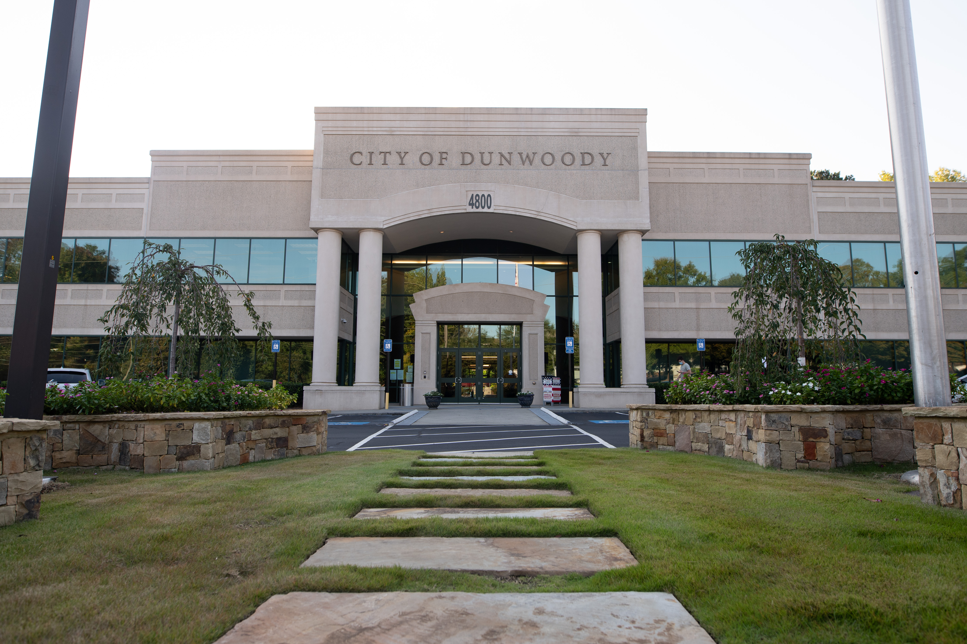
City of Dunwoody / Budget Retreat
Finance
September 30, 2026

Slide 2
Mission Statement - Finance
Finance Department Mission Statement:
  To safeguard and optimize the City’s financial resources through transparent, accountable, and efficient fiscal management by delivering accurate and timely financial and administrative services that strengthen public trust and promote long-term financial sustainability.

Slide 3
Finance – Proposed 2027 Budget
Total Budget: $2,245K
  Personnel Services: $1,592K
    Department positions (10 total):
      Finance Director
      Assistant Finance Director
      Accounting Manager
      Accountant (2)
      Revenue Accountant
      Business License Specialist (2)
      Purchasing Manager
      Purchasing Coordinator

Slide 4
Finance – Proposed 2027 Budget
Leadership – Finance Director and Assistant Finance Director
  Provides strategic leadership in budgeting, accounting, investment, debt management, purchasing, and revenue collection, ensuring financial compliance and accurate reporting.
Accounting – Accounting Manager and Accountant (2)
  Ensures the accuracy of all financial transactions of the City. Main functions include accounting, reporting, accounts payable, payroll, fixed assets, grant accounting, completion of internal and external audits, and annual financial statements.

Slide 5
Finance – Proposed 2027 Budget
Revenue Collection – Revenue Accountant and Business License Specialist (2)
  Tracks, records, and reports on the City’s incoming funds. Main functions include managing the business and alcohol licensing process (new and renewal), record daily cash receipts, credit card payments, and checks, manage accounts receivable, and external and internal audit preparation.
Procurement – Purchasing Manager and Purchasing Coordinator
  Manages the procurement process to ensure applicable laws, rules, regulations, policies, procedures, and City ordinances are followed. Main functions include managing the bid process, prepare and award contracts, monitor vendors and contracts, and administer the purchase card program.

Slide 6
Finance – Proposed 2027 Budget
Total Budget: $2,245K
  Operations: $653K
    Property/Liability Insurance - $211K
    Retirement Advisor - $78K
    Dues & Fees - $69K
    External Audit - $63K
    Payroll Fees - $51K

Slide 7
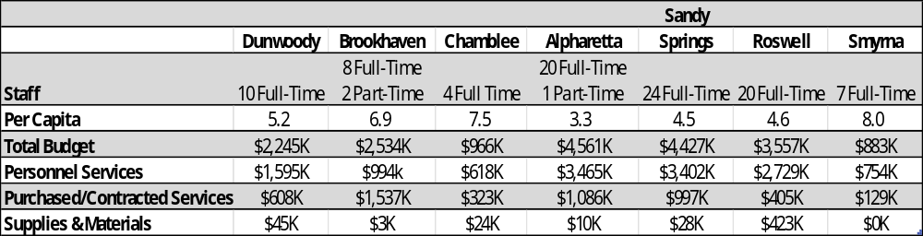
Finance – Quick Comparison

