Slide 1
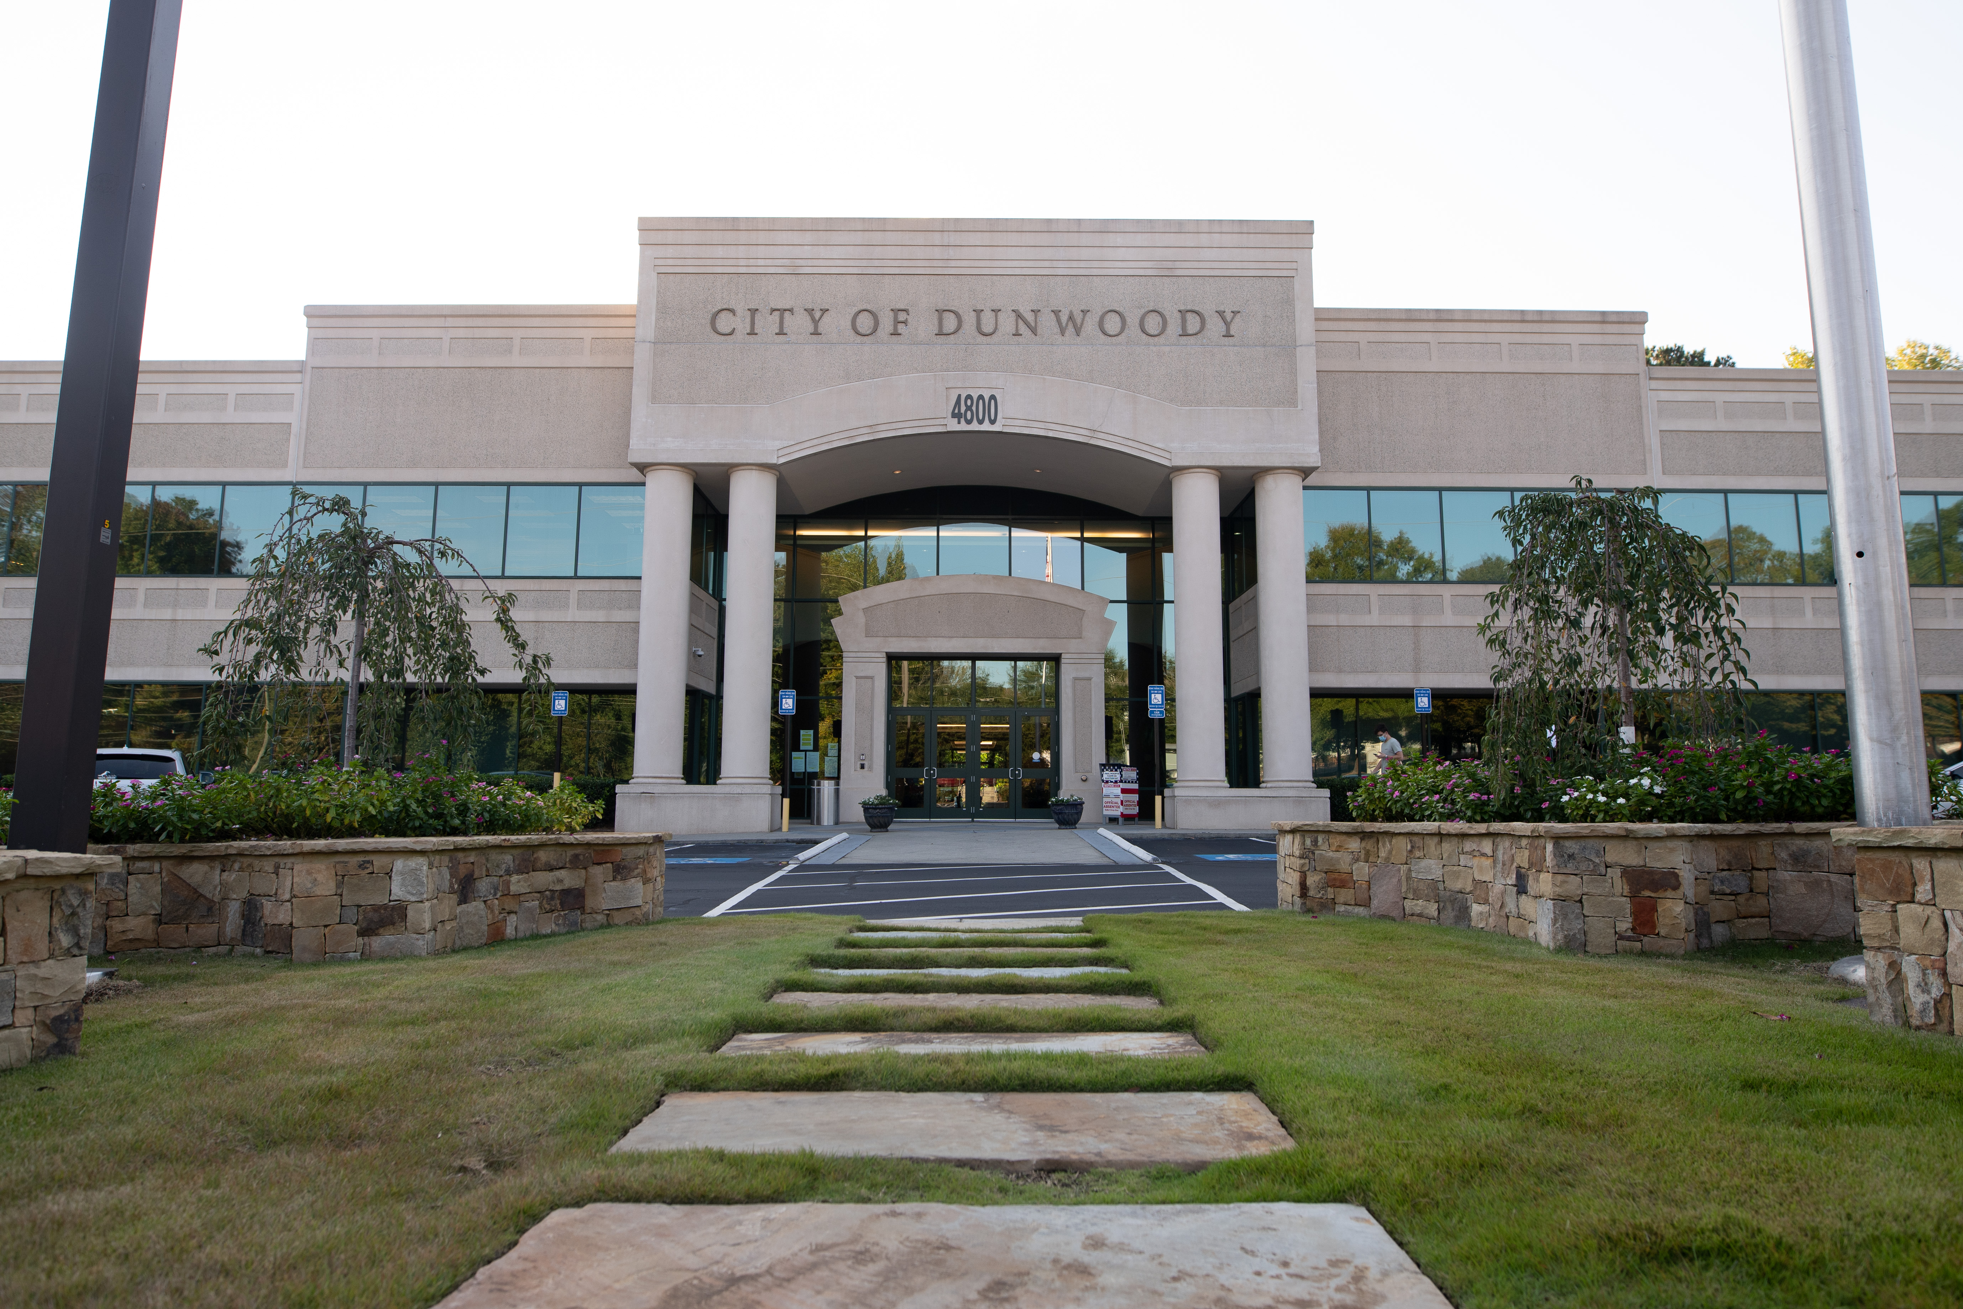
City of Dunwoody / Budget Retreat
City Manager’s Cost Center
September 30, 2026

Slide 2
City Manager – Mission Statement
To develop a responsive, dynamic, representative local government organization that continually assesses its purpose and seeks the most effective and efficient techniques and technologies for serving the community.

Slide 3
City Manager – Proposed 2027 Budget
Total Budget: $1.18M
  Personnel Services: $1.15M (96.6% of budget)
    City Manager
    Assistant City Manager
    Risk Manager
    Executive Assistant to Mayor and City Manager
    Front Desk Receptionist
  Operations $17K (1.5% of budget)
  City Contingency $10K (0.8% of budget)

Slide 4
City Manager– Quick Comparison
Alpharetta
  Combines City Manager (3 pos.), City Clerk (2), Communications (2), and Economic Development (3) in one cost center. (10 total.)
  $3.2M budget
    $2.2M personal services
    $1.1M operations (IT, web hosting, etc.)
Brookhaven
  6.5 positions, City Manager, Deputy CM, Assistant CM, Dir Strategic Partnership, Program Administrator/Grants, Administrative Asst (Front Desk Reception), Intern
  $1.5M budget
    $1.2M personal services
    $228K operations (contracted services, etc.)

Slide 5
City Manager– Quick Comparison
Chamblee
  City Manager, Deputy CM, Budget & Strategy Manager, Executive Asst, Spec Projects Manager, Management Analyst (6 total)
  $1.4M budget
    $1.0M personal services
    $527K operations ($278K one-time costs)
Roswell
  Combines Law, City Council, Clerk, Court, HR, etc. Approx 78.
  $6.2M budget
    $3.6M personal services
    $2.6M operations. ($990K legal, $980 other prof srvc, $324K IT charges.)

Slide 6
City Manager– Quick Comparison
Sandy Springs
  City Mgr, Asst CM (x2), Executive Proj Mgr
  $1.3M budget
    $1.3M personal services (96.7% of budget.)
    $44K operations (3.2% of budget.)
Smyrna
  Combines City Admin, Dep CA, Community Services Admin, City Clerk, Spec Project Manager, Deputy City Clerk, Admin Coor, City Attorney, ICMA Fellow, City Hall Receptionist.
  $1.0K budget
    $888K personal services
    $150K operations.

