Slide 1
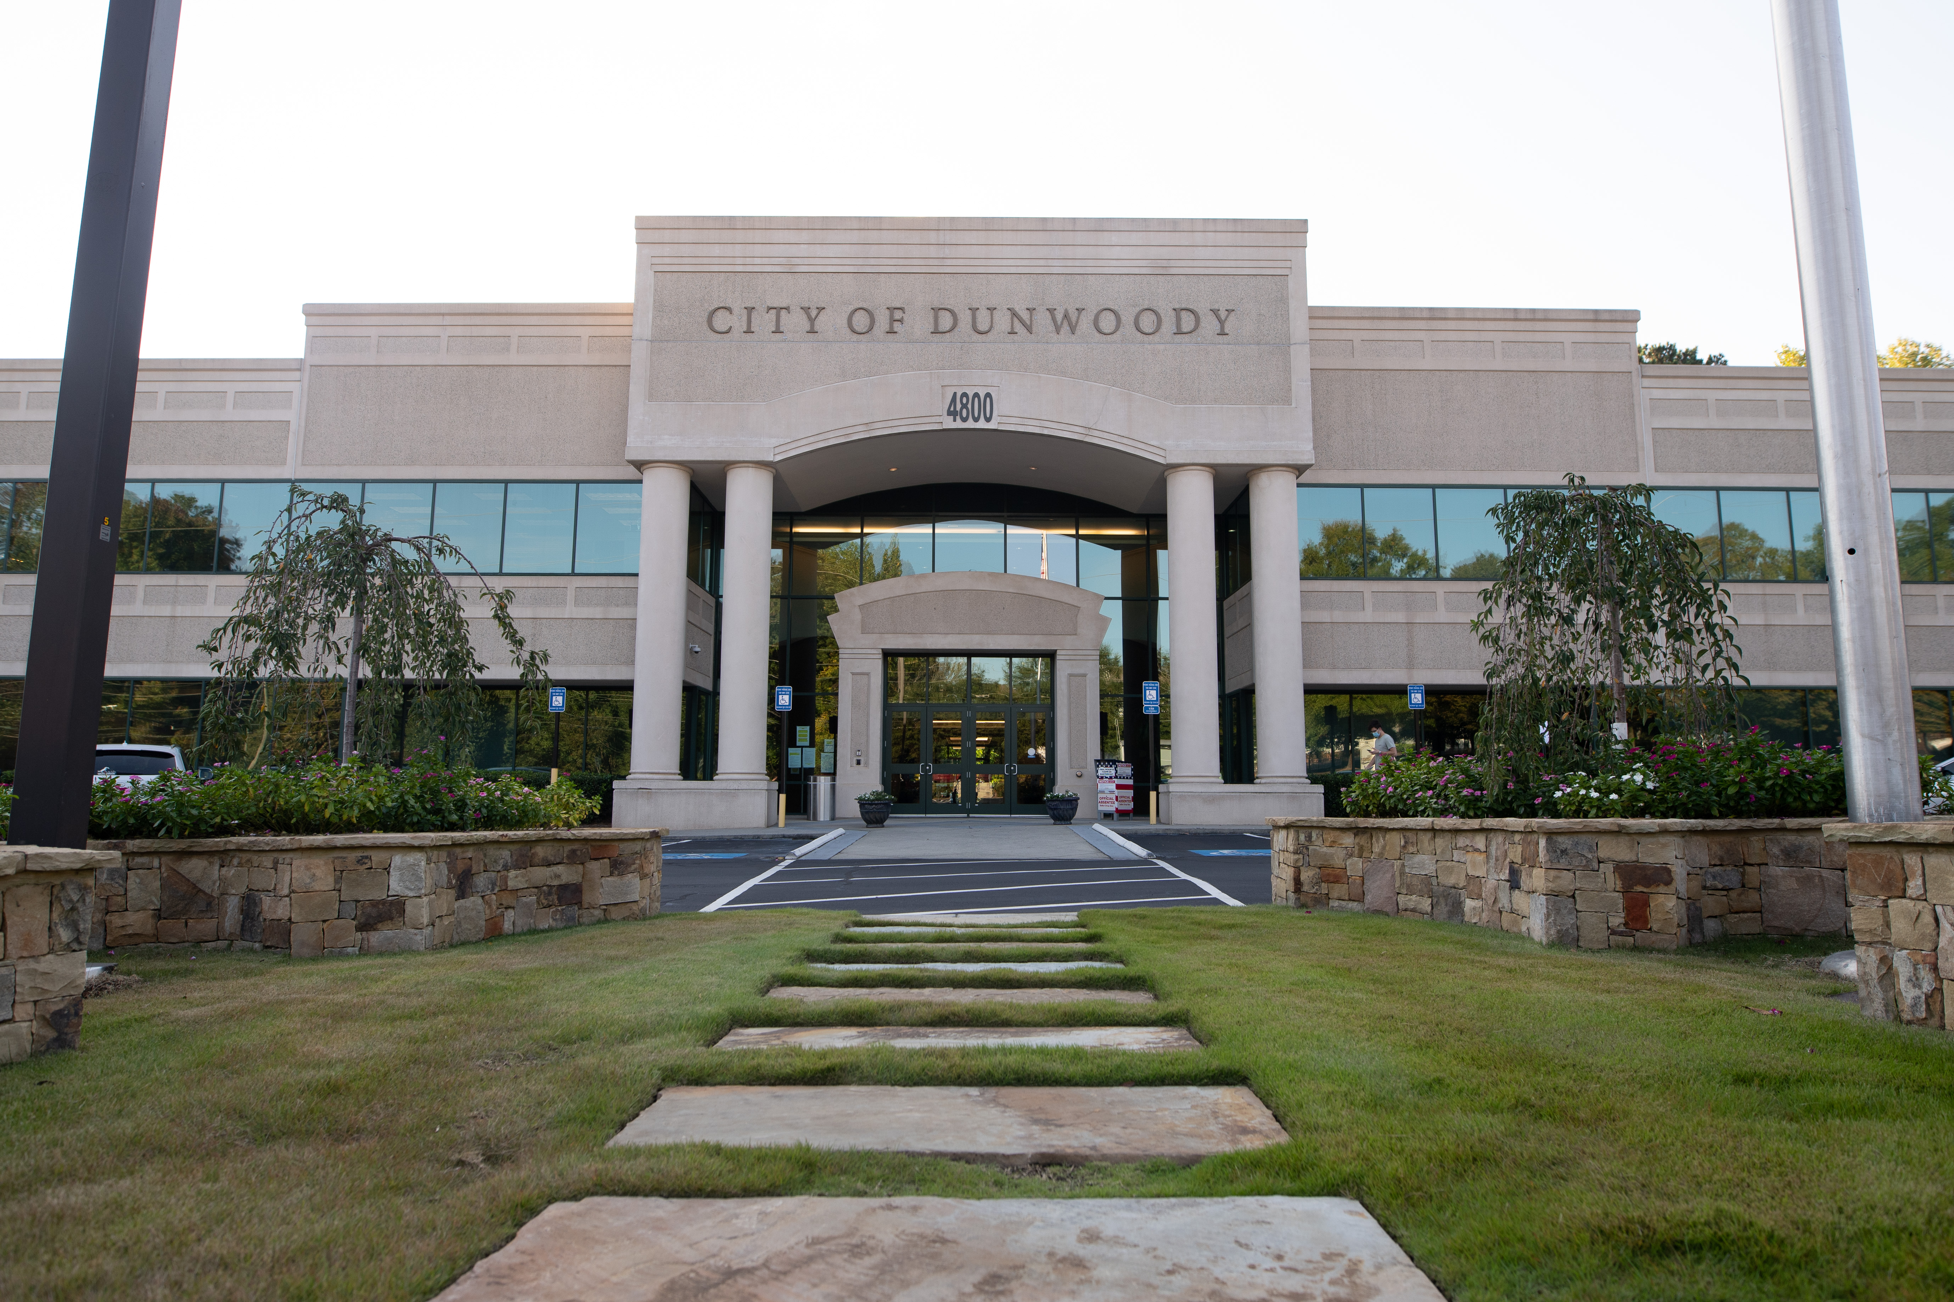
City of Dunwoody / Budget Retreat
Municipal Court
September 30, 2026

Slide 2
Municipal Court Mission Statement
The City of Dunwoody Municipal Court is committed to delivering fair, impartial, and timely adjudication of all citations and cases that come before us. We serve our community with integrity, professionalism, and respect, ensuring every individual is treated equally under the law. We are dedicated to maintaining transparency in our processes and decisions, fostering public trust and confidence in the administration of justice. Our mission is to uphold justice, promote accountability, and support the safety and well‑being of all who live, work, and travel in the City of Dunwoody.

Slide 3
Municipal Court Staff
1 Court Clerk
3 Deputy Clerks
1 Chief Judge
4 Associate Judges
5 Solicitors
1 Public Defender
1 Spanish Interpreter

Slide 4
Municipal Court
The Municipal Court has responsibility for the following:
Accurate processing, reporting, and recordkeeping of all citations and cases adjudicated by the Court.
Providing customer service to the public, assisting with fines, court dates, and case inquiries.
Supporting judges, solicitors, and the public defender through case management, calendars, and courtroom workflow.
Processing and reporting all dispositions, including state traffic convictions to DDS and criminal history data to GCIC, within mandated timeframes.
Preparing monthly state agency reports.
Managing GSCCCA‑required surcharges to ensure all fines and fees are handled and disbursed according to law.
Processing Failure to Appear cases and submitting required DDS notifications.
Maintaining all court records.

Slide 5
Municipal Court – Proposed 2027 Budget
Total Budget: $842,290
Professional Services – 5 Solicitors $150,240
Professional Services – 5 Judges $86,000
Technical Services – Spanish and various language interpreters $32,360
Professional Services – 1 Public Defender $13,000
Education, Training, Dues and Fees – 4 Clerks and 5 Judges $9,480
  Includes court clerks and judges annual mandated training and membership dues and fees

Slide 6
Municipal Court – Quick Comparison
City | Per Capita Population | Clerk Positions | Budget (2027) | Annual Citations | Court Sessions/ week
Dunwoody | 51683 | 4 | 843,395 | 8,500 | 3
Alpharetta | 65818 | 5.5 | 1,454,654 | 11,000 | 3
Brookhaven | 55161 | 5.5 | 863,000 | 7,700 | 4
Chamblee | 31164 | 5 | 800,000 | 7,200 | 3
Roswell | 92833 | 5 | 1,079,427 | 8,500 | 6
Sandy Springs | 108080 | 10 | 1,843,700 | 12,500 | 4

