Slide 1
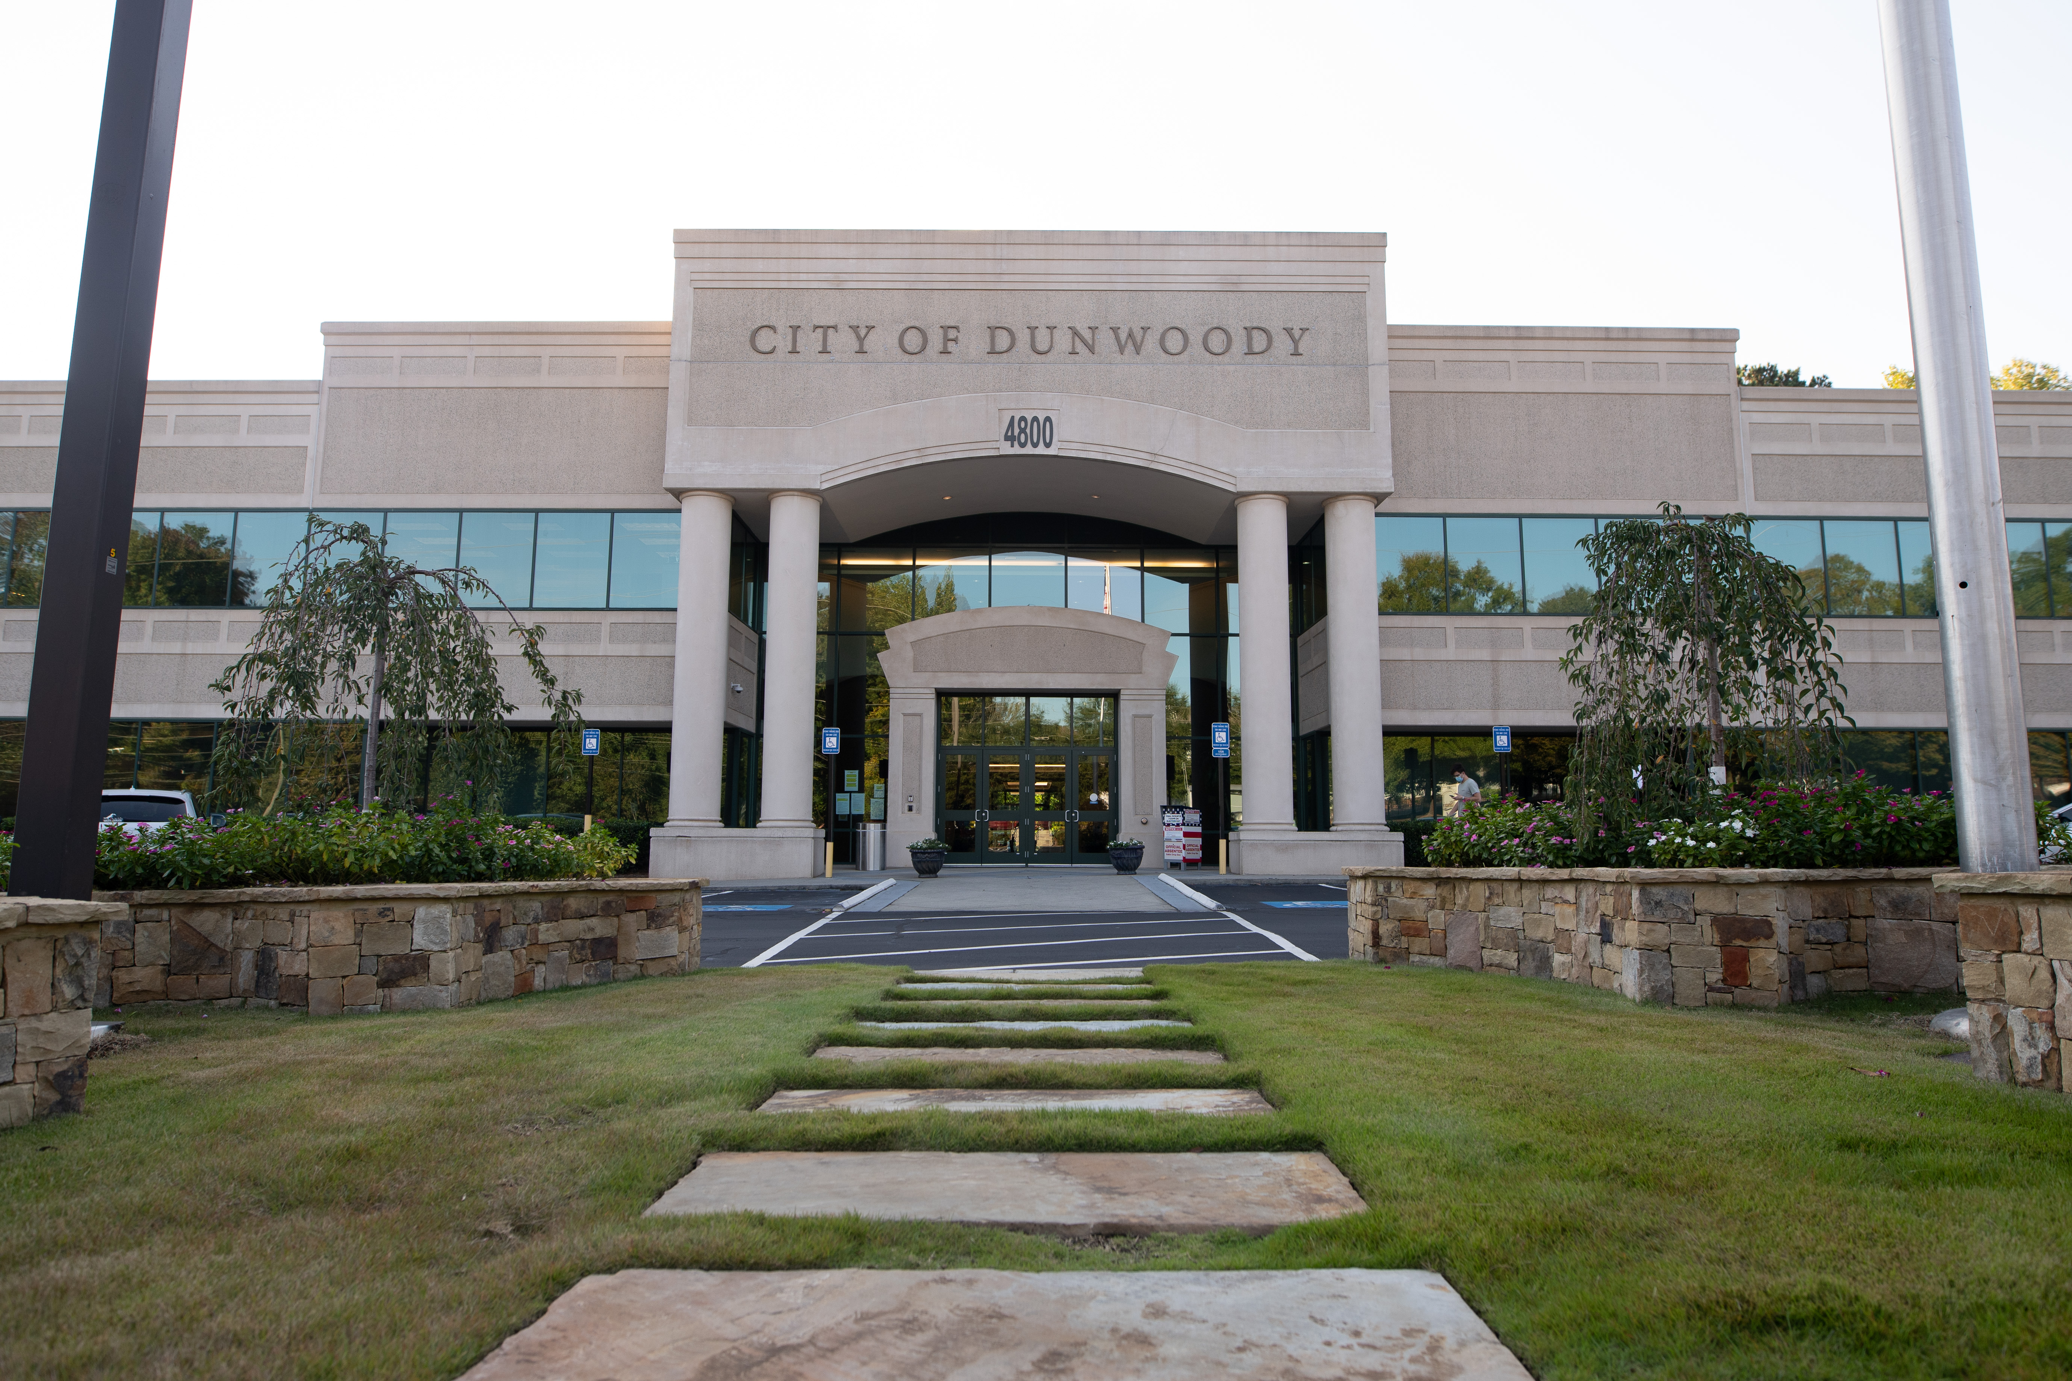
City of Dunwoody / Budget Retreat
Human Resources
September 30, 2026

Slide 2
Human Resources Mission Statement
The Human Resources Department is responsible for providing support to department managers and employees regarding employment, training, employee relations, benefits, and compensation in order to attract, develop, motivate, and retain a diverse workforce within a supportive work environment.

Slide 3
Human Resources
Total Budget: $639,480
Human Resources Director
Human Resources Manager
Human Resources Generalist

Slide 4
Human Resources
The HR team has responsibility for the following:
  Recruitment (inc. PD file reviews) and onboarding
  Benefits administration
  Compensation administration
  Employee relations (inc. investigations)
  Training (inc. annual EEO training)
  Performance management
  Policy administration and legal compliance (inc. Employee Handbook updates at least annually)
  Leave administration (inc. workers’ comp; STD; LTD; FMLA; military leave)
  Wellness program administration (in house program; no vendor)
  HRIS administration

Slide 5
Human Resources
All three positions share the HR responsibilities to varying degrees.
The HR Generalist is generally the first point of contact for leave administration, as well as the initial candidate point of contact for recruitment, and the Chair of the Wellness Committee.
The HR Manager and HR Director spend more time on compensation and benefits administration, as well as employee relations, performance management, policy administration, and legal compliance.

Slide 6
Human Resources – Proposed 2027 Budget
Total Budget: $639,480
  Wellness Program: $20,600
    Angioscreens, biometric screenings, hearing screenings, flu shots, presentations, employee events, and wellness challenges
  Education and Training: $12,000
    Includes City-wide employee education assistance and continuing professional education for HR
  Recruitment advertising: $10,000
    Advertising for open positions, including field-specific professional membership job postings and a LinkedIn account to increase overall visibility
  Other Operating Costs: $24,035
    Includes compensation consultant, legal training costs, legal policy reviews, employee assistance program (EAP), applicant tracking system, employment background checks, and Paycom file feeds

Slide 7
Human Resources – Quick Comparison
City Name | HR Positions | Budget | City Employees | Employee to HR Ratio
Dunwoody | 3 | $639,480 | 142.5 | 47.5
Alpharetta | 5 + 4 | $1,194,219 | 483 | 96.6 / 53.7
Brookhaven | 4 | $763,246 | 219 | 54.8
Chamblee | 3 | $635,167 | 187 | 62.3
Roswell | 9.5 | $944,424 | 676 | 71.2
Sandy Springs | 5 | $1,131,100 | 618 | 123.6
Smyrna | 6 | $1,255,474 | 448 | 74.7

