Slide 1
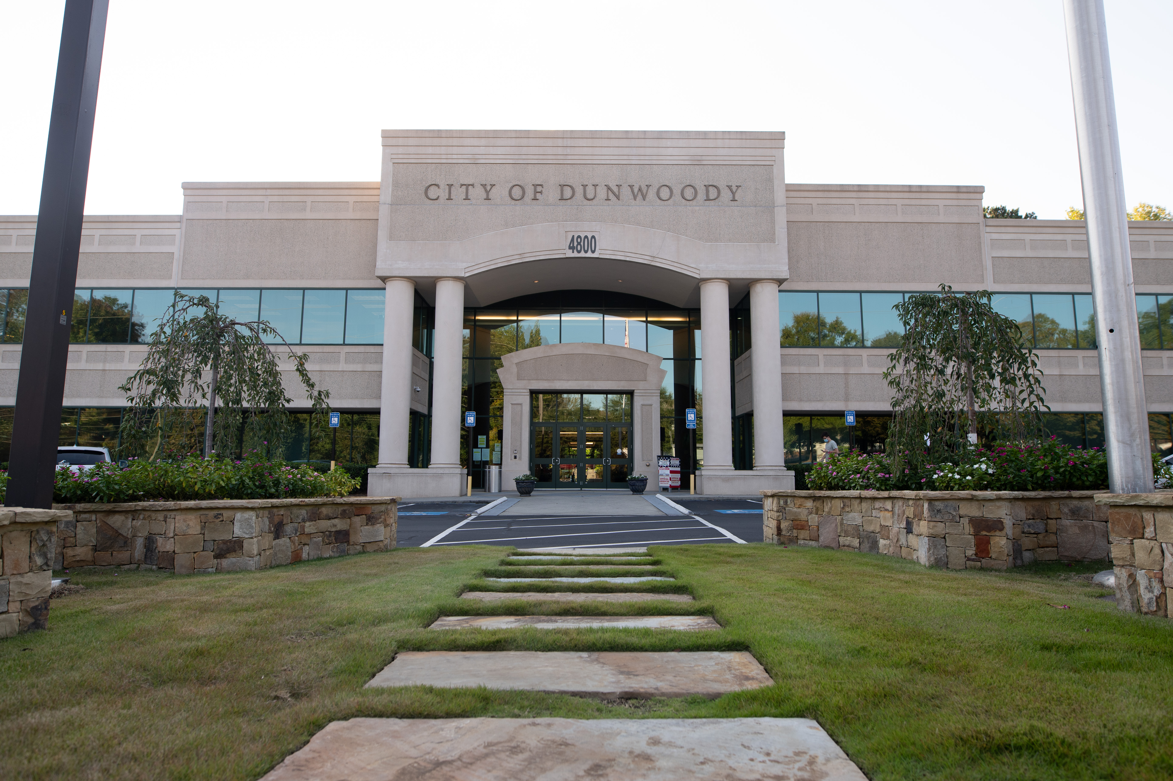
City of Dunwoody / Budget Retreat
City Clerk
September 30, 2026

Slide 2
City Clerk Mission Statement
To assist the citizens and staff of the City of Dunwoody by providing prompt, courteous, and professional service that facilitates the transparent flow of information between the City, its citizens, and its stakeholders. This department manages agendas and minutes for the City Council as well as City boards and commissions. It also maintains organized and accurate records of all contracts, agreements, resolutions, ordinances, and other documents relevant to the City of Dunwoody.

Slide 3
City Clerk
Total Budget: $ 617,955
City Clerk
Deputy City Clerk
Records Clerk
  Professional Services: $102,500
    General Election and possible Runoff Election (DeKalb County) and Code of Ordinance supplements
  Repairs and Maintenance: $20,000
    Open records software and online Code of Ordinance administration
  Other Operating Costs: $16,600
    Includes advertising for November 2027 General Election, millage rate, and other unforeseen ads, travel for staff for training, dues and fees for professional organizations, training for staff

Slide 4
City Clerk
The City Clerk’s Office has responsibility for the following:
      Keeper of the city seal and city records
      Notice of city council and various board meetings to media
      Agenda preparation and publishing
      City council meeting summaries and minutes
      Submitting adopted ordinances to Municipal Code for codification
      Processing open records requests
      Records management
      Contract management
      Election duties and responsibilities

Slide 5
City Clerk
The City Clerk and Deputy City Clerk share the City Clerk responsibilities, for the most part. Both assist with processing open records requests as needed
The Records Clerk processes all open records requests

Slide 6
City Clerk – Quick Comparison
City | Staff Size | Dept. Budget (FY)
Dunwoody | 3 | $617,955 (2027)
Alpharetta | 3 | $611,608 (2027)
Brookhaven | 2.5 | $318,258 (2026)
Chamblee | 3 | $1,037,510 (2026)
Roswell | Unknown | Unknown
Sandy Springs | 3 | $697,700 (2027)
Smyrna | 4 | Included in Administration and Governing Body budgets

Slide 7
City Clerk
Open Records:
Estimated number of requests – 6,000/year
Estimated cost per request - $39.70 = $238,173/year
2025 open records request revenue - $772
2026 open records request revenue - $1,707

