Slide 1
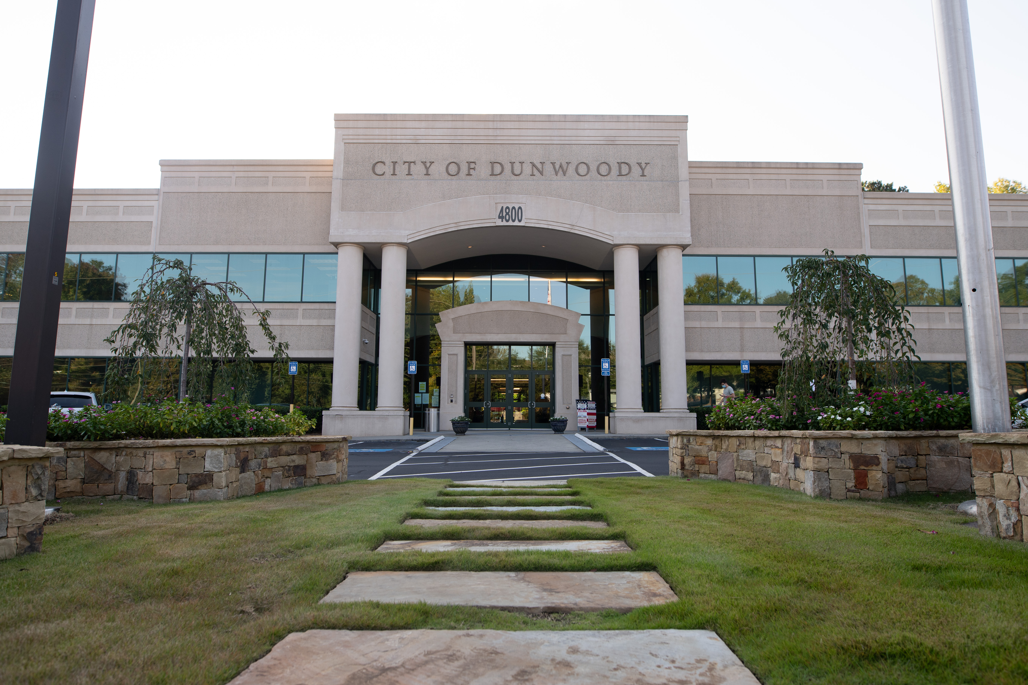
City of Dunwoody / Budget Retreat
Economic Development
September 30, 2026

Slide 2
Economic Development – Mission
The Economic Development Department advances the City’s economy through business attraction and retention, strengthening our five commercial districts, guiding strategic redevelopment efforts, and investing in placemaking that enhances Dunwoody's identity, quality of life, and long-term vibrancy.

Slide 3
Eco. Dev. – Proposed 2027 Budget
Total Budget: $587,580
  Director of Economic Development
  Business Retention & Cultural Affairs Manager
Operations: $134,500
  Professional Services – Public Art: $50,000
  Professional Services – Create Dunwoody: $35,000
  Advertising: $29,000
  Dues & Fees, Food, Education & Travel: $20,500
Placemaking is 63% of Operations Budget

Slide 4
Dev. Authority– Proposed 2027 Budget
Total Budget: $78,800
  Professional Services – Create Dunwoody: $35,000
  Professional Services: $20,000
  Dues & Fees, Food, Education & Travel: $17,000
  Technical Services – CoStar, LOCI: $6,800
The Development Authority is a net investor of funds to the City.
  Provided Cash Grants to TriNet and Hapag-Lloyd
  Continued investment in Create Dunwoody
  Focus on Dunwoody Village ULI Plan and other Commercial Districts
Placemaking is 45% of budget

Slide 5
Economic Development – Responsibilities
Promote Cross-ecosystem Collaboration
Business Formation & Recruitment
Business Retention & Expansion
Place Transformation & Redevelopment
Placemaking & Public Art
Branding & Marketing

Slide 6
Economic Development – Responsibilities
City Committees
  Dunwoody Development Authority
  Dunwoody Art Commission
  Urban Redevelopment Agency
Community Boards
  Create Dunwoody
  Greater Perimeter Chamber
  Leadership Perimeter
  Access Georgia Foundation

Slide 7
Eco. Dev. – Quick Comparison
CITY | POSITIONS
Dunwoody | 2
Alpharetta | 3
Brookhaven | 1
Chamblee | 2
Roswell* | 1 + 5
Sandy Springs | 2
Smyrna | 2
* 1 City position and 5 Roswell Inc. positions

