Slide 1
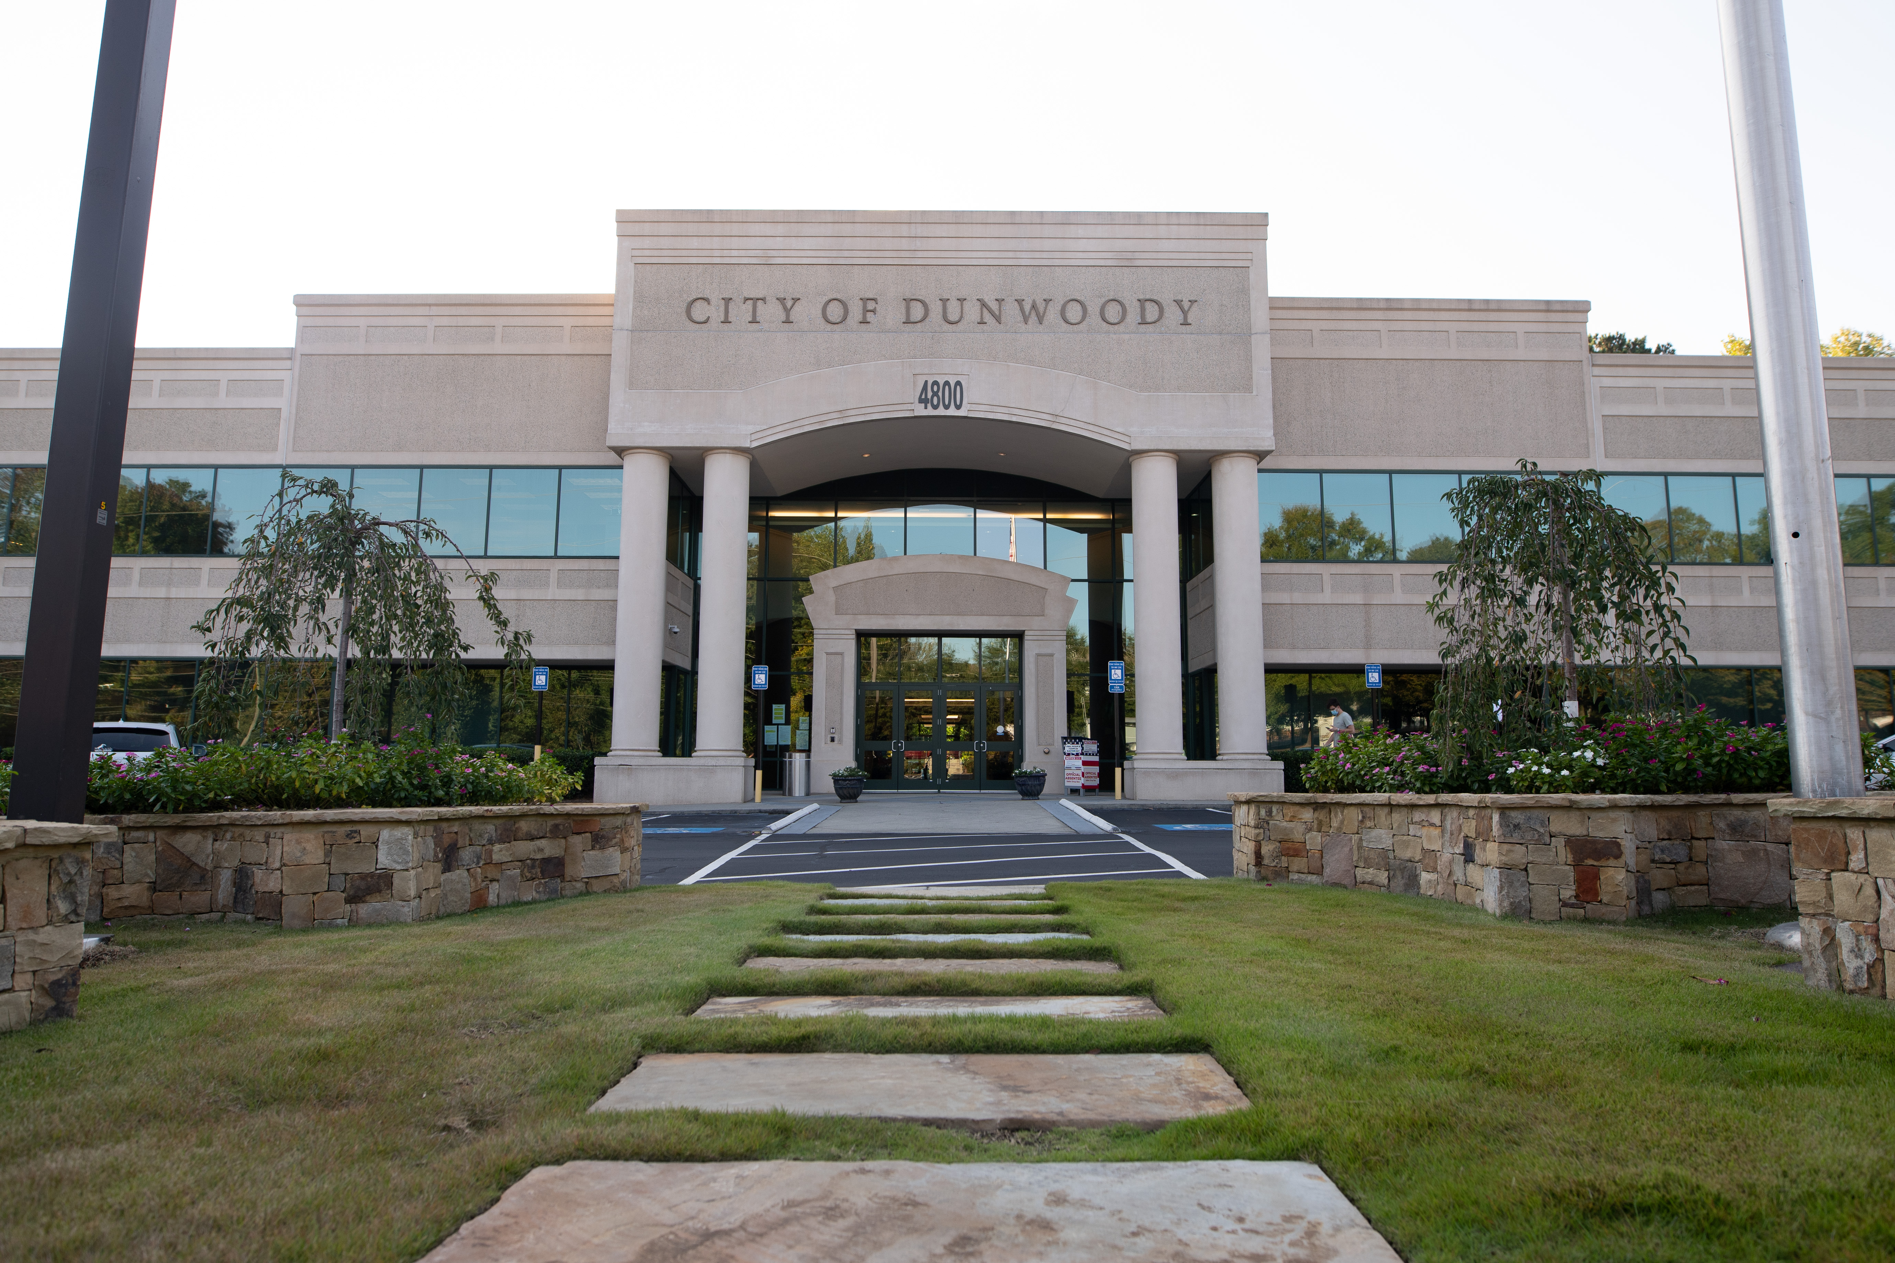
City of Dunwoody / Budget Retreat
Communications
September 30, 2026

Slide 2
Communications – Proposed 2027 Budget
Mission: To strengthen trust and pride in the City of Dunwoody through timely and strategic communications that connect residents to City services, celebrate our community, and share our vision for the future.
Total Budget: $582,845
2 Positions: Communications Director & Communications Manager
Responsibilities: Dunwoody Digest, D-news, media relations, press releases, video, social media, website, advertising, graphic design, City Manager’s newsletter, Dunwoody 101, Holiday HQ, Youth City Council, Dunwoody VIPS volunteer newsletter, KPI reports, Budget Book, and ADA web compliance.
We share responsibility across most communications functions, while each role provides primary leadership in specific areas based on expertise and capacity.

Slide 3
Communications – Proposed 2027 Budget
Operations: $145,235
    Website: $14,734 for hosting, $5K ADA compliance crawl
    Advertising: $15,000
    Dunwoody Digest: $70K for 4 issues: printing cost remains stable (roughly $10K for 23K copies); postage has increased by about 15 percent
    Holiday HQ snowflakes & banners: $14,875 (41 snowflakes)
    Dunwoody 101: $3,800 (2x a year)
    Media tracking: $4,500
Savings: Dropped Dunwoody App (-$1068), Canceled music subscription (-$715), Dropped media tracking subscription to lower level (-$2750), Switched to new website popups platform (-$1,080)

Slide 4
Communications – Quick Comparison
City | Employees | Dept. Budget | Notes
Dunwoody | 2​ | $582K
Alpharetta | 2​ | $3.2M | Part of the City Administration's Budget​
Brookhaven | 5​ | $1.1M | Includes social media manager and administrative assistant​
Chamblee | 2​ | $730K | $130K for printing, binding & postage​
Roswell | 13 (3 for special events)​ | $2.08M | $43 for video contract​
Sandy Springs | 9​ | $4.5M | Includes $702K for a Call Center, $351 for website​
Smyrna | 2​ | $2.8M | Includes $640K for fireworks and City's annual birthday celebration, $79K for advertising, $29K for printing​

