Slide 1
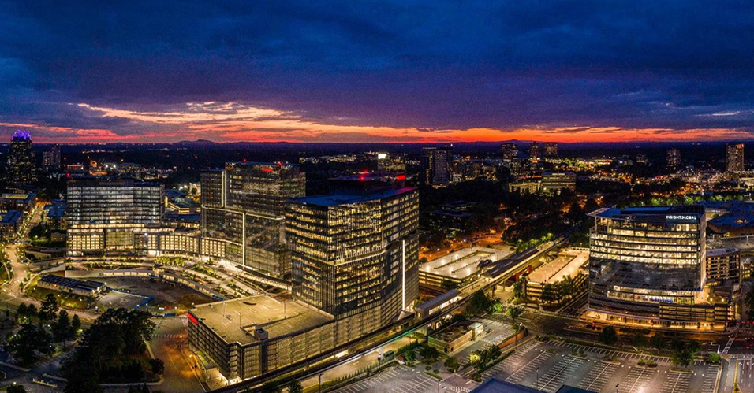
City Council Retreat
March 21-22, 2022

Slide 2
Topics
Day One
Suwannee
Public Art
Activation/Branding Park Events
Downtown Development
Finance
Operating Millage
ARP Funding
Capital, Bonds, and SPLOST
Other Topics

Slide 3
Topics
Day Two
The focus on topics are always two-fold.
How does City Council codify expectations? (Note: This doesn’t mean put into code, but more in terms of clarifying what “what’s” need to be met or what problems need to be solved.)
Are there policy changes that need to be made, policies created, or is this a case where the guidance above will suffice?

Slide 4
Topics
Public Works
Pedestrian / Bicycle Safety
Connectivity/Master Planning – Non-Motorized Transportation
Traffic / I-285

Slide 5
Topics
Development
Edge City 2.0
Dunwoody Village
Perimeter Mall
Branding / City and Events
Affordable Housing
Sustainability

Slide 6
Topics
Public Safety
Compensation and Benefits
Hiring Issues not Related to Compensation
Retention v Recruitment
EMS Issues
Non Traditional Police Activities (Mental Health)

Slide 7
Topics
Parks
Austin
Vermack

Slide 8
City Council Retreat
March 21-22, 2022

