Slide 1
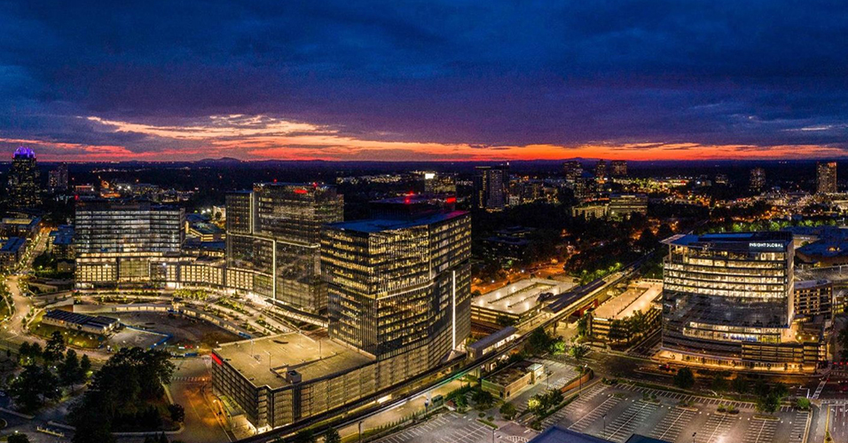
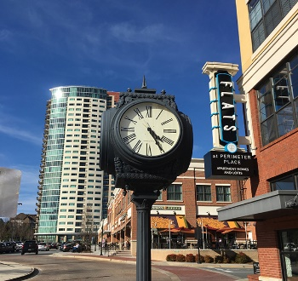

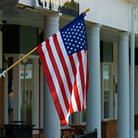



City Council Retreat
Financial Topics
March 21-22, 2022

Slide 2
Financial Topics
The focus today will be on these parts:
  Operating Millage Rates
  ARP Funding
  Capital Needs, Bonds, and SPLOST

Slide 3
Editorial Note
Before anyone panics, this presentation contains a forecast for the city’s General Fund operating budget.
Forecasts, by nature, are pessimistic and conservative.
The staff can say with certainty – the city is currently financially healthy.
However, staff wants Council to be fully informed that the revenue structure designed at incorporation, does not match in any form the current demands of the citizens of the city.

Slide 4
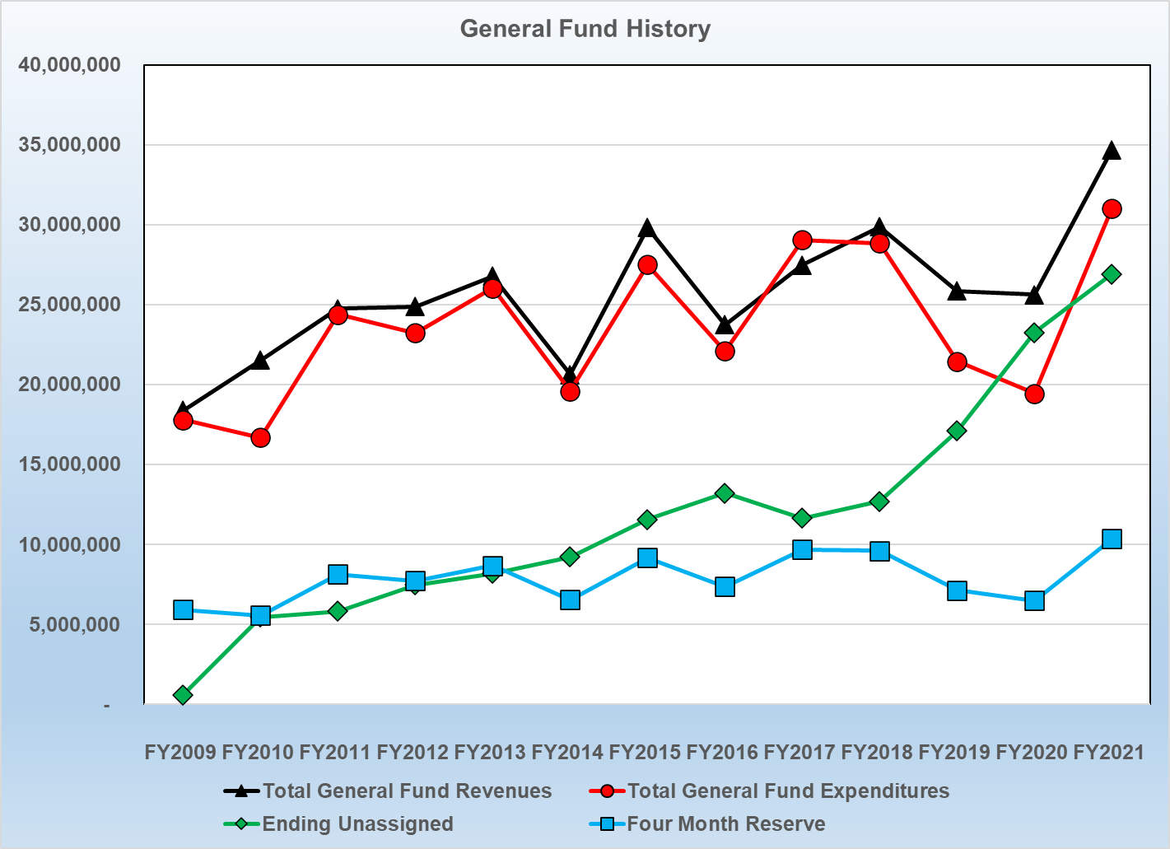
General Fund History
With over a decade of data, this is how the General Fund revenues, expenditures, year-end fund balance, and a four-month year end reserve, look.
The growth in undesignated fund balance is a direct result of prudent City Council actions at the start of COVID.
However, given the changes over the past year, staff recommends now working with this fund balance growth and developing a comprehensive use for it, fitting the current needs of the city.

Slide 5
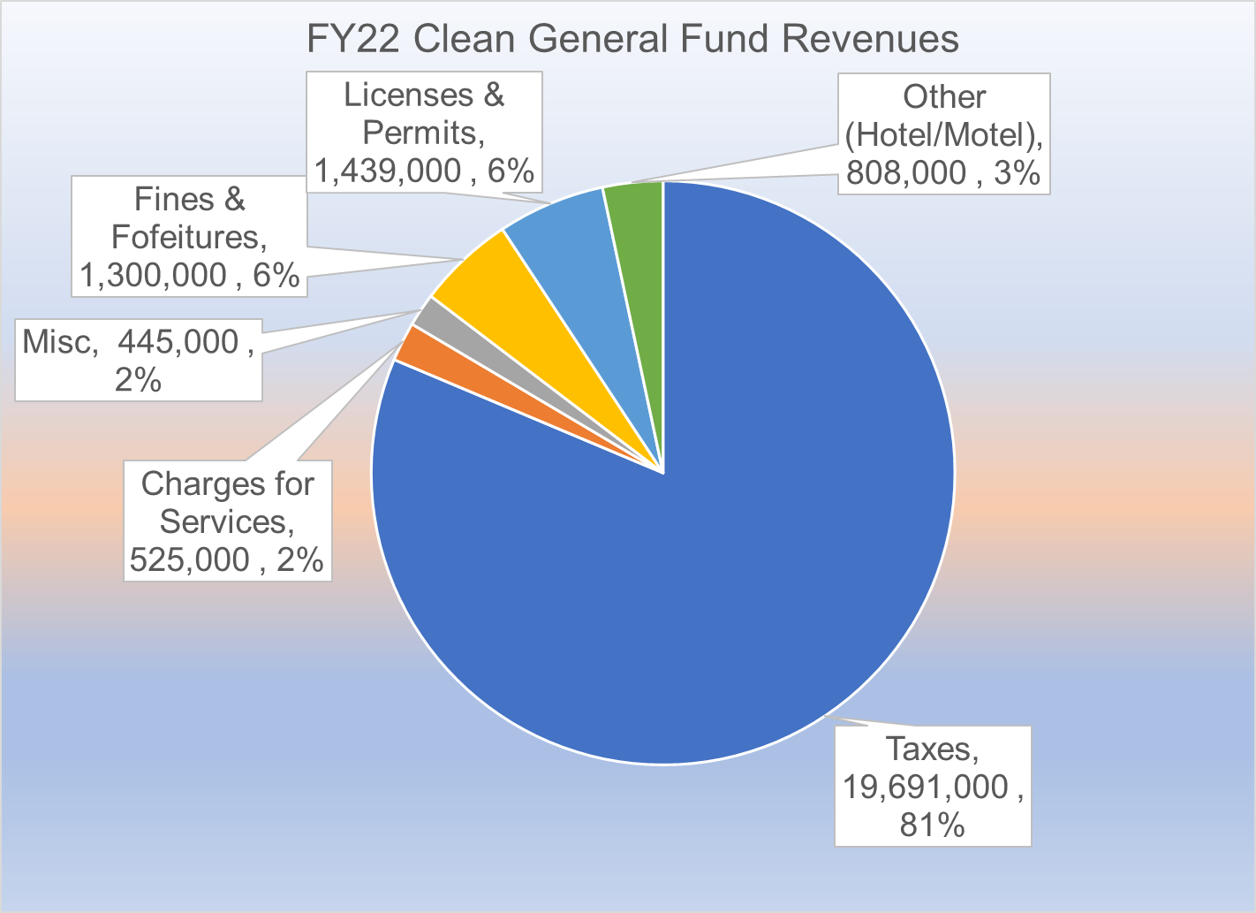
General Fund Revenue
Before looking at using fund balance lets look at the existing revenue mix. This is the General Fund.
Side Bar (literally):
This graph does not show ARP or fund balance, one-time sources.
Hotel/Motel is a bit understated on purpose for FY2022.
Issues with the various sources:
Taxes: Residential property values are frozen and commercial is precarious in terms of growth without big projects like High St. It is safe to assume commercial growth is minimal until return to work is the norm.
All the other sources - combined -barely move the needle.
Basically, revenues are not very diverse, and the main source is not projected to grow much.

Slide 6
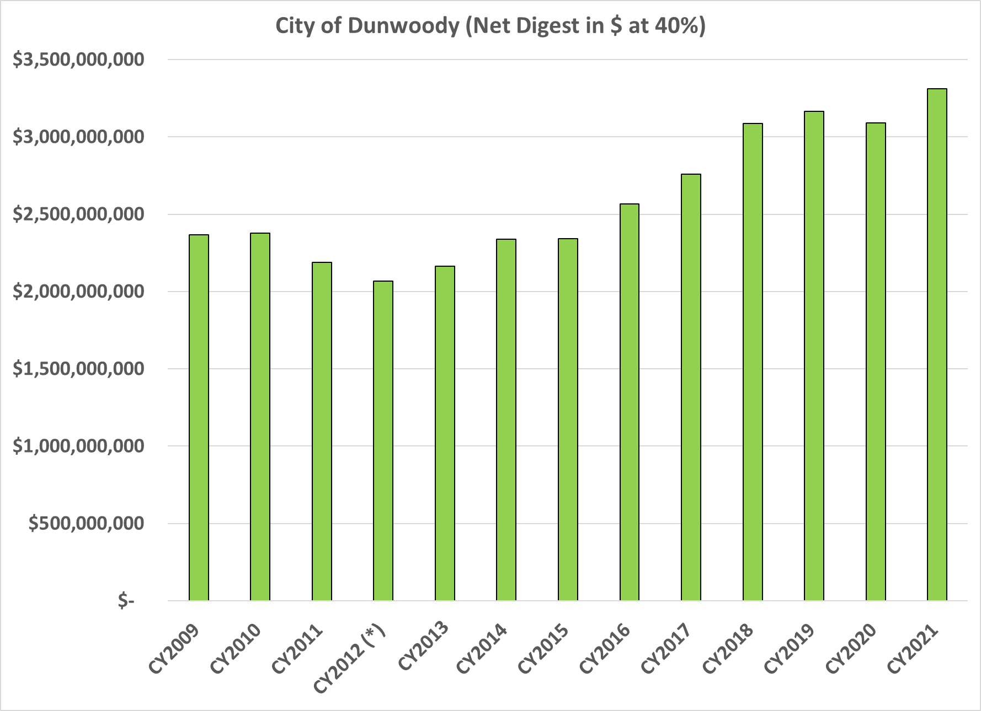
Tax Digest
While there has been growth in the digest since incorporation…

Slide 7
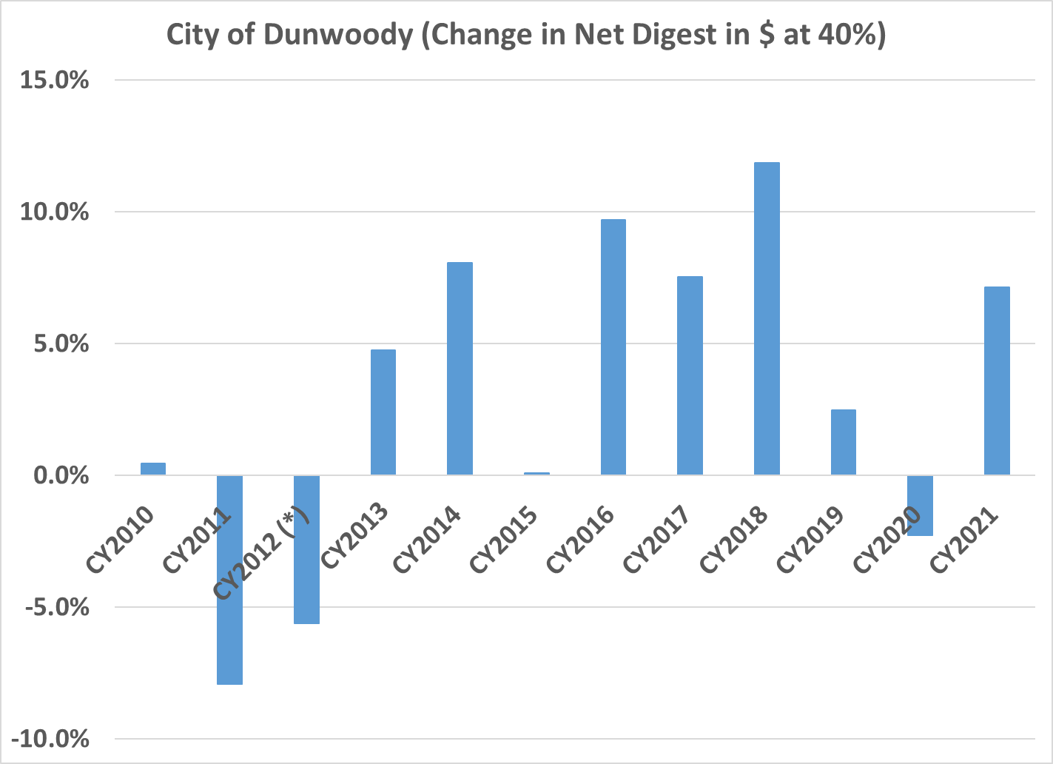
Tax Digest
… it has not been steady or uniform.

Slide 8
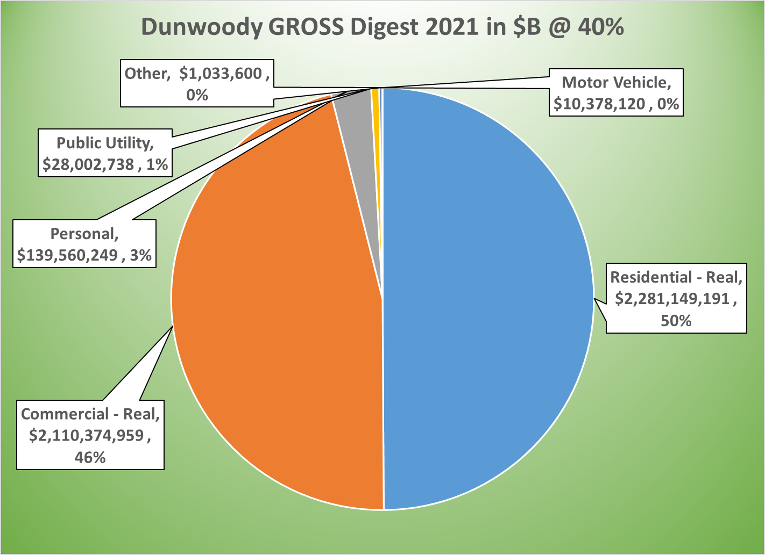
Tax Digest
Gross digest is close to 50/50…

Slide 9
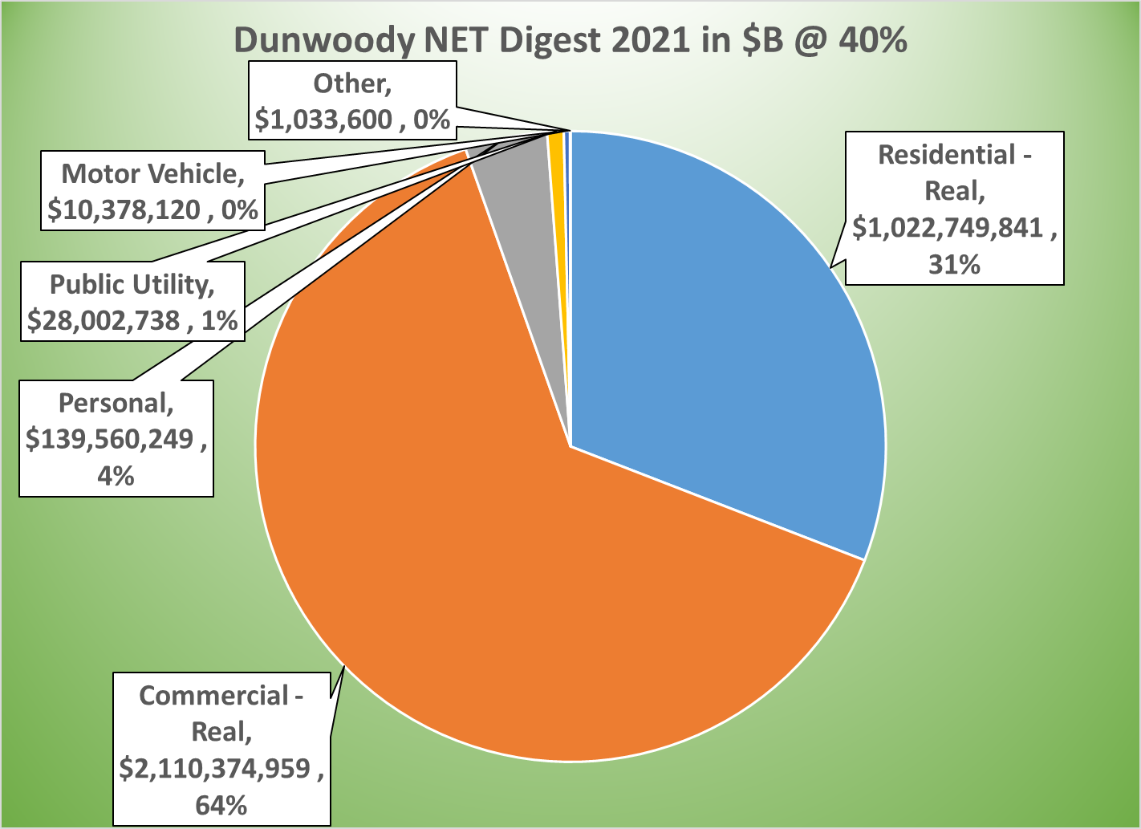
Tax Digest
… but exemptions change the mix.

Slide 10
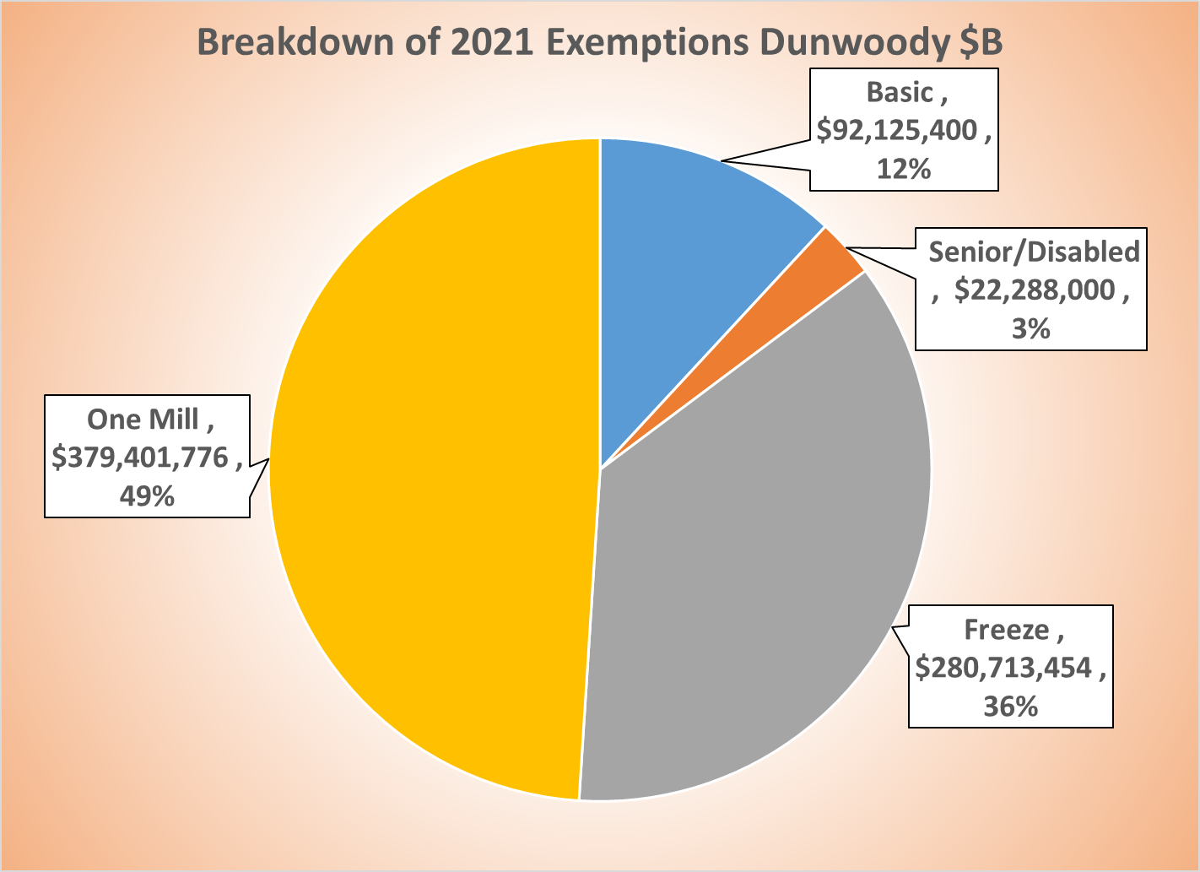
Tax Digest
The one mill and the freeze exemption for residential are the biggest deductions…

Slide 11
Tax Digest (per Capita)
These are the key “measures” of a city, gross digest, net digest, and exempt digest all per capita. Notice anything?

Slide 12
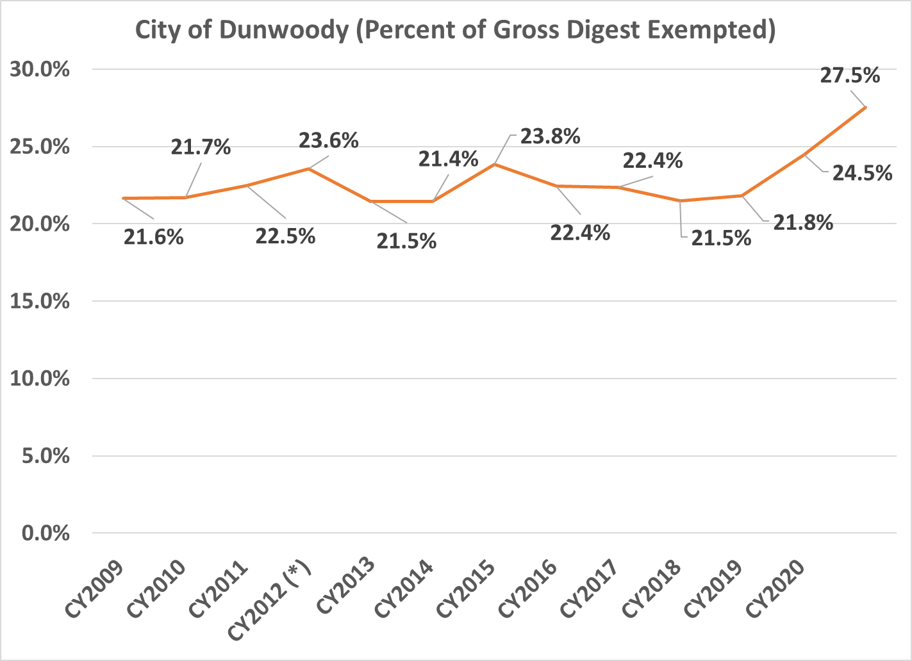
Tax Exemptions
Now, over ¼ of the digest is exempted from taxes.

Slide 13
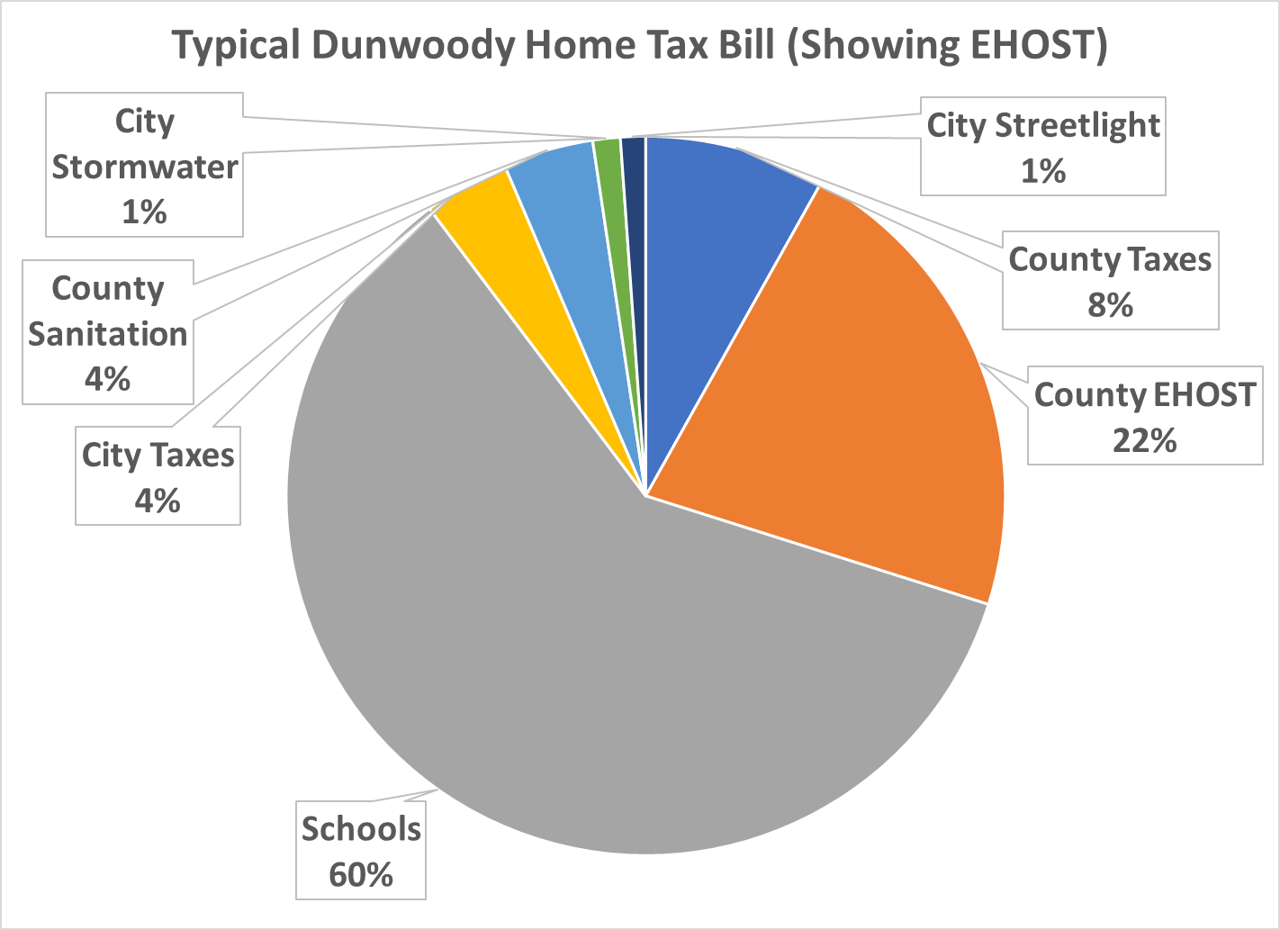
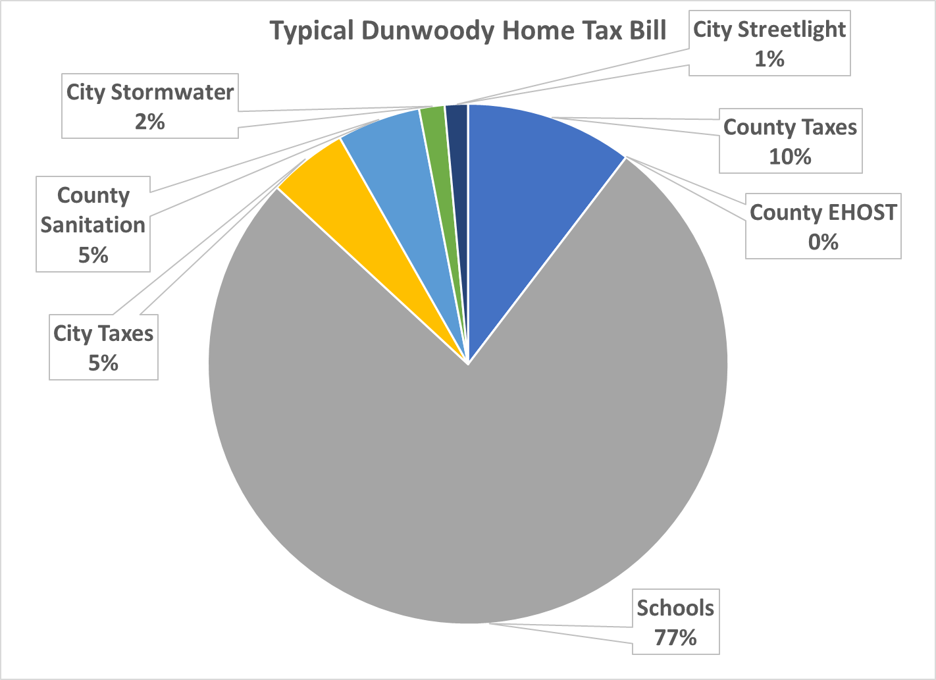
Your Typical Tax Bill (Two Views)
Depending on how one counts the EHOST credit (currently only given to countywide taxes), city taxes are 4 to 5% of a typical total bill.
Schools are between 60-77% of the bill and the county is between 10-32%. Again, depending on how to count the EHOST credit.

Slide 14
Average Homeowner
The previous slide was labeled a “typical” tax bills, as those percentages can very. But what is the typical Dunwoody home.
We can say $464K but, there a big caveat…..

Slide 15
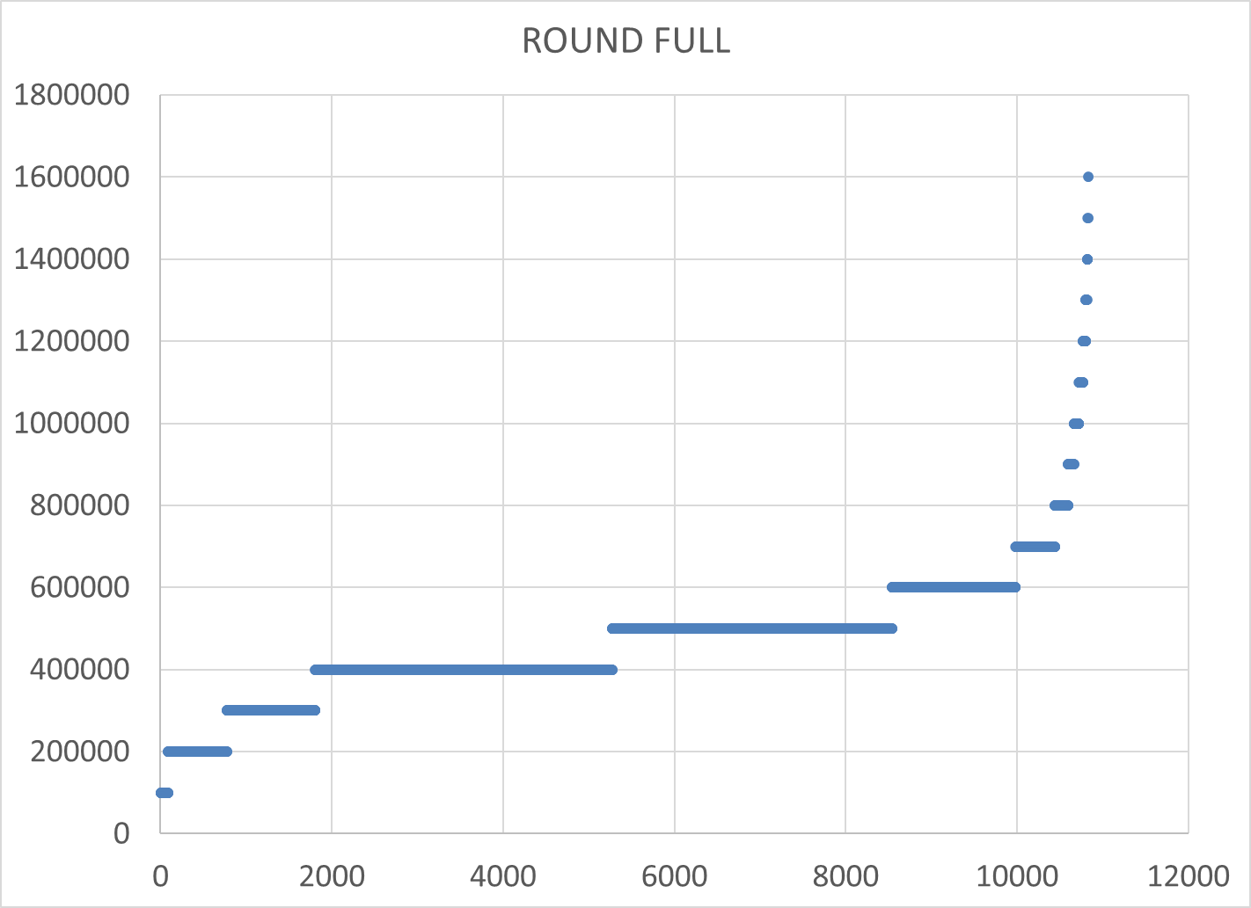
Average Homeowner
Instead of average let’s round all the homesteaded property values to the nearest $100K.
This is the value assessed (100%), so the $464K comes from here, but there’s a chunk in $500K (rounded),too.

Slide 16
Average Homeowner
But, the city doesn’t to those values for most residents.
House values are frozen based on the year you bought it. Using an average here doesn’t work well.
For a proxy, we will use a house that is frozen at 75% of its current value.

Slide 17
So, what will we use?
The city freezes residential values and then takes an additional 1.000 mill reduction. So, as the freeze changes, so does the other reduction.

Slide 18
Time out, millage rate?
Some Notes: We highlight city plus county because some cities use county services. Also, exemptions can make rate behave differently in terms of tax bill. Most residents in Dunwoody are actually taxed at 14.704, not 15.704

Slide 19
Time out, millage rate?
Same thing, but some nearby Fulton cities included.

Slide 20
WHY?
Why this information? It’s to give the Twitter-level background needed for the next step. A five year operating forecast.
Remember that history of revenues and expenditures? We’re going to take that five years into the future.

Slide 21
Assumptions
Health care costs born by the city escalate at 10% a year, slightly higher than lately, but it’s a forecast…
City staff will average a 4% raise going forward. Not guaranteed, but it’s a forecast….
Overall revenue growth hovers around 2.5%. Yes, it’ll likely be higher but on forecasts…..
A one time $2.5M transfer to capital in FY22 or 23 or $500K a year each year for five years. Same impact.
That one time ARP revenue replacement will go back to ARP to remove federal strings.
Every year an additional $500K of new operations are added…

Slide 22
Caveats
This is a forecast for a small suburban city. It’s not a complex econometric model, nor does it need to be. The goal is to approximate growth in revenue and expenses and see if the city will be short based on those assumptions.

Slide 23
NOW, THE UNVEIL!
Don’t panic. Remember everything here errs to the really, really, really conservative financial view.

Slide 24
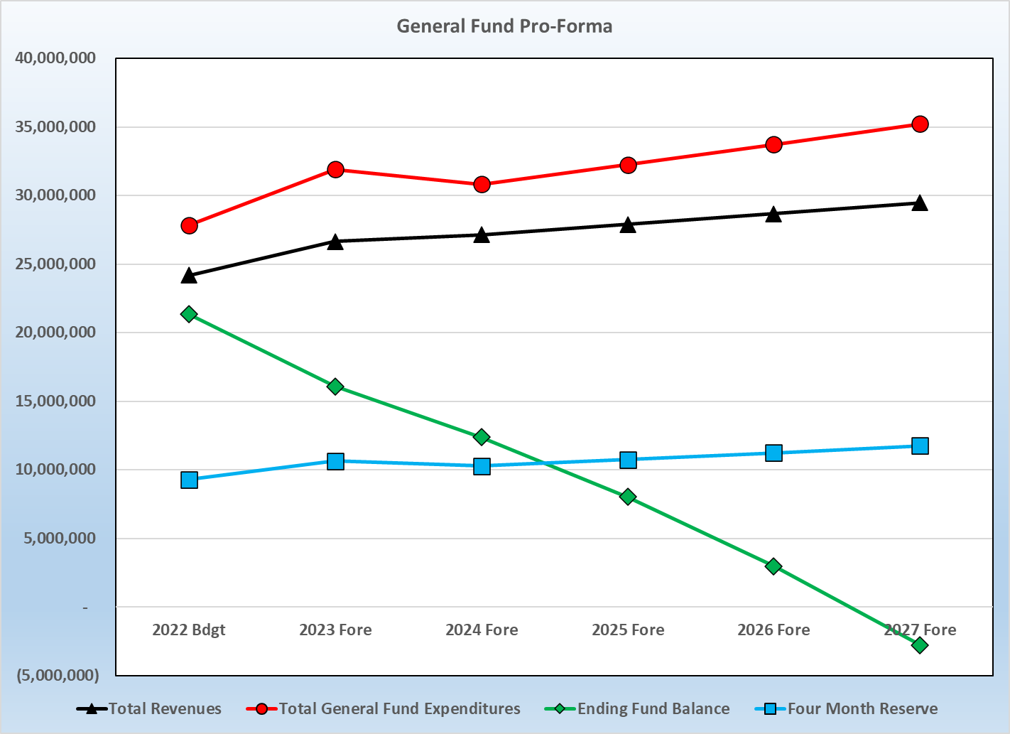
With expenditures always being slightly higher than revenues, fund balance dips below four months in 2025 and below zero in2027.

Slide 25
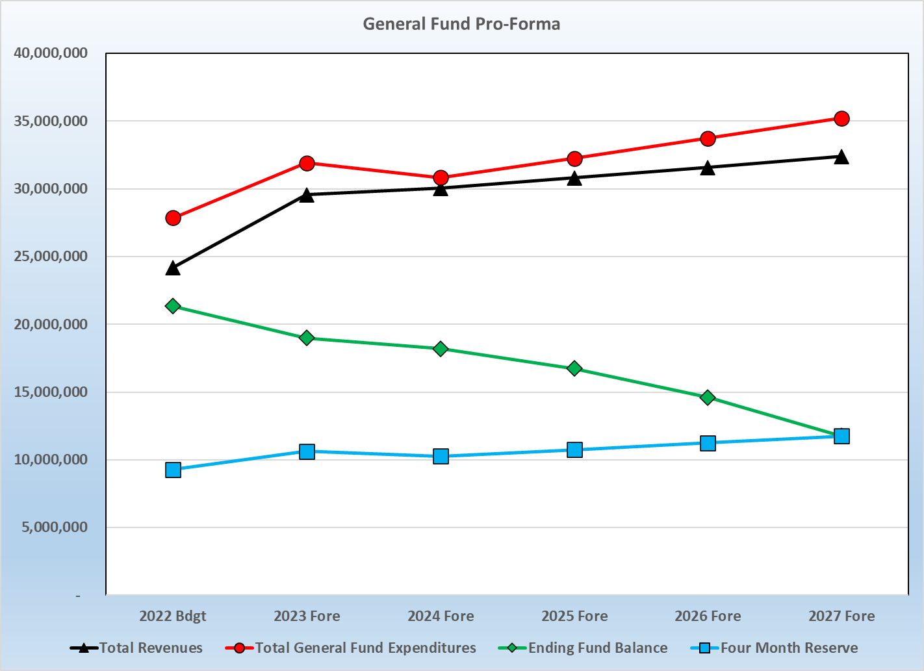
Cutting to the chase, 0.878 fixes this.
Also, yes, this shows a downward trend, but the conservative nature addresses that.
Finally, if the actuals become much better during this time, any increase can be rolled back.
Like all good forecasts, this is an estimate and can and will undergo revision.

Slide 26
Average Homeowner
The impact….

Slide 27
CONTEXT
Remember, this does not say that the city’s finances are in bad shape. It is saying that the desires of the community today do not necessarily match the revenue model the city was created under. Annual budgets and CIP’s will only be recommended that match the current revenue stream.

Slide 28
SO, WHAT DO YOU WANT FROM US NOW?
The main asks now, is to talk about this….
Operations: Future park operations, police staffing issues, support department staffing, etc. Think in terms of WHAT are issues that need addressing.
Revenues: The freeze, the one mill, the fact that other smaller sources don’t move the needle. To change revenues is a heavy life and there’s really one main vehicle you control.
Annual big increases: 4% raises, 10% health care, general inflation. Remember, there is a lot of things that just “happen.”

Slide 29
MOVING ON!

Slide 30
ARPA Funding
That “final rule” thing – was released on January 6, effective April 1, 2022.
Broad categories of uses:
  Replace lost public sector revenue, using this funding to provide government services up to the amount of revenue lost due to the pandemic. NOTE: Staff recommends using this not to replace revenue, but to “destring” $10M of the funding into ARP2.
  Respond to the far-reaching public health and negative economic impacts of the pandemic, by supporting the health of communities, and helping households, small businesses, impacted industries, nonprofits, and the public sector recover from economic impacts NOTE: This is where most of the efforts of Dunwoody will fall.
  Provide premium pay for essential workers, offering additional support to those who have and will bear the greatest health risks because of their service in critical sectors NOTE: Staff looks at this as one time funding and recommends pay issues be met with sustainable funding.
  Invest in water, sewer, and broadband infrastructure, making necessary investments to improve access to clean drinking water, to support vital wastewater and stormwater infrastructure, and to expand affordable access to broadband internet NOTE: For Dunwoody, most all stormwater issues are fundable.

Slide 31
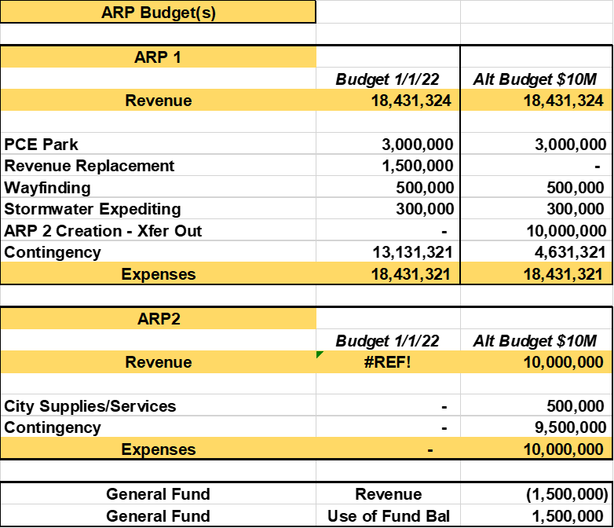
ARPA Funding
As of today, there has been $5.3 million appropriated (does not yet mean spent) of ARPA Funding.
Note: Staff recommends to crawl back the $1.5M of true revenue replacement in light of the final ARPA Rules. This chart shows it with the current budget.

Slide 32
ARPA Funding
This version removes the $10M ARP 2 designation for clarity only, its behind the scenes basically. Focus, more on the New Budget column.

Slide 33
MOVING ON, AGAIN!

Slide 34
Bonds: Cutting to the Chase
Let’s talk bonds a bit….
In March 2020, the city was about to issue hotel/motel backed revenue bonds to construct amenities in the Perimeter area.
Needless, to say that didn’t happen. Currently, city staff are not likely to recommend a hotel/motel tax backed bond anytime in the near future.
However, discussion has also occurred informally about general obligation debt through voter referendum being in the city's future.
The discussion on such should first “determine the needs” before determining the amount, but let’s work backward.

Slide 35
Bonds: Cutting to the Chase
First, City Council will be asked to approve a financial advisory form at a meeting this month or next. All numbers shown are internal to city staff and subject to change.
Basically, staff sees any bond issue being in a range between $30 to $40 million.
Given that range, the millage rate could be as low as 0.593 and as high as 0.925. There are multiple variables in play, so let’s just do both the high and the low.

Slide 36
Bonds: Cutting to the Chase
But, now let's discuss the other issues which may influence the need to go forward in the short term or not…
The forecast shows that $2.5 million could be pulled out of the General Fund today or over the next five years.
The sale of Shallowford could generate approximately $7m.
That would mean, in the next twelve months, the city could have $9.5 million for unrestricted capital.
For reference, SPLOST might break $7 million this year for the first time.

Slide 37
Bonds: Cutting to the Chase
But, now let's discuss the other issues which may influence the need to go forward in the short term or not…
The SPLOST referendum will need to be renewed in 2023.
Discussion points that may occur for 2023:
  Parent v Baby SPLOST. The SPLOST law that applies to DeKalb severely restricts its spending – transportation and public safety, with a very limited amount for capital repairs. Main option to be added, park and community facilities.
  Distribution formula. Currently, on a per capita basis for the city and the unincorporated area. Other options, could be based off digest size or point of sale.
In either case, the voters will most likely be voting on a self taxing renewal in the upcoming year.

Slide 38
Bonds: Cutting to the Chase
With that all in mind….
The operating needs of the city are current, the capital needs are long term.
Short term capital needs could be getting a cash infusion within the year.
Voters will be asked to renew the SPLOST next year – Dunwoody’s share of that could be $42 million or more. What if it had Parks?
Does the city have enough bandwidth to add in more projects above these? Think – citizen input, not necessarily staff time.
The question is - does a general obligation bond fit in the current situation?

Slide 39
City Council Retreat
Econ 201
March 21-22, 2022

