Slide 1
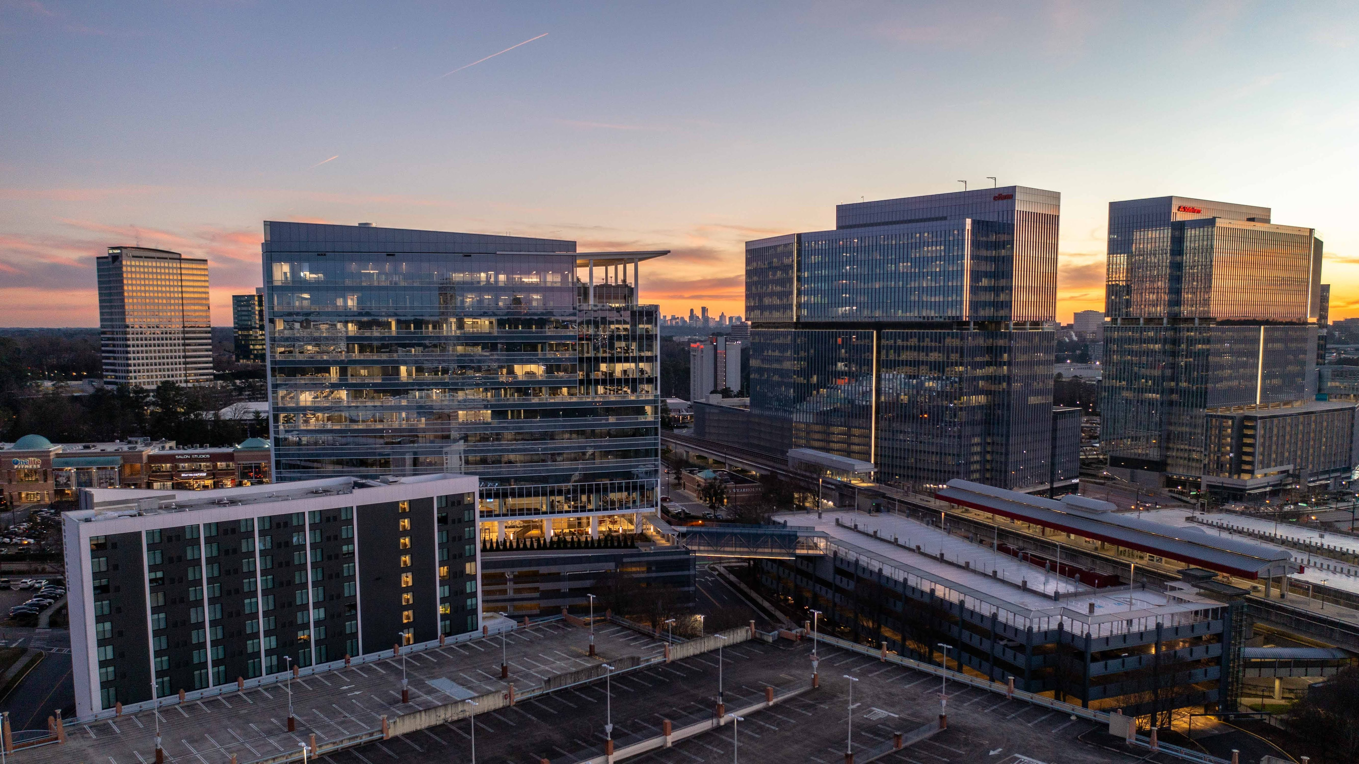
EDGE CITY 2.0
Project Overview
City Council Retreat

Slide 2
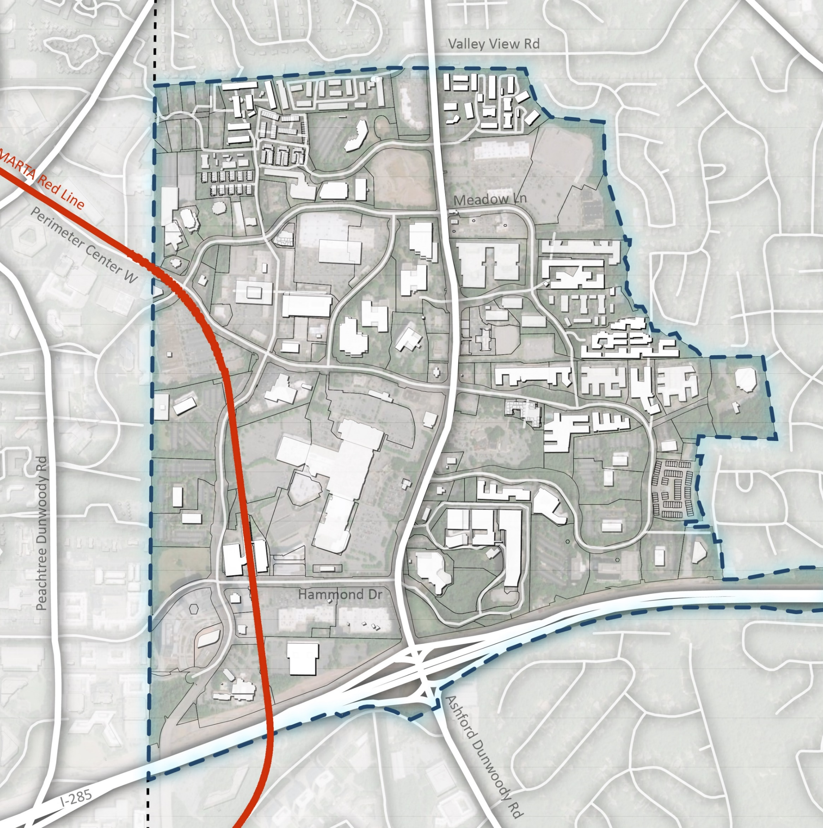
EDGE CITY 2.0 STUDY AREA
Valley View in the north
I-285 in the south
The City of Dunwoody municipal boundary to the west
PCID Boundary to the east.

Slide 3
PROJECT BACKGROUND
The Edge City 2.0 advances the vision for the Perimeter Center character area identified in Dunwoody Next, the City’s 2020 – 2040 Comprehensive Plan.
Dunwoody Next envisioned the Perimeter Center area as a more walkable, connected, and livable regional center.
This process will explore a range of market-driven strategies paired with community input to “try out” where the different scenarios might lead the community.

Slide 4
PROCESS
Research & Discovery
Invite
Success
Vision
Framework
Current land use
Past development patterns
Transportation network
Cultural and natural resources
Demographics
Economics
Past studies
Craft planning principles that will guide the decision-making and the rest of the project
Based on the data gathered from City staff, public, research, and observations
Develop scenarios for future development
Public input is critical in determining which scenario best aligns with the community’s vision
Select preferred growth scenario
Edge City 2.0 will provide the City of Dunwoody, Perimeter CID, and their partners with an implementable strategic roadmap for the next twenty years
3 catalytic projects and immediate “Quick Hit” initiatives
​

Slide 5
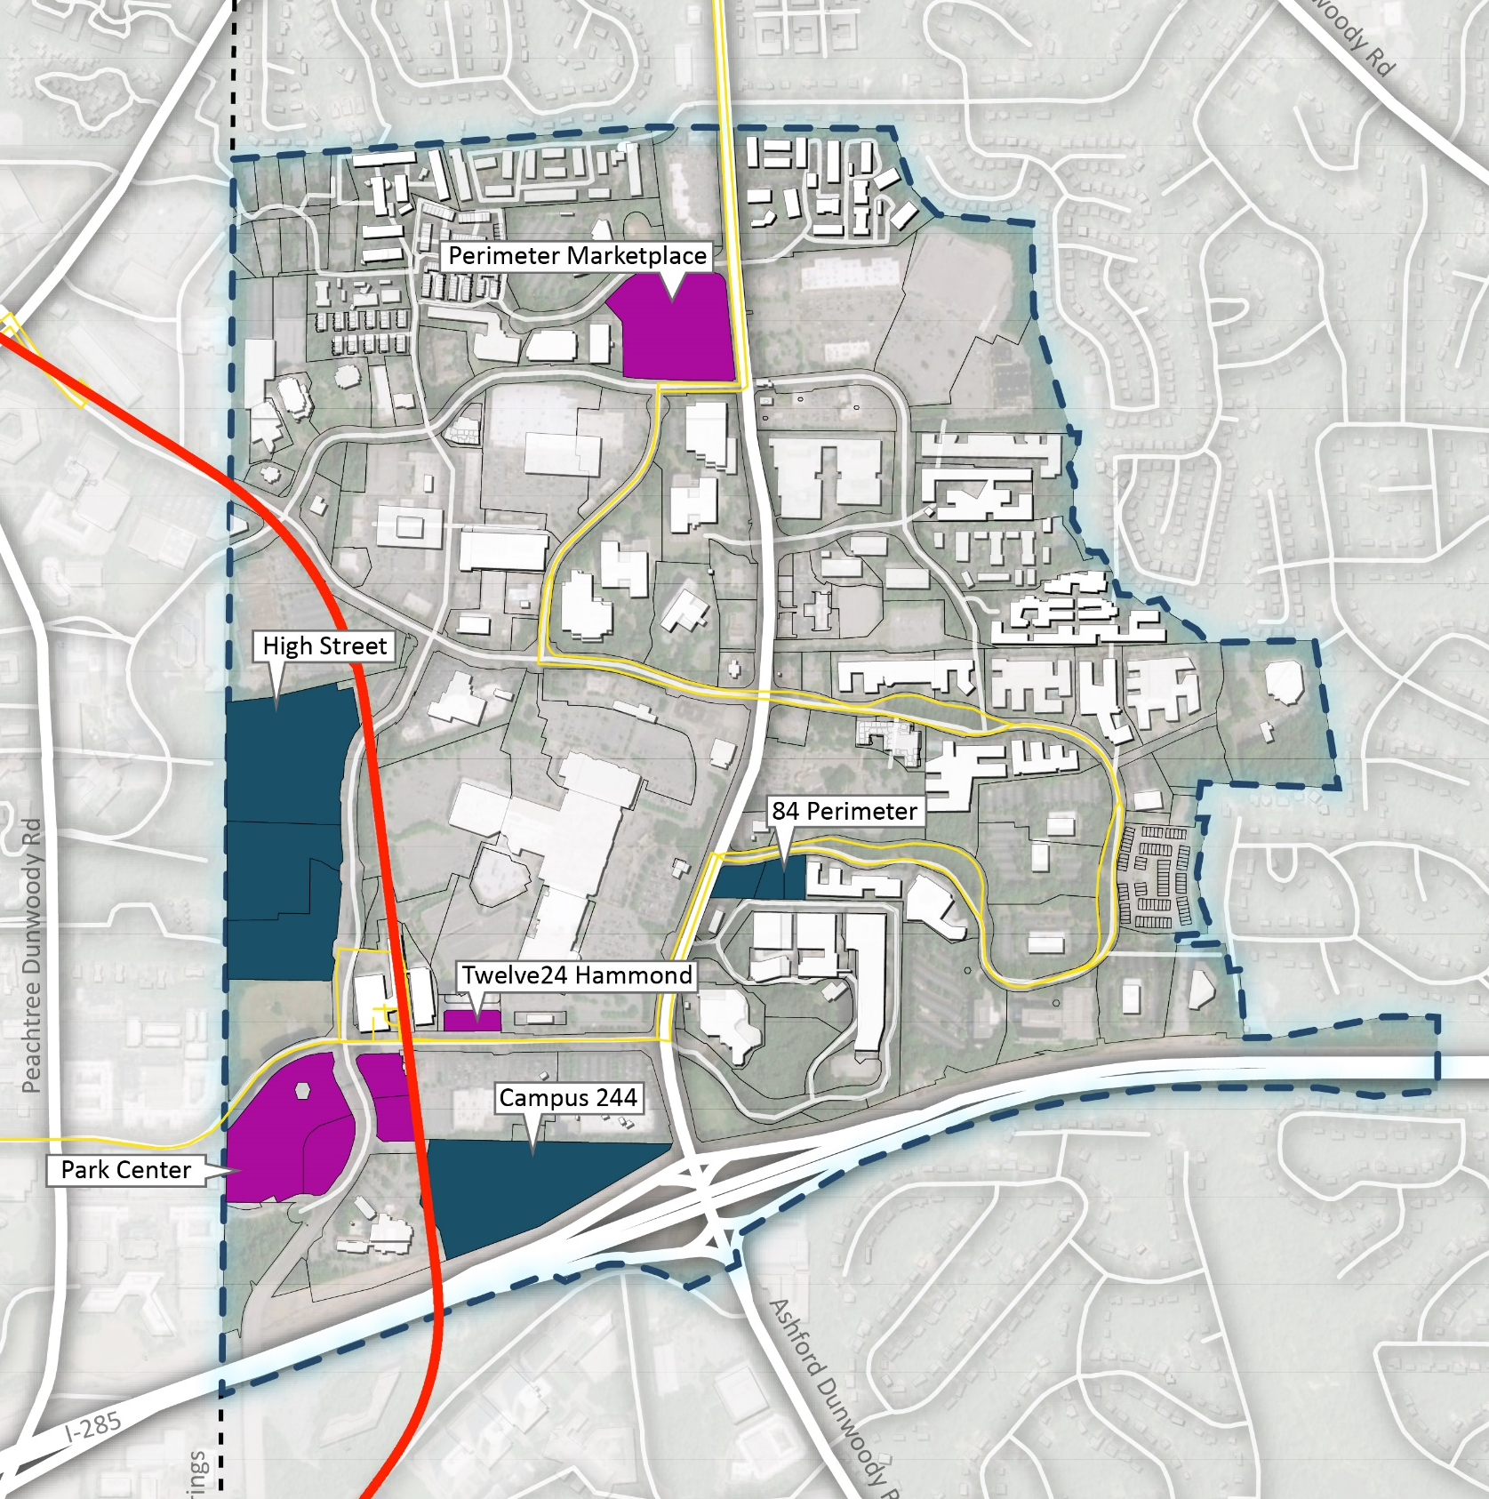
RECENT DEVELOPMENTS
Perimeter Marketplace
Park Center
Twelve24 Hammond
PROPOSED DEVELOPMENTS
High Street
Campus 244
84 Perimeter
Ashford Lane: Food Hall & Lawn

Slide 6
UPCOMING EVENTS & NEXT STEPS
PUBLIC MEETING
The North Terraces Building | 400 Perimeter Center Terrace, Dunwoody, GA 30339
Thursday, March 24th
EXISTING CONDITIONS REPORT
To be completed early April
POP-UP EVENT
Montessori School of Dunwoody | 1730 Mt Vernon Rd, Dunwoody, GA 30338
Saturday, April 30th
Community Outreach
Lemonade Days
Dunwoody Arts Festival

