Slide 1
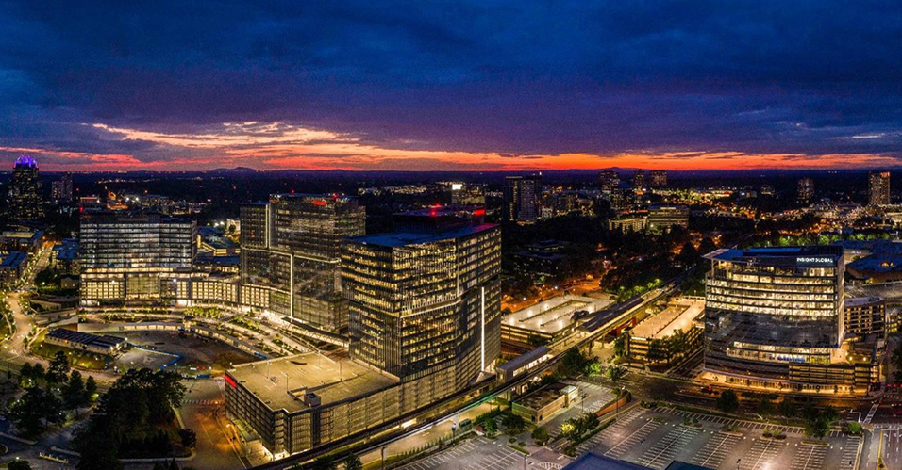
City Council Retreat Police Exit Trends and ARP Information
March 21-22, 2022

Slide 2
Police Department
Exit Trends
For 2021 and 2022 year to date, 22 employees have left the Police Department – including both voluntary and involuntary.
Tenure ranged from five weeks to 12.75 years.
Seventeen exit interviews were conducted. They were not conducted for involuntary separation or those who resigned without notice.

Slide 3
Police Department
Exit Trends
Most common reason for separation was career opportunity. Specifically, that there are not enough positions outside of patrol in the DPD, and there is a lack of advancement or movement. Other agencies have room to grow.
Another very common reason was the department requirement for education to promote to sergeant. In some instances, leaving for an employer where education was not required to advance was a factor.
Positive feedback was benefits – health and retirement.

Slide 4
Police Department
Exit Trends
In the City’s thirteen year history, only five employees have noted compensation as a reason for leaving. However, in 2021, just over half of exiting employees rated base pay as excellent or good, with the rest saying fair and one civilian saying poor.
Recently, 35% stated that they were leaving law enforcement all together.

Slide 5
Police Department
Options
Regrade police officer/detective by increasing one pay grade.
Officer upgrade would require sergeant and lieutenant to also be upgraded. Could be tied to an across the board increase for these four positions.
Create a Senior or Master Police Officer position, which would partially address advancement issues.

Slide 6
Police Department
Options
The creation of this position would not be recommended if the regrading of positions and increase above is also in place (due to compression issues.)
Out of Alpharetta, Brookhaven, Chamblee, Johns Creek, Milton, Roswell, and Sandy Springs, only Sandy Springs requires education for promotion to sergeant.
Removing the education requirement for promotion to sergeant could assist with recruitment and retention.

Slide 7
Police Department
Possible ARP Funding
Licensed Mental Health Clinician(s) 1-2 FTE
Est One Year Cost per Clinician $100K.
Additional License Plate Reader Cameras
Est One Year Cost per 20-30 cameras $75K.
Additional Lighting
PIB Access Rd
Winters Chapel Rd
TBD Location
Est ask for installation $500K

Slide 8
Police Department
Possible ARP Funding
Public Safety Ambassador Program
Est first year cost $250K.
Part Time Officer Program
Est first year cost $200K
Reserve Officer Program
Est first year cost $75K.

