Slide 1
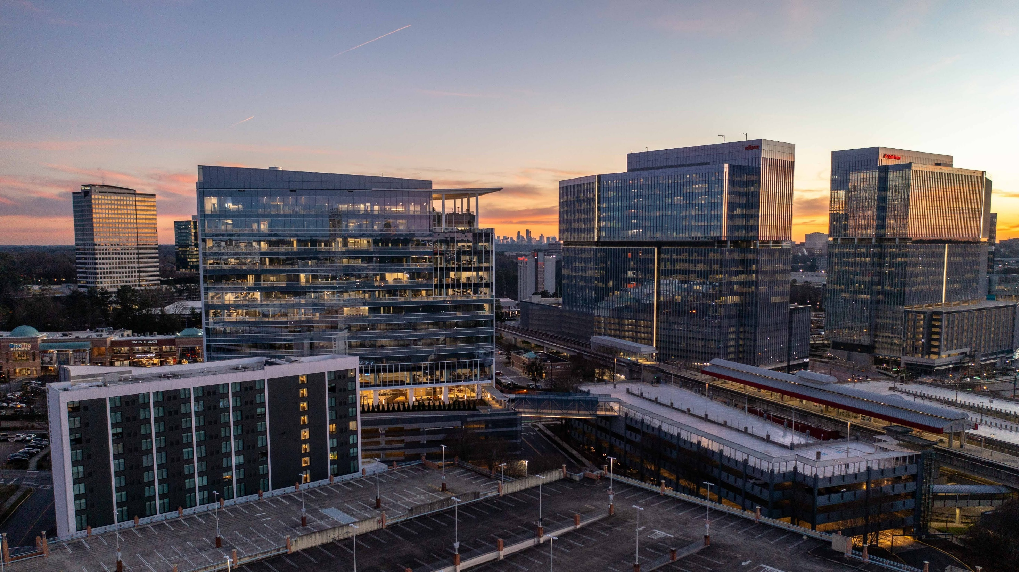
Commercial Real Estate Review
March 12, 2024

Slide 2
How do we position Dunwoody’s Economy to Thrive?

Slide 3
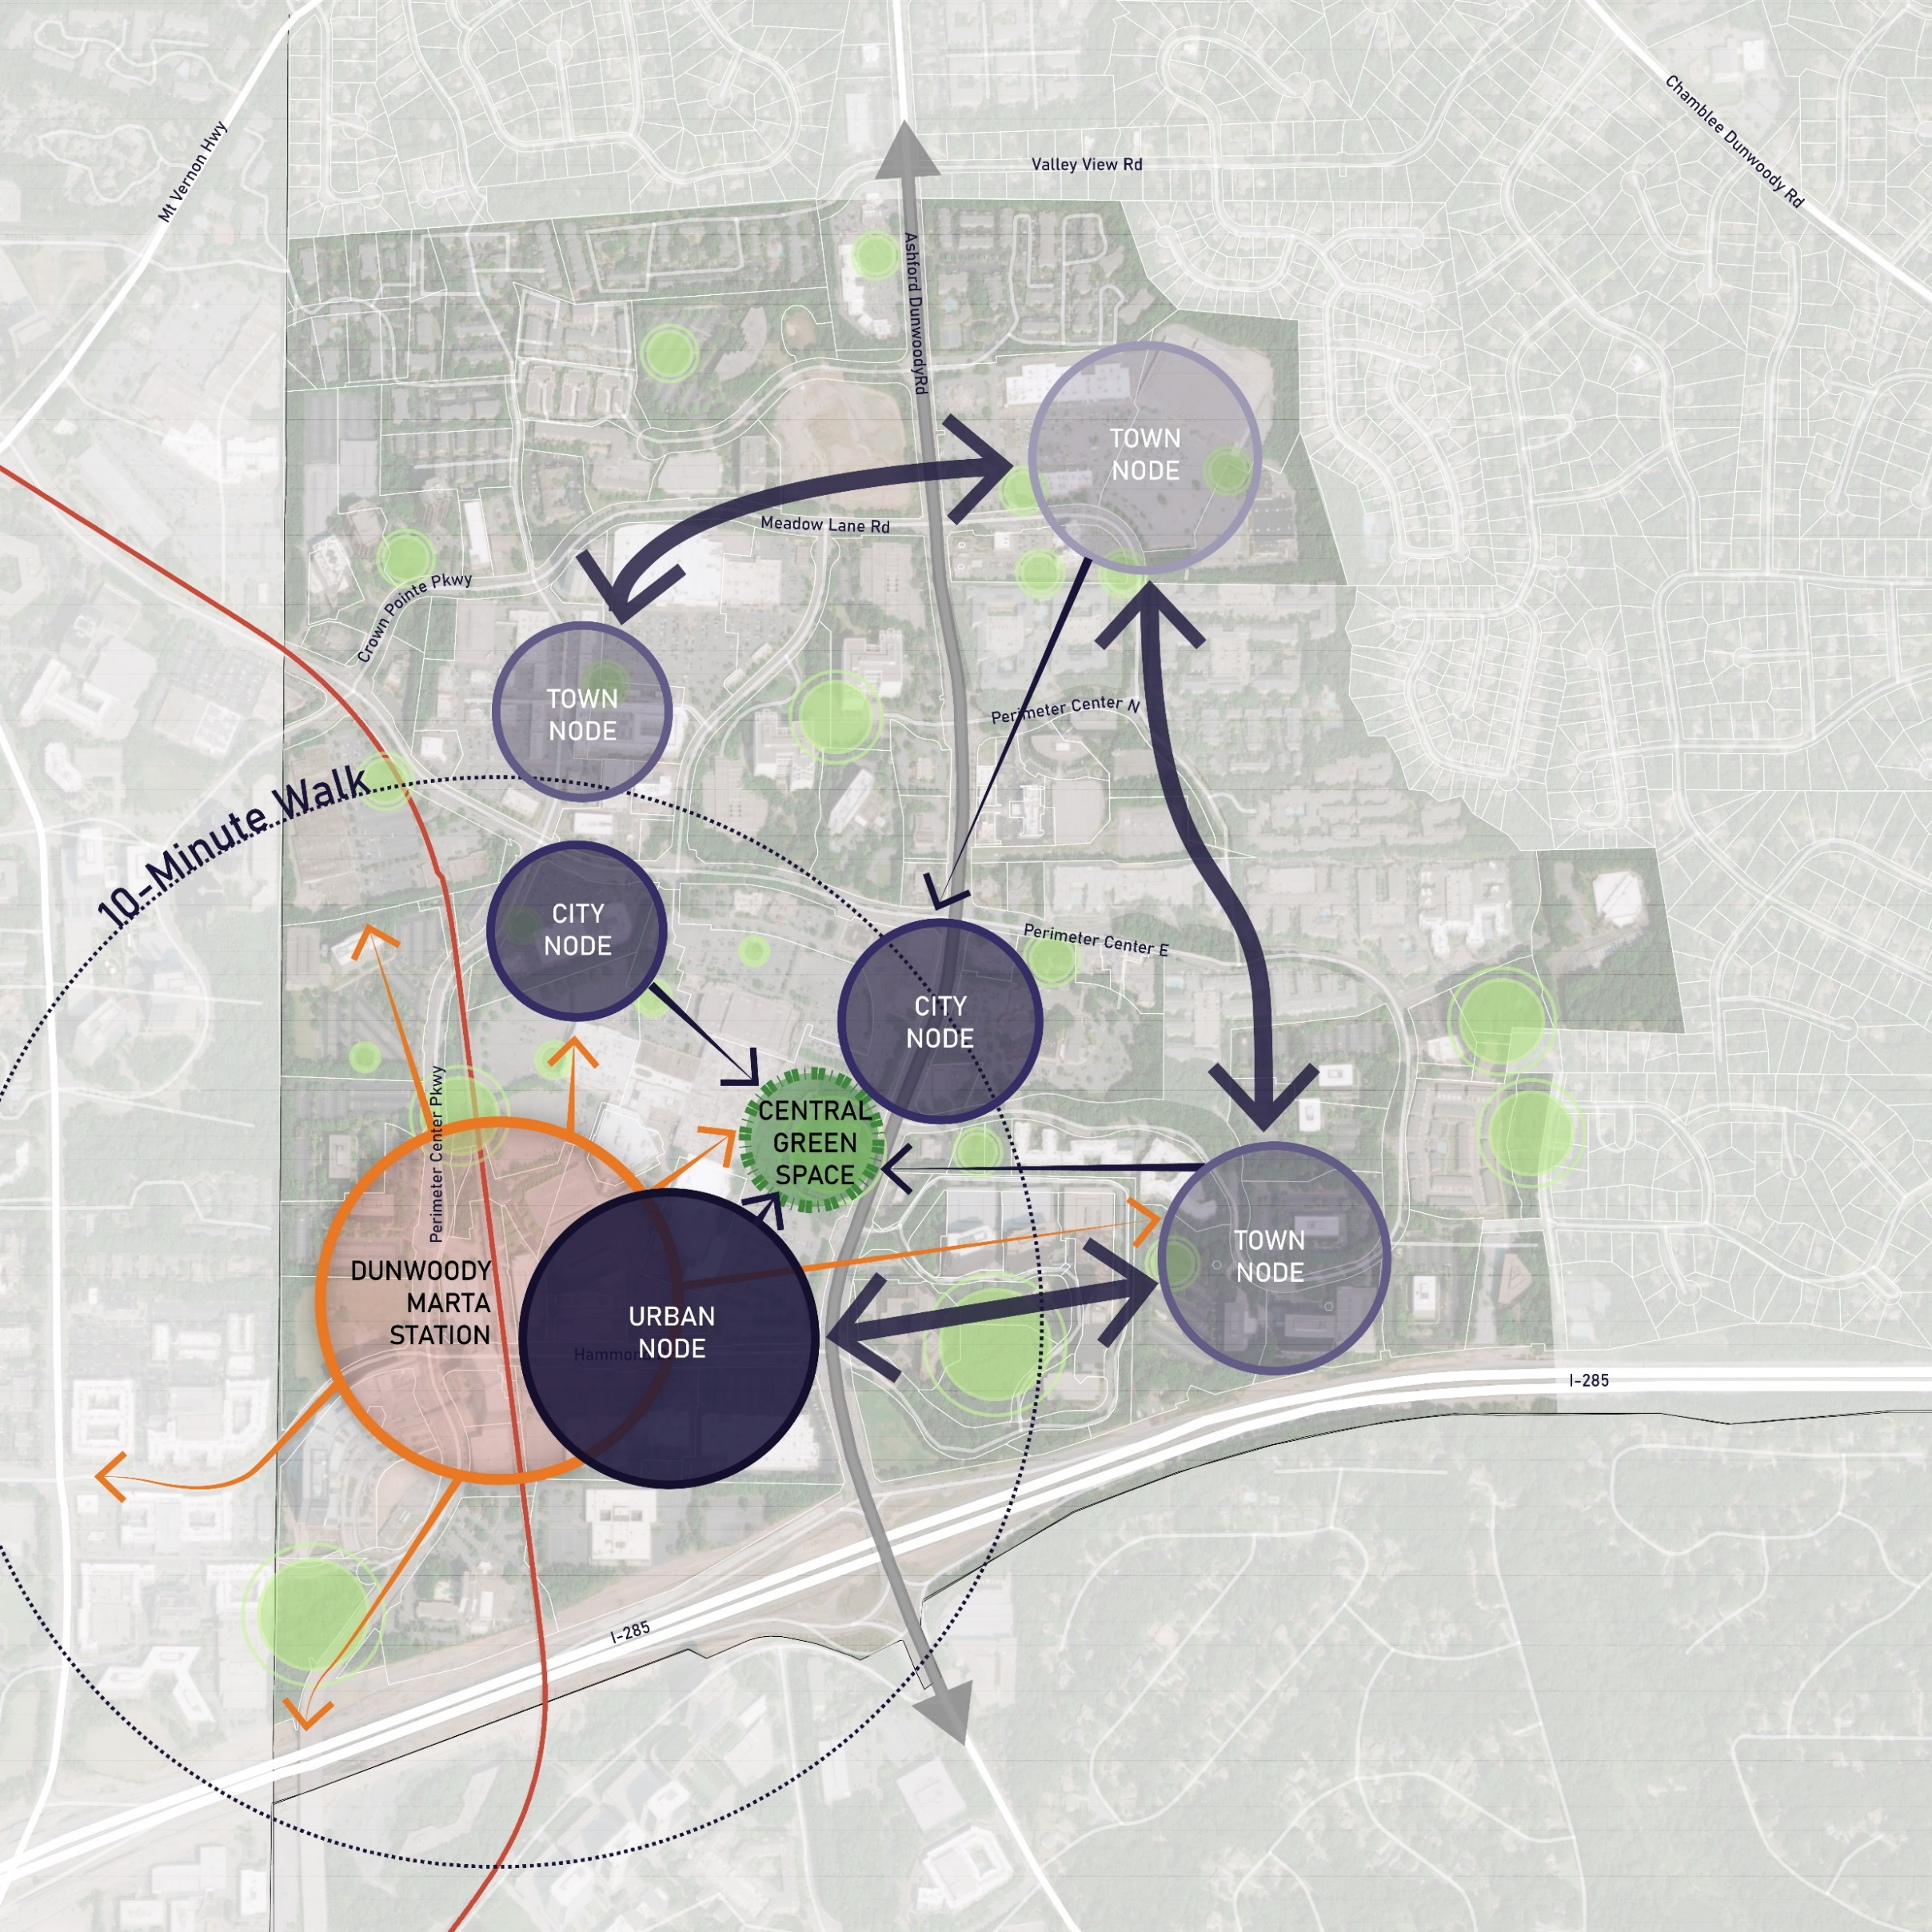
EDGE CITY 2.0
Higher intensity development focused near the Dunwoody MARTA station with lower intensity development in the northern and eastern portions of the study area
Central, programmed greenspaces in walking distance to MARTA and higher density development
Pockets of greenspace in surrounding neighborhoods
Provides elevated quality of life, promoting health, wellness, and overall connectivity

Slide 4
Four Big Ideas from Edge City

Slide 5
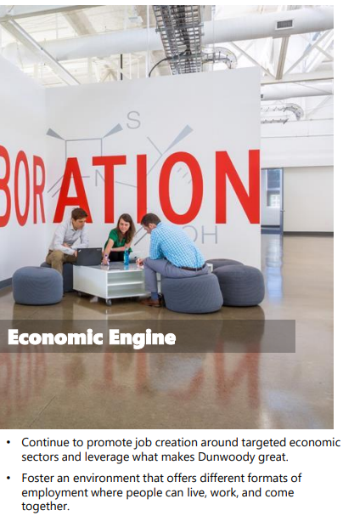
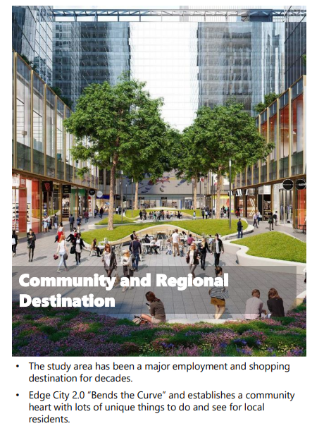
Notes:
Recruitment & Retention efforts
unique identity and sense of place

Slide 6
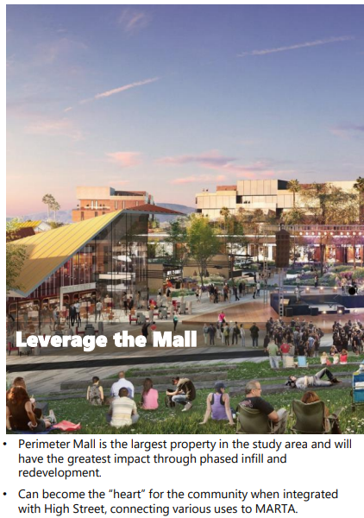
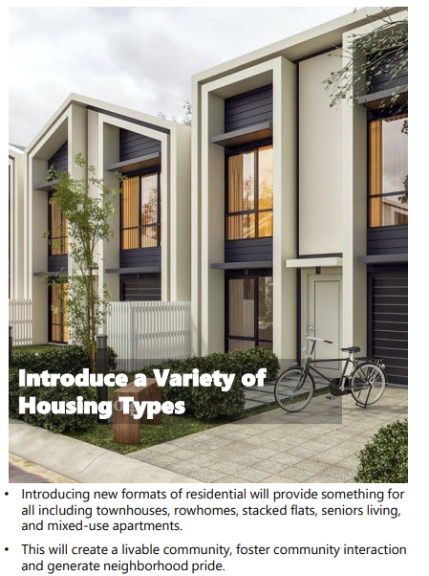

Slide 7
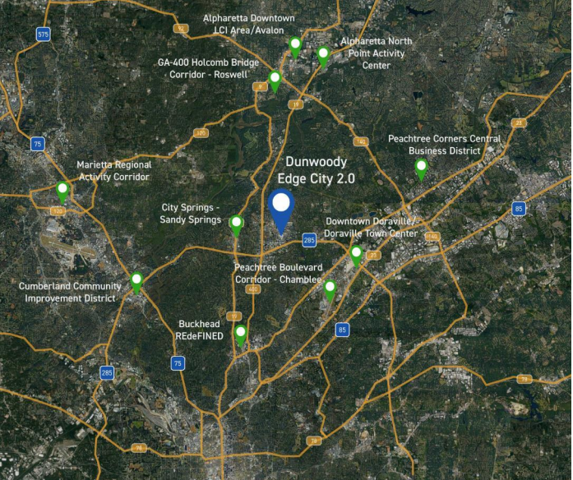
Competitive Review
(2 Mile Radius)
Highest Education Attainment & Largest Daytime Population
Second Highest Median Home Value & Second Highest Per Capita Consumer Spending behind Buckhead
Third Highest Average Household Income & Third Highest Number of Residential Units

Slide 8
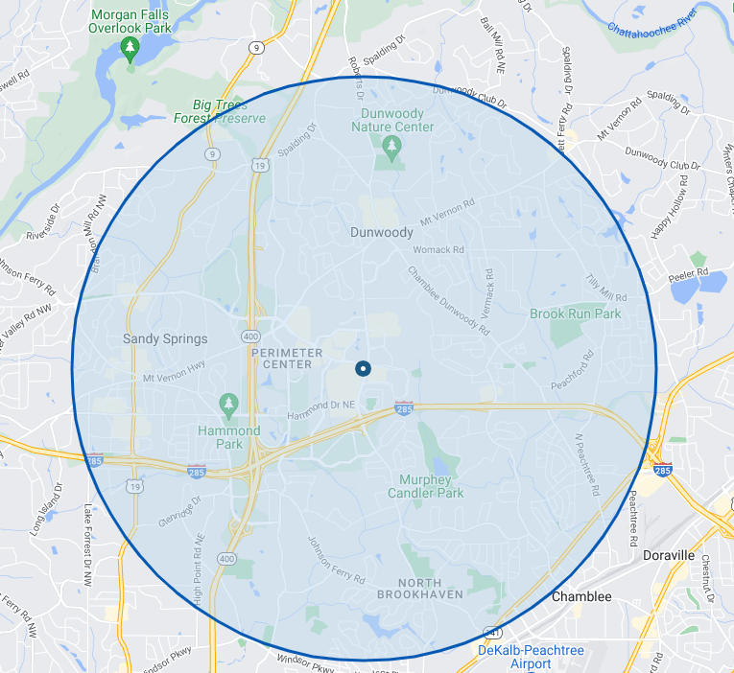
3 Mile Radius
120,000 Population
118,000 Jobs
Hotel Room Nights: 1.4 million
Notes:
We are a regional destination
285 @ 400 – MARTA – Regions Population and Employment

Slide 9
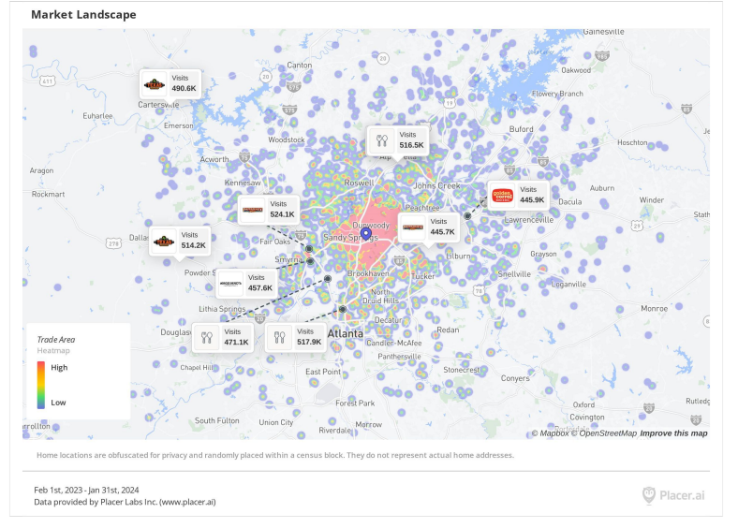
Notes:
Insert Placer map

Slide 10
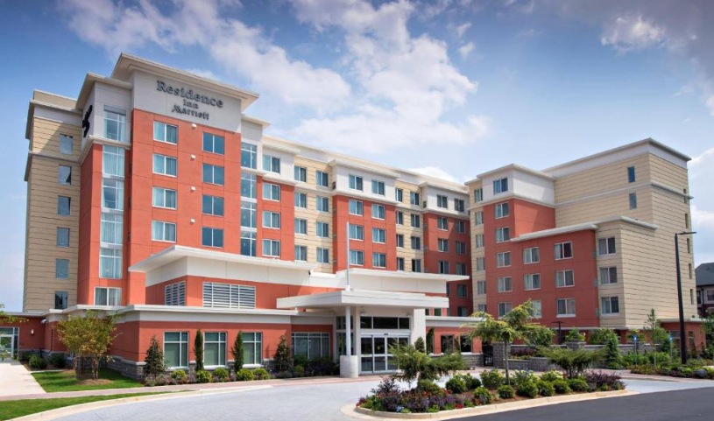
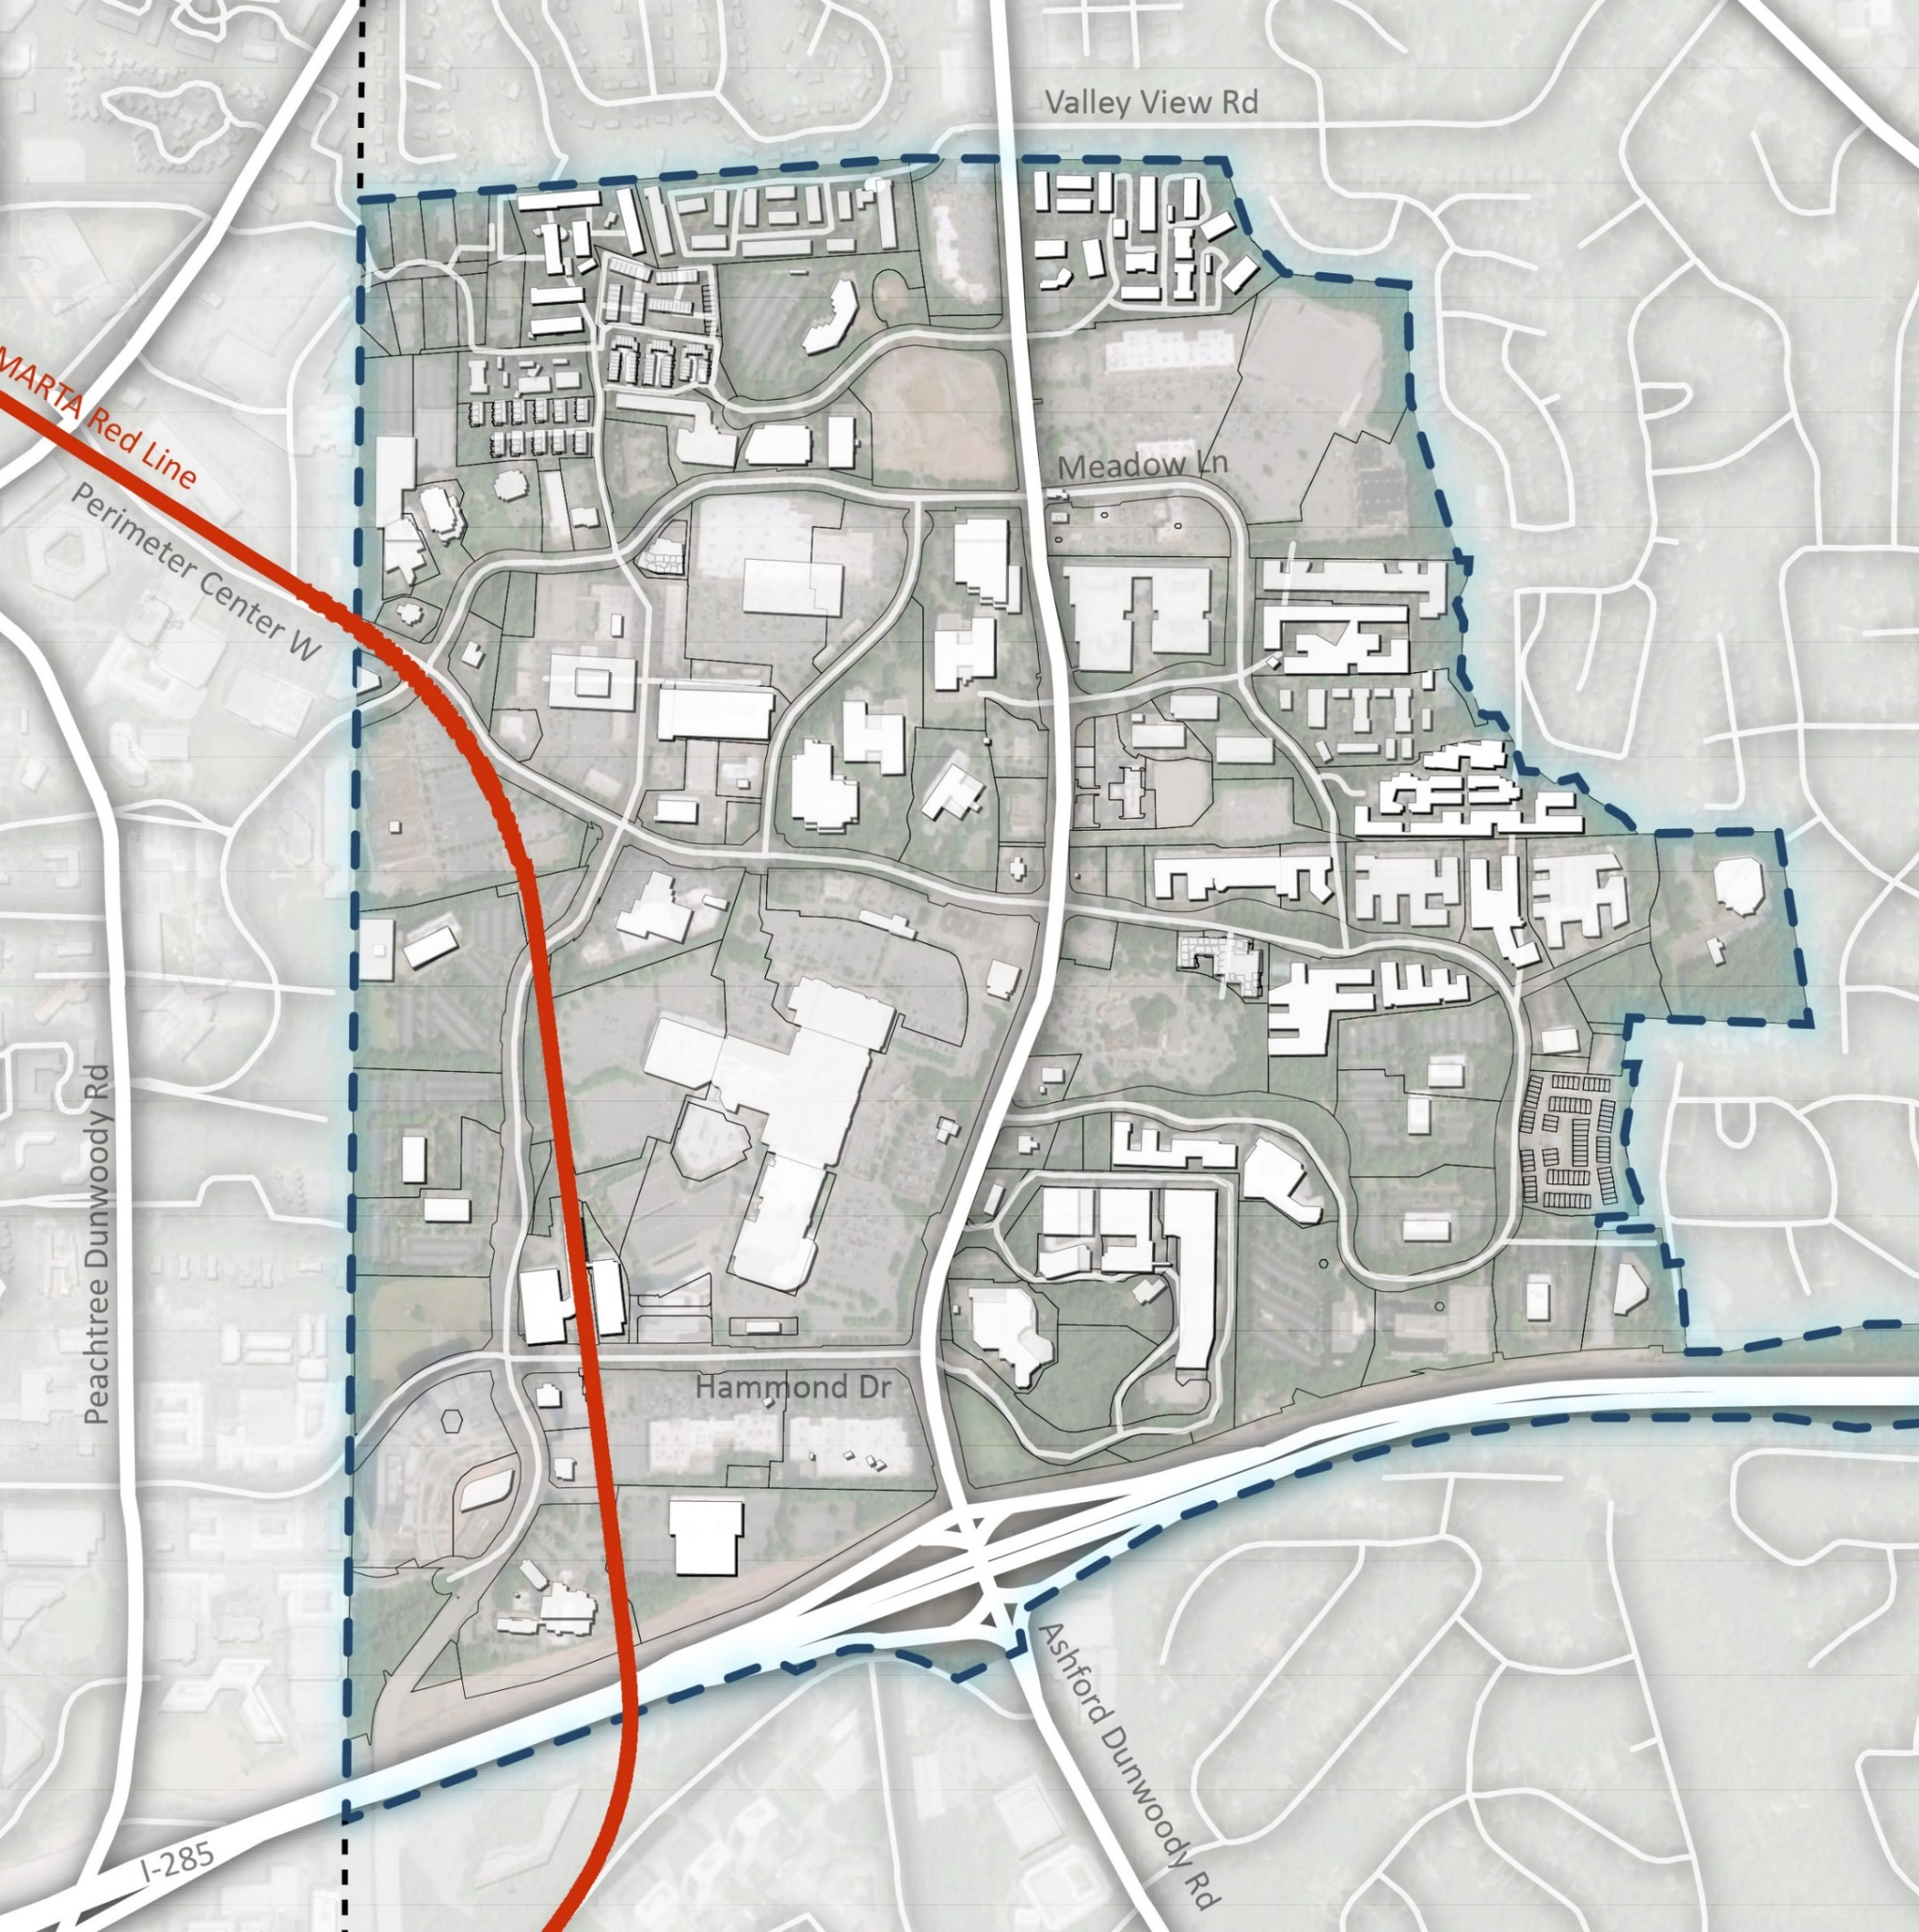
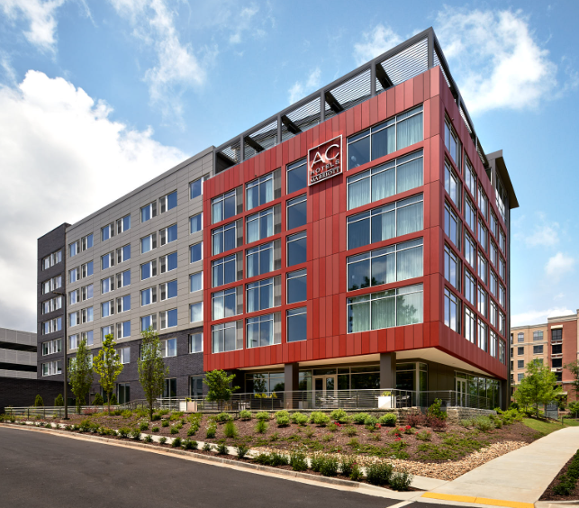
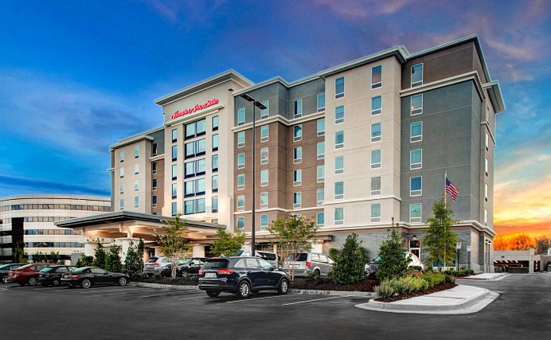
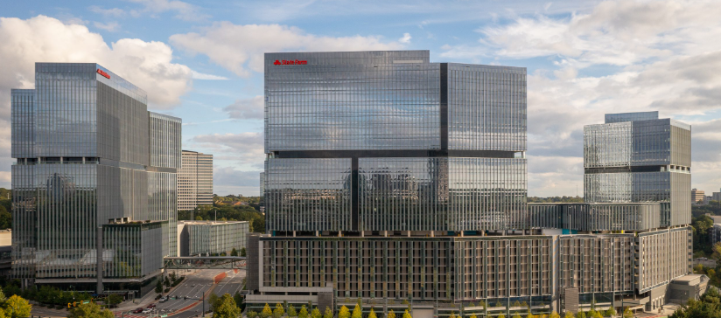
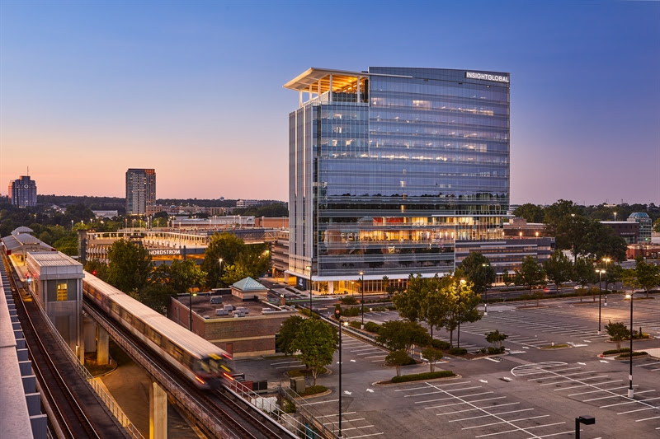
Residence Inn Hotel
$700M of Commercial Development since incorporation
AC Hotel
Hampton Inn Hotel
Park Center 1, 2, and 3
Twelve24 Hammond Office and Hotel

Slide 11
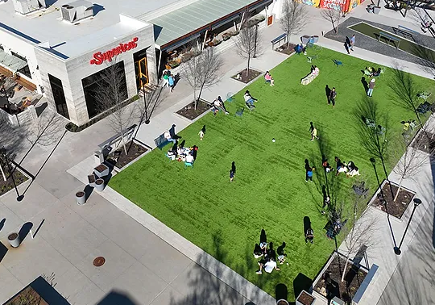
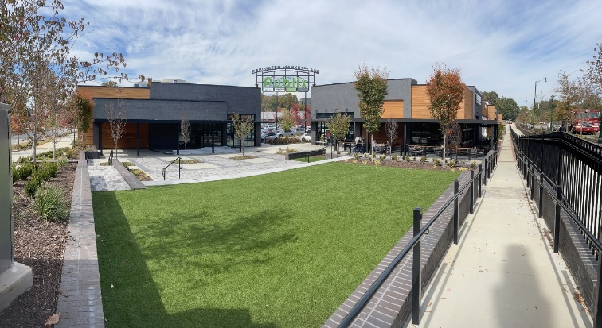
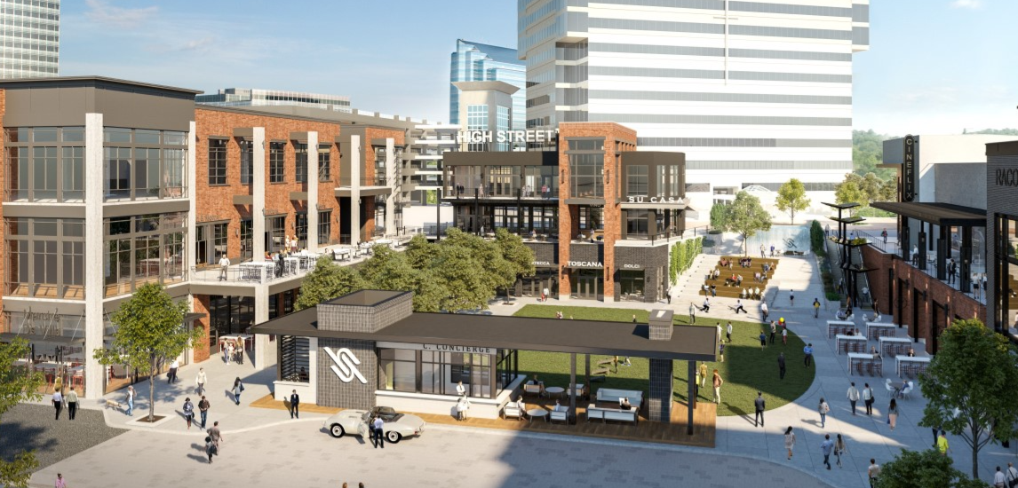
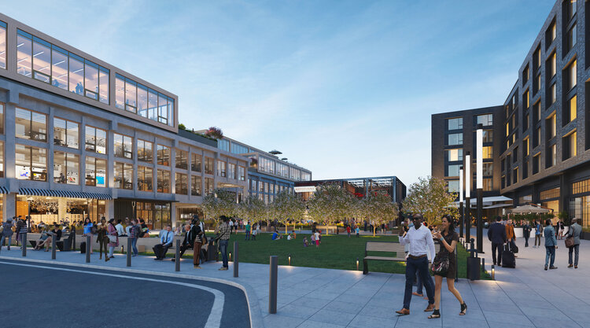
$600M of Commercial Development under construction
Ashford Lane
Perimeter Marketplace
Campus 244
High Street

Slide 12
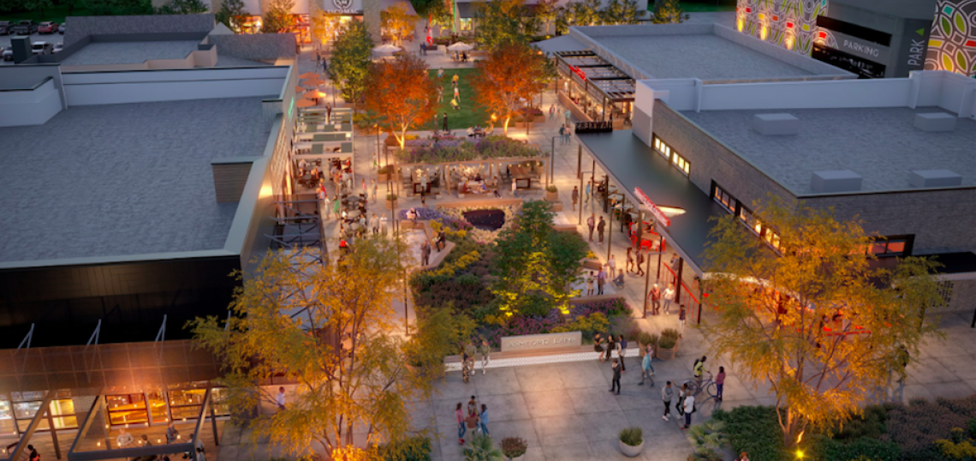
Market Trends RETAIL
4.5M Square Feet
3% Vacancy
3.9% Availability
20% of Commercial Valuation
Rents well above Metro average. Vacancy low but future retail development will be a fraction of the past and focused on F&B, Entertainment, Convenience & Services.

Slide 13
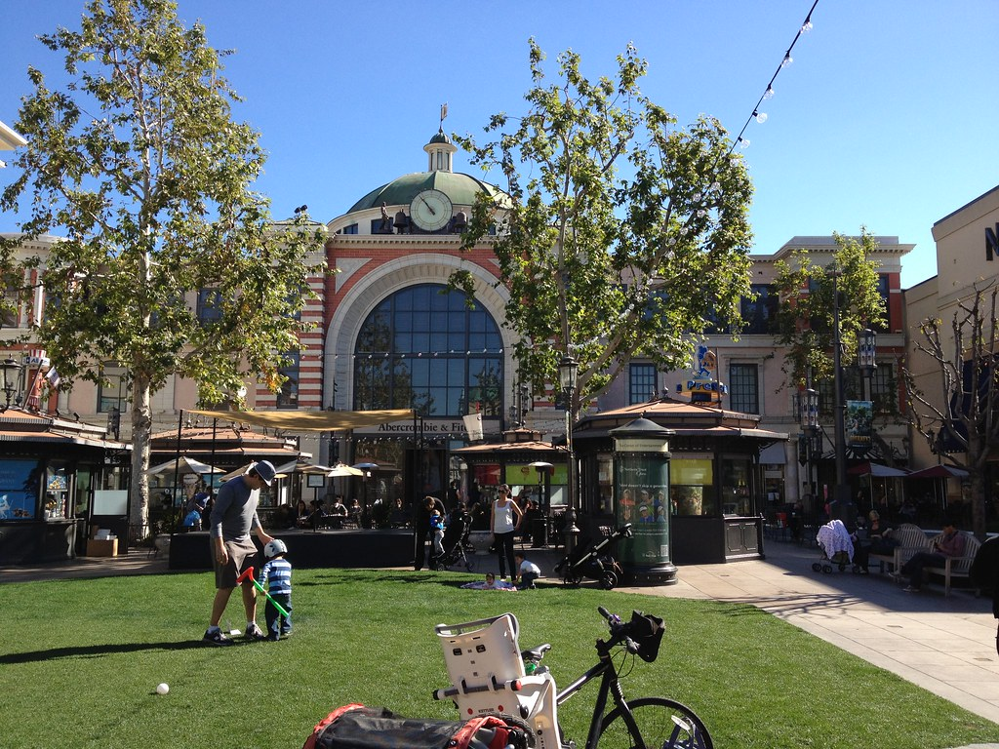
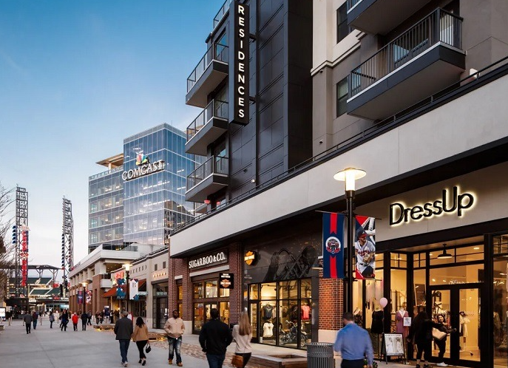
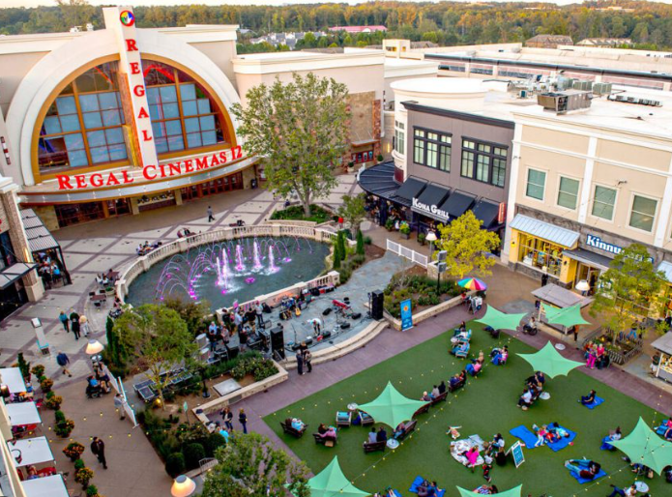
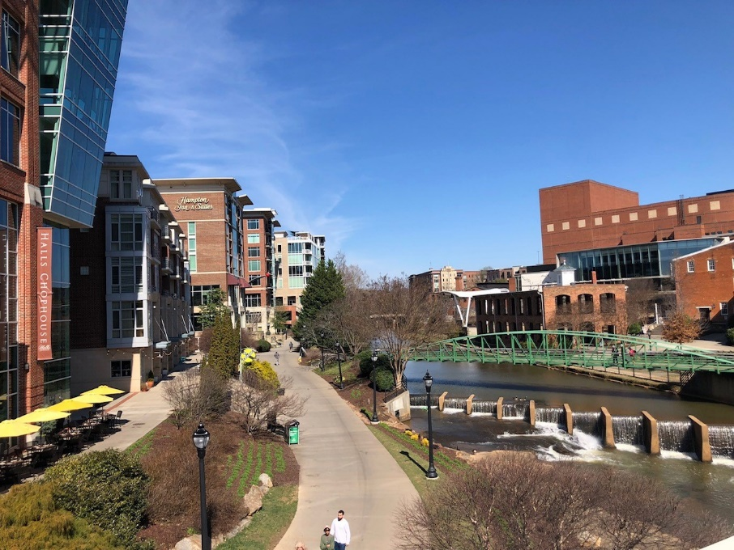
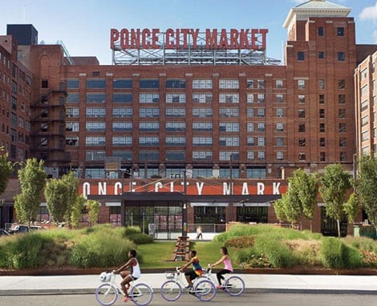
Retail is Changing
Connect
Engage
Experience
Notes:
Restaurants are the new anchor tenant for Retail Shopping Centers
Outdoor Greenspace connected to Retail.
Eater-tainment Concepts.
Yesterday – shopping as a destination, car oriented and convenient.
Today – hub of daily life, curated experience built around restaurants
Best of Both Worlds – Convenience Retail: grocery anchored, Big Box, etc.
Destination: Restaurant anchored, greenspace, active, etc.

Slide 14
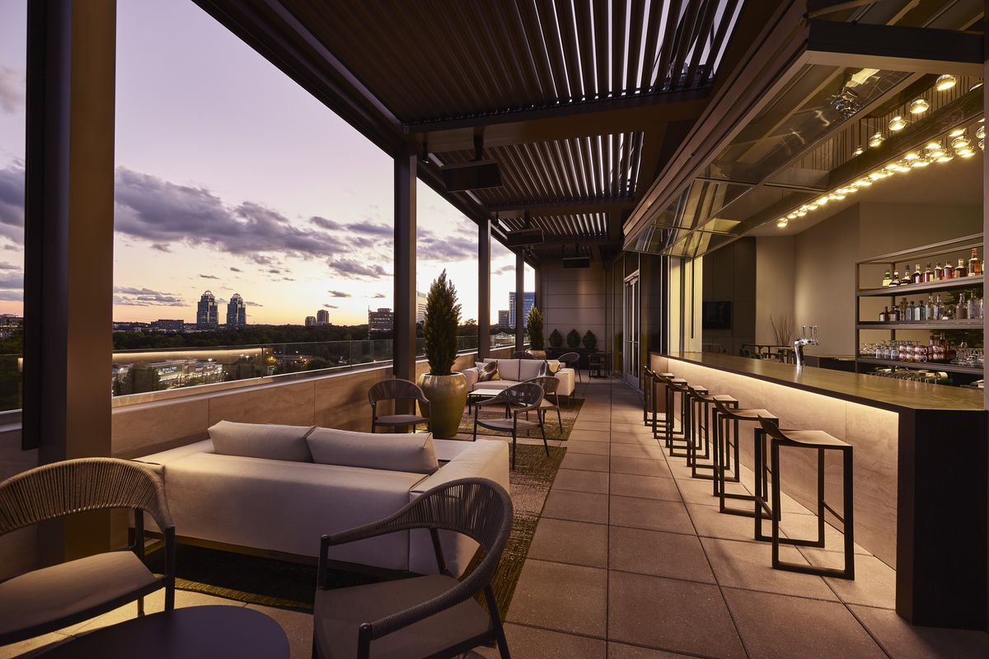
Market Trends HOTELS
2100 Rooms
65.5% Occupancy
$95 Revenue Per Available Room
5% of Commercial Valuation
Area hotels tend to be more upscale and larger than average. Dunwoody is leading occupancy and Average Daily Rate. Hotel Motel Tax & Visitor Spending add to impact.

Slide 15
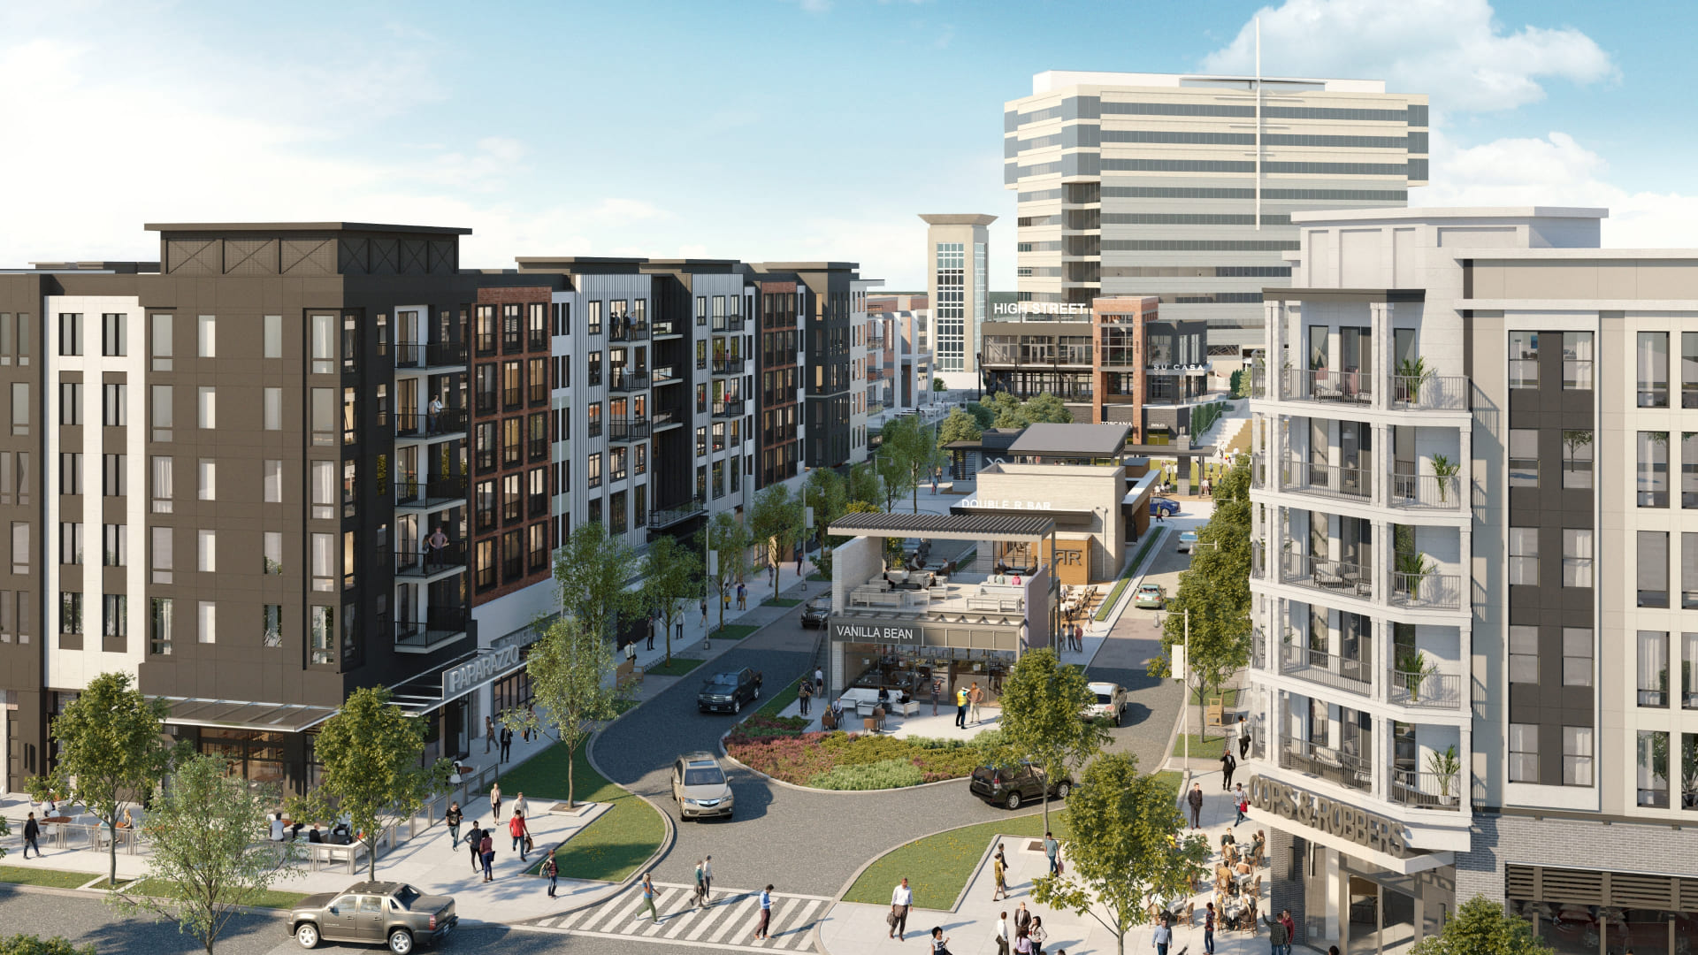
Market Trends APARTMENTS
11,176 Units
14% Vacancy
$1,722 Average Rent
40% of Commercial Valuation
Rental market above the Metro average. Continued strong demand anticipated over the next 20 years.

Slide 16
Market Trends OFFICE
10.2M Square Feet
25.5% Vacancy Rate
30.5% Availability Rate
25% of Commercial Valuation
Perimeter continues to attract larger corporate tenants but vacancy still well above pre-pandemic average. Uncertainty in office sector will dampen new development over near term.

Slide 17
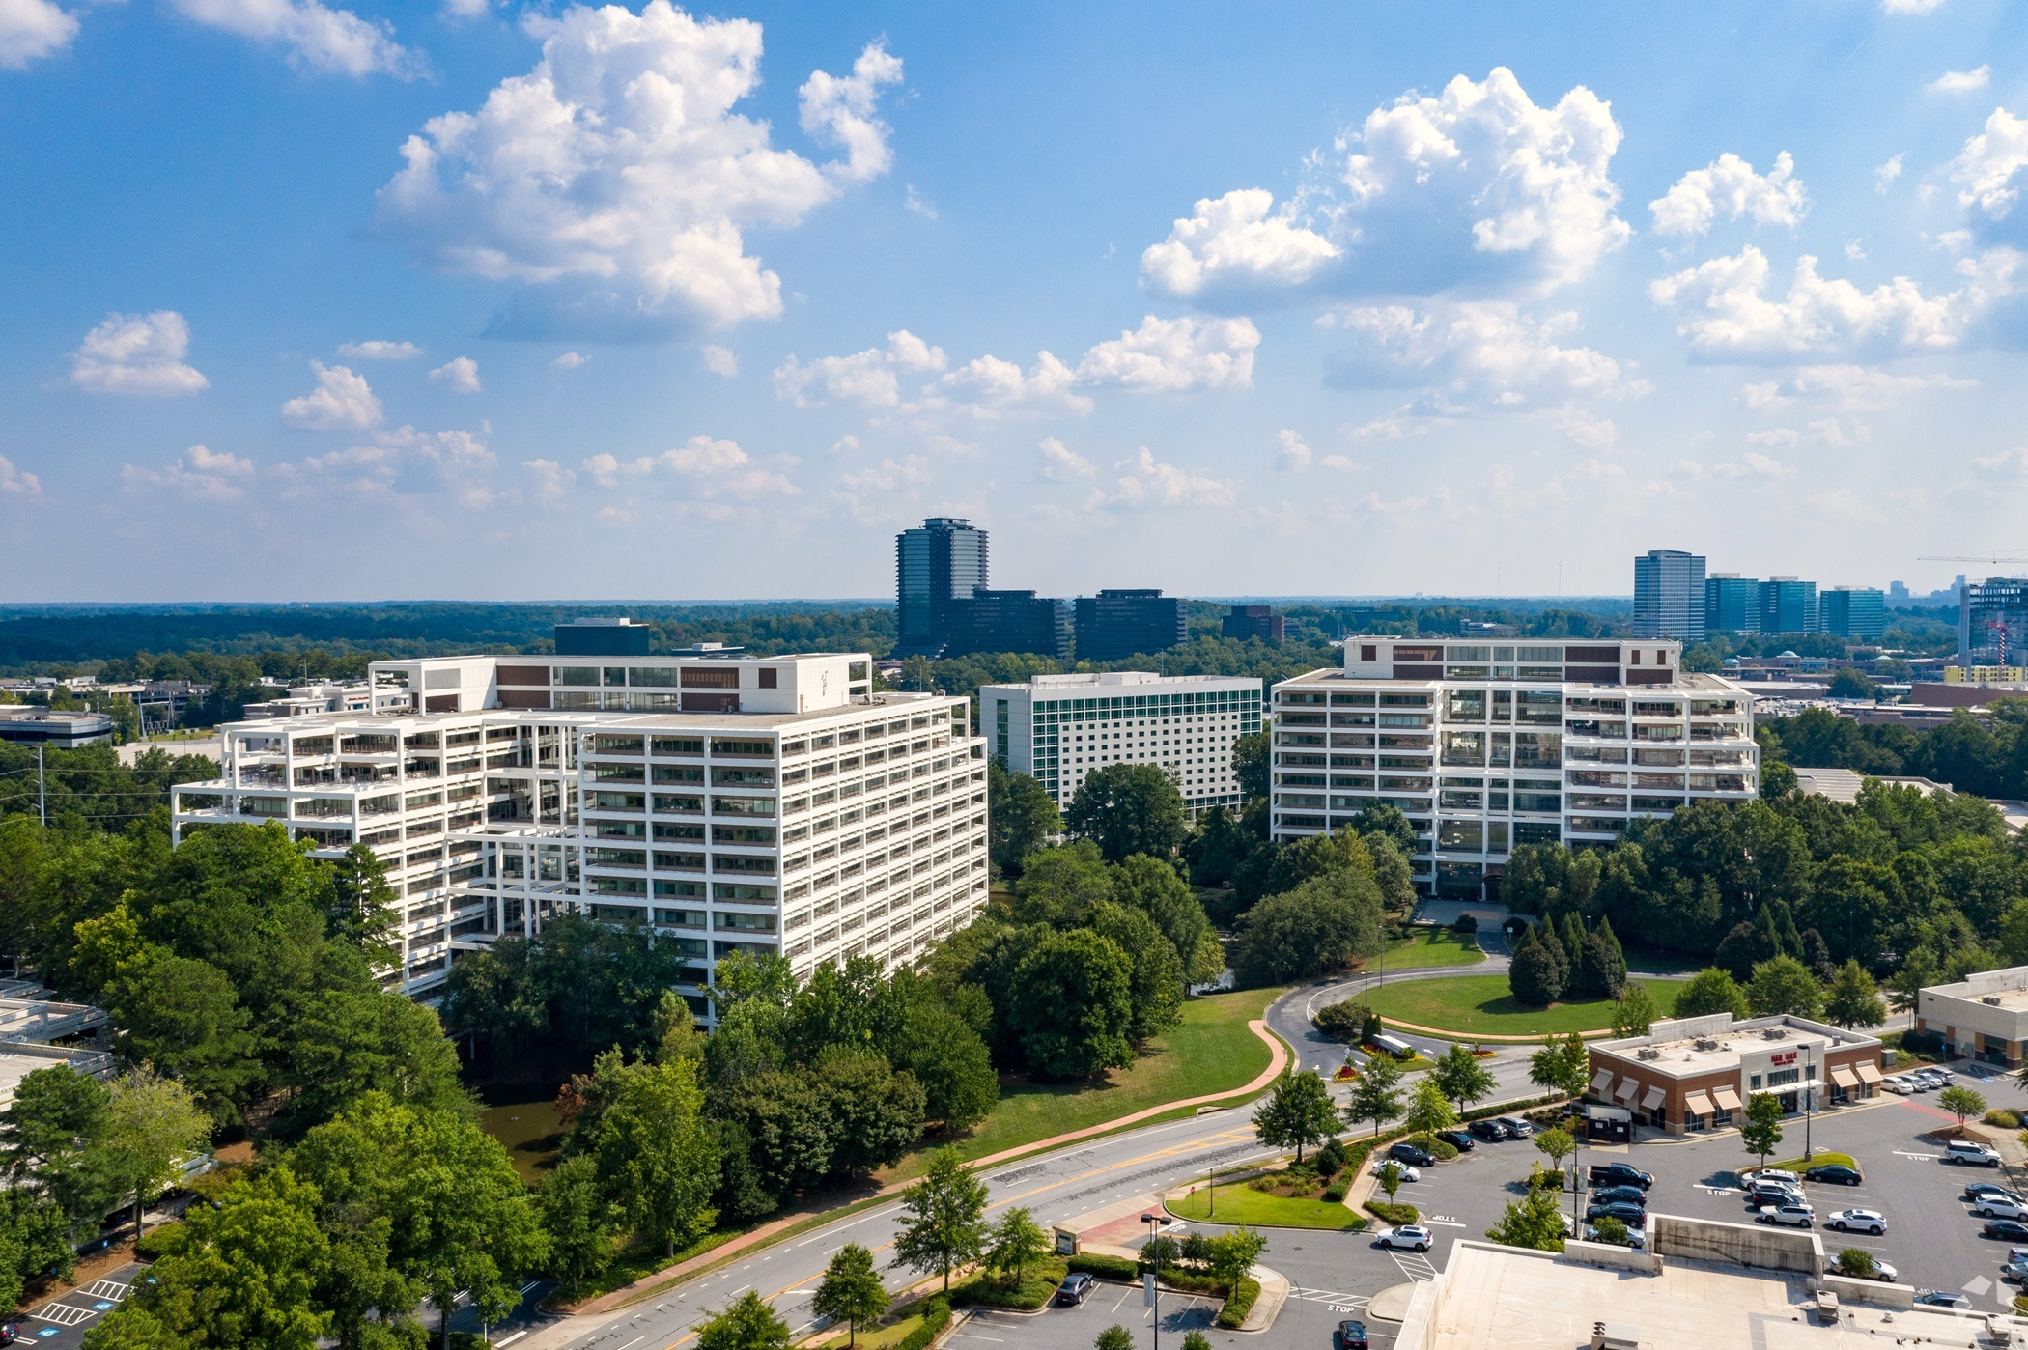
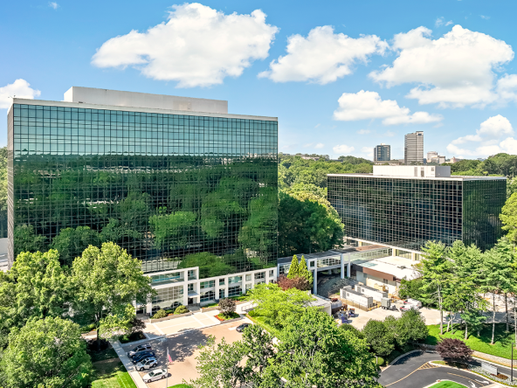
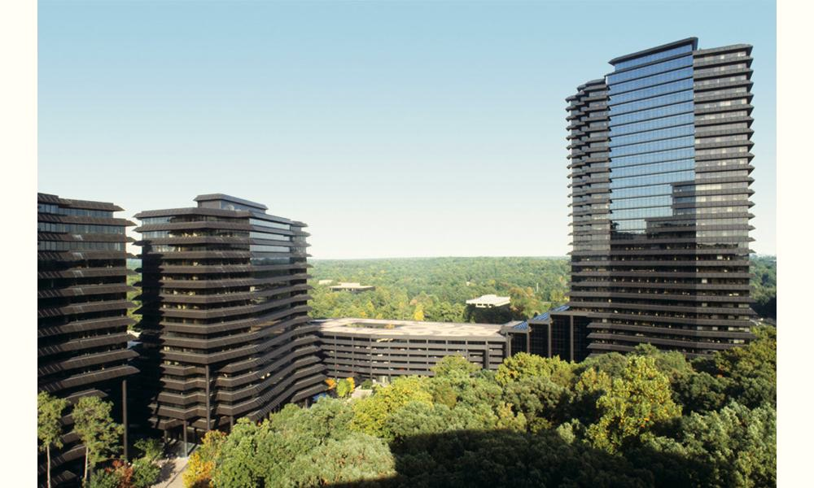
Vacancies
400,000 square feet
Ravinia 1, 2, and 3
Terraces
600,000 square feet
500,000 square feet
64 & 66 Perimeter Center East

Slide 18
Recruitment

Slide 19
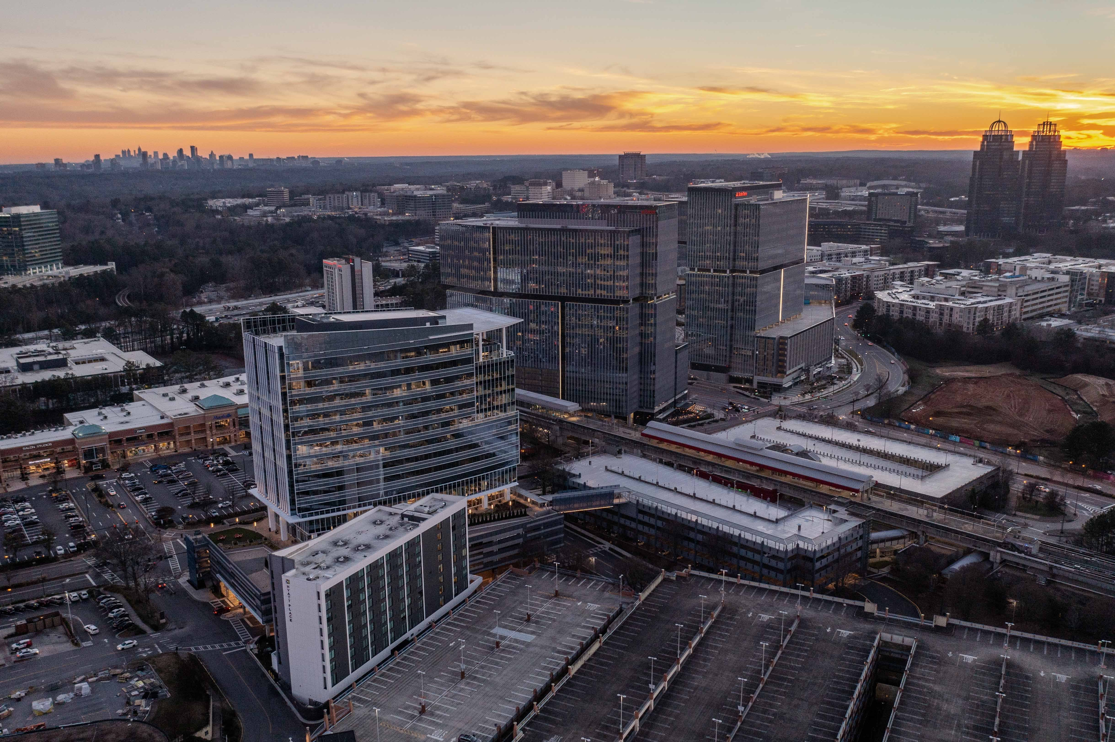
Outlook
Flight to Quality
Sub-leases
Value Buyers
4 R’s
Renovation
Repositioning
Repurposing
Redevelopment
Notes:
The office market is at a Pivot Point – how office is being utilized is shifting while tenant footprints are shrinking. This process is putting a premium on mixed-use developments that lean into Amenities. It’s about Neighborhoods as much as anything else – vibrant places will outperform static uninteresting places.

Slide 20
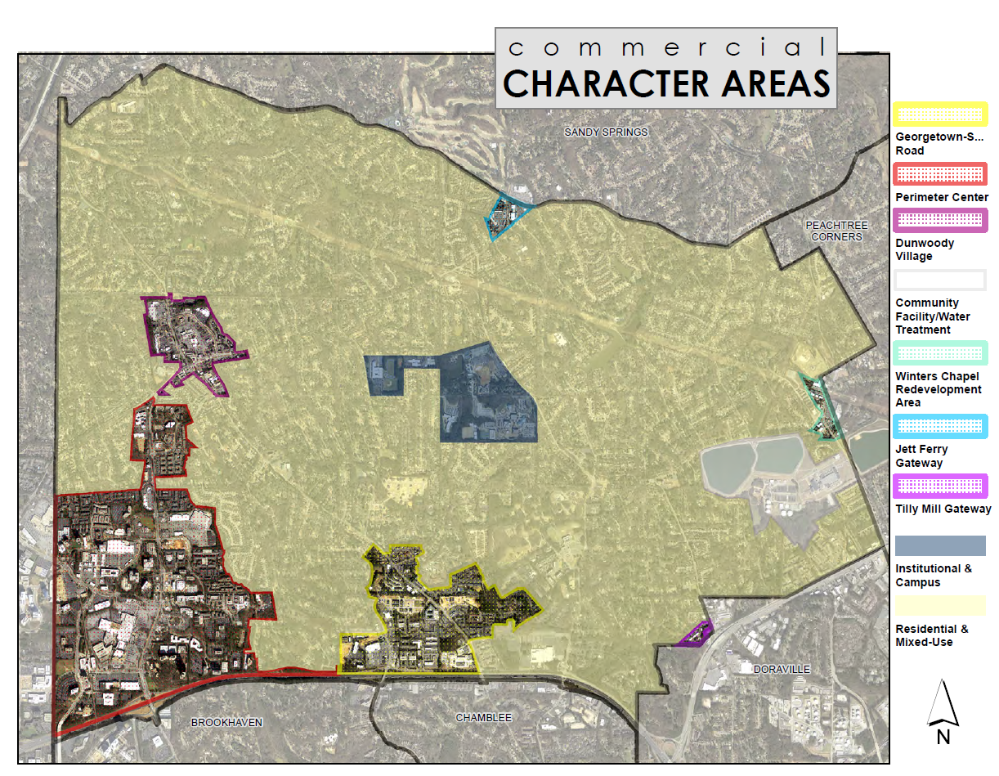
Add map of Commercial Character areas

Slide 21
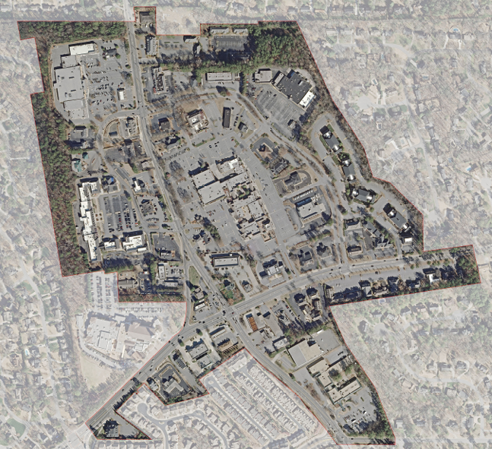
Dunwoody Village
533,000 SF Retail
4.6% Vacancy
276,000 SF Office
1% Vacancy

Slide 22
Dunwoody Village
Dunwoody Village Parkway
Townhomes
Village Courtyard
Chamblee-Dunwoody Gateway Project
Merchants Association

Slide 23
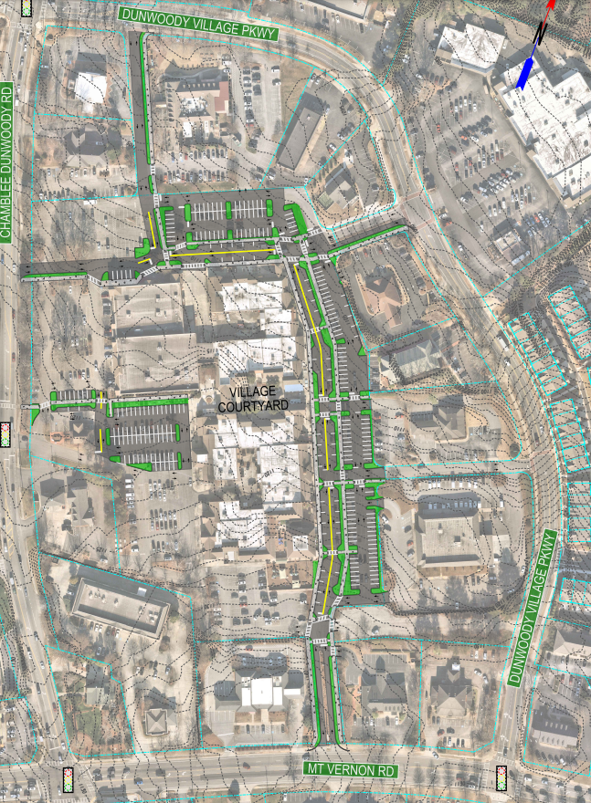
Dunwoody Village
Post Office 2.5 Acres
Northern Parcels 2.5 Acres
Regency Parking 1.3 Acres

Slide 24
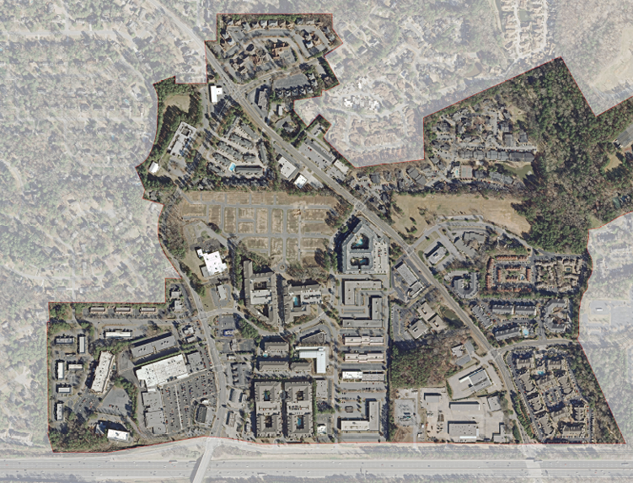
Georgetown
245,00 SF Retail
0% Vacancy
730,000 SF Office
8.8% Vacancy

Slide 25
Georgetown
Project Renaissance
Townhomes
URA Property
Georgetown Gateway Project
School Property
Dunwoody Park Office Site

Slide 26
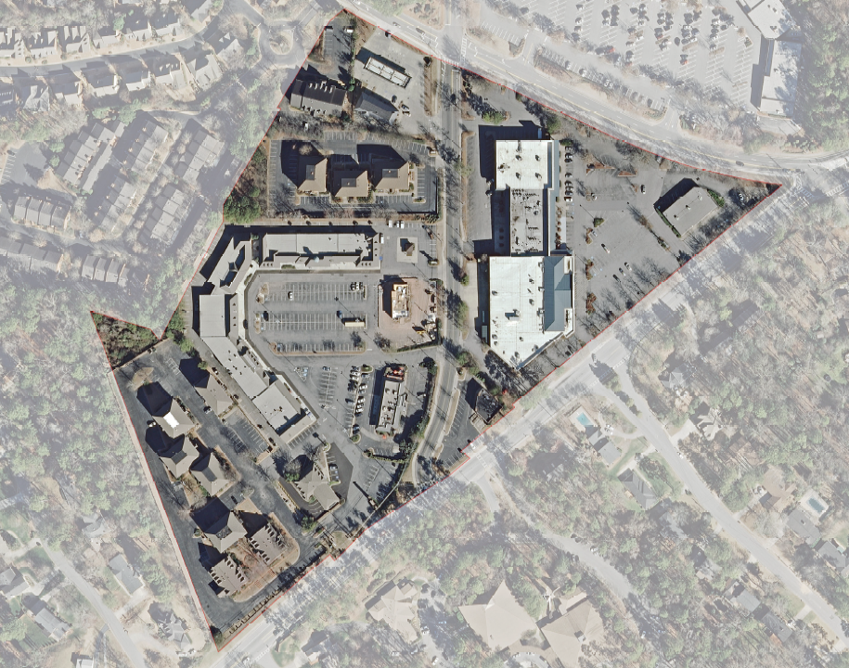
Jett Ferry
141,000 SF Retail
26% Vacancy
72,000 SF Office
3.9% Vacancy

Slide 27
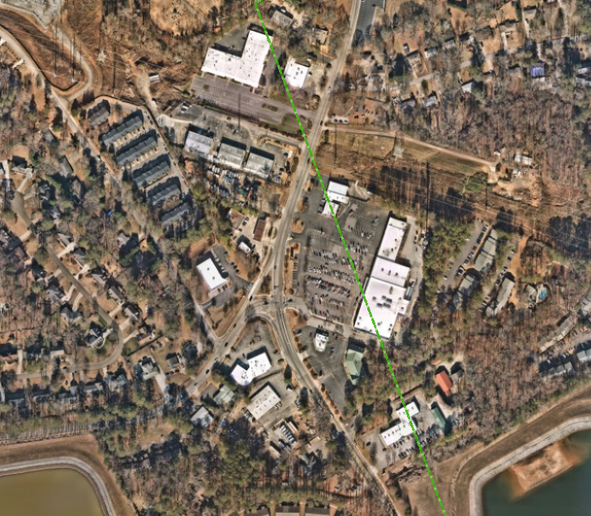
Winters Chapel
32,000 SF Office & Retail
0% Vacancy

Slide 28
Place-Transformation
Place-Development
Place-Making
Place-Marketing
Place-Management
Proactive collaboration between Public and Private interests is critical to creating quality of life amenities that will ensure our long-term competitiveness in recruiting investment from Residents, Visitors, and Businesses.

Slide 29
Questions?

