Slide 1
Council Retreat Dunwoody Parks & Recreation
March 12, 2024

Slide 2
Department
Rachel Waldron
Parks & Recreation Director
Kate Borden
Recreation Program Manager
Gabe Neps
Operations Manager
Andrea Perez
Recreation Coordinator
Dylan Gesford
Recreation Coordinator
Brandon Alvarado
Facilities Coordinator
David Alexander
Grounds Coordinator
Antwain Adams
Part-Time Recreation Leader
XXXXXX
Part-Time Recreation Leader
Kelvin Alford
Facilities Associate

Slide 3
Priorities
Development of Existing Properties
Wildcat Park build-out
Homecoming Park build-out
Waterford Park playground and trail connection to Kingsley neighborhood
Associated operating expenses as properties are developed:
Full-Time and Part-Time Recreation Leaders to assist with events, marketing and athletics
Additional Operations Associates to maintain new assets
Operational budget increased as facilities come on-line

Slide 4
Park Only Bond
Cost Estimates (October ’22)
Demolition and site clearing: $272,000
Erosion Control: $36,000
Utilities: $74,000
Hardscape and Furnishings: $2,800,000
Program Elements: $3,400,000
Landscape: $700,000
Contingencies: $3,200,000
Total $10,500,000
Maintenance Cost Projections
Grounds, non-warranty items, utilities, etc.
Year One: $149,600
Year Two: $206,980
Year Three: $217,365
Notes:
Combine with Operations slide depending on content
Projects plus timeline
Brent to expand rec center positions
Breakout option with “with bond” on own slide?

Slide 5
Park Only Bond
Cost Estimates (March ‘23)
Demolition and site clearing: $218,000
Erosion Control: $20,500
Utilities: $114,000
Hardscape and Furnishings: $1,600,000
Program Elements: $860,000
Landscape: $320,000
Contingencies: $1,500,000
Total $4,600,000
Maintenance Cost Projections
Grounds, non-warranty items, utilities, etc.
Year One: $98,800
Year Two: $128,740
Year Three: $135,177
Notes:
Combine with Operations slide depending on content
Projects plus timeline
Brent to expand rec center positions
Breakout option with “with bond” on own slide?

Slide 6
Planned Trails 2024-2034
Legend
Trails Existing
Trails Programmed in
5-Year Capital Budget
Trails not Fully Funded
6

Slide 7
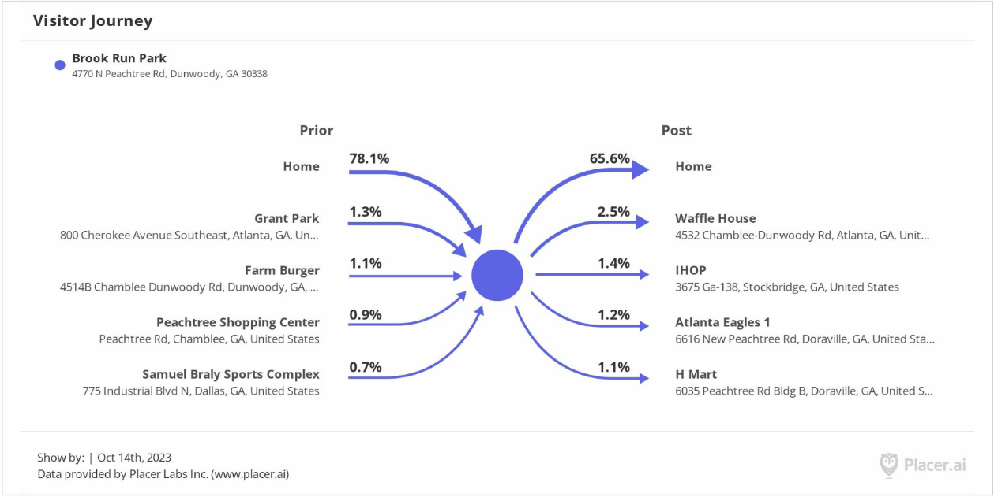
User Data
Groovin’ on the Green October 14 (DEPARTURE- The Journey Tribute Band)

Slide 8
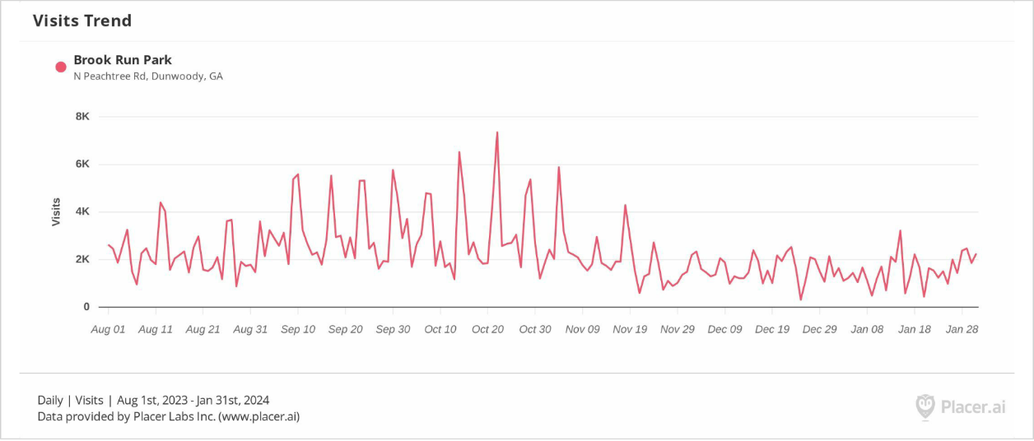
User Data
Brook Run Park visits
August 1, 2023 to January 31, 2024

