Slide 1
Finances:
Budgets, Revenues, Expenditures, Millages, and Trends
City of Dunwoody, Georgia
March 12-13, 2024

Slide 2
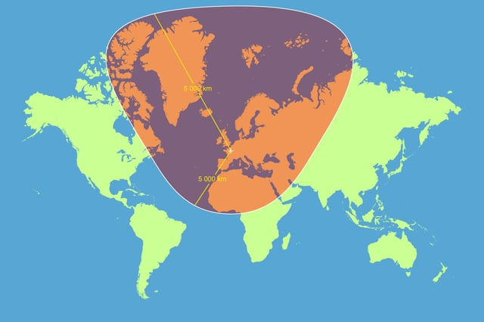
Maps…

Slide 3
How is Funding Dedicated? ($60.8M)

Slide 4
How is Funding Prioritized? ($60.8M)

Slide 5
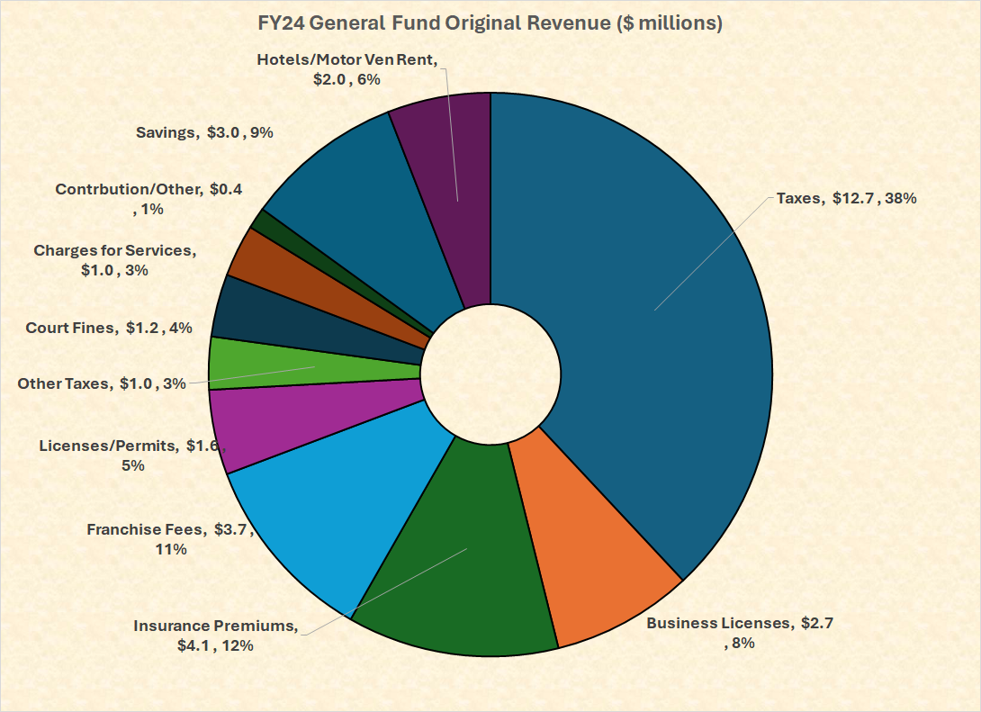
How Do We Pay the General Bills? (Pt I) ($33.4M)

Slide 6
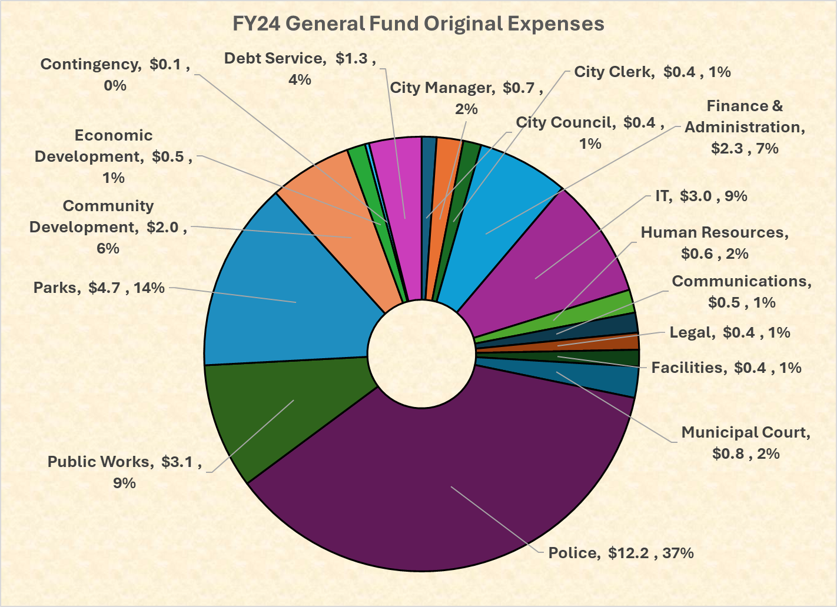
How Do We Pay the General Bills? (Pt II) ($33.4M)

Slide 7
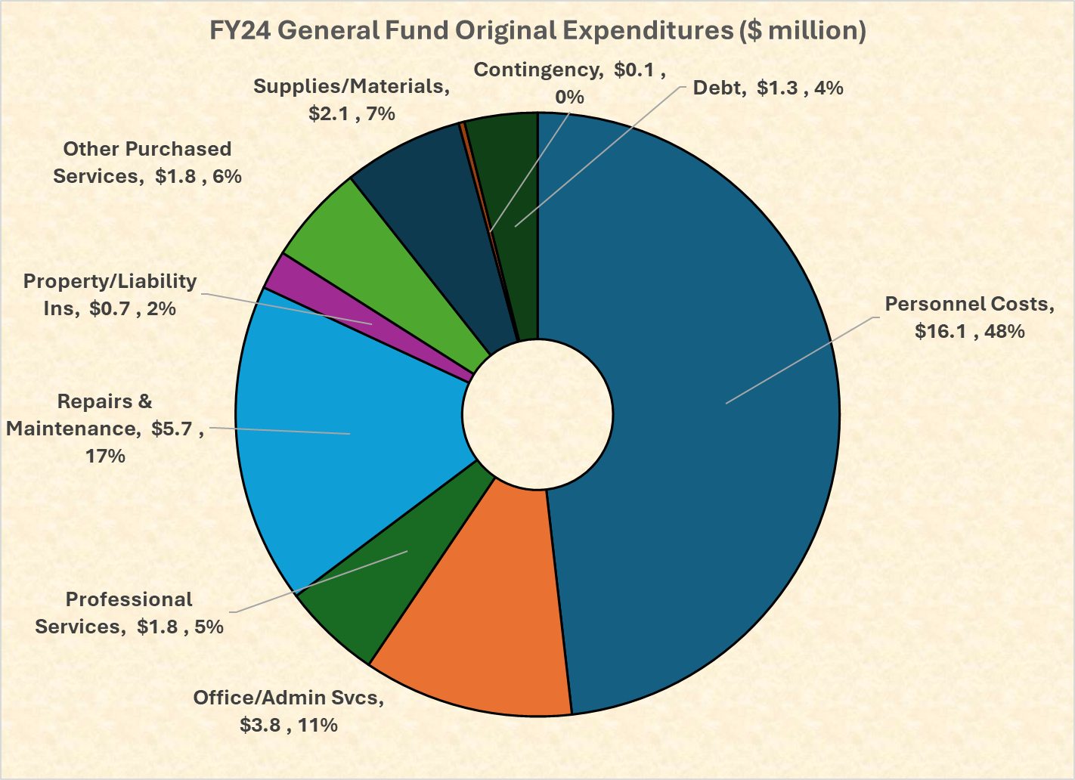
How Do We Pay the General Bills?(Pt III) ($33.4M)

Slide 8
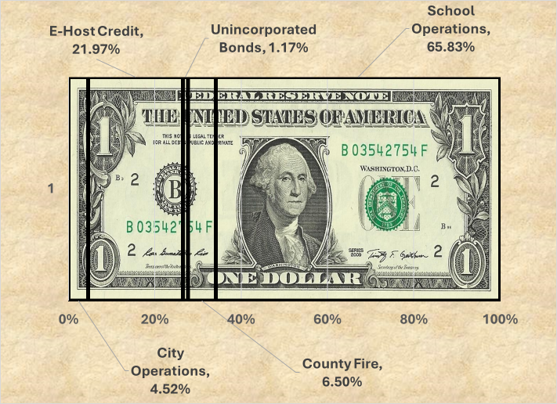
The Tax Bill…

Slide 9

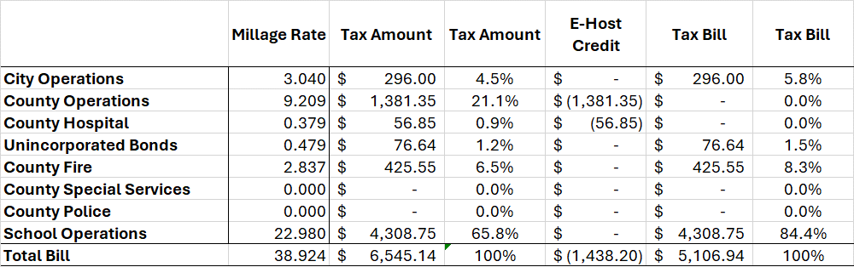
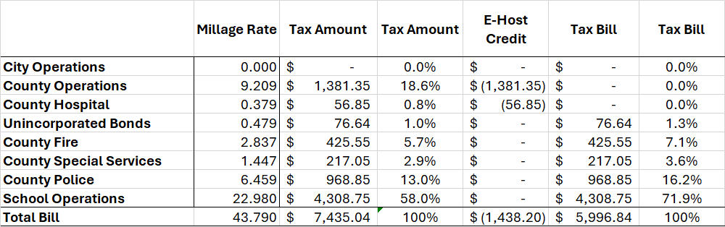
The Tax Bill…

Slide 10
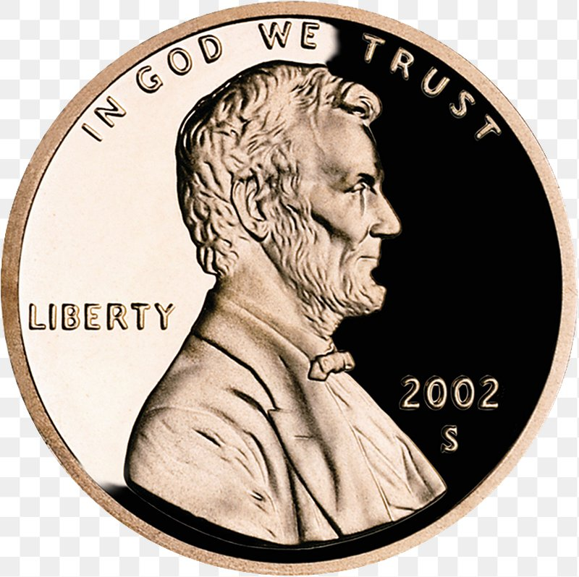
The Sales Tax Bills…
One penny to school capital needs.
One penny to city and county (population based) capital needs.
One penny to operate MARTA
One penny to relieve property taxes (county only so far).

Slide 11
Fund Balance / Park Projects
Amounts ($7.68M)……
  $1.78M remaining from the Shallowford Road sale (Capital Fund).
  $1.00M budgeted in Park Equity (ARP2).
  $300K remaining in Contingency (ARP2).
  $4.6M estimated above the six-month reserve. (This uses 75% of the projected amount ($6.1M) as the year has just started.)

Slide 12
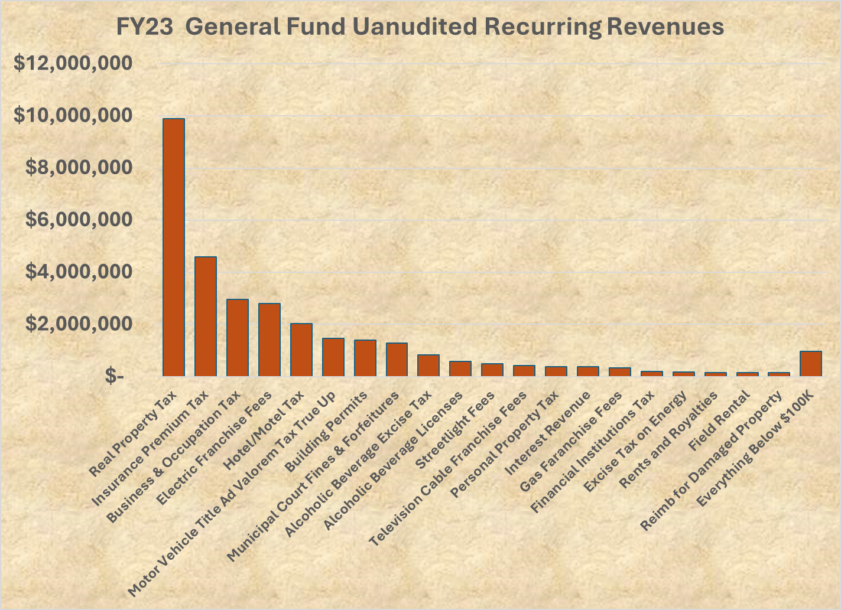
General Fund, Diversified or Not…

Slide 13
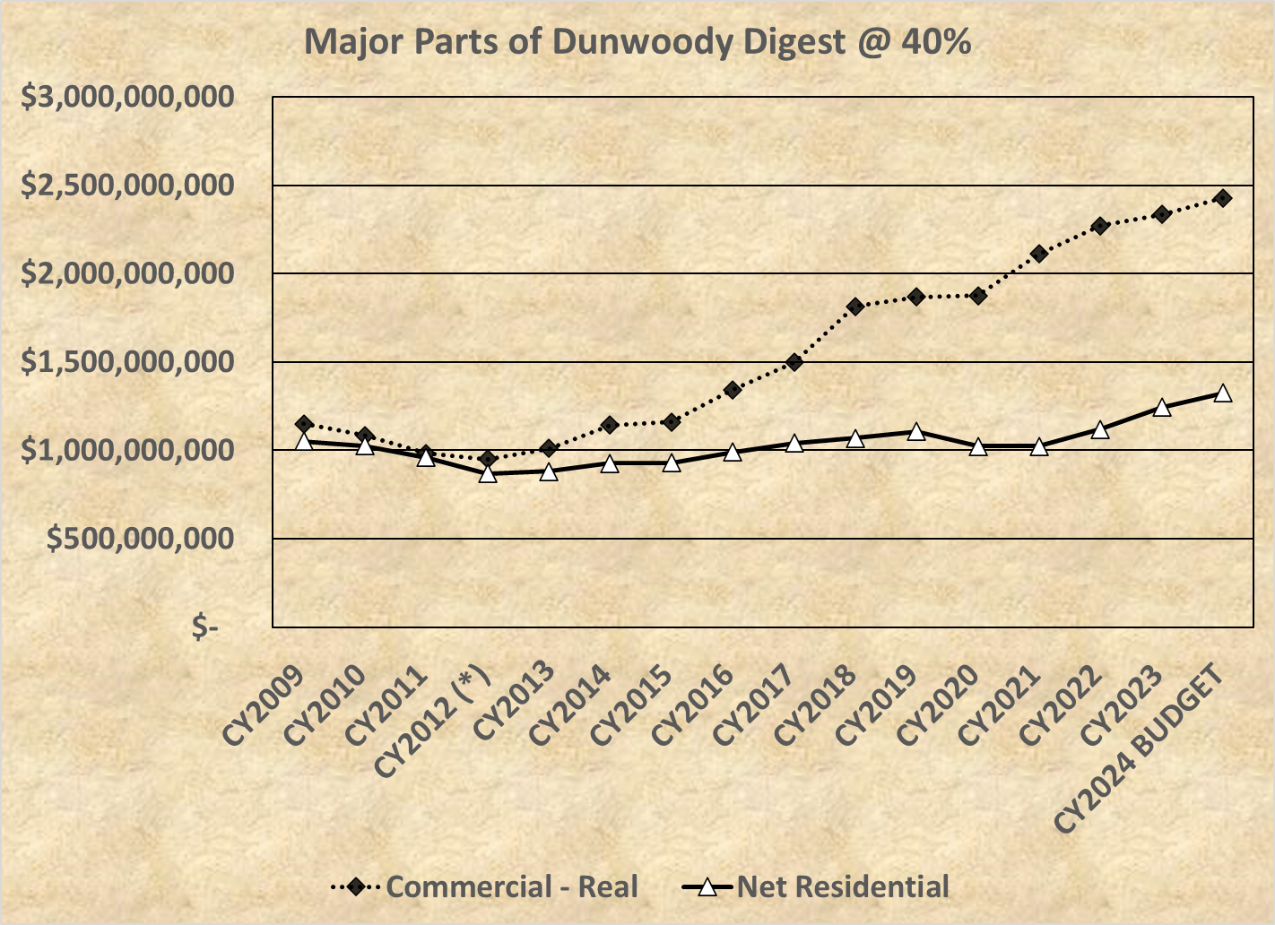
Tax Digest Trends…

Slide 14
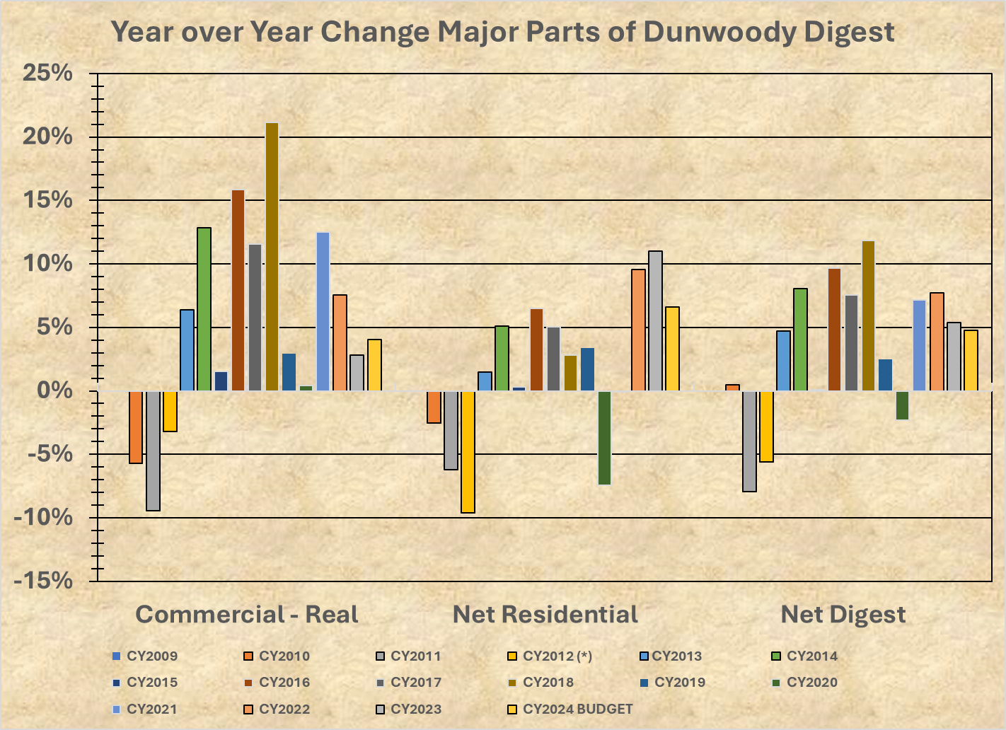
Tax Digest Trends…

Slide 15
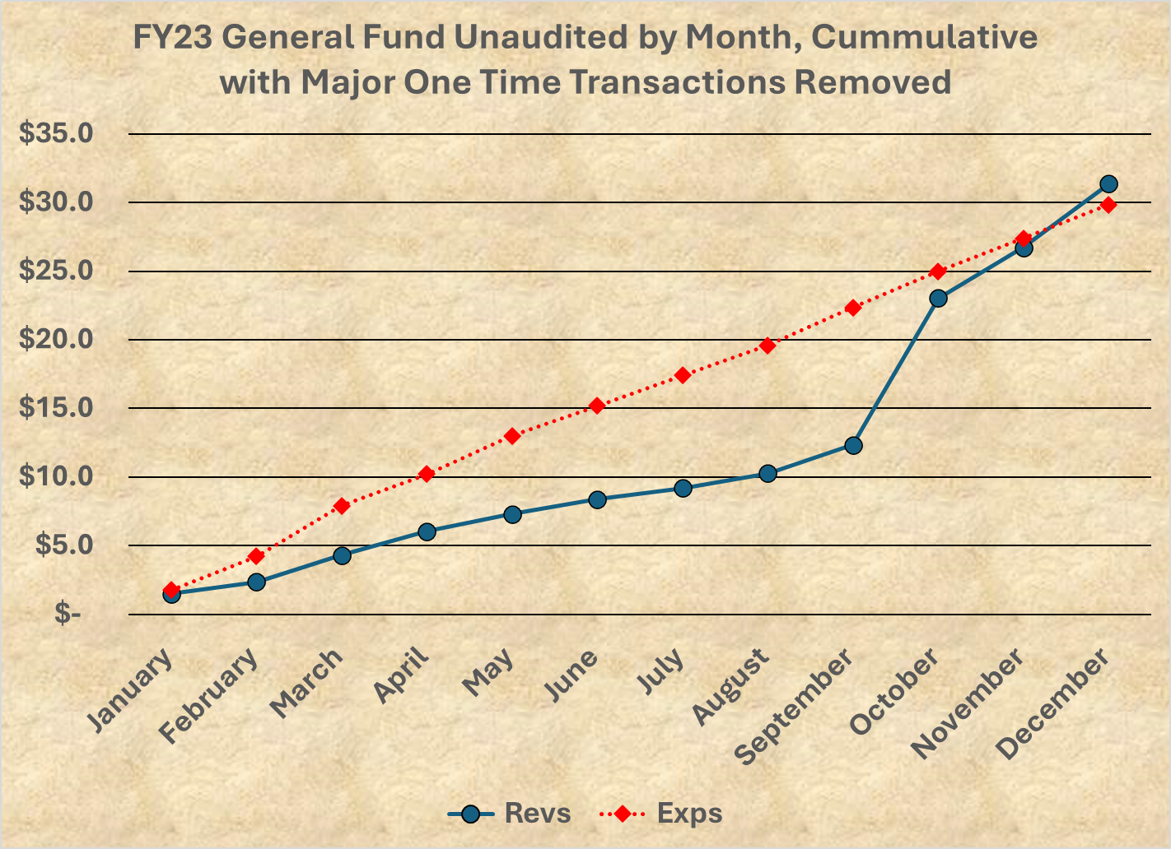
General Fund Trends…

Slide 16
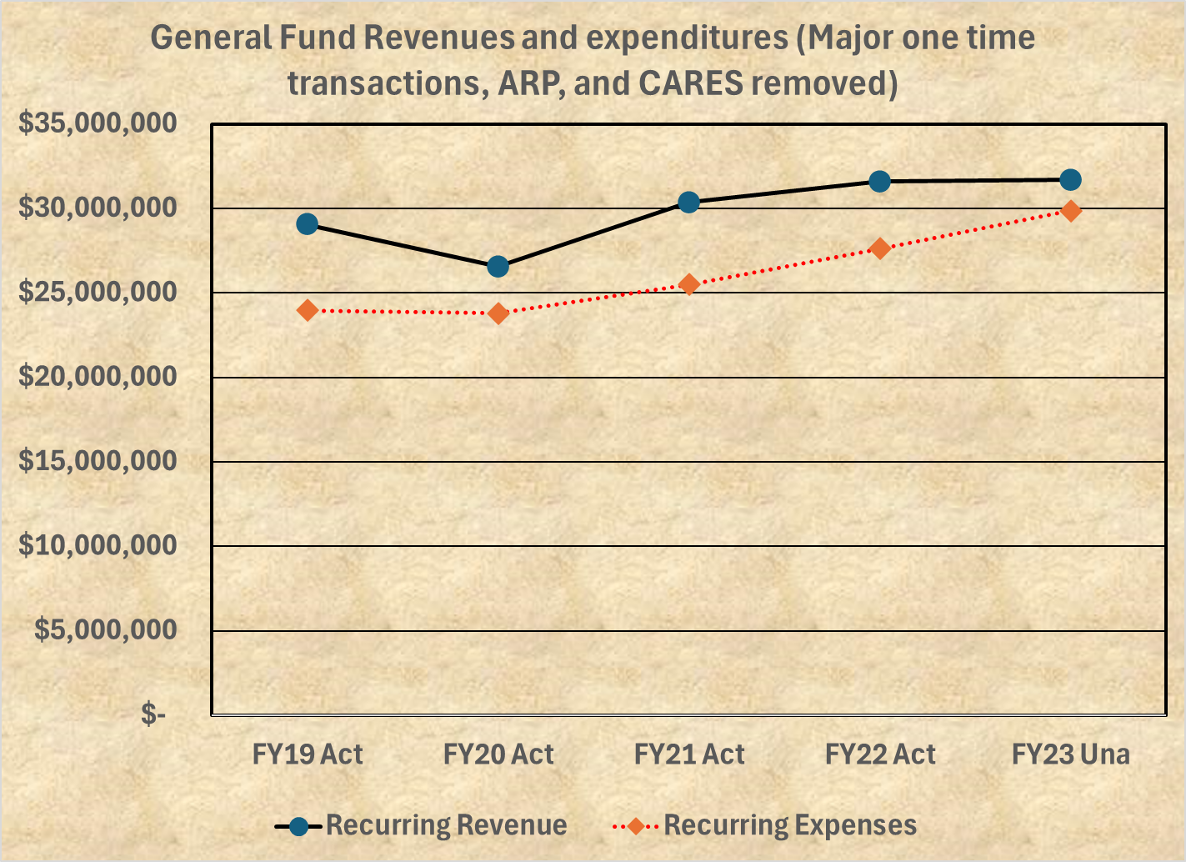
General Fund Trends…

Slide 17

Property Tax Freeze…
At 5% growth, a residential property would go from $350K to $542K in ten years. This could help handle inflation and expansion of services.
The city has a hard freeze where unless the property is sold, the value is taxed at the original value even a decade later.
Newer freezes in Georgia have caps, such as 3% which still allow for some growth with inflation.

Slide 18
Future Budget Tying…
For future budgets, spending could be tied to the future Comprehensive Plan Update
Leverage Dunwoody’s location at the heart of growing job centers, transportation systems and neighbor communities.
Redevelop target areas with a vibrant mix of uses, transportation options, high quality design, and amenities.
Foster a business-friendly climate.
Expand parks and greenspace in more locations across the city, and improve recreational opportunities.
Cultivate and expand access to arts and culture as part of what makes Dunwoody special.
Maintain and enhance residential amenities and housing types within neighborhoods.
Cultivate and expand access to arts and culture as part of what makes Dunwoody special.
Promote connectivity and choice for all modes of travel, including, transit, biking, and walking.
Expand housing choice and make aging-in-place an achievable reality for residents.

