Slide 1
Dunwoody Police Department
BerryDunn Study
  Initiated the study in October of 2022.
  Final report was received in October of 2023.
  Data collection was from our 2021 statistics. The information has changed since then, so our priorities will continuously evolve.
  There were 33 recommendations within the report listed as Critical/Priority, High/Primary, and Medium/Non-Urgent.
  The principal findings and recommendations focused on Patrol staffing levels and the need for Community Service Officers (CSOs).
  Since 2021, our focus has shifted since our staffing levels are up and there is no longer a pandemic.

Slide 2
Dunwoody Police Department
BerryDunn Study
  Focus was also on recruitment, retention, and promotion.
  With the support of Mayor, Council, and the City Manager, we have addressed a gap in services we provide with the addition of 4 sworn personnel for our Crime Response Team.
  Raised the hiring bonus to $15K. We have seen an immediate increase of our applications due to this. We have advertised in all SM platforms and utilizing the sign trailer throughout the city. As of this presentation, we have 6 officer openings. We have 5 in background (4 sworn).
  Seek the approval of CSOs later this year. This will drastically assist our officers with calls for service. Researching online reporting and various ways citizens can self-report (e.g., lost cell phone).
  Currently working on Action Plans with senior staff: staffing, training, staff development, and strategic plan.

Slide 3
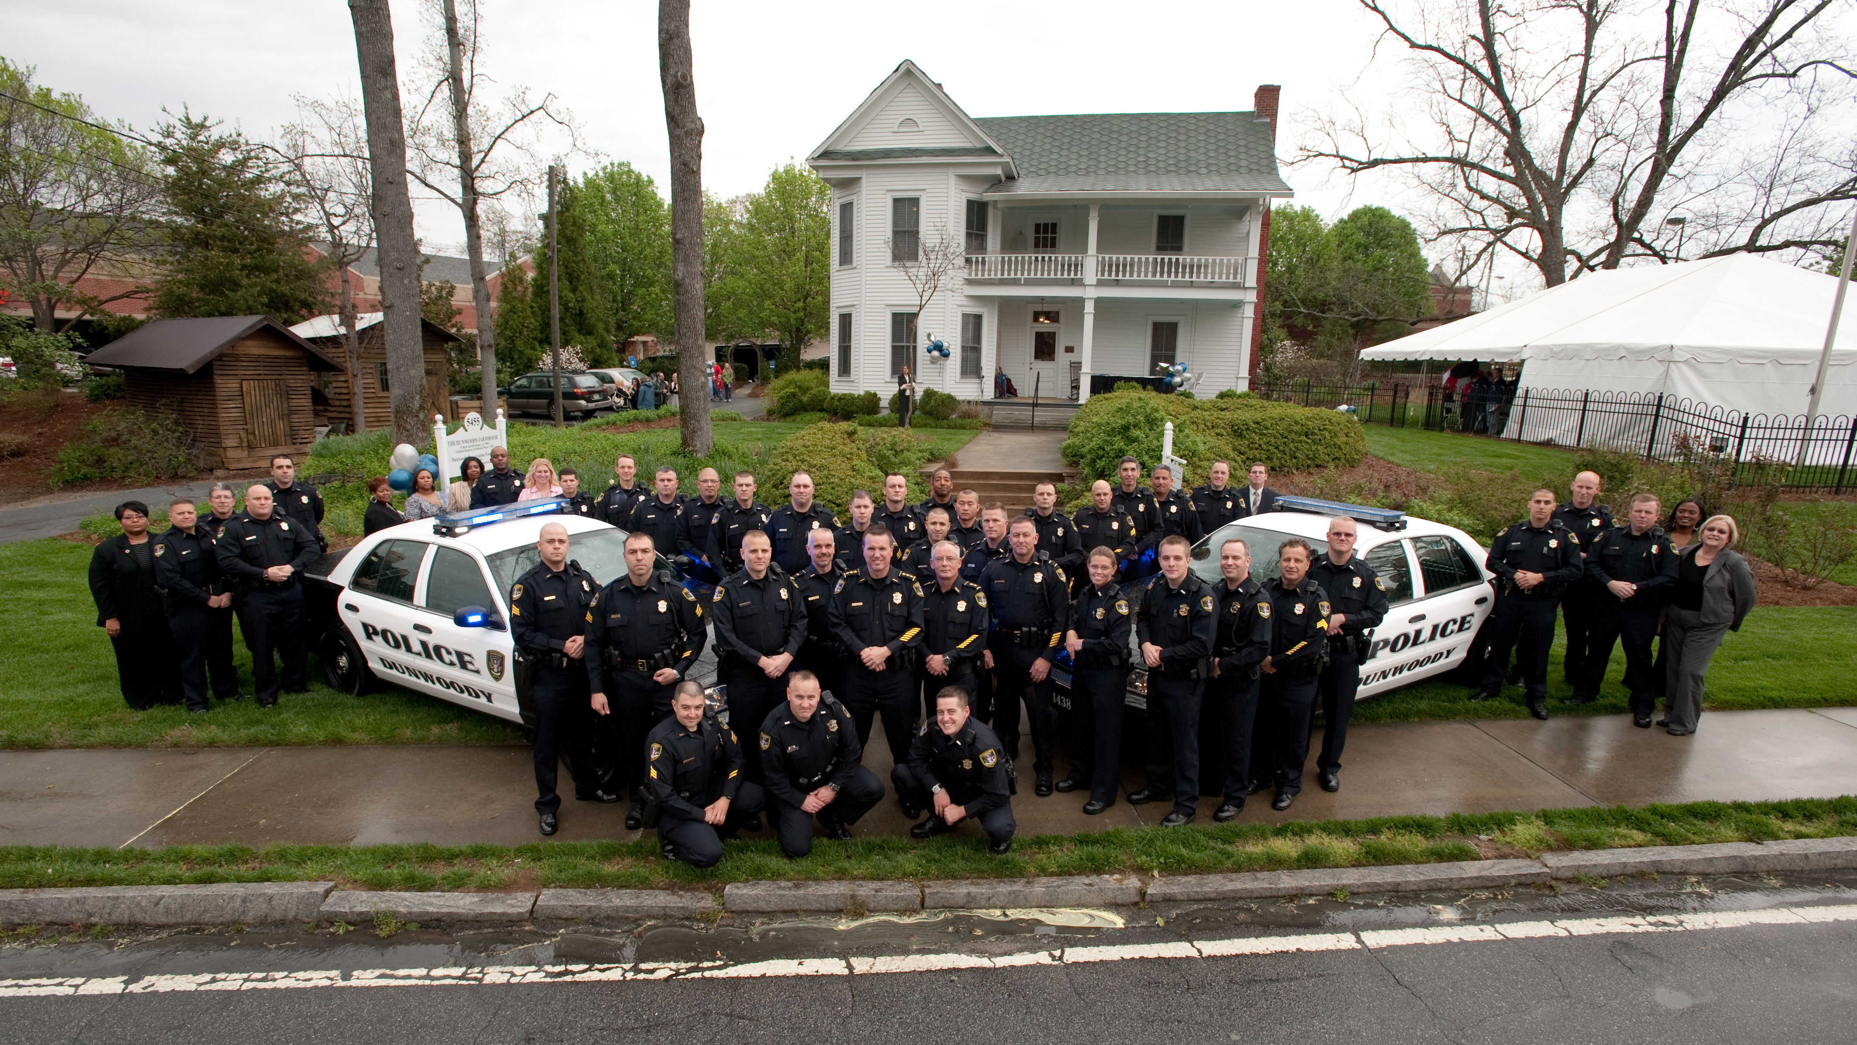
What does the Dunwoody Police Department look like in the future?

Slide 4
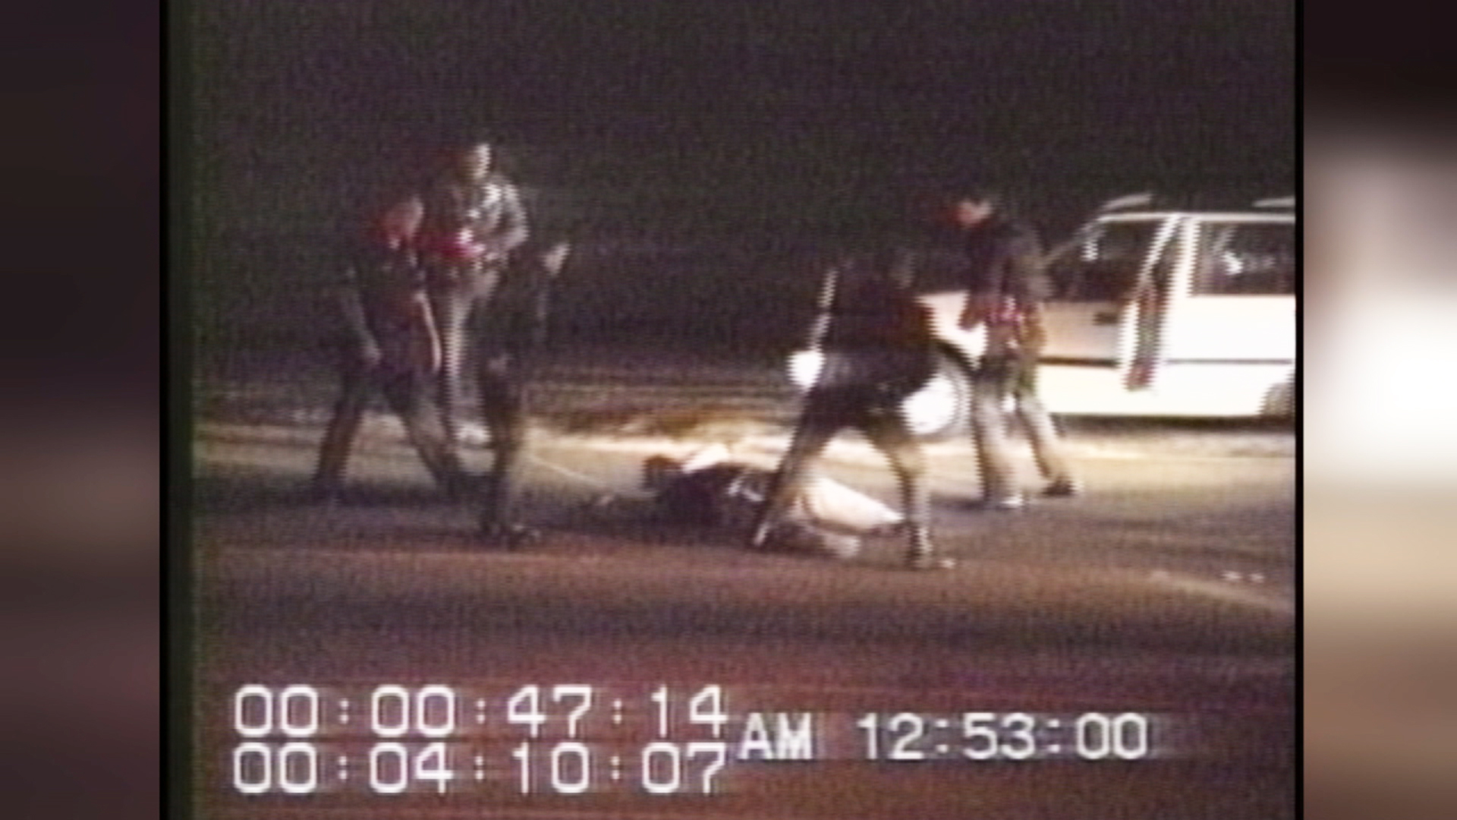

Slide 5
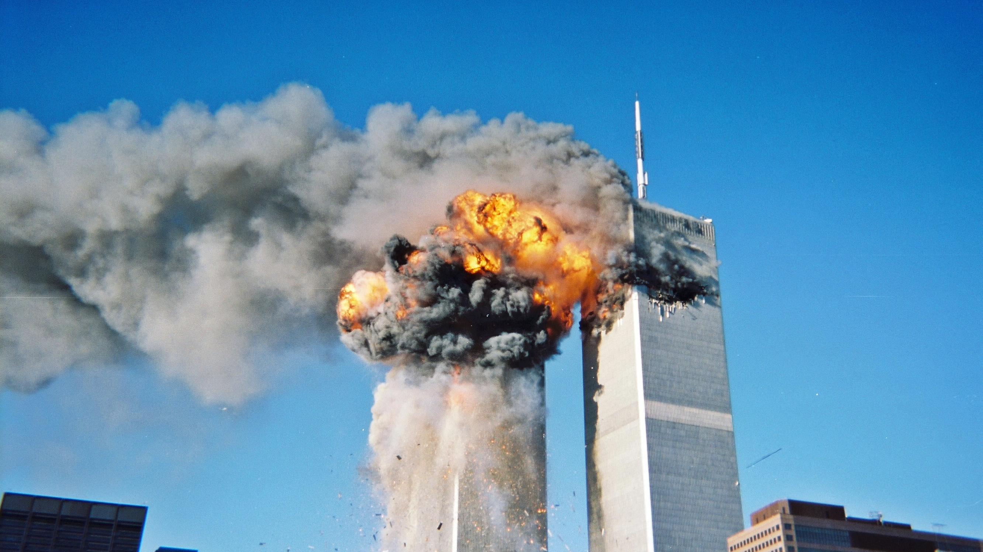

Slide 6
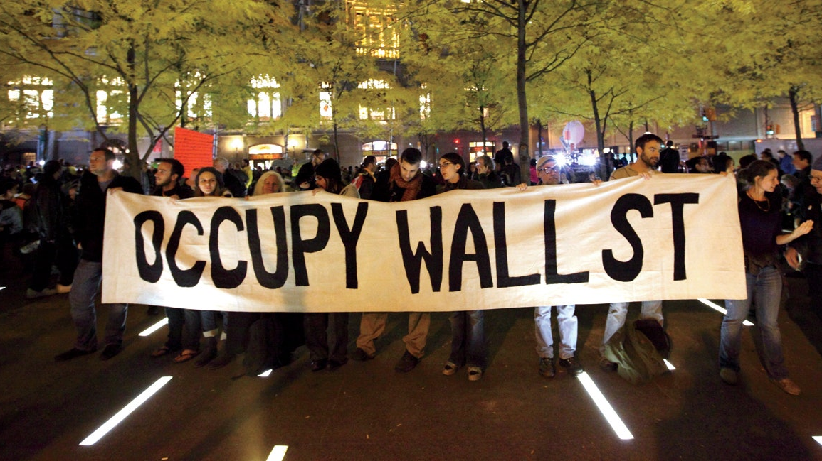

Slide 7
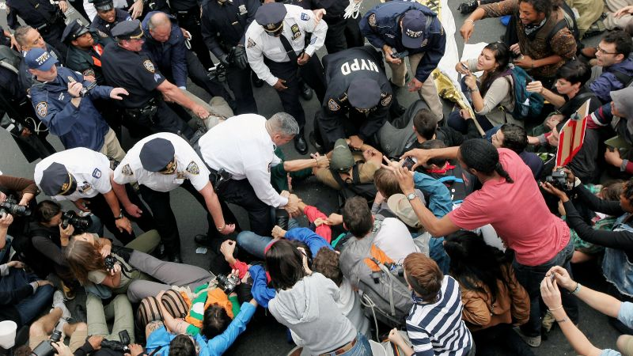

Slide 8
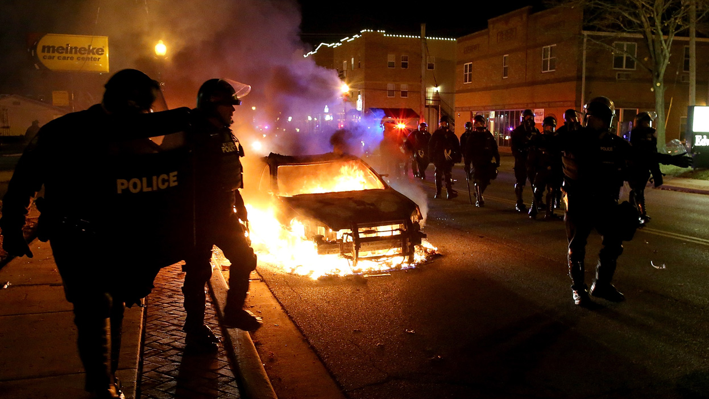

Slide 9
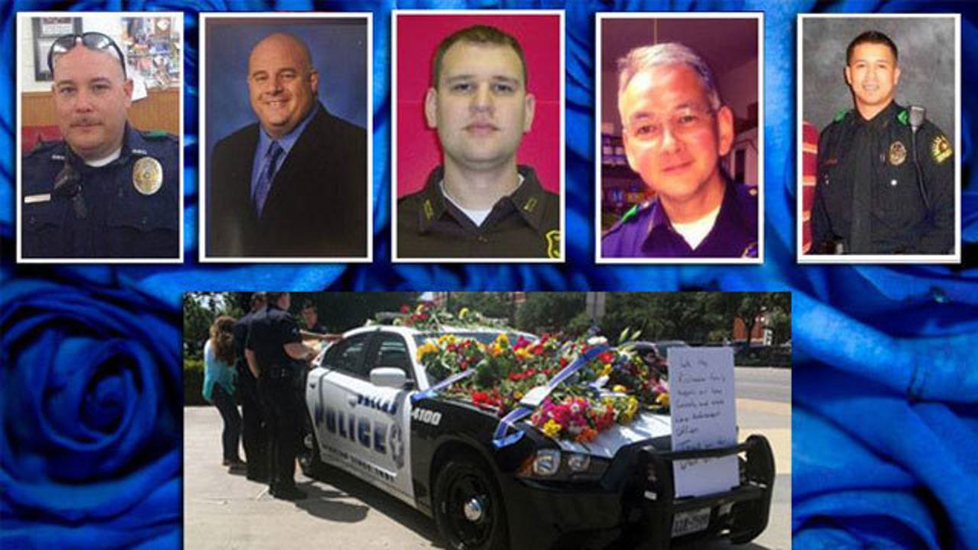

Slide 10
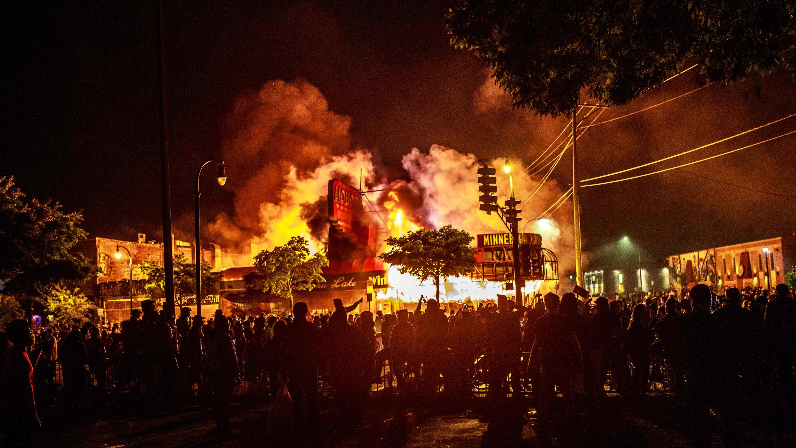

Slide 11
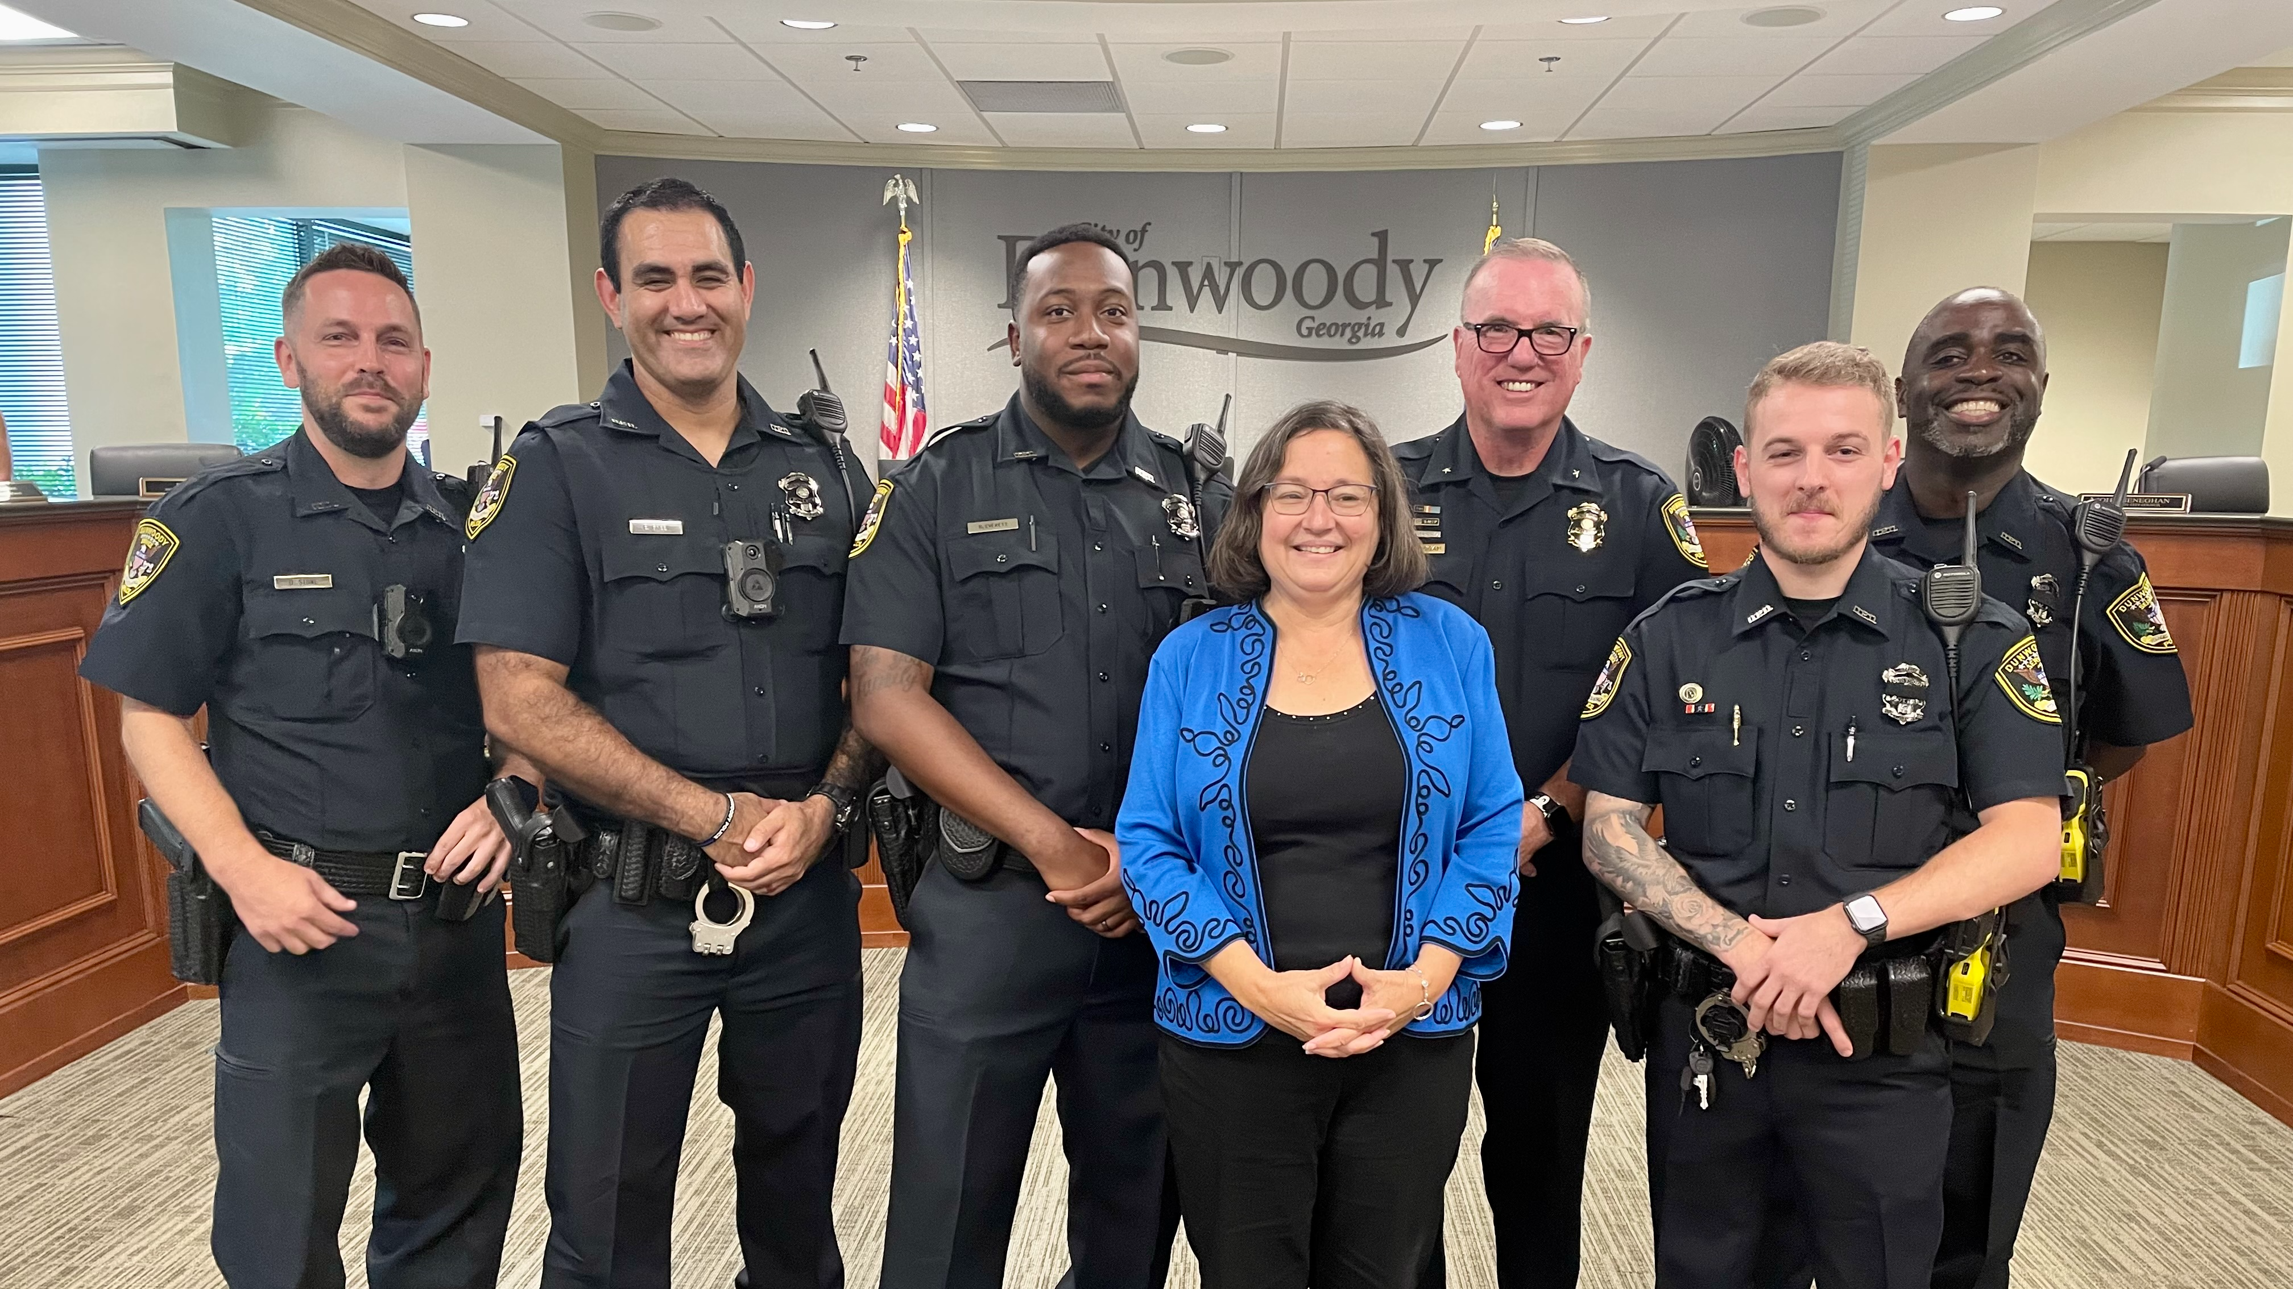
What affect has these events had on recruitment and retention?
Smaller pool of candidates
Experienced officers leaving the profession
Veteran officers don’t want their children to become a police officer
Increase in turnover rate
Competitive market has pushed an increase in pay and benefits

Slide 12


Slide 13
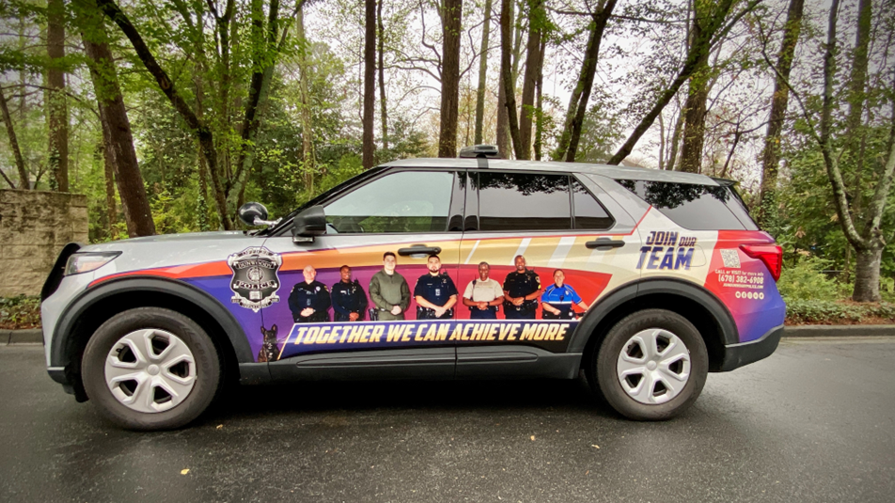

Slide 14
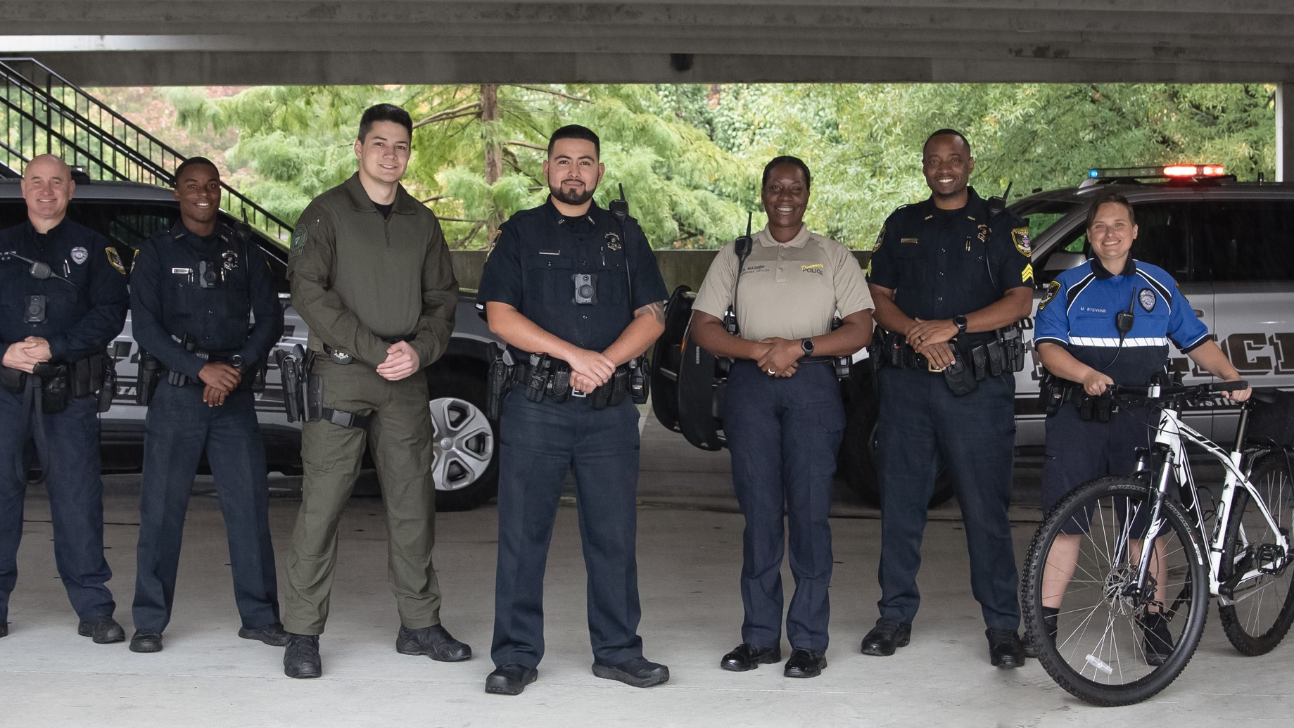
Diversity
Race | 2020 Census | Dunwoody PD
White | 60.8% | 58.3%
African American | 13.5% | 23.3%
Asian American | 18% | 3.3%
Hispanic | 8.9% | 15%
2 or More Races | 4.4% | Unknown
Females | 52.1% | 10.0%

Slide 15
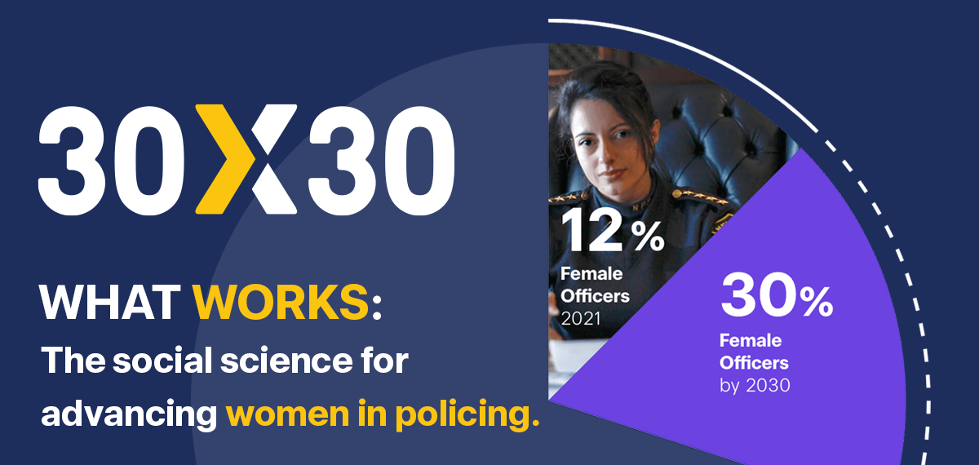

Slide 16
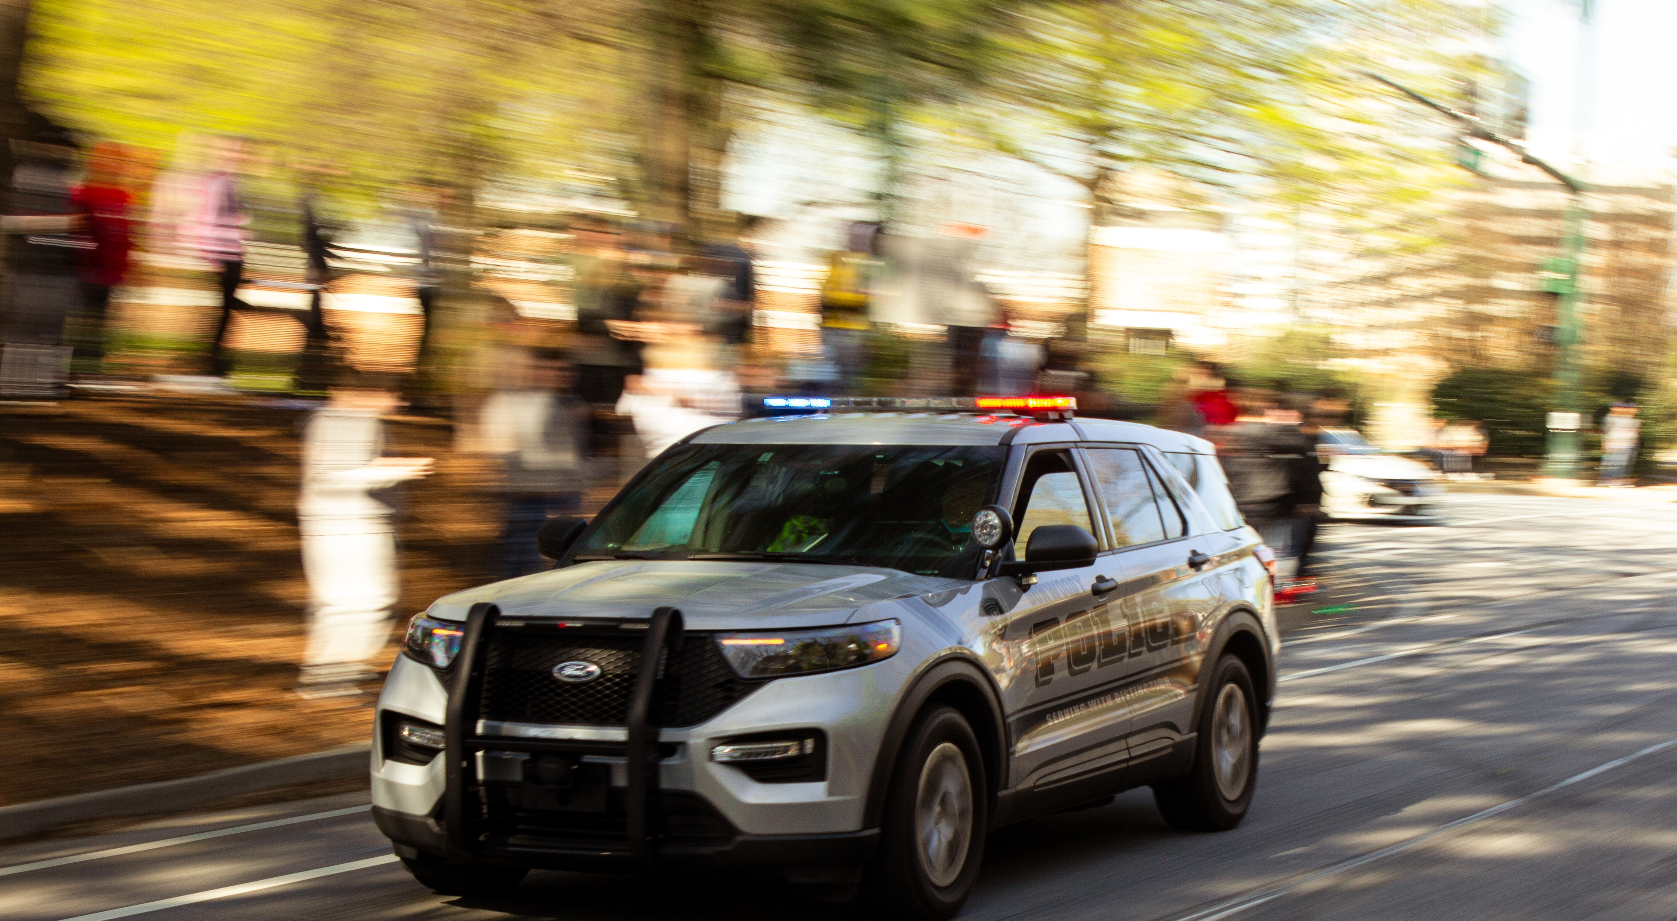
What’s next?
Implement BerryDunn Recommendations
  4 Public Safety Ambassadors (Civilians)
  7 Patrol Officers
  1 PSR (Civilian)
  4 Investigators
  1 Administrative Position (Civilian)

Slide 17
What’s next?
Continued emphasis on recruitment and retention
Initiate 30 x 30 campaign
Focus on mental health of our staff
Implement alternative reporting system
Implement Brazilian Jiu-Jitsu training for officers
Development and expansion of our Real Time Crime Center
Development of our people + succession planning

Slide 18

Crime | 2021 | 2023 | Difference | % Change
Homicide | 3 | 1 | -2 | -67%
Forcible Rape | 3 | 7 | 4 | 133%
Robbery | 31 | 24 | -7 | -23%
Aggravated Assault | 47 | 67 | 20 | 43%
Burglary | 93 | 132 | 39 | 42%
Larceny | 1228 | 1653 | 425 | 35%
Motor Vehicle Theft | 89 | 97 | 8 | 9%
Arson | 0 | 4 | 4 | Not Calculable
Total | 1494 | 1985 | 491 | 33%

Slide 19
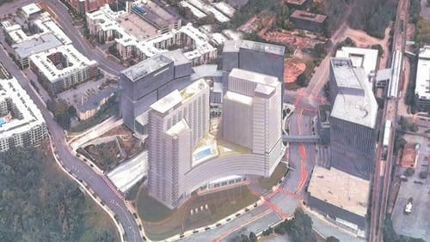

Slide 20
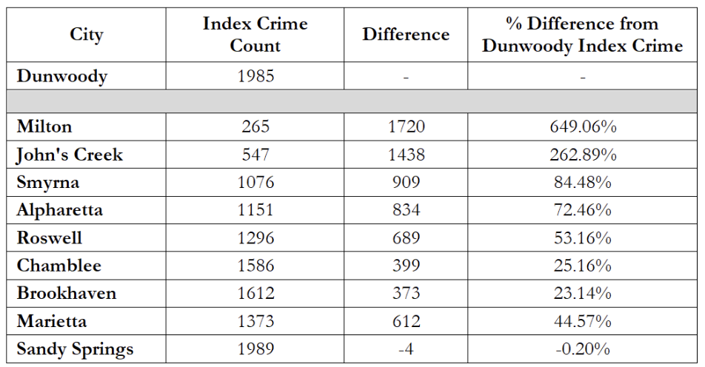

Slide 21
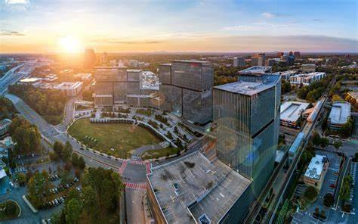
Perimeter Area

Slide 22
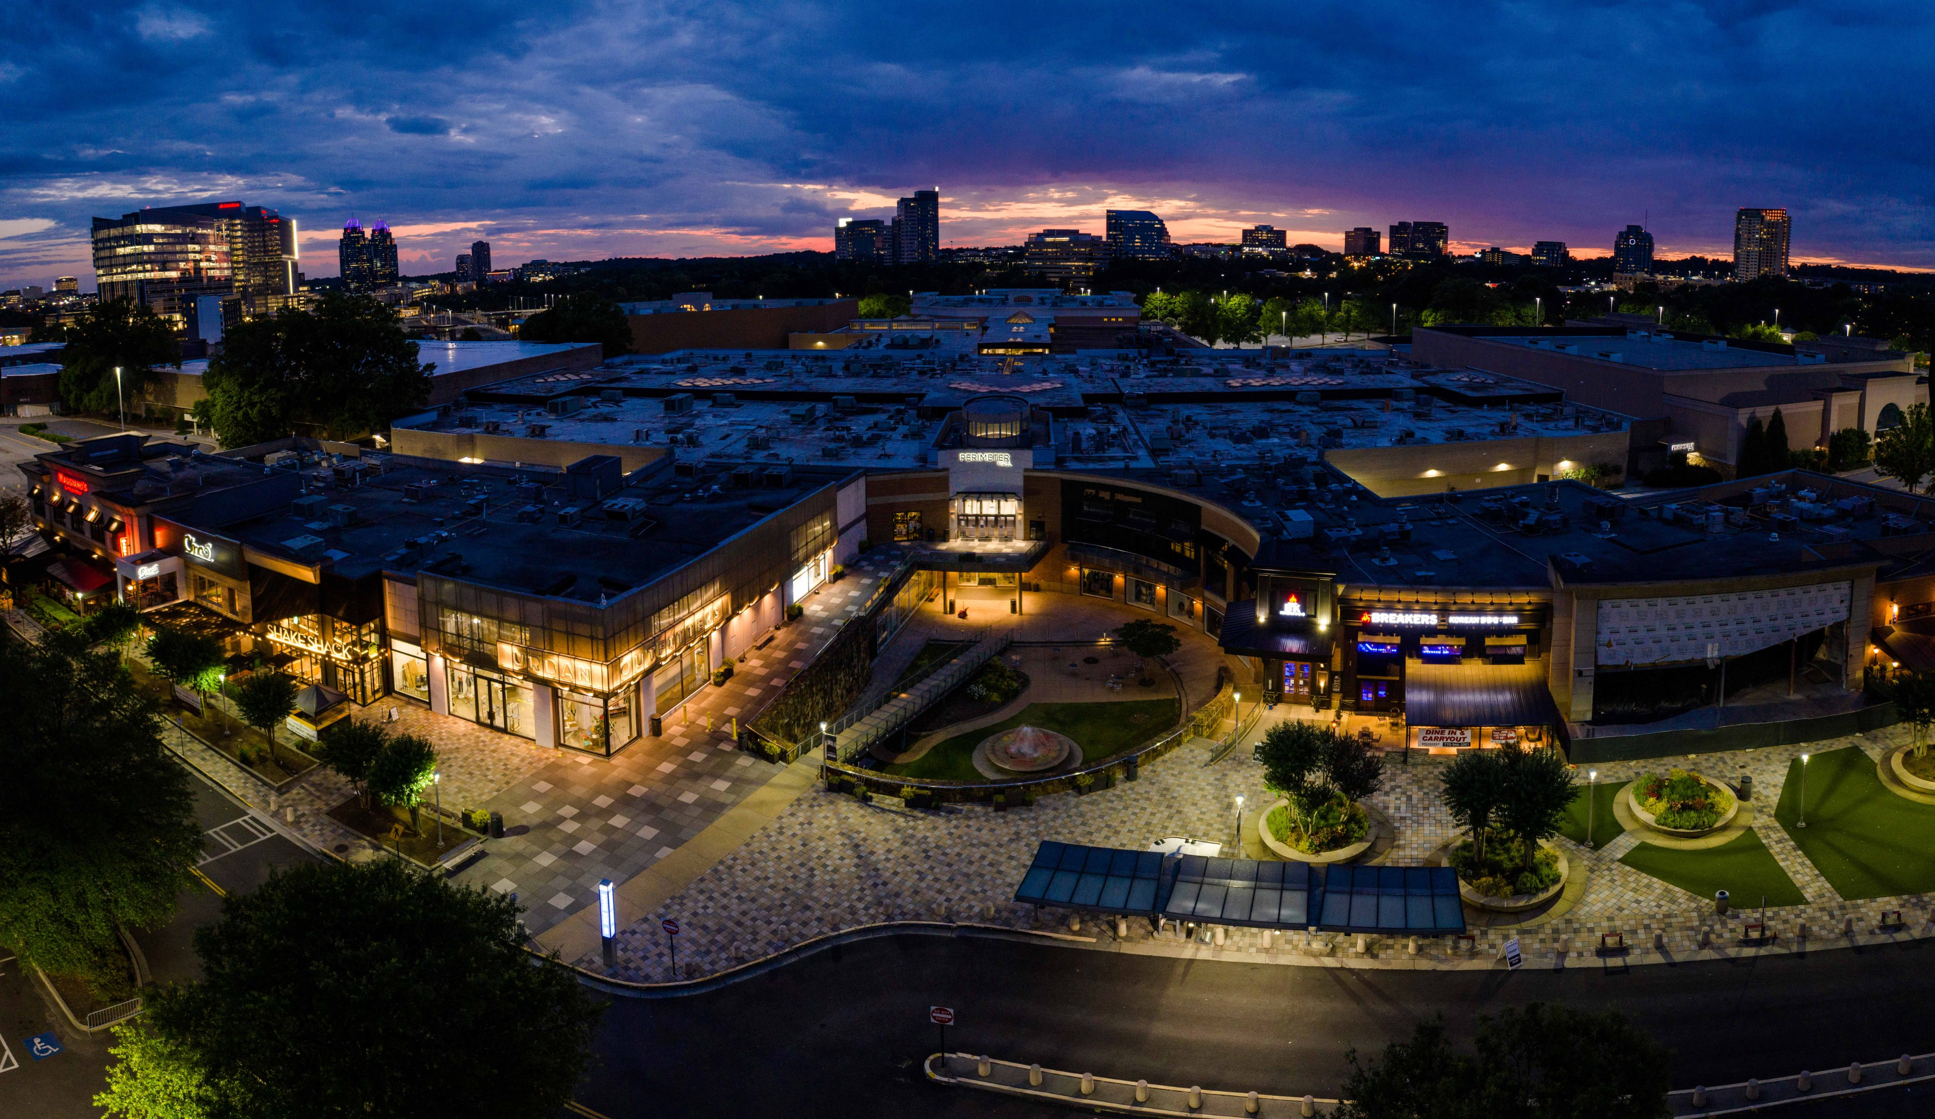



VIBRANT
The Perimeter is a destination for shopping, leisure, hotel stays, and much more. High Street and Campus 244 will draw even more people to the area.
The Perimeter is also the place to do business, attracting many types of businesses to the area as one of the most successful business hubs.
The Perimeter is also the economic engine for Dunwoody, Sandy Springs, and Brookhaven helping keep property taxes low.

Slide 23
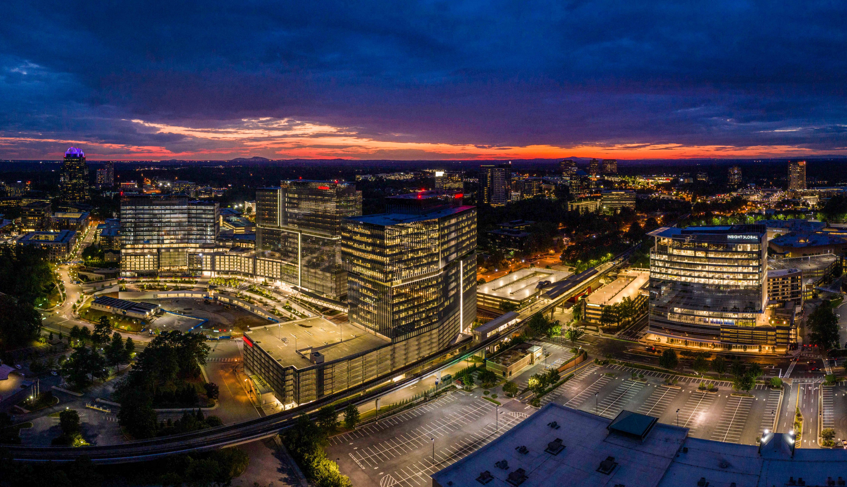
123
Challenges

Slide 24
123
Traffic

Slide 25
123
Vacancies

Slide 26
123
Crime

Slide 27

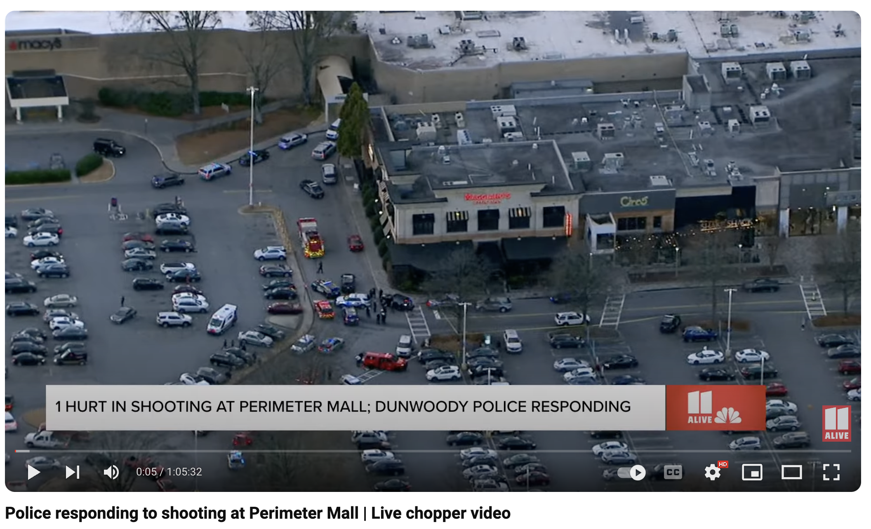
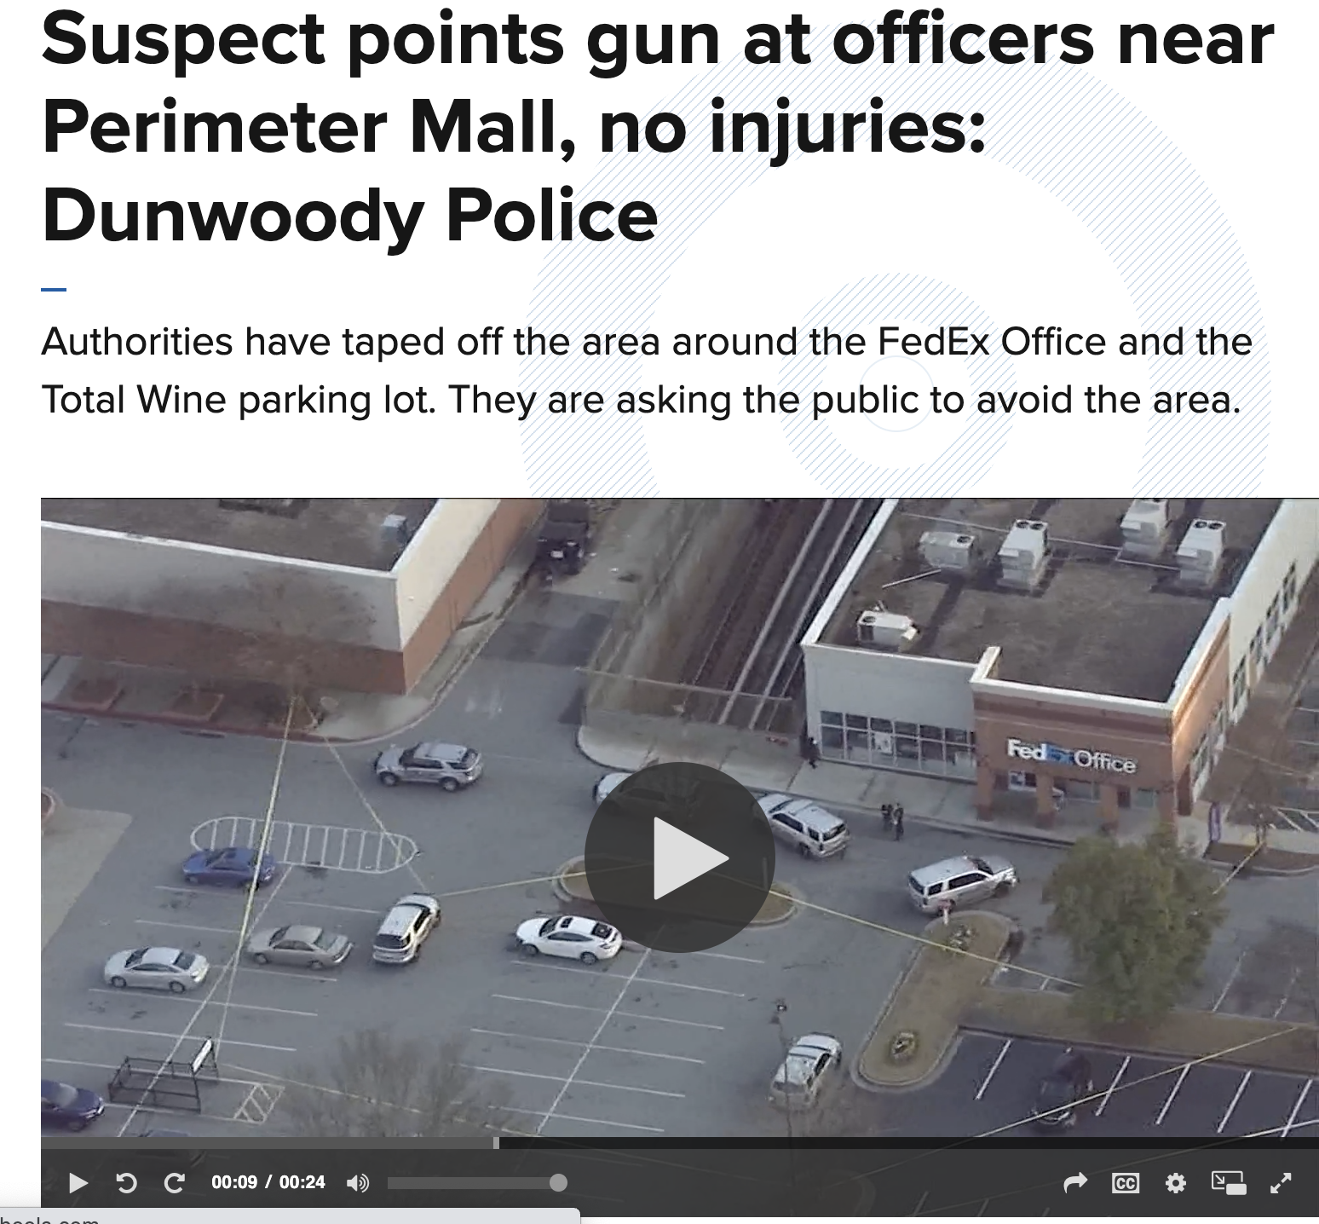
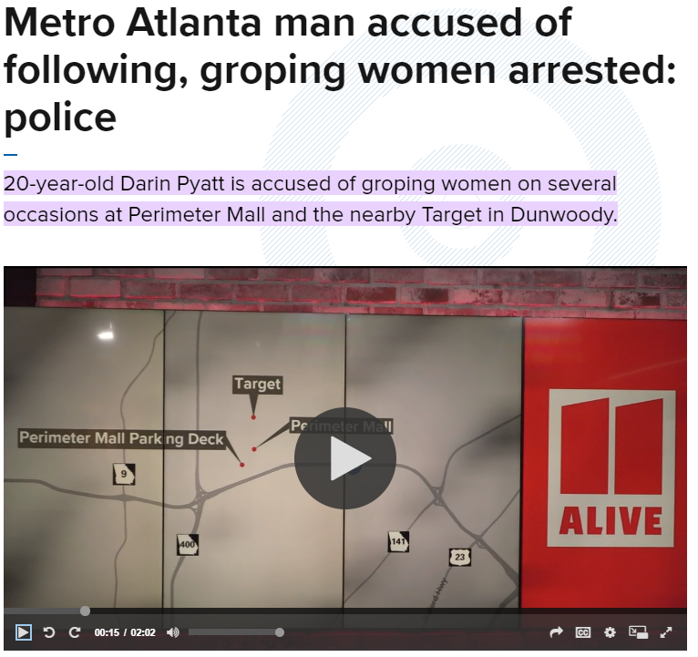
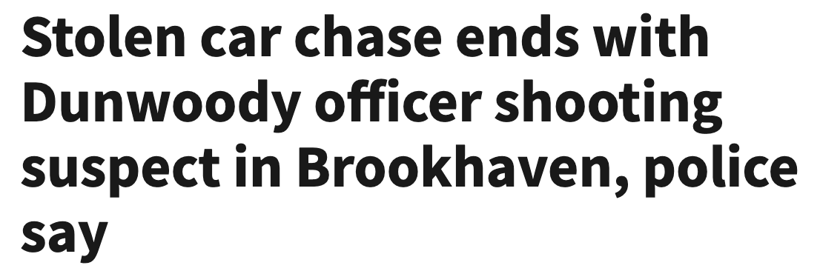

Slide 28
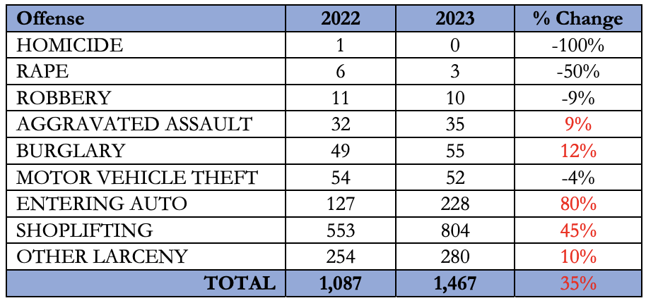
Overall Crime in PCID

Slide 29
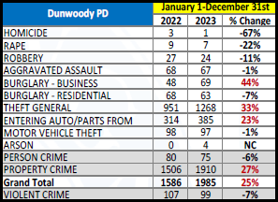
Overall Crime in Dunwoody

Slide 30
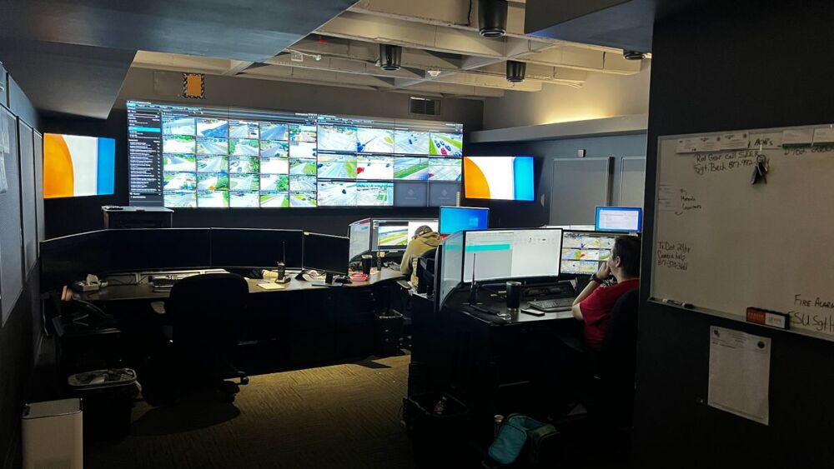
Real Time Crime Center

Slide 31
Connecting Technology
PCID Board approved direct funding
  Surveillance Cameras
  License Plate Readers
  Gunshot Detection
Park Place
High Street

